Slide 1
Natural Language Processing
- B.SRIJA

Slide 2
WHAT IS NLP?
A sub-field of Artificial Intelligence (AI)
By combining the power of artificial intelligence, computational linguistics and computer science, NLP allows a machine to understand natural language, a task that was so far the exclusive privilege of humans.

Slide 3
HISTory
Machine translation from Russian to English was the first NLP application, back in the 1950s. The results at the time were not specially good and for decades the following example was used to illustrate the limits of the field: when the Biblical saying “The spirit is willing but the flesh is weak” was translated into Russian, and then translated back in English, the result was “The vodka is good but the meat is rotten”.
Since the 1950s a lot of progress has been made and NLP became a major issue, in both the economic and social development, when the Internet went from being a small neighborhood of friendly computers to a huge repository of exploitable data.

Slide 4
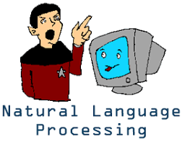
DEFINITION
Natural Language Processing is a theoretically
motivated range of computational techniques for
analyzing and representing naturally occurring
texts/speech at one or more levels of linguistic
analysis for the purpose of achieving human-like
language processing for a range of tasks or applications.

Slide 5
Why WE NEED NLP?
Huge amounts of data
Internet = at least 20 billions pages in the form of:
Text data : sites, blog, tweets .......
Audio data : speech .......
Applications for processing large amounts of texts require NLP expertise

Slide 6
An example
News:
AN EARTHQUAKE struck Indonesia today - a strapping 7.7 magnitude earthquake that struck early today off the northern coast of the island of Sumatra. It caused minor damage and there are no reports of any deaths, although electricity was interrupted in several places.
Location : Indonesia Magnitude: 7.7
Region: Sumatra (Northern Cost) Deaths: Nil Damage: Minor
Tweet
@Nokia announces release of new PDA phones see is.gd/iuTuY
Who: Nokia
What: Product announcement

Slide 7
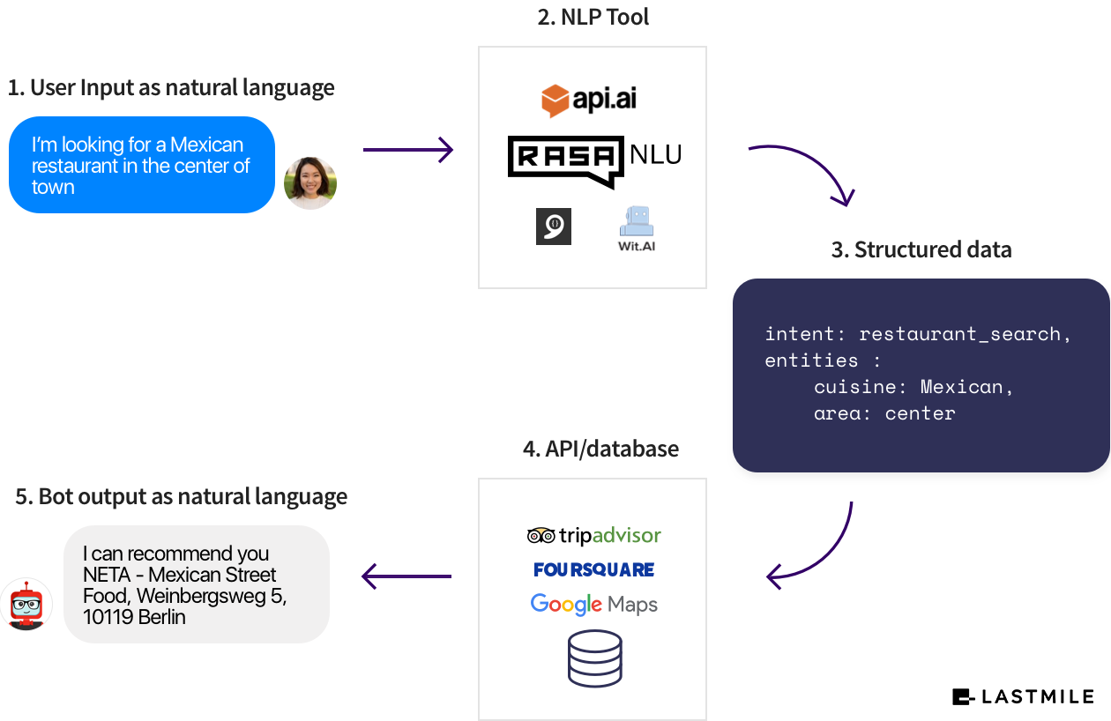
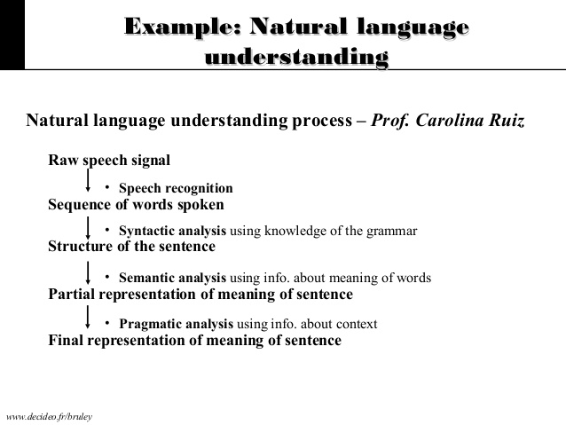
How does it work?

Slide 8
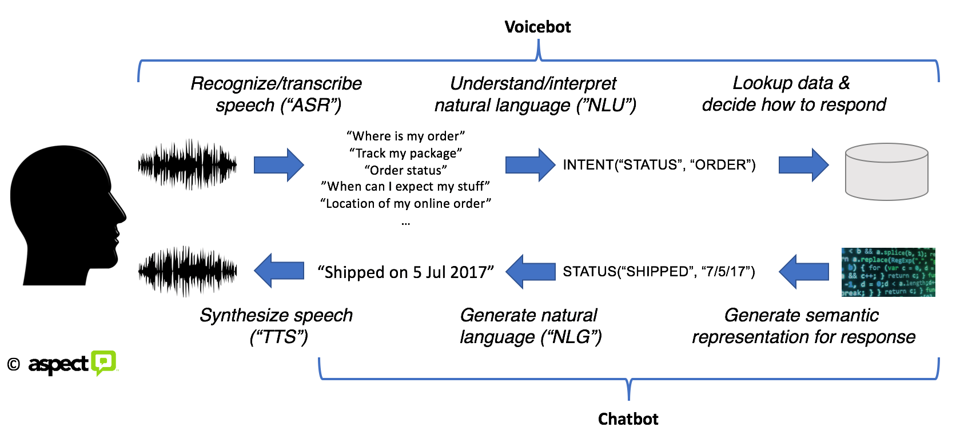

Slide 9
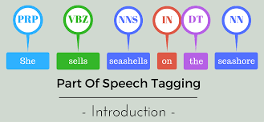
MAJOR Areas of Research & Development
Text Processing:
Processing raw text
Morphological Analysis :
Running --> run + ing
POS Tagging :

Slide 10
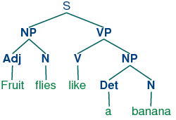
Stemming :
running --> run
Parsing :
Identifying sentence structure
Machine Translation :
Translating content in one natural language to another natural language
Example : Translating and English Sentence to Malaylam with the help of a software
越式炸春卷 to Vietnamese fried spring rolls

Slide 11
Text to speech :
Converting electronic text to digital speech
Automatic Speech Recognition :
Automatic transcription of spoken content to electronic text
Speech to speech translation :
Translating spoken content from one language to another in real time or offline.

Slide 12


industrial Applications
Search Engines :
Advanced Text Editors
Commercial Machine Translation Systems :

Slide 13
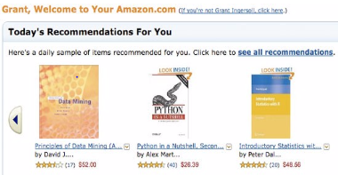
Information Extraction :
Barrack Obama elected Person: Barrack Obama ->Who
as president of US Position: President -> What
Event: elected -> What
Collaborative filtering :
The art / technology to make recommendations based on user behavior .
Translation Memories
Fraud Detection

Slide 14
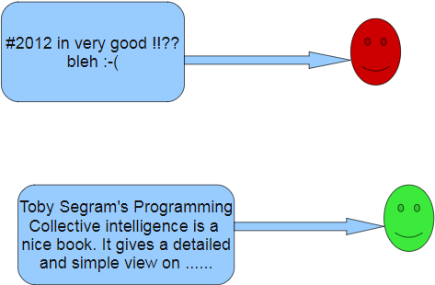
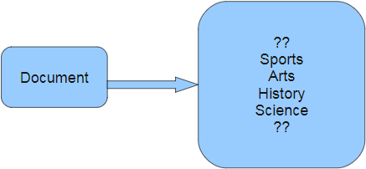
Sentiment Analysis :
Document classification:
Opinion Mining

Slide 15
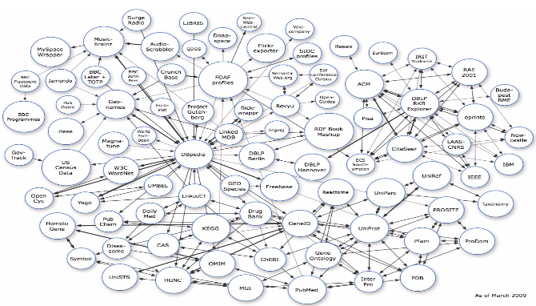
Semantic web/search

Slide 16
NLP in other Domains
Bio-Medical
Forensic Science
Advertisement
Education
Politics
E-governance
Business Development
Marketing
and where ever we use language !!!

Slide 17
MOStly used libraries in NLP
We recommend NLTK only as an education and research tool. Its modularized structure makes it excellent for learning and exploring NLP concepts, but it's not meant for production.
TextBlob is built on top of NLTK, and it's more easily-accessible. This is our favorite library for fast-prototyping or building applications that don't require highly optimized performance. Beginners should start here.
Stanford's CoreNLP is a Java library with Python wrappers. It's in many existing production systems due to its speed.
SpaCy is a new NLP library that's designed to be fast, streamlined, and production-ready. It's not as widely adopted, but if you're building a new application, you should give it a try.
Gensim is most commonly used for topic modeling and similarity detection. It's not a general-purpose NLP library, but for the tasks it does handle, it does them well.

Slide 18
conclusion
With the advent of better search engines, blogs, social networks, e-commerce, the society slowly began to understand that, even perfectible as it is, NLP provides us a precious help every day.
NLP is a young field, full of promises and with an international community that continues to develop new algorithms, techniques and resources. The recent results using Deep learning are amazingly improving several hard NLP tasks.
Let's wait for the day when machines would be able to pass the Turing test?

Slide 19
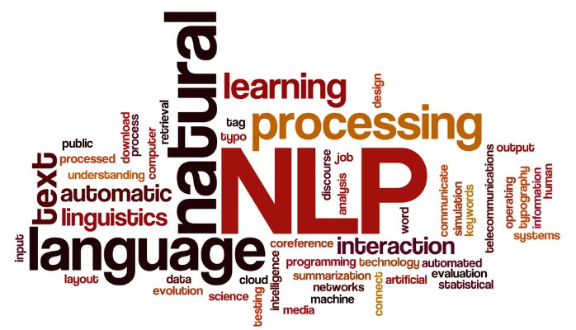
THANK YOU !!!

