Slide 1
Sigma Chi Survey Analysis
Midwest Big Data Hub All Hands Meeting
Nov 7, 2018
Jim Barkley

Slide 2
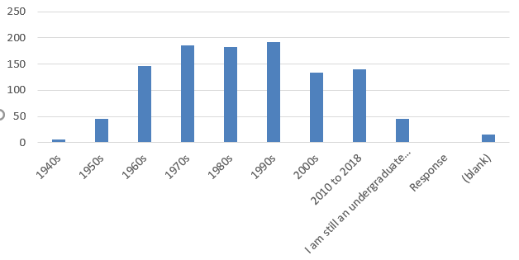
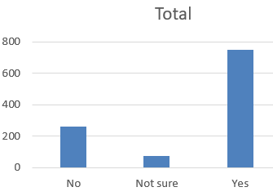
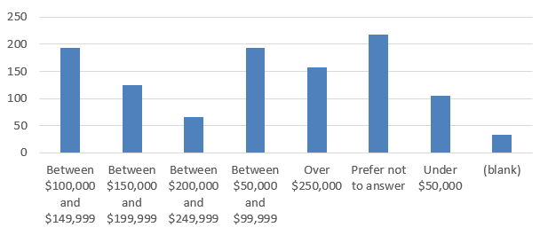
1,093 Total Unique Survey Respondents Over Three Days
Graduation Year
Life Loyal Sig
Household Income

Slide 3
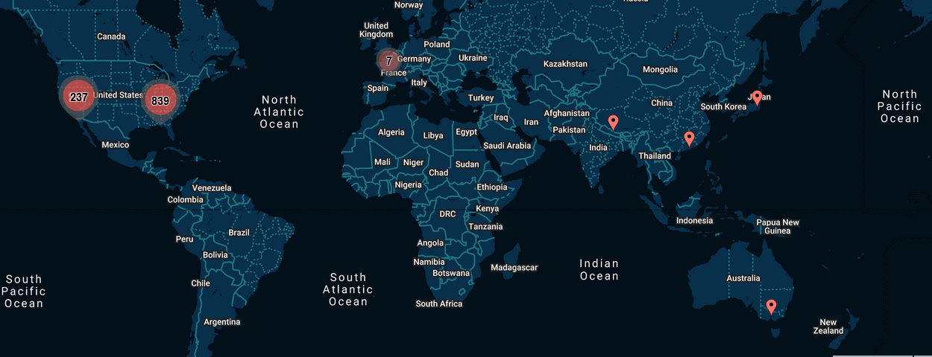
Global Respondents by IP Location

Slide 4
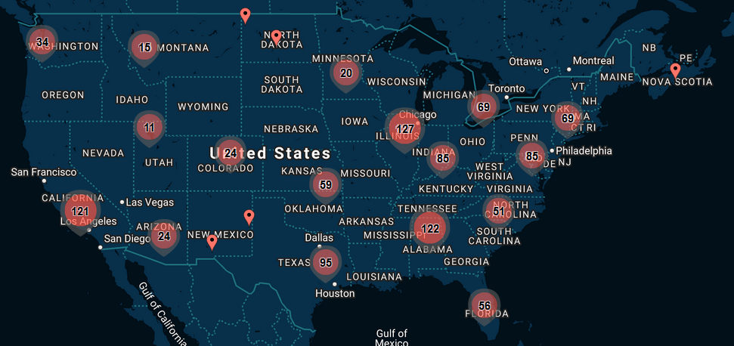
U.S. Respondents by IP Location

Slide 5
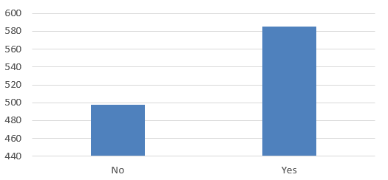
Do You Consider Yourself Engaged?
Engaged
Active in chapter or HQ operations
Donate
Keep up with individuals and magazine
Not Engaged
Work; too busy
No chapters nearby; lack of interest from chapter
Only keep up with brothers

Slide 6
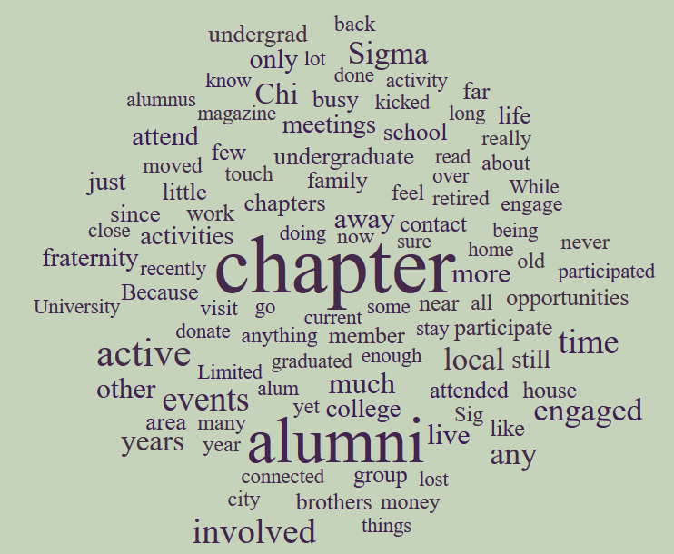
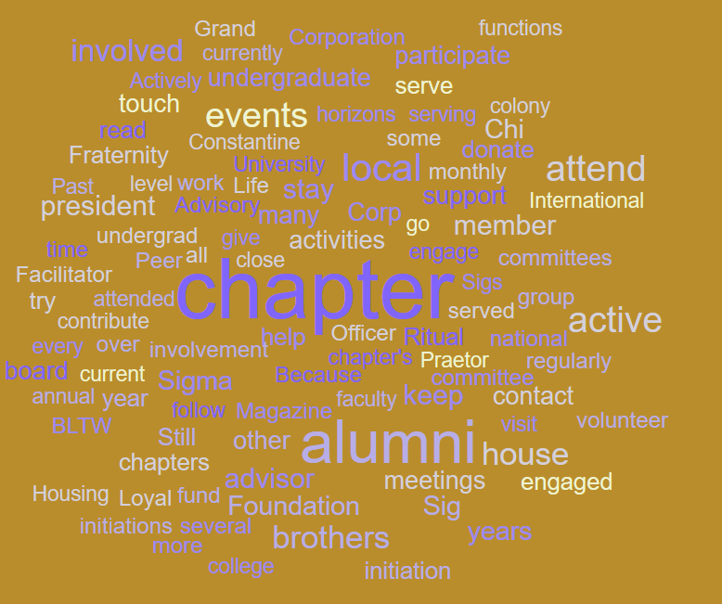
Do You Consider Yourself Engaged?
Engaged
Not Engaged
“Attend homecoming every year and are in contact with several brothers regularly “
“I am a horizons guide and try to stay up to date with my active chapter”
“I go back to the house once a year. Give some $$ to local chapter house funds. Stay in touch with some bros. thats it”
“Not an alumnus chapter within 800 miles”
“We have occasional lunches but that's about it”
“Work, lack of interest from my old chapter for alumnis”

Slide 7
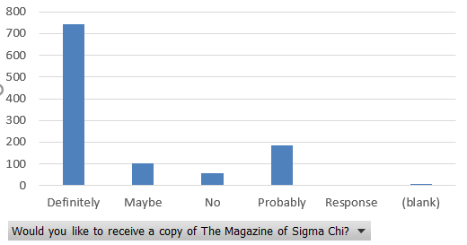
Magazine Interest

Slide 8
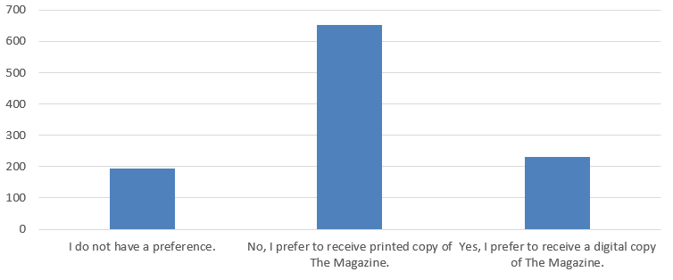
Printed or Digital?

Slide 9
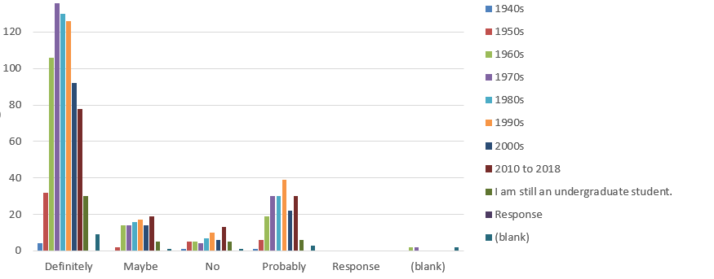
Magazine Interest by Graduation Decade

Slide 10
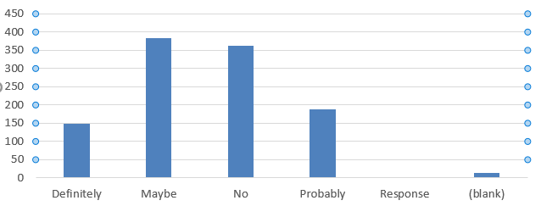
Willing to Donate $100 or More?

Slide 11
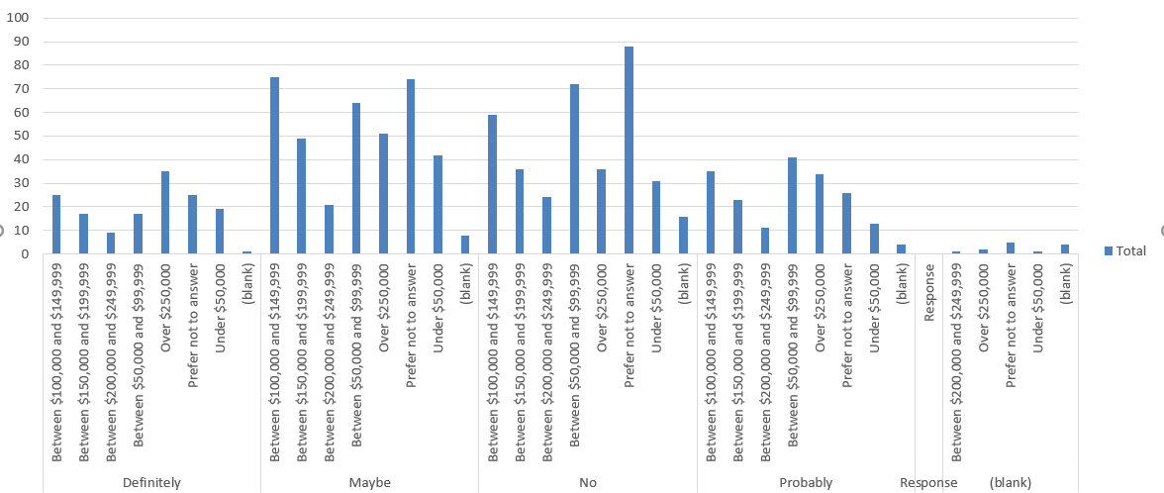
Willing to Donate $100 or More?

Slide 12
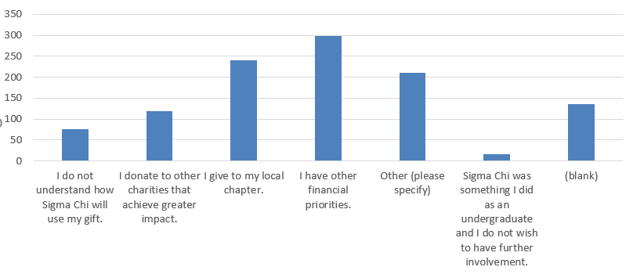
What is Your No. 1 Reason for Not Giving Back?

