Slide 1

DATA ANALYSIS & VISUALIZATION USING AWS
Batch – A6
Supervisor Details:
Name: Dr. B. Anjanadevi
Designation: Associate Professor
Team:
B.Srija -- 21331A1214
N.Lahari -- 22335A1206
K.Prabhath Naidu -- 21331A1255
DEPARTMENT OF INFORMATION TECHNOLOGY
MAHARAJ VIJAYARAM GAJAPATHI RAJ COLLEGE OF ENGINEERING (A)

Slide 2
Introduction
Outlines of the Presentation
Abstract
Introduction
Problem Statement
Literature Survey
Existing System
Proposed System
System requirements
System flow diagram
Methodology
Implementation
Results
Conclusion
References

Slide 3
Project Abstract
This project explores how cloud technologies, particularly Amazon Web Services (AWS), can make managing data easier and faster. By using AWS tools—Amazon S3 for scalable storage, AWS Glue for data transformation, Amazon Athena for querying, and Amazon QuickSight for visualization—this project shows how these tools can handle data more efficiently. The expected outcomes include faster analysis, cost-effective data storage, and enhances decision-making capabilities through better visualization techniques. This approach supports enhanced data-driven insights across various industries.

Slide 4
Introduction
In today's data-driven world, organizations encounter significant challenges with traditional tools like SQL, Spark and Power BI, Tableau especially regarding scalability, integration and complex infrastructure when managing data. This project aims to address these challenges by using cloud computing solutions through Amazon Web Services (AWS). AWS tools offer automatic scalability, handling data without complex setups, which is crucial for handling the growing data demands of modern organizations. Their pay-as-you-go pricing model not only reduces infrastructure costs but also makes them more economical for projects with variable workloads. Moreover, AWS provides user-friendly interfaces and an integrated ecosystem, simplifying data management, processing, and visualization. This leads to quicker insights and improved decision-making. Overall, this project highlights the impact of AWS cloud technologies in efficiently managing data across various sectors and improves decision making.

Slide 5
Problem Statement
To perform efficient data analysis and visualization using Amazon Web Services (AWS), leveraging tools like S3, Glue, Athena, and QuickSight. This approach aims to overcome the limitations of traditional tools by improving data processing speed and enhancing real-time insights, all while reducing costs.

Slide 6
Literature Survey
S.No | TITLE | AUTHOR | DESCRIPTION | AWS TOOLS USED | DATASET
1 | Big Data Analytics on AWS Cloud using AWS Athena and QuickSight (2021) | Anand Mishra Gajendra Kumar | This article explores Big Data analytics using AWS services like S3, Athena, and QuickSight, demonstrating efficient data processing, querying, and visualization | AWS S3, Athena,Glue, Quicksight | COVID data
2 | AWS Data visualization using Lambda & DynamoDB (2021) | EjMiguel Francisco Caliwag Angela Caliwag | This paper demonstrates a system for temperature data collection using a DHT22 sensor connected to a Raspberry Pi 4B, interacting with AWS IoT to store data in DynamoDB, trigger Lambda functions, and visualize it with AWS QuickSight.. | AWS IoT,Dynamo DB, Lambda, Quicksight | The dataset consists of temperature and humidity readings collected from a DHT22 sensor.
3 | Sentimental Analysis on Voice using AWS (2020) | G.Satyanarayan Dr. Bhuvana J Balamurugan | This paper explores the use of Amazon Comprehend, Athena, Glue, Transcribe, and Lambda for sentiment analysis on audio data to detect emotions in conversations | AWS Comprehend, Athena, Glue, Lambda, Transcribe, Quicksight | Audio files.

Slide 7
Literature Survey
4 | Weather Data Forecast and Analytics (2020) | Vishal D. Wavhale, Saurav Bira, Vivek Kumar, Vidit Raj Choudhari | This paper uses AWS Lambda for serverless computing, AWS S3 for data storage, and API Gateway to manage requests from various weather APIs for efficient weather data visualization and analytics. | AWS Lambda,S3, API Gateway, Cloud Watch, Quicksight | Weather data from various APIs, including Google Weather API, AccuWeather API, OpenWeather API, and Dark Sky API.
5 | Amazon Athena: Serverless Architecture and Troubleshooting (2023) | Amol Kulkarni | The paper discusses Amazon Athena's serverless architecture, features, troubleshooting methods, and its integration with tools like Amazon S3, AWS Glue, and QuickSight for data analysis. | Amazon S3,Athena,Glue, Quicksight | --
6 | Cloud-Based Microgrid Monitoring (2023) | Angelos Patsidis, Adam Dyśko | The research discuses a scalable architecture for monitoring multi-vector microgrids using AWS tools such as AWS Lambda, AWS CloudFormation, Amazon DynamoDB, Amazon QuickSight, Amazon S3, Amazon EC2, Amazon Kinesis, and AWS IoT Core. | Amazon s3,Glue, Glue crawler, Quicksight, Lambda,Kinesis, EC2,Dynamo DB,AWS IOT, CloudFormation | Data from microgrids

Slide 8
Literature Survey
7 | Ingest and Visualize CSV Files using AWS Platform For Transition from Unstructured to Structured Data (2023) | G.Satyanarayan Dr. Bhuvana J Balamurugan | This paper presents a methodology for processing and visualizing CSV files utilizing various AWS tools, specifically Glue for ETL operations, Amazon Redshift as a cloud-based data warehouse that allows for fast querying and analysis of large datasets, and QuickSight for interactive data visualization. | AWS Sagemaker, S3,Kinesis,Glue, Red Shift,Quick sight | --
8 | Architecting Real-Time Big Data Analytics: An AWS-Powered Framework Integrating AI and ML for Predictive Insights (2018) | Sai Tarun Kaniganti | This study shows real-time big data analytics framework utilizing Amazon Kinesis for data ingestion,Lambda/Glue for serverless processing, and S3 for scalable storage,SageMaker to build and deploy machine learning models, enabling predictive analytics from streaming data. | AWS Kinesis,s3, Dynamo DB, Sage maker | --
9 | Serverless Architecture for Big Data Analytics (2019) | Md Mijanur Rahman, Md Hasibul Hasan | This describes a serverless architecture for big data analytics using AWS services to build a data lake with four layers—Raw, Curated, Exploratory, and Provisioning using Glue, S3, SageMaker, Athena, Quicksight | AWS S3,Athena, Glue,Quick sight, Sage maker | --

Slide 9
Existing System
The current data management solutions often rely on traditional tools and frameworks such as SQL databases, Spark and visualization tools like Power BI or Tableau. These systems often struggle with scalability, complex integration and infrastructure, resulting in performance issues and limited insights. As a result, we experience delays in data analysis and processing. Existing solutions also need high infrastructure costs for servers, hardware and require complex configurations, making them less suitable for variable workloads.

Slide 10
Proposed System
The proposed system aims to enhance data management and analysis by leveraging Amazon Web Services (AWS) to exceed the performance limitations of existing solutions. By utilizing AWS tools, including Amazon S3 for scalable storage, AWS Glue for efficient data extraction and transformation, Amazon Athena for quick querying, and Amazon QuickSight for dynamic visualization, the system will streamline data handling processes. This integrated approach is designed to achieve improved analysis and better visualization, with a focus on enabling real-time insights and decision-making. Ultimately, the goal is to ensure that organizations can effectively manage data with minimal latency, minimum cost and maximum efficiency

Slide 11
System Requirements
Hardware
RAM: 8 GB or more.
Internet: High-speed and stable connection.
Processor: Multi-core processor for efficient data handling.
Storage: Minimum 500 GB for data backup and processing.
Software
AWS Services: Amazon S3, AWS Glue, Amazon Athena, Amazon QuickSight.
Operating System: Windows 10/11, macOS, or Linux.
Browser: Latest version of Chrome, Firefox, or Edge for accessing AWS Console

Slide 12
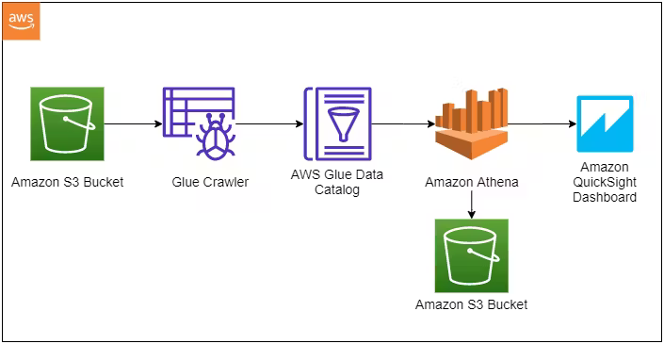
System flow Diagram
Fig.1 The dataflow of the system

Slide 13
METHODOLOGY
Data is stored in two S3 buckets—one with raw formats and the other in Parquet.
AWS Glue Crawler scans the S3 buckets to identify the data schema.
The schema information is stored in the AWS Glue Data Catalog for easy management.
AWS Glue performs ETL operations, transforming raw data into an optimized format like Parquet.
The transformed data is saved back to S3 in Parquet format for efficient analysis.
Athena is used to run SQL queries, and QuickSight visualizes the results for insights.

Slide 14
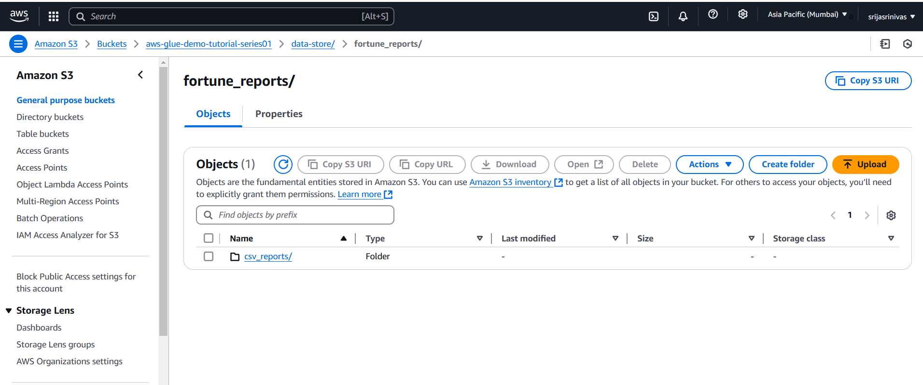
IMPLEMENTATION
Fig.2 This figure represents the data uploaded into S3 bucket

Slide 15
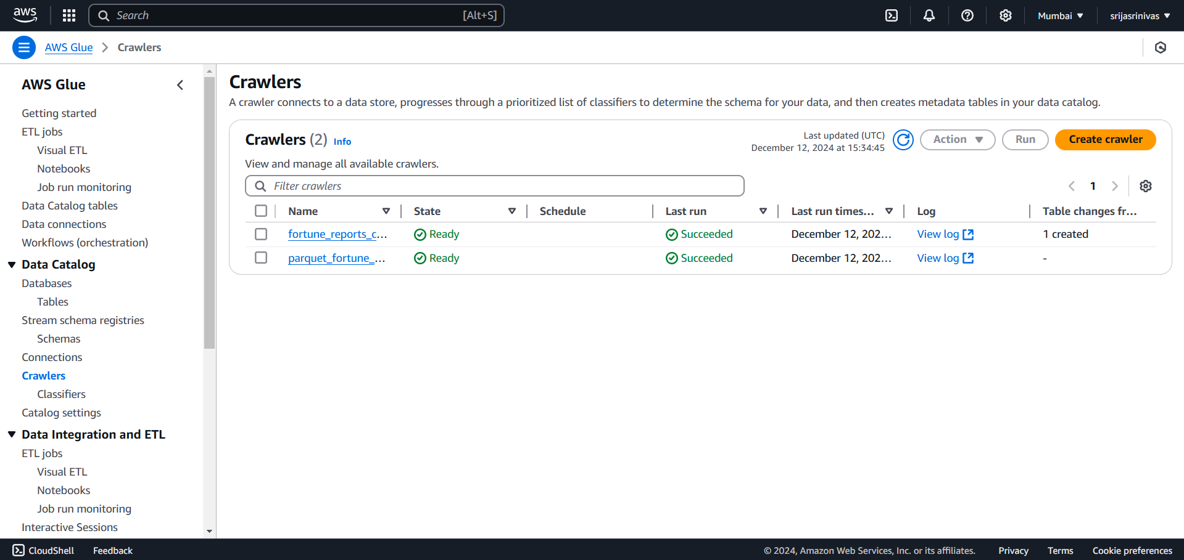
IMPLEMENTATION
Fig.3 This figure represents the crawlers created in AWS Glue

Slide 16
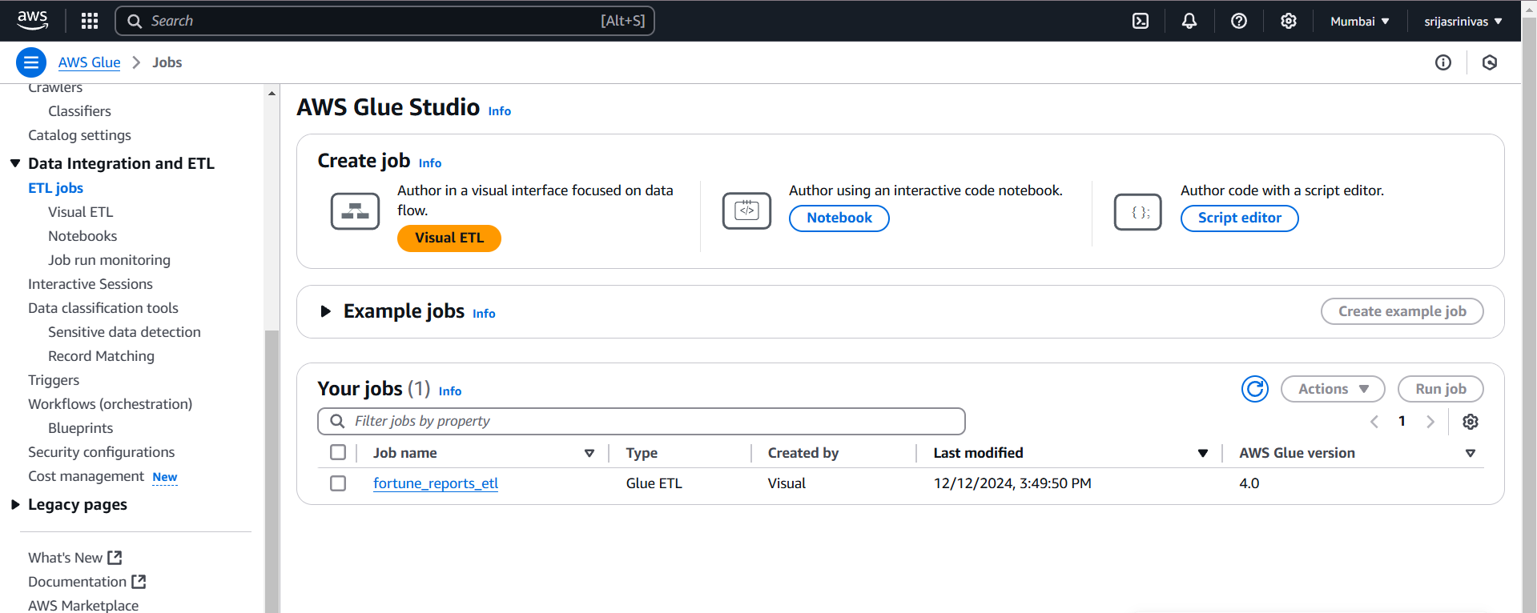
IMPLEMENTATION
Fig.4 This figure represents the ETL job created in AWS Glue

Slide 17
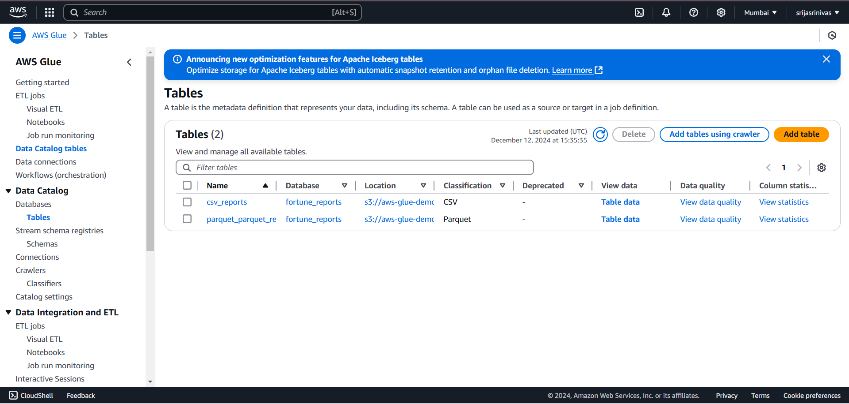
IMPLEMENTATION
Fig.5 This figure represents the tables stored in the AWS Glue Data Catalog

Slide 18
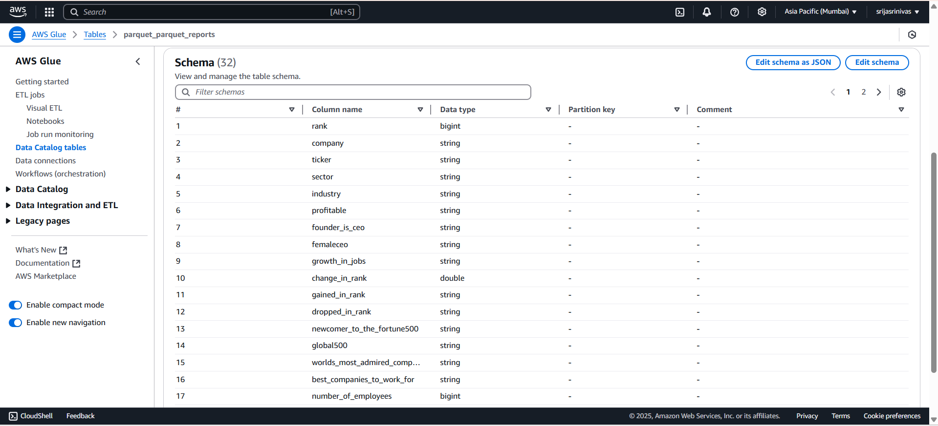
RESULT
Fig.6 This figure represents the schema of the parquet data that is inferred by glue crawler.

Slide 19
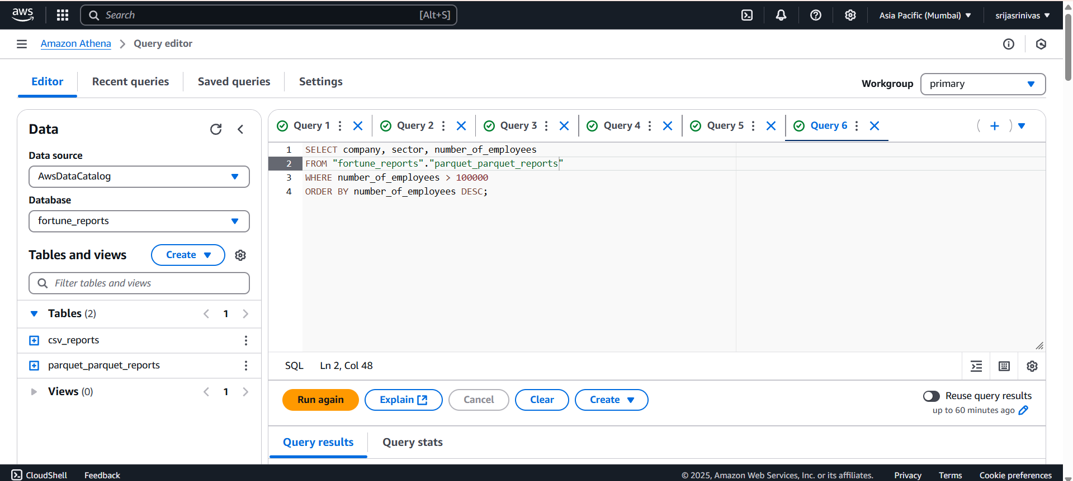
IMPLEMENTATION
Fig.7 This figure represents the data query analysis performed in AWS Athena

Slide 20
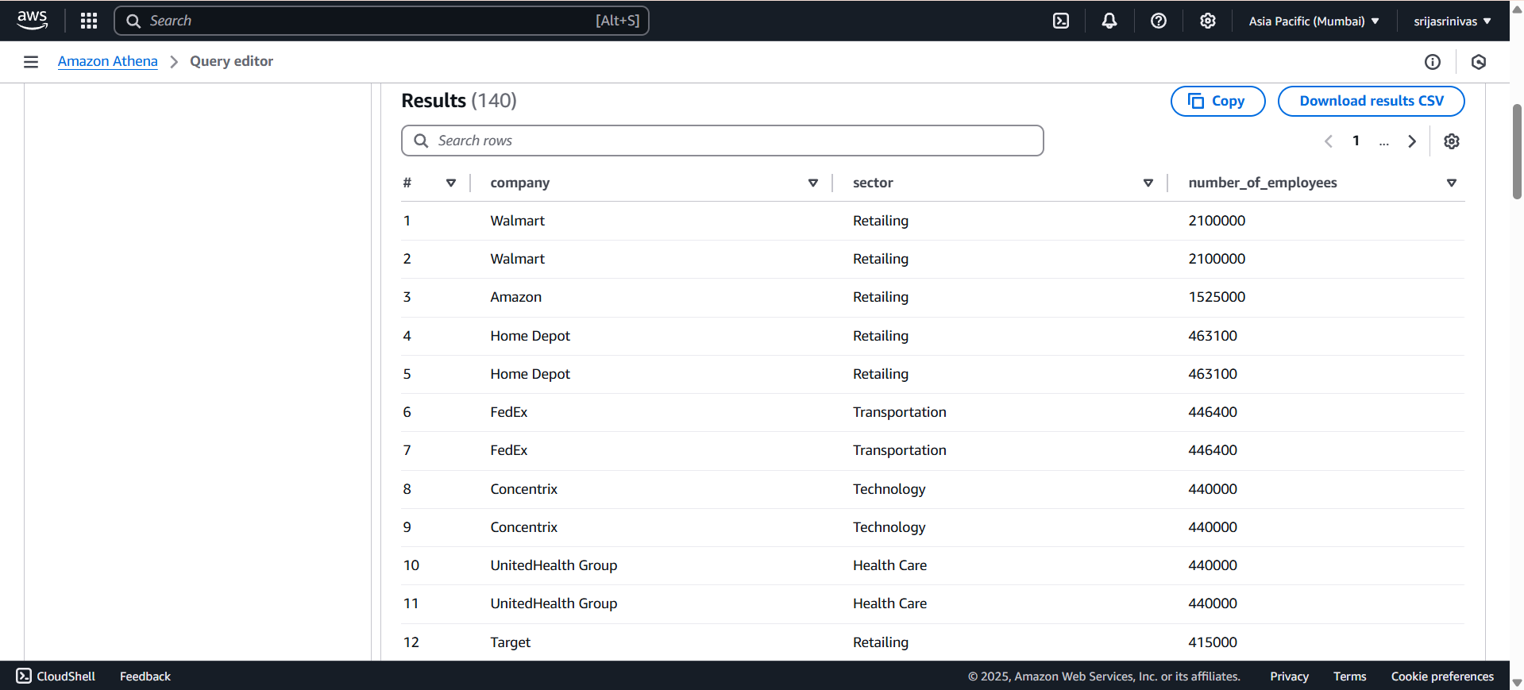
RESULT
Fig.8 This figure represents the query results performed in AWS Athena

Slide 21
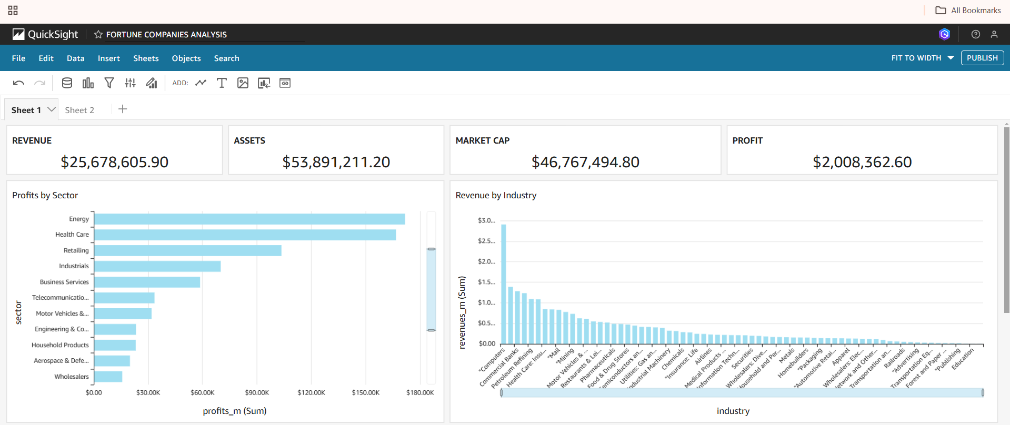
RESULT
Fig.9 This figure represents the data visualization in Quicksight

Slide 22
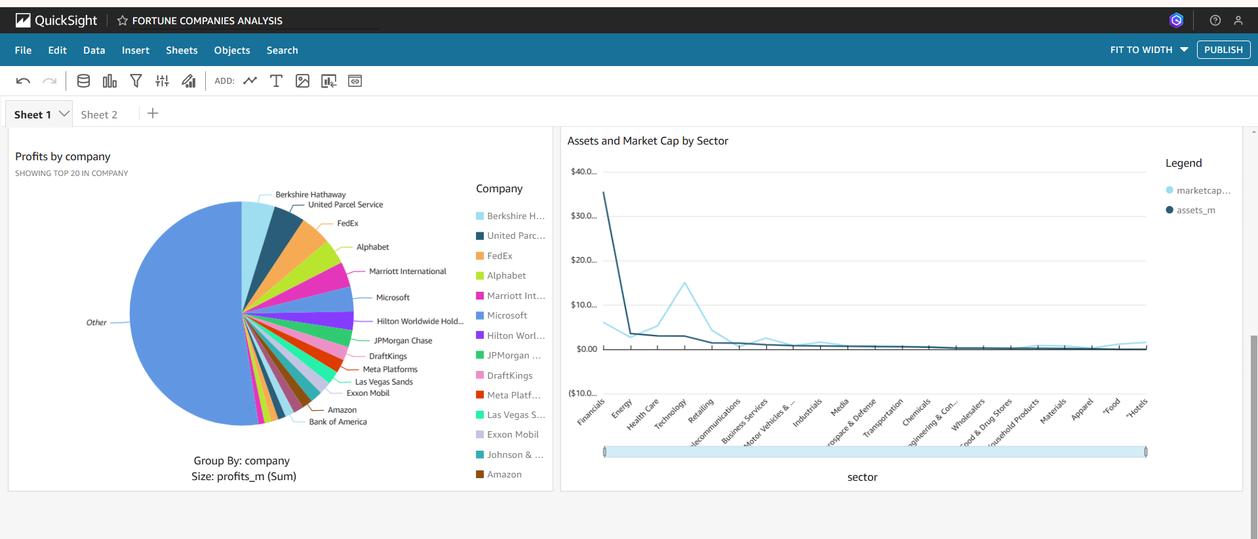
RESULT
Fig.10 This figure represents the data visualization in Quicksight

Slide 23
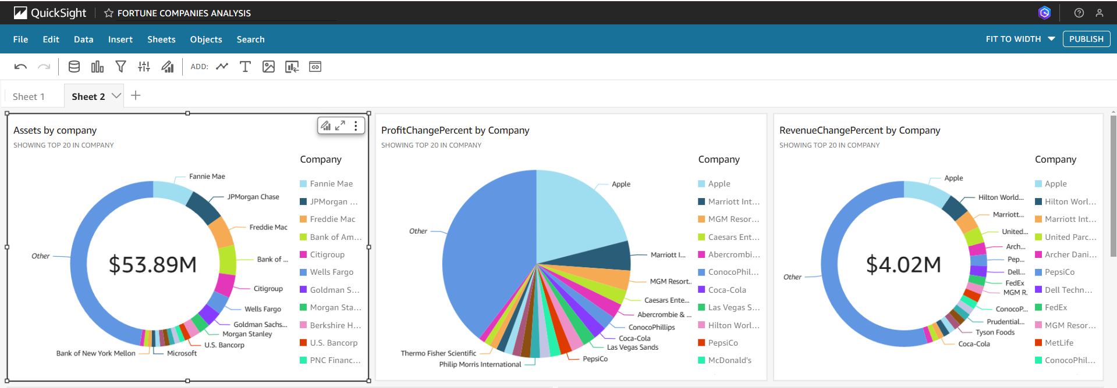
RESULT
Fig.11 This figure represents the data visualization in Quicksight

Slide 24
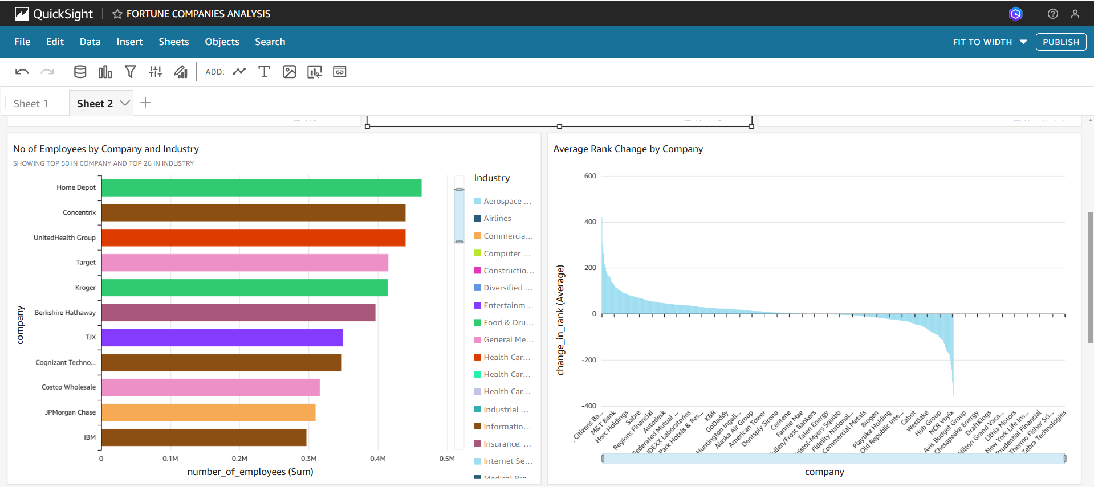
RESULT
Fig.12 This figure represents the data visualization in Quicksight

Slide 25
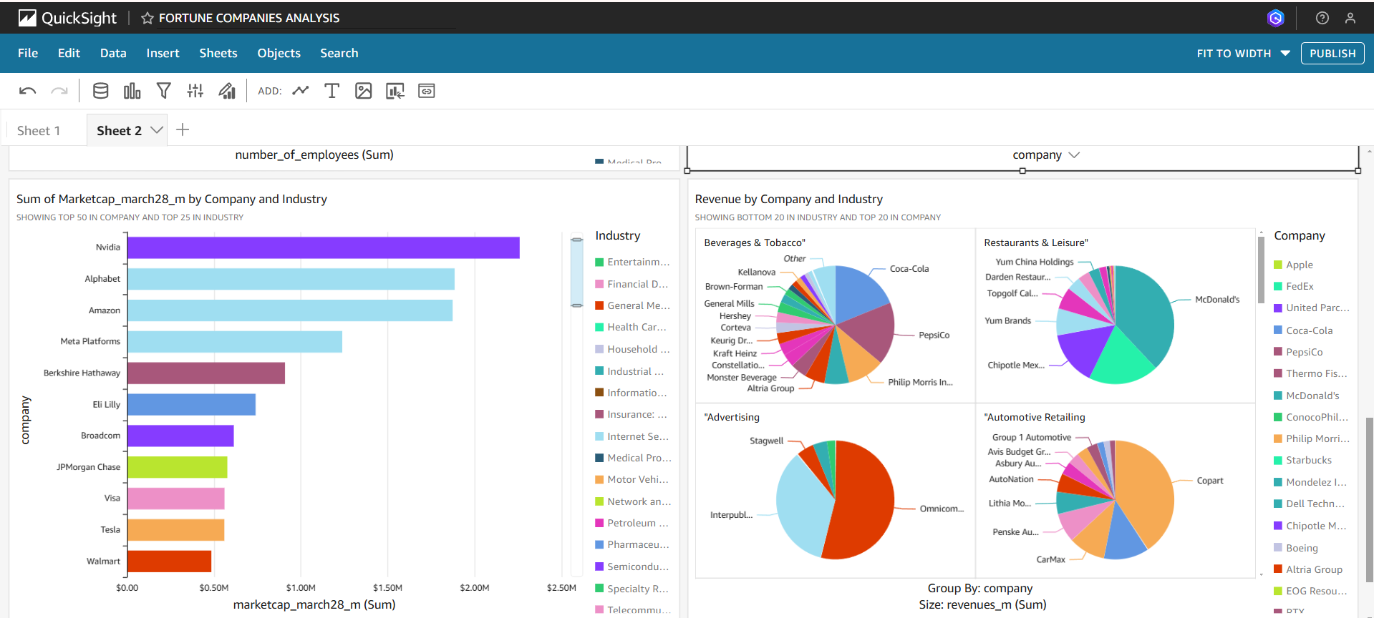
RESULT
Fig.13 This figure represents the data visualization in Quicksight

Slide 26
Conclusion
In this project, we explored AWS services such as S3, Glue, Athena, QuickSight. We worked with S3 buckets and objects to store our data, and worked with AWS Glue to create Glue Crawlers and build a Glue Data Catalog. This allowed us to generate tables and define schemas for our dataset. We also configured IAM roles, policies and permissions on who can access the data. We used Athena for querying data and QuickSight for visualizations. This provided us with a solid understanding of foundational AWS services, preparing us to efficiently utilize these tools for scalable data analytics and visualization in aws cloud environment.

