Slide 1
Credit Card Fraud Detection
Course Name: Algorithms for Data science
Date: 12-06-2024

Slide 2
Agenda
Problem Statement and Data Overview
Central Tendency and Data Reduction
Descriptive Statistics and Visualizations
Machine Learning Models and Predictions
Insights, Challenges, and Future Work
Queries

Slide 3
Problem Statement
We are solving the problem of detecting fraudulent credit card transactions using Data science and machine learning techniques.
Fraudulent transactions are a major concern for financial institutions and identifying them quickly can prevent significant losses.
The goal of this project is to build a predictive model that classifies transactions as either fraudulent or legitimate based on features such as transaction amount, time, and anonymized features.

Slide 4
Data Overview
Dataset Name: Credit Card Fraud Detection Dataset
Source: Kaggle
Key Dataset Features:
Number of Rows (Records): 284,807
Number of Columns (Features): 31
Numerical Features (V1-V28): Principal component-transformed features.
Time and Amount: Transaction-specific data.
Class: Target variable (0 = Non-fraudulent, 1 = Fraudulent).

Slide 5
Data Overview
Feature Descriptions:
Time: Seconds elapsed between the transaction and the first transaction in the dataset.
V1 to V28: Principal components obtained via PCA (features are anonymized for privacy).
Amount: Transaction amount.
Class: Target variable indicating whether the transaction is fraudulent (1) or legitimate (0).
Dataset Highlights:
Highly imbalanced, with fraudulent transactions accounting for approximately 0.17% of the data.
Anonymized features make it ideal for exploring predictive modeling techniques without domain bias.
Suitable for both exploratory analysis and machine learning tasks due to its large size and clear objective.

Slide 6
Central Tendency & Data Reduction
Central Tendency:
Mean: We calculated the mean for features like transaction amount to understand the typical value for a transaction.
Median: The median gives a better representation of the central value of the transaction amounts due to the skewed distribution of data.
Mode: We used the mode to determine the most frequent transaction amounts.
Data Reduction:
To reduce the complexity of our dataset, we performed Principal Component Analysis (PCA) to reduce dimensionality and retain most of the variance.
PCA helped us capture the majority of the information with fewer components (2 components), improving model efficiency and performance by removing noise and redundant features.
We also used feature selection to identify the most important features for fraud detection.

Slide 7
Data Reduction
To make the dataset more efficient for modeling, dimensionality reduction was performed using Principal Component Analysis (PCA):
Before PCA: 31 features.
After PCA: Reduced to 15 components, explaining 98.5% of the variance in the dataset.
The reduction preserved key data characteristics while removing redundant features. The new components effectively summarize the data with minimal loss of information.

Slide 8
Descriptive Statistics
We calculated variance, standard deviation, skewness, and kurtosis to understand the spread and shape of our data.
High variance in features like the transaction amount suggests a broad range of transaction values.
The skewness indicates that most transactions are small, but there are a few large transactions, which could potentially represent fraudulent activity.
We also looked at the kurtosis, revealing whether the data had heavy tails (large outliers).

Slide 9
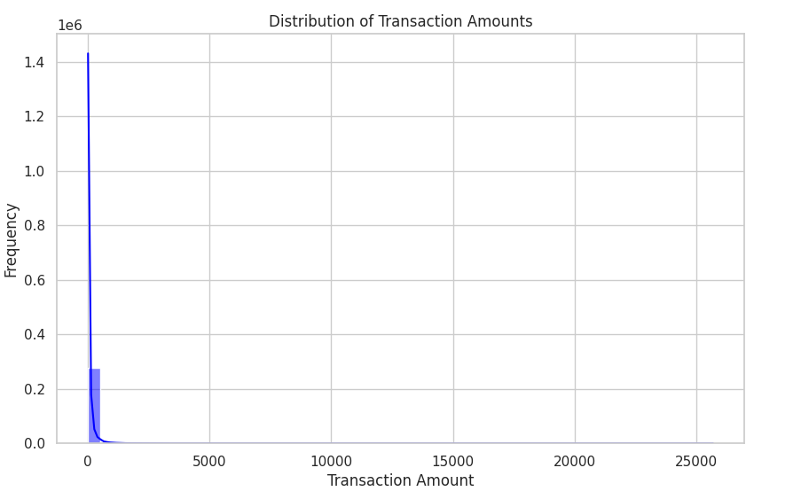
Visualizations
Title: Histogram for Distribution of Transaction Amounts
Histogram of transaction amounts: Helps us understand the distribution of the data and the presence of outliers.
This histogram shows the distribution of transaction amounts in the dataset.
The x-axis represents the transaction amounts, and the y-axis represents the frequency of transactions.
The histogram also includes a kernel density estimate (KDE) to show the distribution curve.

Slide 10
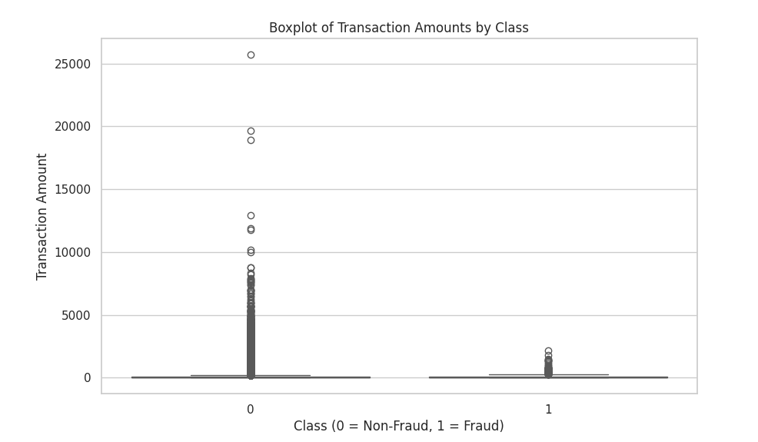
Visualizations
Title: Boxplot to Detect Variability and Outliers
The boxplot visualizes the distribution of transaction amounts for both fraudulent (Class 1) and non-fraudulent (Class 0) transactions.
The boxplot helps detect outliers and variability in transaction amounts for each class.
The differences in the interquartile range (IQR) and median between the two classes provide insight into the behavior of fraudulent versus non-fraudulent transactions.

Slide 11
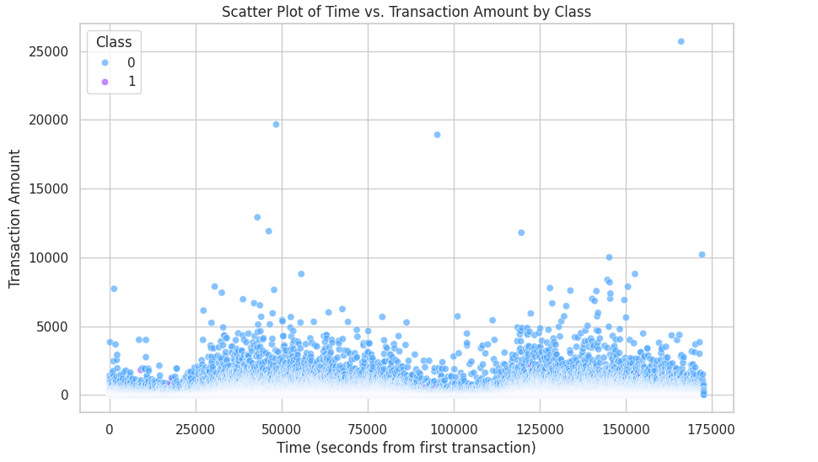
Visualizations
Title: Scatter Plot of Time vs. Transaction Amount by Class
This scatter plot visualizes the relationship between the time (in seconds from the first transaction) and the transaction amount.
Different colors represent fraudulent and non-fraudulent (blue) transactions, highlighting how the two classes behave over time.
The plot may show clustering or patterns that can help identify trends in fraudulent behavior.

Slide 12
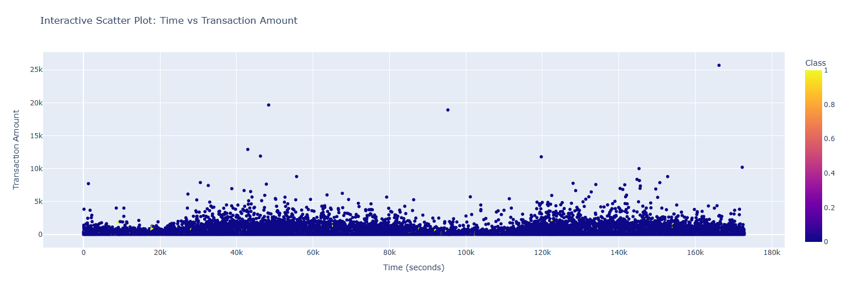
Visualizations
Title: Interactive Scatter Plot: Time vs Transaction Amount
This interactive scatter plot provides a dynamic view of the relationship between transaction time and transaction amount.
Users can hover over points to see specific data values for individual transactions.
Fraudulent transactions are marked in red, and non-fraudulent ones in blue.
This type of visualization helps with exploring trends and outliers interactively.

Slide 13
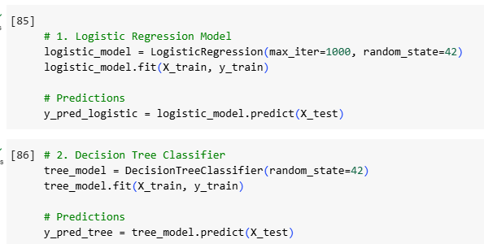
Machine Learning Models & Predictions
Model Selection:
We selected several machine learning models for this classification problem:
Logistic Regression: A simple model for binary classification (fraudulent vs. non-fraudulent).
Decision Tree Classifier: A non-linear model suitable for capturing complex patterns.
We trained the models on the dataset and evaluated their performance using accuracy, precision, recall, and F1-score.

Slide 14
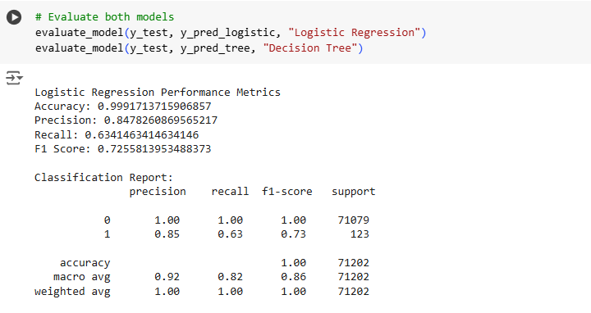
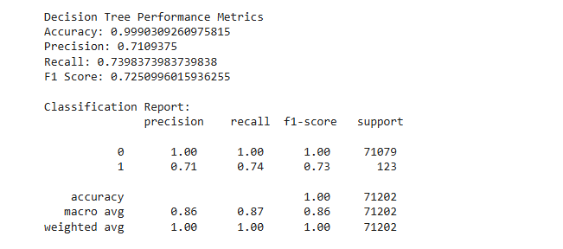
Machine Learning Models & Predictions
Model Evaluation :
Accuracy: Fraction of correct predictions.
Precision: Accuracy of positive predictions.
Recall: Coverage of actual positives.
F1 Score: Harmonic mean of precision and recall.
Confusion Matrix: Visual representation of classification performance.

Slide 15
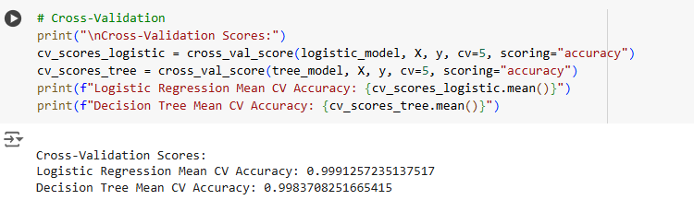
Machine Learning Models & Predictions
We also performed cross-validation to ensure that our models generalize well to unseen data.
Cross-Validation: Used cross_val_score to calculate the mean accuracy across 5 folds for both models.

Slide 16
Insights & Challenges
Insights:
The transaction amount and time were found to be the most significant features for predicting fraudulent transactions.
PCA helped in reducing the complexity of the data without losing critical information, which resulted in more efficient model training.
The models showed varying results in terms of accuracy and recall. While the decision tree achieved high accuracy, the KNN model demonstrated better performance in detecting fraudulent transactions (higher recall).
Challenges:
One of the primary challenges was dealing with the imbalanced dataset, where fraudulent transactions were rare compared to legitimate ones. We addressed this with techniques like oversampling and precision-recall curves to improve model performance on the minority class (fraudulent transactions).
Another challenge was ensuring that our models didn’t overfit to the majority class (non-fraudulent transactions), which we tackled through cross-validation and hyperparameter tuning.

Slide 17
Future Work
Advanced Models: We plan to implement Neural Networks or Ensemble Methods (like Random Forests) to improve model performance.
Anomaly Detection: Exploring unsupervised anomaly detection methods could be valuable for identifying fraudulent transactions in real-time.
Data Augmentation: By collecting more transaction data and including different types of transactions (e.g., international transactions), we could improve the model's generalizability.

Slide 18
THANK YOU
Presented by:
Srija Gunaganti
Naga Avinash Matta
Venkata Sahith Thiruckovalluru
Yeshwanth Gujjalapati

