Slide 1
Forms

Slide 2
Forms:
Using the <form> Tag
To accept input from a user, you must wrap all of your input fields inside a <form> tag. The purpose of the <form> tag is to indicate where and how the user's input should be sent. First, let's look at how the <form> tag affects page layout. Forms are block-level elements.
The two most commonly used attributes of the <form> tag are action and method. Both of these attributes are optional. The following example shows how the <form> tag is typically used:
<form action="someaction" method="get or post">
content, form controls, and other HTML elements
</form>
action specifies the URL to which the form is submitted. Again, remember that for the form to be submitted successfully, the script must be in the exact location you specify and must work properly.
The method attribute supports two values: get or post. The method indicates how the form data should be packaged in the request that's sent back to the server. The get method appends the form data to the URL in the request.

Slide 3
Input Controls
The HTML <input> element is the most used form element.
An <input> element can be displayed in many ways, depending on the type attribute.
Here are some examples:
Type | Description
<input type="text"> | Displays a single-line text input field
<input type="radio"> | Displays a radio button (for selecting one of many choices)
<input type="checkbox"> | Displays a checkbox (for selecting zero or more of many choices)
<input type="submit"> | Displays a submit button (for submitting the form)
<input type="button"> | Displays a clickable button

Slide 4
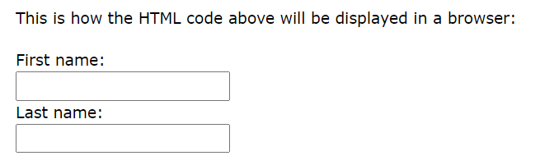
Text Fields
The <input type="text"> defines a single-line input field for text input.
Example
A form with input fields for text:
<form> <label for="fname">First name:</label><br> <input type="text" id="fname" name="fname"><br> <label for="lname">Last name:</label><br> <input type="text" id="lname" name="lname"> </form>

Slide 5
The Name Attribute for <input>
Notice that each input field must have a name attribute to be submitted.
If the name attribute is omitted, the value of the input field will not be sent at all.
<form action="/action_page.php"> <label for="fname">First name:</label><br> <input type="text" id="fname" value="John"><br><br> <input type="submit" value="Submit"> </form>

Slide 6
Value attribute
The value attribute specifies the value of an <input> element.
The value attribute is used differently for different input types:
For "button", "reset", and "submit" - it defines the text on the button
For "text", "password" - it defines the initial (default) value of the input field
For "checkbox", "radio", "image" - it defines the value associated with the input (this is also the value that is sent on submit)

Slide 7
The <label> Element
The <label> tag defines a label for many form elements.
The <label> element is useful for screen-reader users, because the screen-reader will read out loud the label when the user focus on the input element.
The <label> element also help users who have difficulty clicking on very small regions (such as radio buttons or checkboxes) - because when the user clicks the text within the <label> element, it toggles the radio button/checkbox.
The for attribute of the <label> tag should be equal to the id attribute of the <input> element to bind them together.

Slide 8
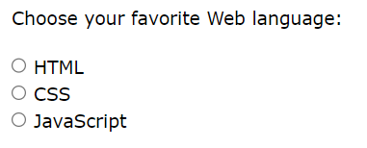
Radio Buttons
The <input type="radio"> defines a radio button.
Radio buttons let a user select ONE of a limited number of choices.
<p>Choose your favorite Web language:</p> <form> <input type="radio" id="html" name="fav_language" value="HTML"> <label for="html">HTML</label><br> <input type="radio" id="css" name="fav_language" value="CSS"> <label for="css">CSS</label><br> <input type="radio" id="javascript" name="fav_language" value="JavaScript"> <label for="javascript">JavaScript</label> </form>

Slide 9
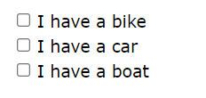
Checkboxes
The <input type="checkbox"> defines a checkbox.
Checkboxes let a user select ZERO or MORE options of a limited number of choices.
<form> <input type="checkbox" id="vehicle1" name="vehicle1" value="Bike"> <label for="vehicle1"> I have a bike</label><br> <input type="checkbox" id="vehicle2" name="vehicle2" value="Car"> <label for="vehicle2"> I have a car</label><br> <input type="checkbox" id="vehicle3" name="vehicle3" value="Boat"> <label for="vehicle3"> I have a boat</label> </form>

Slide 10
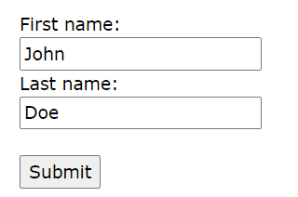
The Submit Button
The <input type="submit"> defines a button for submitting the form data to a form-handler.
The form-handler is typically a file on the server with a script for processing input data.
The form-handler is specified in the form's action attribute.
<form action="/action_page.php"> <label for="fname">First name:</label><br> <input type="text" id="fname" name="fname" placeholder="John"><br> <label for="lname">Last name:</label><br> <input type="text" id="lname" name="lname" placeholder="Doe"><br><br> <input type="submit" value="Submit"> </form>

Slide 11
Other useful input tags
Email:
<input type="email" name="email" id="email" placeholder="Enter Your Email">
Password:
<input type="password" name="password" id="password" placeholder="Enter Your Password">

Slide 12
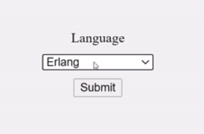
Drop down box
<form action="#">
<label for="lang">Language</label>
<select name="languages" id="lang">
<option value="javascript">JavaScript</option>
<option value="php">PHP</option>
<option value="java">Java</option>
<option value="golang">Golang</option>
<option value="python">Python</option>
<option value="c#">C#</option>
<option value="C++">C++</option>
<option value="erlang">Erlang</option>
</select>
<input type="submit" value="Submit" />
</form>

Slide 13
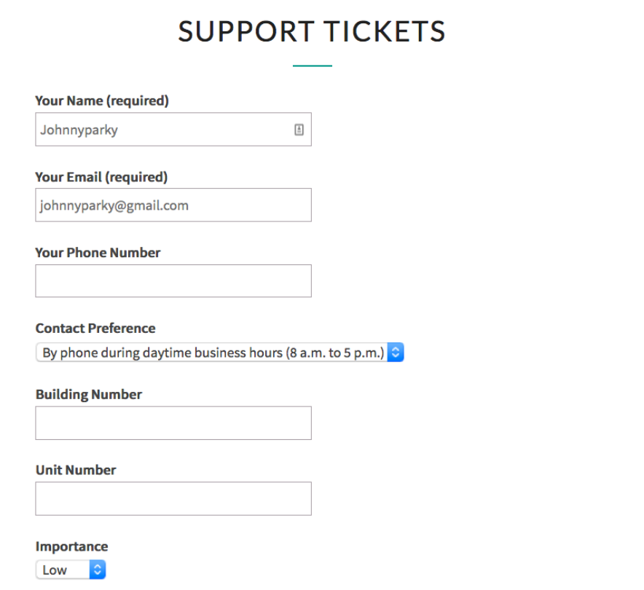
Form

