Slide 1
HTML

Slide 2
What is html?
HTML is an acronym which stands for Hyper Text Markup Language which is used for creating web pages and web applications.
Hyper Text: HyperText simply means "Text within Text." A text has a link within it, is a hypertext. Whenever you click on a link which brings you to a new webpage, you have clicked on a hypertext. HyperText is a way to link two or more web pages (HTML documents) with each other.
Markup language: A markup language is a computer language that is used to apply layout and formatting conventions to a text document. Markup language makes text more interactive and dynamic. It can turn text into images, tables, links, etc.
Web Page: A web page is a document which is commonly written in HTML and translated by a web browser. A web page can be identified by entering an URL. A Web page can be of the static or dynamic type. With the help of HTML only, we can create static web pages.
HTML is a markup language which is used for creating attractive web pages with the help of styling, and which looks in a nice format on a web browser. An HTML document is made of many HTML tags <> and each HTML tag contains different content.

Slide 3
Description of HTML Example
<!DOCTYPE>: It defines the document type or it instruct the browser about the version of HTML.
<html > :This tag informs the browser that it is an HTML document. Text between html tag describes the web document. It is a container for all other elements of HTML except <!DOCTYPE>
<head>: It should be the first element inside the <html> element, which contains the metadata(information about the document). It must be closed before the body tag opens.
<title>: As its name suggested, it is used to add title of that HTML page which appears at the top of the browser window. It must be placed inside the head tag and should close immediately. (Optional)
<body> : Text between body tag describes the body content of the page that is visible to the end user. This tag contains the main content of the HTML document.
<h1> : Text between <h1> tag describes the first level heading of the webpage.
<p> : Text between <p> tag describes the paragraph of the webpage.
<!DOCTYPE html>
<html>
<head>
<title>Web page title</title>
</head>
<body>
<h1>Write Your First Heading</h1>
<p>Write Your First Paragraph.</p>
</body>
</html>

Slide 4
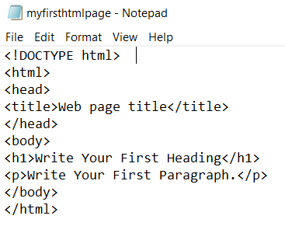
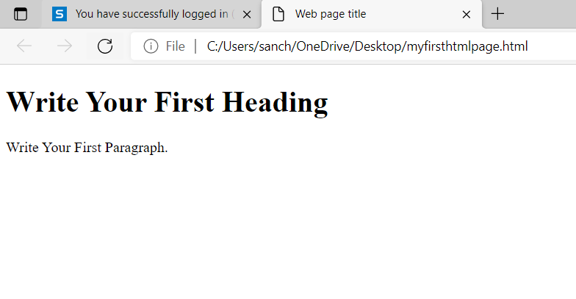
EXAMPLE

Slide 5
HTML Versions
Since the time HTML was invented there are lots of HTML versions in market, the brief introduction about the HTML version is given below:
HTML 1.0: The first version of HTML was 1.0, which was the barebones version of HTML language, and it was released in1991.
HTML 2.0: This was the next version which was released in 1995, and it was standard language version for website design. HTML 2.0 was able to support extra features such as form-based file upload, form elements such as text box, option button, etc.
HTML 3.2: HTML 3.2 version was published by W3C in early 1997. This version was capable of creating tables and providing support for extra options for form elements. It can also support a web page with complex mathematical equations. It became an official standard for any browser till January 1997. Today it is practically supported by most of the browsers.
HTML 4.01: HTML 4.01 version was released on December 1999, and it is a very stable version of HTML language. This version is the current official standard, and it provides added support for stylesheets (CSS) and scripting ability for various multimedia elements.
HTML 5 : HTML5 is the newest version of HyperText Markup language and is currently being used.

Slide 6
Features of HTML
It is a very easy and simple language. It can be easily understood and modified.
It is very easy to make an effective presentation with HTML because it has a lot of formatting tags.
It is a markup language, so it provides a flexible way to design web pages along with the text.
It facilitates programmers to add a link on the web pages (by html anchor tag), so it enhances the interest of browsing of the user.
It is platform-independent because it can be displayed on any platform like Windows, Linux, and Macintosh, etc.
It facilitates the programmer to add Graphics, Videos, and Sound to the web pages which makes it more attractive and interactive.
HTML is a case-insensitive language, which means we can use tags either in lower-case or upper-case.

Slide 7
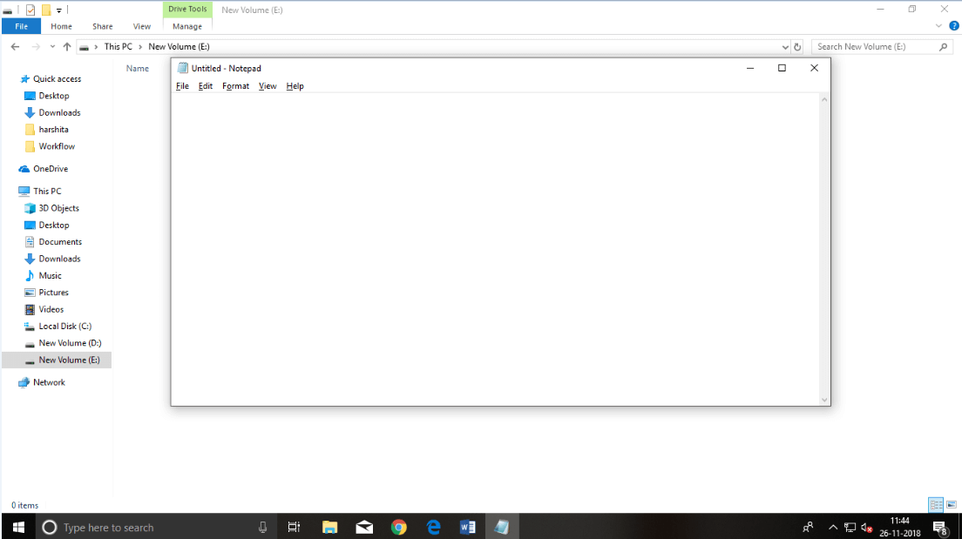
HTML code with Notepad
Step 1: Open Notepad (Windows)

Slide 8
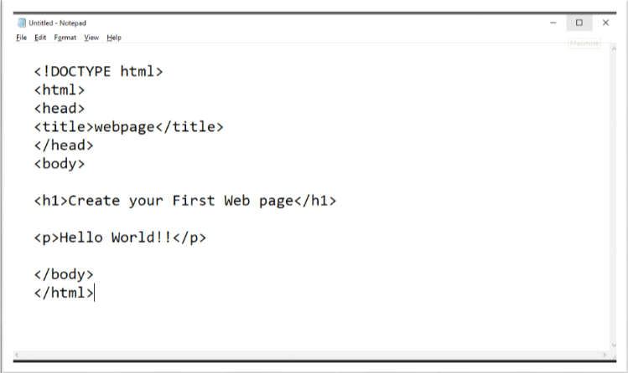
Step 2: Write code in HTML

Slide 9
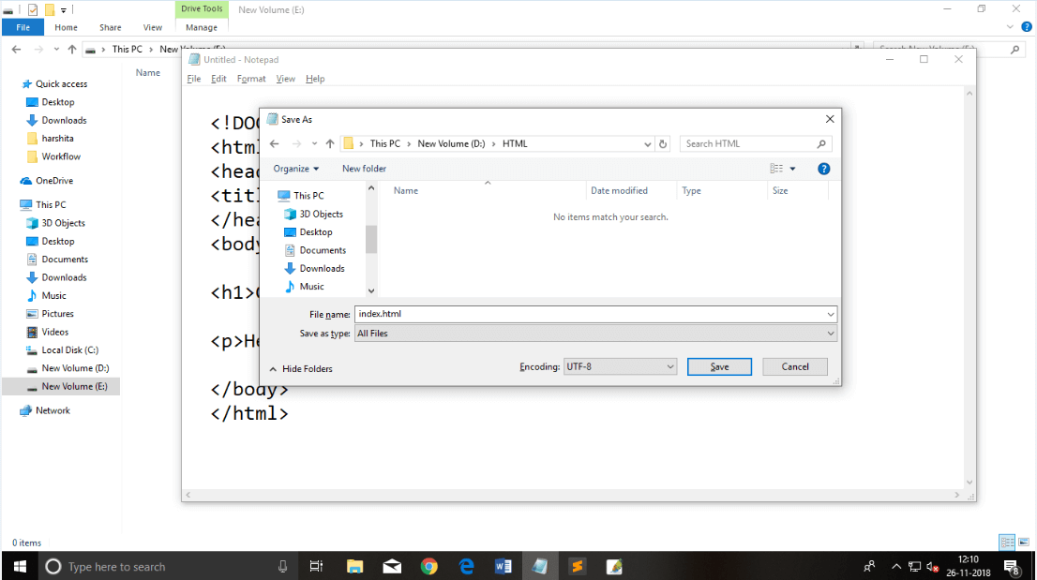
Step 3: Save the HTML file with .htm or .html extension.

Slide 10
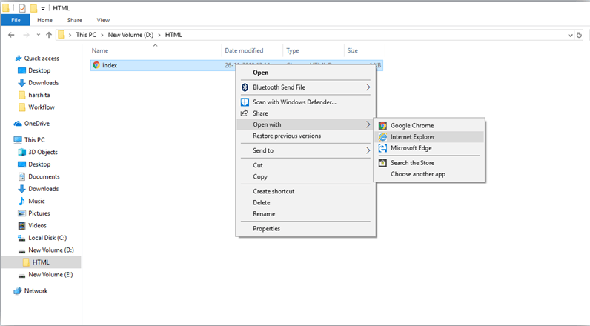
Step 4: Open the HTML page in your web browser.
To run the HTML page, you need to open the file location, where you have saved the file and then either double-click on file or click on open with option

Slide 11
