Slide 1

DevOps Incident Management System
SOA Project Review-1
Date& Time
 | Under the Guidance of Dr.Navyatha Ravi Assistant Professor, Department of Computer Science and Engineering, KLH CSE Bowrampet Campus
Team Members Pranav Mahajan – 2420030727 B.Srijan – 2420030201 Aditya Ram - 2420030383

Slide 2
Outline of Project Work
Focus
Introduction
Literature Survey
Challenges
Research Objectives
Conclusion & Future Work
References
Publications Details

Slide 3
Problem Statement
Modern software systems consist of multiple services, applications, databases, and infrastructure components. When failures occur, identifying, assigning, tracking, and resolving incidents becomes difficult if these activities are handled manually or through disconnected tools.
Traditional incident management approaches may lead to:
  Delayed identification and resolution of incidents.
  Lack of centralized incident tracking.
  Difficulty in assigning incidents to appropriate teams.
  Poor communication between development and operations teams.
  Limited visibility into incident status and resolution history.
  Tight coupling between system components when a centralized application is used.
Proposed Solution
The DevOps Incident Management System provides a centralized and scalable platform for managing incidents using microservices and Service-Oriented Architecture.
The system manages the complete incident lifecycle:
Incident Creation → Assignment → Status Tracking → Resolution → Notification
It uses independent services, REST APIs, secure authentication, service discovery, API gateway routing, and event-driven communication to improve scalability, maintainability, and reliability.

Slide 4
Objectives
Develop a centralized incident management system for creating, tracking, assigning, and resolving DevOps incidents.
Implement a microservices-based architecture where major functionalities are independently developed and deployed.
Provide secure authentication and authorization using JWT-based security and Role-Based Access Control (RBAC).
Enable efficient incident assignment and tracking based on teams, services, severity, and incident status.
Implement event-driven communication using Apache Kafka for asynchronous incident and notification events.
Use service discovery and API gateway to provide reliable communication and centralized routing between microservices.
Maintain independent databases for each service to improve service autonomy and scalability.
Automate testing and deployment using tools such as JUnit, Mockito, Docker, and GitHub Actions.

Slide 5
Literature Survey
Authors | Title of the Paper | Methodology | Inferences | Limitation/Future work
Kim et al. | The DevOps Handbook | DevOps practices, automation, continuous delivery and collaboration | Demonstrates how development and operations integration improves software delivery and reliability | Requires suitable tooling and organizational adoption
Newman | Building Microservices | Microservices architecture, service decomposition and independent deployment | Shows how independent services improve scalability and maintainability | Distributed systems introduce communication and monitoring complexity
Richardson | Kafka: The Definitive Guide | Event streaming and asynchronous messaging using Kafka | Event-driven communication enables loosely coupled and scalable services | Requires proper event management, monitoring and fault handling

Slide 6
Problem Gap Identification
There is a need for a secure, scalable and loosely coupled incident management platform that combines microservices, API Gateway, service discovery, event-driven communication and independent databases into a unified DevOps incident management workflow.
From the existing approaches, we identified the following gaps:
1. Fragmented Incident Management
Incident creation, assignment, communication, and resolution may be handled through separate tools, making tracking difficult.
2. Synchronous Dependency
Direct service-to-service communication can create tight coupling and increase the impact of service failures.
3. Lack of Centralized Routing
Without an API Gateway, clients may need to directly communicate with multiple backend services.
4. Security Challenges
Incident management systems require controlled access based on user roles such as administrators, developers, and operations teams.
5. Database Coupling
Using a common database can reduce service independence and make scaling individual services difficult.

Slide 7
Innovation, Creativity, and Novelty
Our project combines several SOA and DevOps concepts into one integrated incident management platform.
1. Event-Driven Incident Workflow
Apache Kafka is used for asynchronous communication and event propagation between services.
2. API Gateway
Spring Cloud Gateway provides a single entry point for clients and handles routing to the appropriate microservice.
3. Service Discovery
Eureka enables services to dynamically discover and communicate with other registered services.
4. Secure Access Control
JWT authentication and RBAC restrict system operations according to user roles.
5. Database per Service
Each microservice maintains its own database, improving service autonomy and reducing database-level coupling.
6. Automated DevOps Pipeline
GitHub Actions can automate build, testing and deployment activities.
7. Complete Incident Lifecycle
The system connects the entire workflow:
Create → Assign → Track → Resolve → Notify

Slide 8
Feasibility and Project Plan
Technical Feasibility
Java and Spring Boot provide a mature platform for developing microservices.
Spring Cloud supports API Gateway and service discovery.
PostgreSQL provides reliable relational data storage.
Apache Kafka supports asynchronous event communication.
Docker enables containerized deployment.
Economic Feasibility
The project primarily uses open-source technologies.
Development can be performed using existing systems and freely available tools.
No specialized hardware is required.
Operational Feasibility
The system provides a centralized interface for incident management.
Role-based access makes the system suitable for different DevOps teams.
Independent services make future modifications easier.

Slide 9
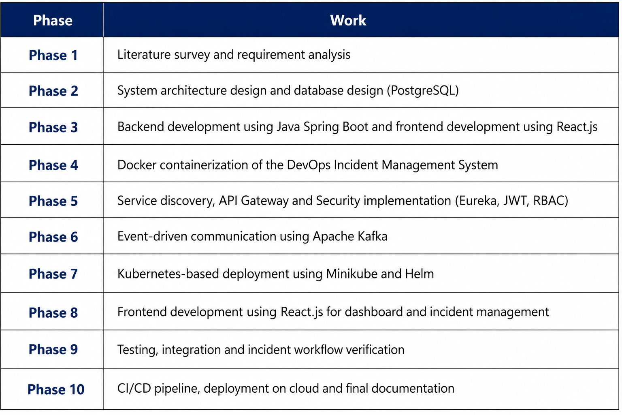
Project Plan / Timeline

