Slide 1

DevOps Incident Management System
SOA Project Review-2
Date& Time
 | Under the Guidance of Dr.Navyatha Ravi Assistant Professor, Department of Computer Science and Engineering, KLH CSE Bowrampet Campus
Team Members Pranav Mahajan – 2420030727 B.Srijan – 2420030201 Aditya Ram - 2420030383

Slide 2
Project Design
System Design
➢ The proposed system follows a microservices-based Service-Oriented Architecture for independent development, deployment, and maintenance of system components.
➢ The system consists of the following major services:
  User/Auth Service
  Incident Management Service
  Service/Team Management Service
  Notification Service
➢ Spring Cloud Gateway acts as the single entry point for client requests.
➢ Eureka Service Registry enables service discovery and communication between microservices.
➢ Each microservice maintains its own PostgreSQL database following the database-per-service approach.
➢ Apache Kafka is used for asynchronous event-driven communication between services.
  Main Workflow
  User → API Gateway → Microservices → Database
  Incident Service → Kafka → Notification Service

Slide 3
System Architecture
Architecture Components:
Client / React.js: Provides the user interface for incident management.
API Gateway: Routes client requests to the appropriate microservice.
Eureka Server: Provides service registration and discovery.
User/Auth Service: Manages users, authentication and authorization.
Incident Management Service: Creates, assigns, tracks and resolves incidents.
Service/Team Management Service: Manages teams and services associated with incidents.
Notification Service: Handles notifications generated from incident events.
PostgreSQL: Provides independent databases for individual services.
Apache Kafka: Enables asynchronous communication through incident and notification events.

Slide 4
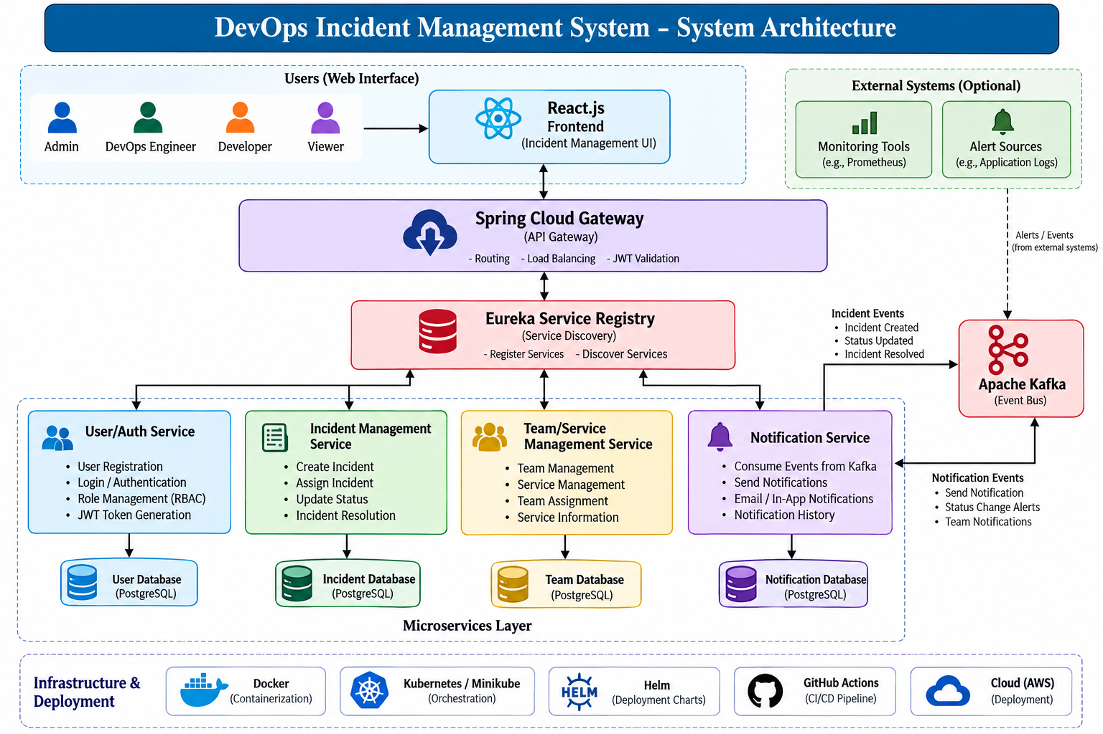

Slide 5
Microservices and Database Design
Microservices
User/Auth Service
• User registration and login
• JWT authentication
• Role management
• User authorization
Incident Management Service
• Incident creation
• Incident assignment
• Severity management
• Status tracking
• Incident resolution
Service/Team Management Service
• Team management
• Service management
• Team assignment
• Service information
Notification Service
• Notification processing
• Event consumption
• Incident status notifications
Database Design
➢ Each microservice maintains its own PostgreSQL database.
➢ Services access only their respective databases.
➢ This reduces database-level coupling and allows services to be developed and scaled independently.

Slide 6
Methodology Adopted
Development Methodology
➢ The project follows an incremental microservices development approach.
Phase 1 — Requirement Analysis
• Identify users, roles and system requirements
• Define incident lifecycle
• Identify functional and non-functional requirements
Phase 2 — System Design
• Design microservices architecture
• Define API contracts
• Design database schemas
• Define service communication
Phase 3 — Implementation
• Develop Spring Boot microservices
• Implement REST APIs
• Implement authentication and authorization
• Develop incident management functionality
Phase 4 — Integration
• Configure API Gateway
• Configure Eureka Service Registry
• Integrate PostgreSQL databases
• Integrate Apache Kafka
Phase 5 — Testing
• Unit testing
• API testing
• Integration testing
• End-to-end workflow testing
Phase 6 — Deployment
• Docker containerization
• Kubernetes deployment
• CI/CD pipeline implementation

Slide 7
Technical Soundness
Backend Technologies
➢ Java + Spring Boot
Used for developing independent microservices and REST APIs.
➢ Spring Cloud Gateway
Provides centralized API routing and acts as the entry point for clients.
➢ Eureka Service Registry
Provides dynamic service discovery between microservices.
Communication
➢ REST APIs
Used for synchronous request-response communication.
➢ Apache Kafka
Used for asynchronous event-driven communication and notification events.
Database
➢ PostgreSQL
Used for persistent relational data storage.
➢ Database per Service
Maintains service autonomy and reduces database coupling.

Slide 8
Security, Testing and Deployment
Security
➢ Spring Security provides application-level security.
➢ JWT Authentication is used to authenticate users.
➢ Role-Based Access Control (RBAC) restricts operations according to user roles.
➢ CORS is configured to control cross-origin requests.
Testing
➢ JUnit for unit testing.
➢ Mockito for testing service dependencies.
➢ Postman for REST API testing.
➢ Integration testing to verify communication between services.
➢ End-to-end testing to verify the complete incident workflow.
Deployment
➢ Docker is used for containerizing services.
➢ Kubernetes/Minikube can be used for container orchestration.
➢ Helm can be used for Kubernetes deployment management.
➢ GitHub Actions is used for CI/CD automation.

Slide 9
