Slide 1
<!DOCTYPE html> <html lang="en"> <head> <meta charset="UTF-8" /> <meta http-equiv="X-UA-Compatible" content="IE=edge" /> <meta name="viewport" content="width=device-width, initial-scale=1.0" /> <link rel="stylesheet" href="style.css" /> <link rel="icon" href="logo.png" type="image/x-icon"> <title>Calculator</title> </head> <body>

Slide 2
<div class="container"> <div class="calculator"> <input type="text" id="inputBox" placeholder="0" /> <div> <button class="button operator clear">AC</button> <button class="button operator">DEL</button> <button class="button operator">%</button> <button class="button operator">/</button> </div> <div> <button class="button">7</button> <button class="button">8</button> <button class="button">9</button> <button class="button operator">*</button> </div> <div> <button class="button">4</button> <button class="button">5</button> <button class="button">6</button> <button class="button operator">-</button> </div> <div> <button class="button">1</button> <button class="button">2</button> <button class="button">3</button> <button class="button operator">+</button> </div> <div> <button class="button">00</button> <button class="button">0</button> <button class="button">.</button> <button class="button equalBtn">=</button> </div> </div> </div> <script src="script.js"></script> </body> </html>

Slide 3
let input = document.getElementById('inputBox'); let buttons = document.querySelectorAll('button'); let string = ""; let arr = Array.from(buttons); arr.forEach(button => { button.addEventListener('click', (e) => { if (e.target.innerHTML == '=') { string = eval(string); input.value = string; } else if (e.target.innerHTML == 'AC') { string = ""; input.value = string; } else if (e.target.innerHTML == 'DEL') { string = string.substring(0, string.length - 1); input.value = string; } else { string += e.target.innerHTML; input.value = string; } }) })

Slide 4
@import url("https://fonts.googleapis.com/css2?family=Sofadi+One&display=swap"); * { margin: 0; padding: 0; box-sizing: border-box; font-family: "Sofadi One", system-ui; } body { width: 100%; height: 100vh; display: flex; justify-content: center; align-items: center; } .calculator { border: 1px solid #000000; padding: 20px; border-radius: 16px; background: transparent; box-shadow: 0px 3px 15px rgba(0, 0, 0, 0.945); } input { width: 320px; border: none; padding: 24px; margin: 10px; background: transparent; box-shadow: 0px 3px 15px rgbs(84, 84, 84, 0.1); font-size: 40px; text-align: right; cursor: pointer; color: #000000; }

Slide 5
input::placeholder { color: #000000; } button { border: 2px solid rgba(0, 0, 0, 0.422); box-shadow: 0px 3px 15px rgba(128, 107, 107, 0.5); width: 60px; height: 60px; margin: 10px; border-radius: 50%; background: transparent; color: #000000; font-size: 20px; cursor: pointer; } .equalBtn { background-color: #a6c3eb; } .operator { color: #f70529be; background-color: rgba(213, 238, 226, 0.692); } .clear { background-color: rgb(237, 232, 227); }

Slide 6
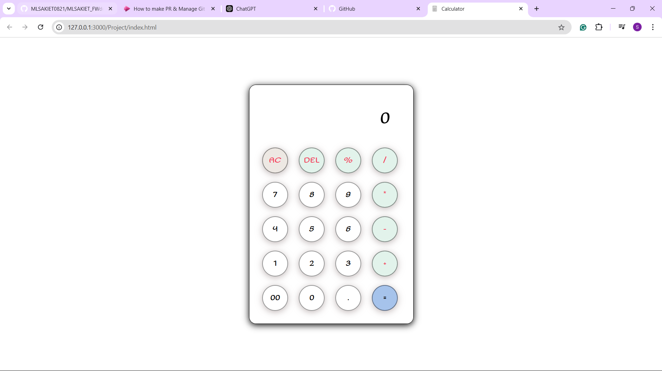

Slide 7
<!DOCTYPE html> <html lang="en"> <head> <meta charset="UTF-8"> <meta name="viewport" content="width=device-width, initial-scale=1.0"> <title>My intro</title> <link rel="stylesheet" href="style.css" > </head> <body>

Slide 8
<div class="container">
<h1>Srijan Poddar</h1>
<img src="img.jpg" alt="Profile Picture">
<p>I'm <b>Srijan Poddar</b>, an enthusiastic individual who loves
exploring new ideas and challenges. I have done my schooling at
<b><i>"Divine Public School"</i></b>. I was a PCM student and passed my
12<sup>th</sup> in 2022 with an aggregate of 83.42%, and I am currently pursuing my B.Tech degree from
<b><i>"KIET Group of Institutions"</i></b> in <b><i>Computer Science and Engineering
branch</i></b>. I enjoy diving deep into projects that allow me to
express my creativity and problem-solving skills. Outside of
work, I'm passionate about playing chess, which inspires me and
keeps me balanced. I believe in the power of lifelong learning
and am always looking for new experiences that broaden my
perspective. Whether through travel, reading, or connecting with
others, I strive to grow both personally and professionally.
</p>

Slide 9
<div class="social-links"> <h3>Connect with me:</h3> <a href="https://www.linkedin.com/in/srijan-poddar-96b39a283?utm_source=share&utm_campaign=share_via&utm_content=profile&utm_medium=android_app " target="_blank">LinkedIn</a> <a href="https://github.com/SrijanPoddar" target="_blank">GitHub</a> <a href="https://www.instagram.com/srijan.poddar/profilecard/?igsh=MWRlNzh6NndlcDA4cg==" target="_blank">Instagram</a> <a href="mailto:srijanpoddar8@gmail.com" target="_blank">Gmail</a> </div> </div> </body> </html>

Slide 10
@import url('https://fonts.googleapis.com/css2?family=Playwrite+GB+S:ital,wght@0,100..400;1,100..400&display=swap'); body { font-family: "Playwrite GB S", cursive; font-optical-sizing: auto; font-weight: 600; font-style: normal; margin: 0; padding: 20px; background: linear-gradient(135deg, #e0f7fa, #b3e5fc); } .container { max-width: 900px; margin: auto; background: white; padding: 30px; border-radius: 10px; box-shadow: 0 10px 30px rgba(0, 0, 0, 0.15); } h1 { text-align: center; font-weight: 700; text-shadow: 4px 4px 15px rgb(255, 143, 123); margin-bottom: 20px; } img { display: block; margin: 0 auto; border: 2px solid black; border-radius: 15%; width: 190px; height: 200px; }

Slide 11
p { font-size: 18px; line-height: 1.6; color: #333; } .social-links { text-align: center; margin-top: 30px; } .social-links a { margin: 0 15px; text-decoration: none; color: #007bff; font-weight: 500; transition: color 0.3s ease; } .social-links a:hover { color: #84ffca; } h3 { font-size: 22px; margin-bottom: 10px; color: #333; }

Slide 12
