Slide 1
Text Clustering
TF-IDF and Clustering

Slide 2


Basic Cluster Terminology
Cluster – a collection of objects that are similar to one another within the same cluster and are dissimilar to the objects in other clusters.

Slide 3
Clustering Process
Initialization
Compute similarity between objects/clusters
Clustering based on similarity between objects/clusters
Stop if a stopping condition (threshold) is met or return to step 1
Notes:
Whats return to 1?

Slide 4
Taxonomy of Clustering
Distance-versus-density-versus-model based clustering and stopping criteria
Distance-based: reduce intra-cluster distance and/or increase inter-cluster distance
Density-based: increase density in a cluster
Model-based: cluster based on a certain mathematic model, e.g., a probability model or a neural network

Slide 5
Distance Matrix
A distance matrix can be created with objects as indexes and distance between objects as elements.
 | Boston | NY | DC | SF | LA
Boston | 0 | 200 | 450 | 3000 | 4000
NY | 200 | 0 | 250 | 2900 | 2700
DC | 450 | 250 | 0 | 2800 | 2500
SF | 3000 | 2900 | 2800 | 0 | 400
LA | 4000 | 2700 | 2500 | 400 | 0

Slide 6
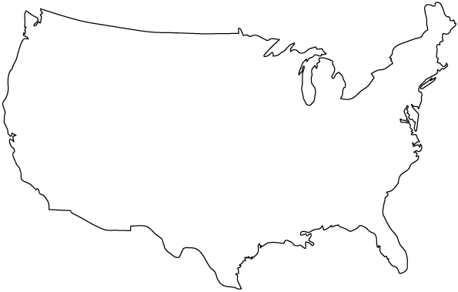
Distance Matrix
Boston
SF
NY
DC
LA

Slide 7
The K-Means Method
Randomly select k of the objects to be k cluster means
For each of the remaining objects:
Assign it to the cluster with the smallest distance from its cluster mean to the object
Recalculate the cluster mean
Calculate the within cluster sum of square-errors:
E = ∑ | object – object’s cluster mean|
all objects
Re-distribute objects if E can be reduced
Repeat 3 until E does not improve significantly over consecutive iterations
Notes:
Explain square error calculation?

Slide 8
K-Means Example (k=2): Initialization
Cluster 1
+
Boston
SF
+
NY
DC
Cluster 2
LA

Slide 9
K-Means Example: Assign Objects
Cluster 1
+
Boston
SF
+
NY
DC
Cluster 2
LA

Slide 10
K-Means Example: Assign Objects
Cluster 1
+
Boston
SF
+
NY
DC
Cluster 2
LA

Slide 11
K-Means Example: Assign Objects
Cluster 1
+
Boston
SF
NY
+
DC
Cluster 2
LA

Slide 12
K-Means Example: Redistribute Objects
Cluster 1
Boston
+
SF
NY
+
DC
LA
Cluster 2

Slide 13
K-Means Example: Redistribute Objects
Cluster 1
Boston
+
SF
NY
+
DC
LA
Cluster 2
E converges as no more object
redistribution can reduce E

Slide 14
Challenges of Clustering Text
Distance-based clustering requires numeric values
How do we convert texts into numbers?
Simple count of terms?
TF-IDF scores?
How do we calculate distance?
Simple distance (Euclidian)
Step distance (Manhattan)
Angle Distance (Cosine)

Slide 15

TF-IDF
Term Frequency / Inverse document Frequency
A ratio of:
How often a word occurs in a document
How many other documents in the corpus also contain that word
Inverse Document Frequency IDF =
Where
D = all documents on corpus
|D| = Size of corpus
t = term
d = individual document
Term Frequency
TF = tf(t,d) Where t = term d=document

Slide 16
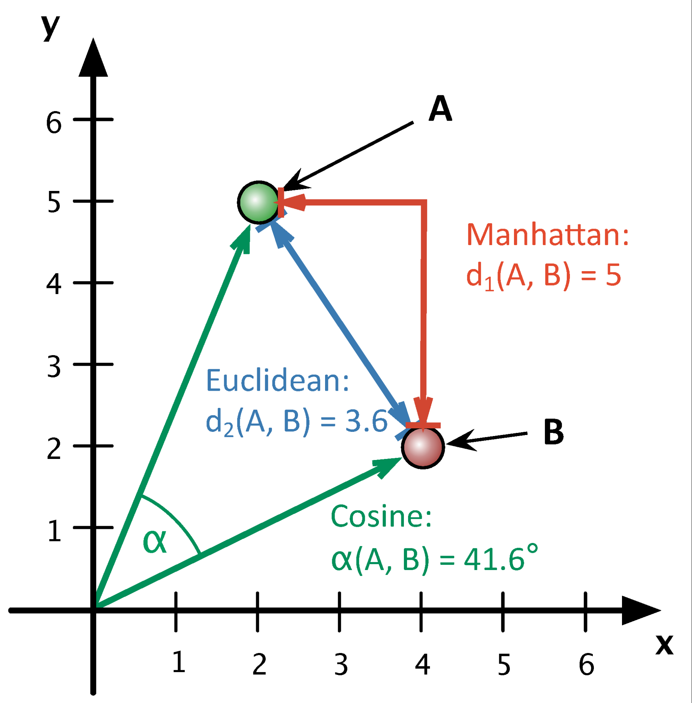

Slide 17
Code Walkthrough
Load
Load the corpus of texts
Pre-process
Pre-process to
Remove noise data
Remove punctuation, stopwords and whitespace
Stem remaining text
Calculate
Calculate tf-idf and load into a matrix
Calculate
Calculate distances
Create
Create clusters

