Slide 1
Aero Tran Flight Reservation System
cs489 Final Project

Slide 2
Problem Statement
AeroTran aims to streamline flight search and reservation
Delivering a user-friendly experience with modern technologies

Slide 3
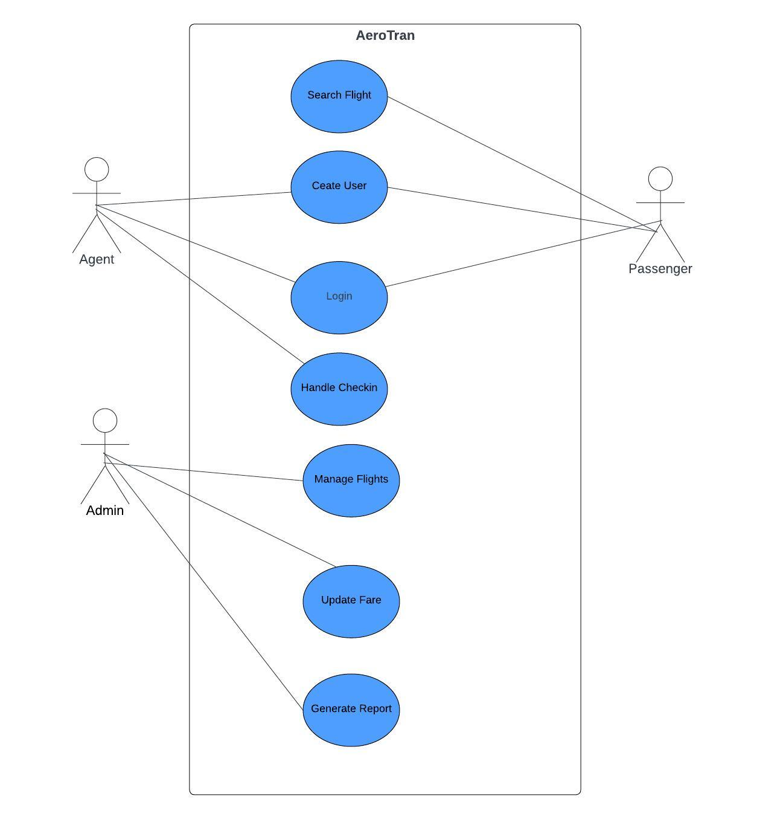
Use Cases

Slide 4
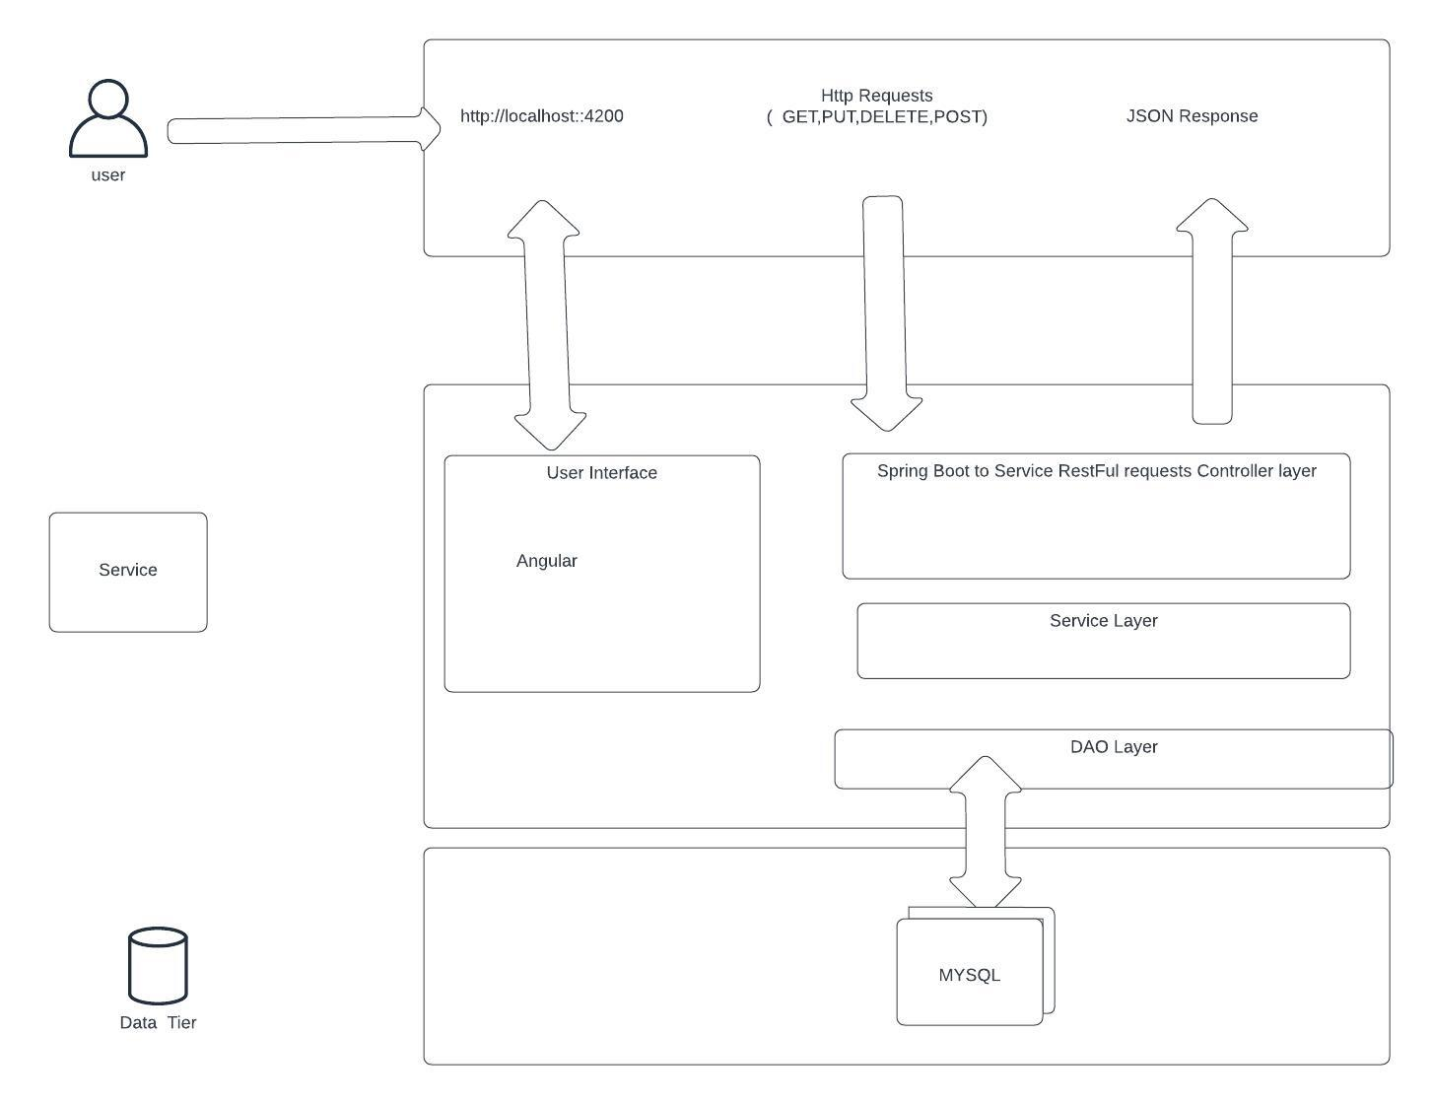
System Architecture

Slide 5
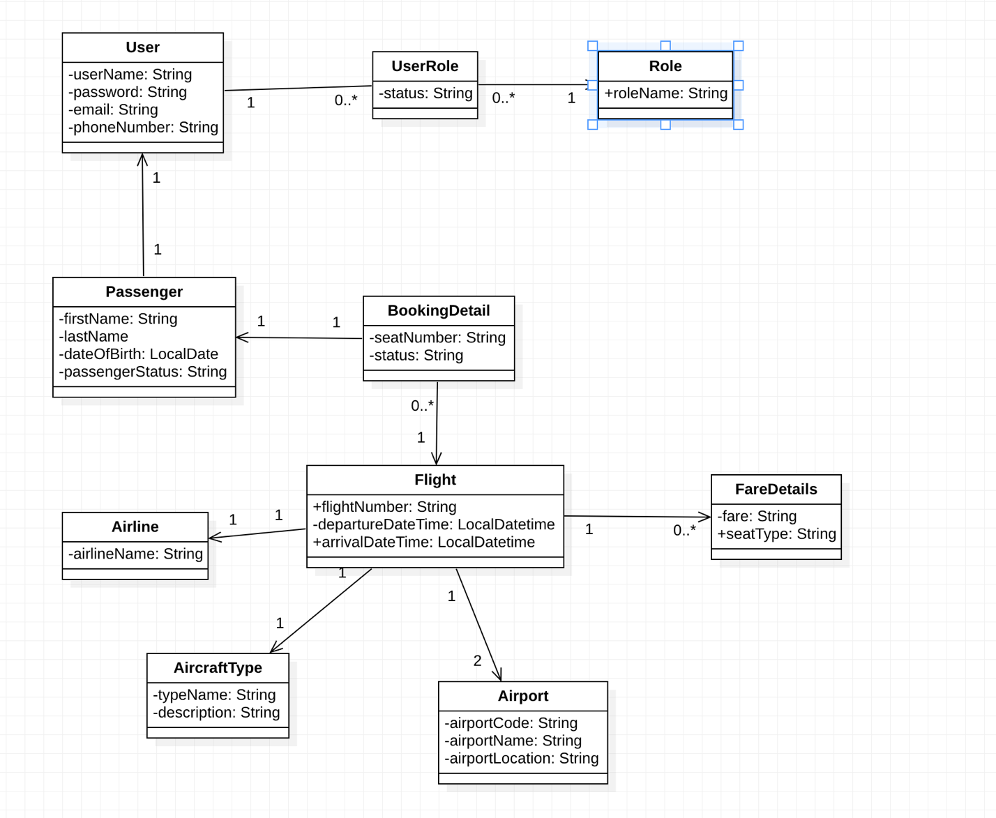
Domain Model

Slide 6
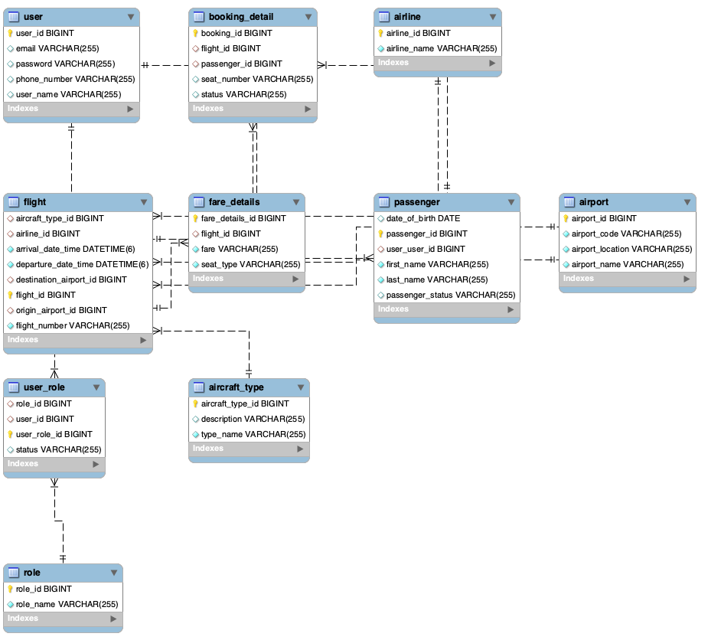
ER Diagram

Slide 7
Thank you

