Slide 1


Team Details
  Team name: FinCrime AI
  Team leader name: Srijana Khadka
  Problem Statement: Analysts are buried in rule-generated alerts and spend hours writing up each case by hand, so financial crime is detected late and reported slowly.

Slide 2
Brief about the idea
Problem. Banks and wallet providers generate thousands of monitoring alerts. Analysts must pull transaction history, judge whether activity is suspicious, and draft a suspicious transaction report (STR) for each one. It is slow, inconsistent, and hard to explain to a regulator.
Idea. FinCrime AI keeps an explainable rules engine for detection and uses Gemini to turn every alert into an investigation brief and a draft STR narrative, grounded only in the flagged transactions. The analyst reviews, asks follow-up questions and decides: escalate, monitor or close.
6
AML / fraud typologies detected with transaction-level evidence
Real-time
screening of each new transaction, re-scoring the customer
1 click
Gemini investigation brief + draft STR narrative
Human-in-
the-loop
analyst decides; every step logged in Firestore

Slide 3
Opportunities
How different is it? Most monitoring tools stop at "alert raised". FinCrime AI also explains the alert, cites the exact transactions, and drafts the report, so analysts start from a brief, not a blank page.
How does it solve the problem? Rules give consistent, auditable detection. Gemini compresses investigation time by summarising evidence, suggesting innocent explanations to check, and drafting the STR narrative.
USP: explainable AI for compliance. Gemini only sees structured case evidence and must cite transaction IDs; it recommends, the human decides. Configurable thresholds (NPR) and a full audit timeline.
Typical rules-only monitoring
FinCrime AI
Output
Alert + score
Alert + evidence + AI brief + draft STR
Explainability
Rule name only
Per-rule evidence with transaction IDs
Analyst workload
Manual write-up for every case
Review and edit an AI draft

Slide 4
List of features offered by the solution
Rules engine, 6 typologies
Structuring, rapid pass-through, high-risk countries, mule velocity, dormant reactivation, profile mismatch.
Real-time screening
Submit a transaction; customer is re-scored in milliseconds and a case is opened or updated.
Evidence-based risk score
0-100 score with severity bands; every hit lists the triggering transactions.
Gemini case analysis
Summary, typology, red flags citing IDs, innocent explanations, recommended action.
Draft STR narrative
One-click draft report narrative for analyst review and copy.
Case copilot + workflow
Ask Gemini questions about a case; escalate, monitor or close with a full audit timeline.

Slide 5
Process flow diagram or Use-case diagram
1
Transactions
New and historical transactions arrive
2
Rules engine
6 typologies, score 0-100, evidence IDs
3
Case in Firestore
Alert ≥ 25 opens or updates a case
4
Gemini analysis
Brief, red flags, recommendation, draft STR
5
Analyst decides
Escalate, monitor or close; audit logged
Feedback loop: analyst decisions and notes are stored on the case, and each new transaction re-scores the customer, so a case grows as evidence accumulates.
Use-case actors: Compliance analyst (reviews cases), Compliance manager (monitors queue and escalations), System (screens transactions).

Slide 6
Architecture diagram of the proposed solution
Cloud Run
Node.js service
• Rules engine (6 typologies)
• Real-time screening API
• Case workflow + audit log
• Gemini client
Cloud Firestore
customers · transactions · cases (AI analysis, timeline)
Analyst
Web dashboard (browser)
Firebase Hosting
HTTPS front door, rewrite to Cloud Run
Design choices
• Zero npm dependencies; Google REST APIs only
• Firestore rules deny all direct client access
• Graceful fallback: in-memory store / offline template, labelled in the UI
Gemini
gemini-2.5-flash via Vertex AI: structured JSON analysis, STR draft, copilot
Service account: Datastore User + Vertex AI User

Slide 7
Technologies to be used in the solution
Cloud Run
Hosts the API and dashboard container; autoscaling; runs as a least-privilege service account.
Firestore
System of record for customers, transactions and cases, including AI analysis and audit timeline.
Firebase
Hosting fronts Cloud Run over HTTPS; Firestore security rules deployed with the Firebase CLI.
Gemini (gemini-2.5-flash)
Structured case analysis, draft STR narrative and case copilot, grounded in case evidence.
Node.js 22, vanilla JS
Dependency-free backend and single-page dashboard; Docker for deployment.

Slide 8
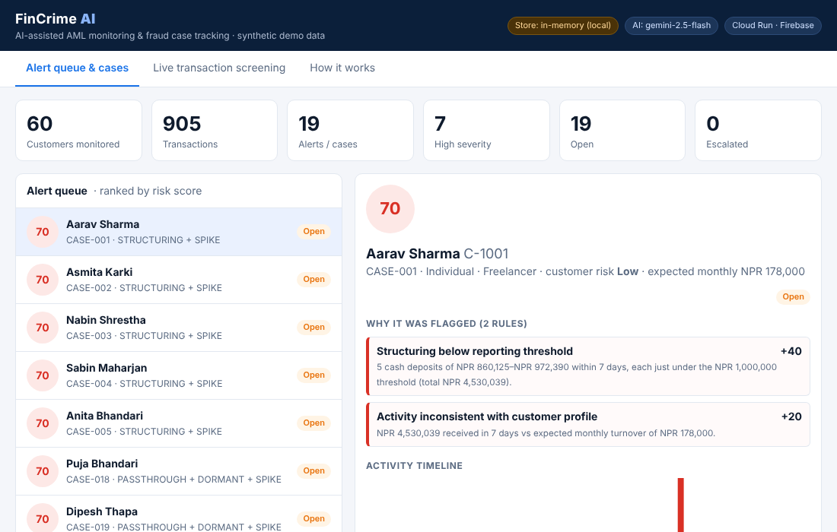
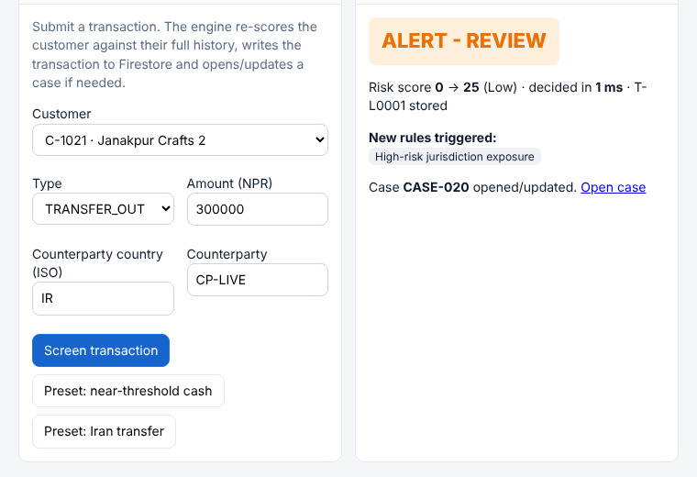
Snapshots of the prototype
Alert queue, risk scores and case detail with rule evidence
Live transaction screening: score change, decision and latency
Screenshots from a local run on synthetic data. The deployed prototype uses the same UI backed by Firestore and Gemini.

Slide 9
Prototype Performance report/Benchmarking
100%
Precision
98%
Recall (392 of 400)
0
False positives in 1,200 customers
0.07 ms
Median scoring time per customer
Method: 20 random seeds x 60 synthetic customers (~18,000 transactions), with 5 typologies injected (20% deliberately evasive) and 4 legitimate large-business decoys per run. Labels are hidden from the engine. Because the data is synthetic and matches the rule typologies, this is a sanity benchmark, not a claim of real-world accuracy.

Slide 10
Additional Details/Future Development (if any)
Next 30 days
Firebase Auth with analyst / manager roles and maker-checker approval; configurable thresholds and country lists in the UI; export STR drafts in the regulator filing format.
Next 90 days
Customer network graph to link mule accounts; BigQuery ML anomaly scoring alongside rules; sanctions and PEP screening; feedback from analyst decisions to tune rules.
Pilot readiness
Connect to real core-banking / wallet feeds, run a back-test on labelled historical cases, and validate thresholds with the institution's compliance policy and local regulation.
Responsible AI. Gemini is constrained to supplied evidence, labels its output as a draft, never files reports automatically, and falls back to a labelled template if unavailable. All data in this prototype is synthetic.

Slide 11
Provide links to your:
GitHub Public Repository: https://github.com/Srijanakhadka2240/Fincrime-AI
Demo Video Link (3 Minutes): https://github.com/Srijanakhadka2240/Fincrime-AI
Final Product Link: https://github.com/Srijanakhadka2240/Fincrime-AI
Replace the red text with your live links before submitting, then test each one in a private/incognito window.

Slide 12


