Slide 1



Greenhouse Gas Emission
Srijani Mukhopadhyay

Slide 2

Learning Objectives
Understand the process of building a regression model to predict supply chain emission factors.
Learn how to load, preprocess, and explore supply chain emission data.
Gain experience in feature engineering and its impact on model performance.
Understand the importance of hyperparameter tuning and cross-validation for model evaluation.
Learn techniques for identifying and handling outliers in a dataset.
Explore different regression models and compare their performance.
Understand the basics of deploying a machine learning model using Streamlit.
GOAL
Source :
https://github.com/Srijani-03/Greenhouse-Gas-Emission-Prediction

Slide 3
Tools and Technology used
Python: The primary programming language used for data analysis and model development.
Pandas: Used for data manipulation and analysis.
NumPy: Used for numerical operations.
Matplotlib and Seaborn: Used for data visualization.
Scikit-learn: A comprehensive library for machine learning, used for model selection, training, evaluation, and preprocessing (e.g., train_test_split, LabelEncoder, StandardScaler, RandomForestRegressor, GradientBoostingRegressor, SVR, GridSearchCV, cross_val_score, PolynomialFeatures).
Joblib: Used for saving and loading the trained model and scaler.
Streamlit: Used for deploying the machine learning model as a web application.
Google Colab: The environment used for developing and executing the code.

Slide 4
Methodology
Data Loading and Merging: Load annual supply chain emission data from multiple sheets of an Excel file (2010-2016) for both commodities and industries.
Data Preprocessing:
Handle missing values (dropping the 'Unnamed: 7' column).
Encode categorical features ('Substance', 'Unit', 'Source') using mapping.
Visualize the distribution of the target variable.
Perform correlation analysis.
Scale numerical features using StandardScaler.
Feature Engineering: Create new features using polynomial and interaction terms to capture more complex relationships.
Data Splitting: Split the data into training and testing sets.

Slide 5
Methodology
Model Selection and Training: Choose and train a regression model (Random Forest Regressor, Gradient Boosting Regressor, Support Vector Regressor).
Hyperparameter Tuning: Optimize the model's hyperparameters using GridSearchCV to improve performance.
Model Evaluation: Evaluate the model's performance using metrics like RMSE and R².
Cross-Validation: Implement k-fold cross-validation for a more reliable performance estimate.
Outlier Treatment: Identify and handle outliers using visualization (box plots) and the IQR method.
Model Saving: Save the trained model and scaler for future use.
Deployment: Deploy the model using Streamlit to create an interactive web application for predictions.

Slide 6
Problem Statement:
We have annual supply chain emission data from 2010–2016 categorized into industries and commodities. The goal is to develop a regression model that can predict the Supply Chain Emission Factors with Margins based on descriptive and quality metrics (substance, unit, reliability, temporal/geographical/technological/data collection correlations, etc.).

Slide 7
Solution:
The solution involves developing a regression model, specifically a tuned Random Forest Regressor, to predict Supply Chain Emission Factors with Margins. The model is trained on preprocessed data that includes original and engineered features, and its performance is evaluated using various metrics and cross-validation. The final trained model and scaler are saved, and a Streamlit application is created for easy deployment and interaction.

Slide 8
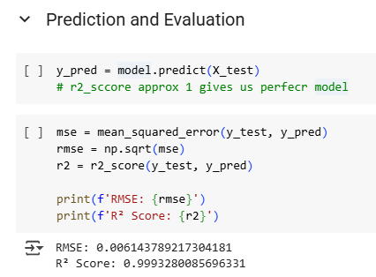
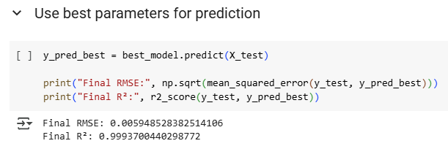
Screenshot of Output:
Fig 1 : before hyperparameter tuning
Fig 2 : after hyperparameter tuning

Slide 9
Conclusion:
This project successfully demonstrates the process of building and deploying a machine learning model for predicting supply chain emission factors. Through data preprocessing, feature engineering, hyperparameter tuning, and cross-validation, we developed a robust model (tuned Random Forest Regressor) that shows high performance in predicting emission factors. The deployment using Streamlit provides a user-friendly interface for utilizing the model. Further work could involve exploring more advanced modeling techniques, incorporating time series analysis, and refining the feature engineering process. The insights gained from feature importance and residual analysis can inform strategies for reducing supply chain emissions.

