Slide 1

SRIJAN SHIVASHANKAR KOTABAGI
PES1UG24EC214
srijanskotabagi@gmail.com
shivashankar.kotabagi@gmail.com

Slide 2

SRIJAN SHIVASHANKAR KOTABAGI
PES1UG24EC214
srijanskotabagi@gmail.com
shivashankar.kotabagi@gmail.com

Slide 3
COMPONENTS
SRIJAN SHIVASHANKAR KOTABAGI

Slide 4
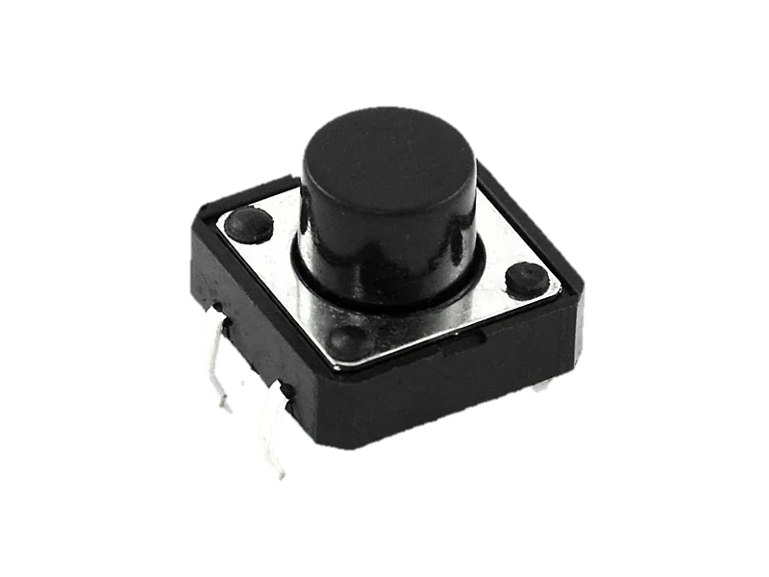
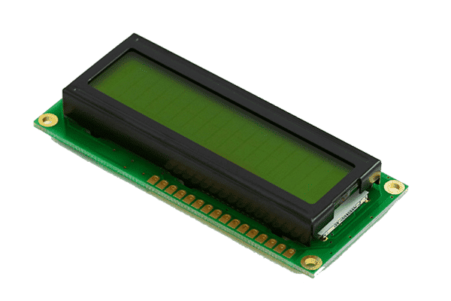
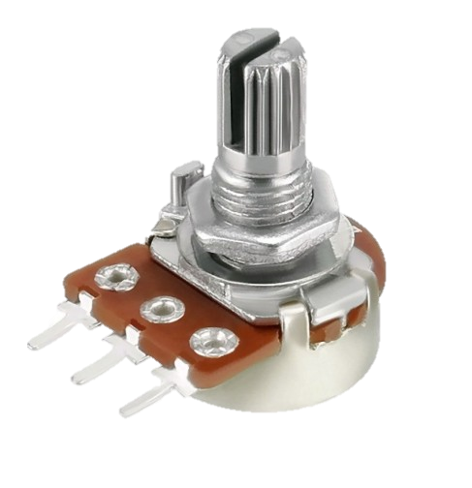
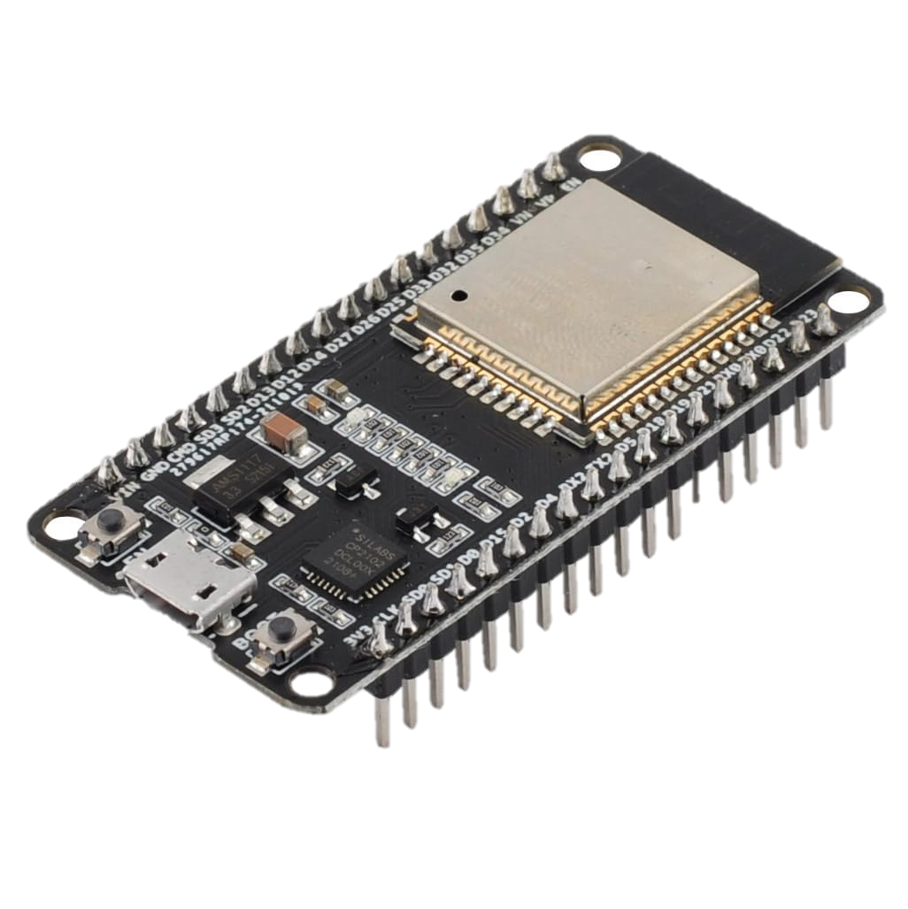
DIAGRAM
COMPONENTS
SRIJAN SHIVASHANKAR KOTABAGI

Slide 5



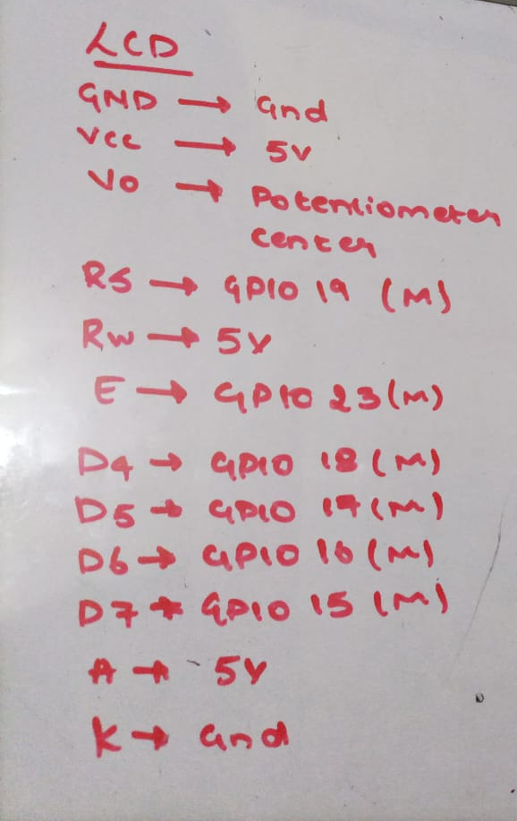
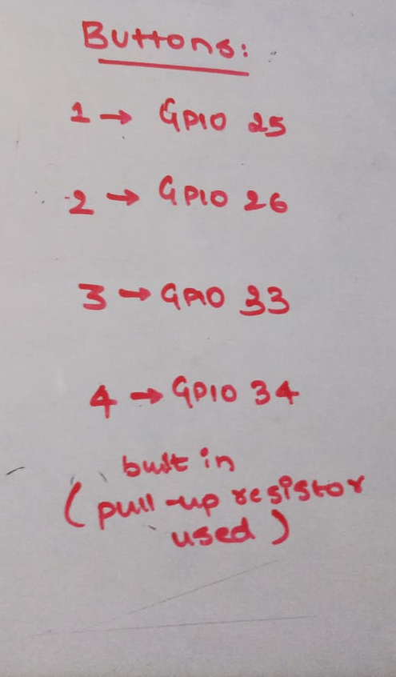
COMPONENTS
TECH IMPLIMENTED TO LEARN
DIAGRAM
SRIJAN SHIVASHANKAR KOTABAGI

Slide 6
DIAGRAM
TECH IMPLIMENTED TO LEARN
SRIJAN SHIVASHANKAR KOTABAGI

Slide 7
DIAGRAM
TECH IMPLIMENTED TO LEARN
HOW AN LCD CAN BE COMMUNICATED WITH EITHER UART, I2C or SPI
SRIJAN SHIVASHANKAR KOTABAGI

Slide 8
DIAGRAM
TECH IMPLIMENTED TO LEARN
CREATING A WEB SERVER
SRIJAN SHIVASHANKAR KOTABAGI

Slide 9
DIAGRAM
TECH IMPLIMENTED TO LEARN
COMMUNICATING WIRELESSLY VIA WIFI BETWEEN MICROCONTROLERS
SRIJAN SHIVASHANKAR KOTABAGI

Slide 10
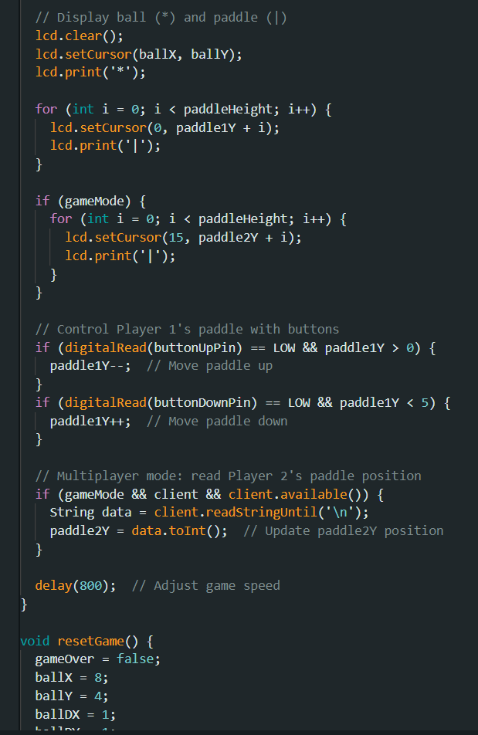
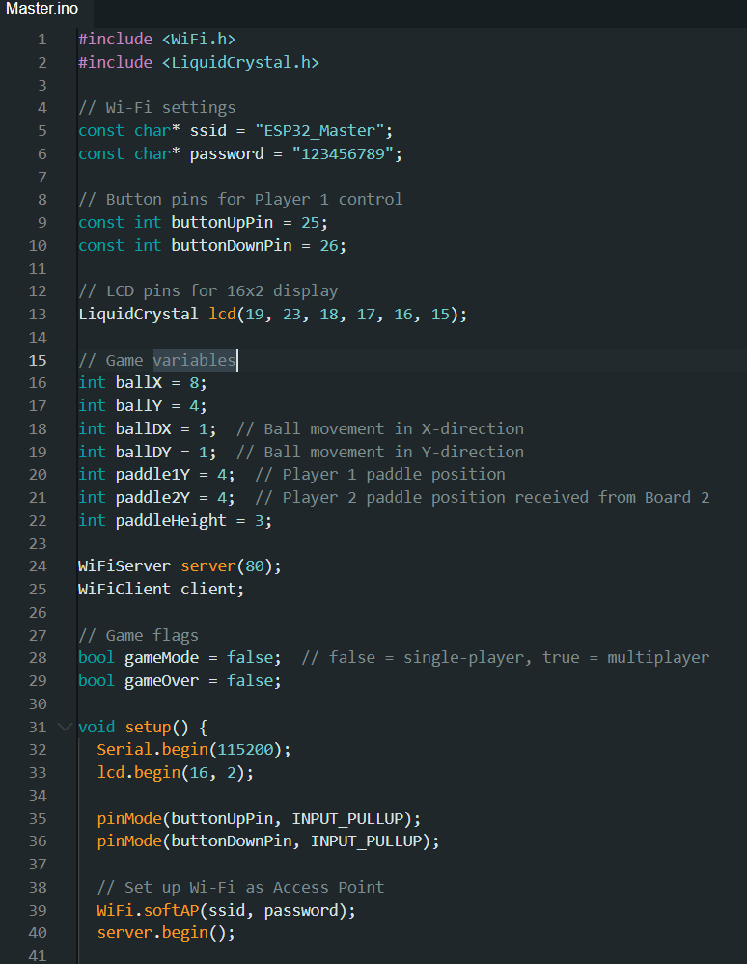
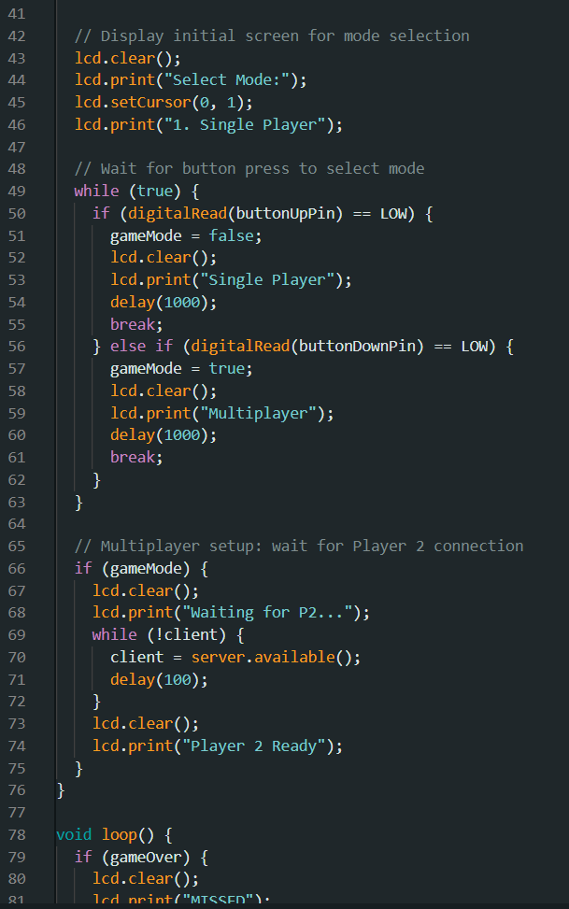


TECH IMPLIMENTED TO LEARN
FUTURE DEVELOPMENTS
CODE FOR THE PROJECT
SRIJAN SHIVASHANKAR KOTABAGI

Slide 11
CODE FOR THE PROJECT
FUTURE DEVELOPMENTS
INTERFACING THE WIFI FOR IOT EXPANSIONS
SECURING LAN TO WAN GATEWAYS
SRIJAN SHIVASHANKAR KOTABAGI

Slide 12
FUTURE DEVELOPMENTS
IT WAS A FUN COURSE !
LEARNT A LOT,
THANK YOU SHASTRY
SRIJAN SHIVASHANKAR KOTABAGI

