Slide 1
Customers versus Subscribers
What makes subscriber different from casual customers?
Date: 24 July 2021.
By: Srijan Sharma

Slide 2
Contents to discuss
Dataset and Assumption.
Graphs and Questions.
Recommendations and Hypothesis.
Conclusion.

Slide 3
Dataset and Assumptions

Slide 4
Taken Dataset was a public dataset provided by organization.
Dataset has three main features trip duration, customer type and birth year.
Assumption:
trip duration was the key to differentiate between customer and subscribers.
Dataset was of 2019, It was assumed to be true for 2021 as well.
Dataset was cleaned and engineered to meet requirements and standards.

Slide 5
Graphs and Questions

Slide 6
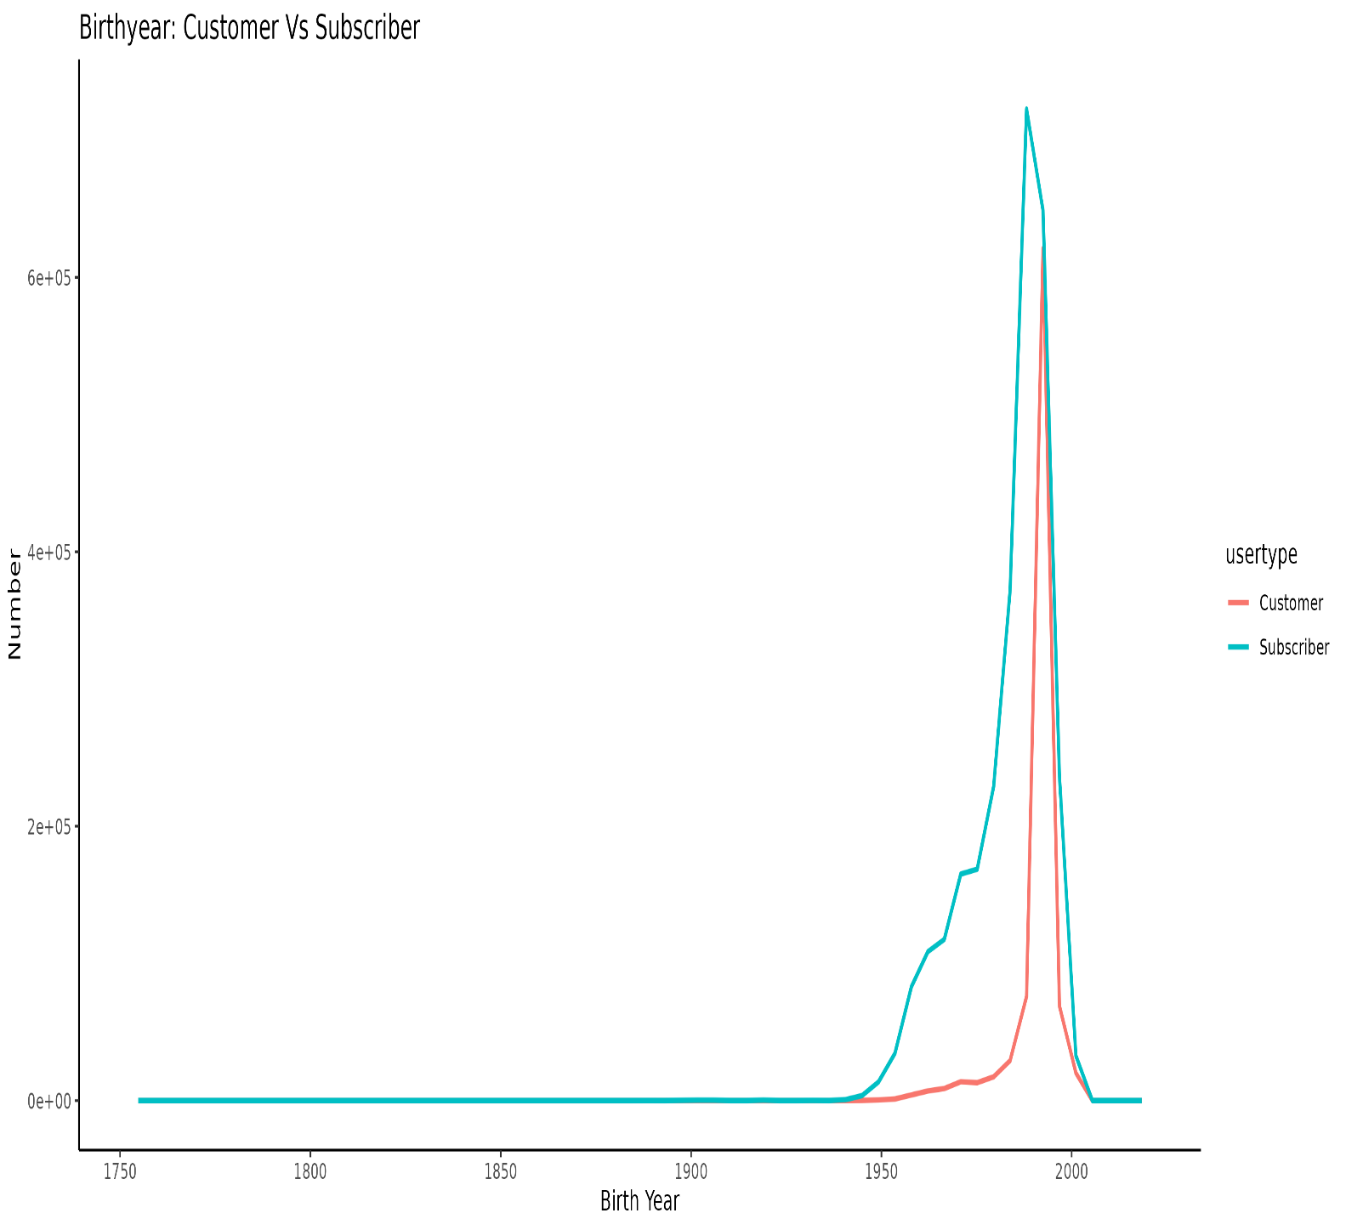
Birth year
Subscriber line start before customer line.
Subscriber are generally older than customer by 4 years at least.
Reason might be care for health condition as a person grows old

Slide 7
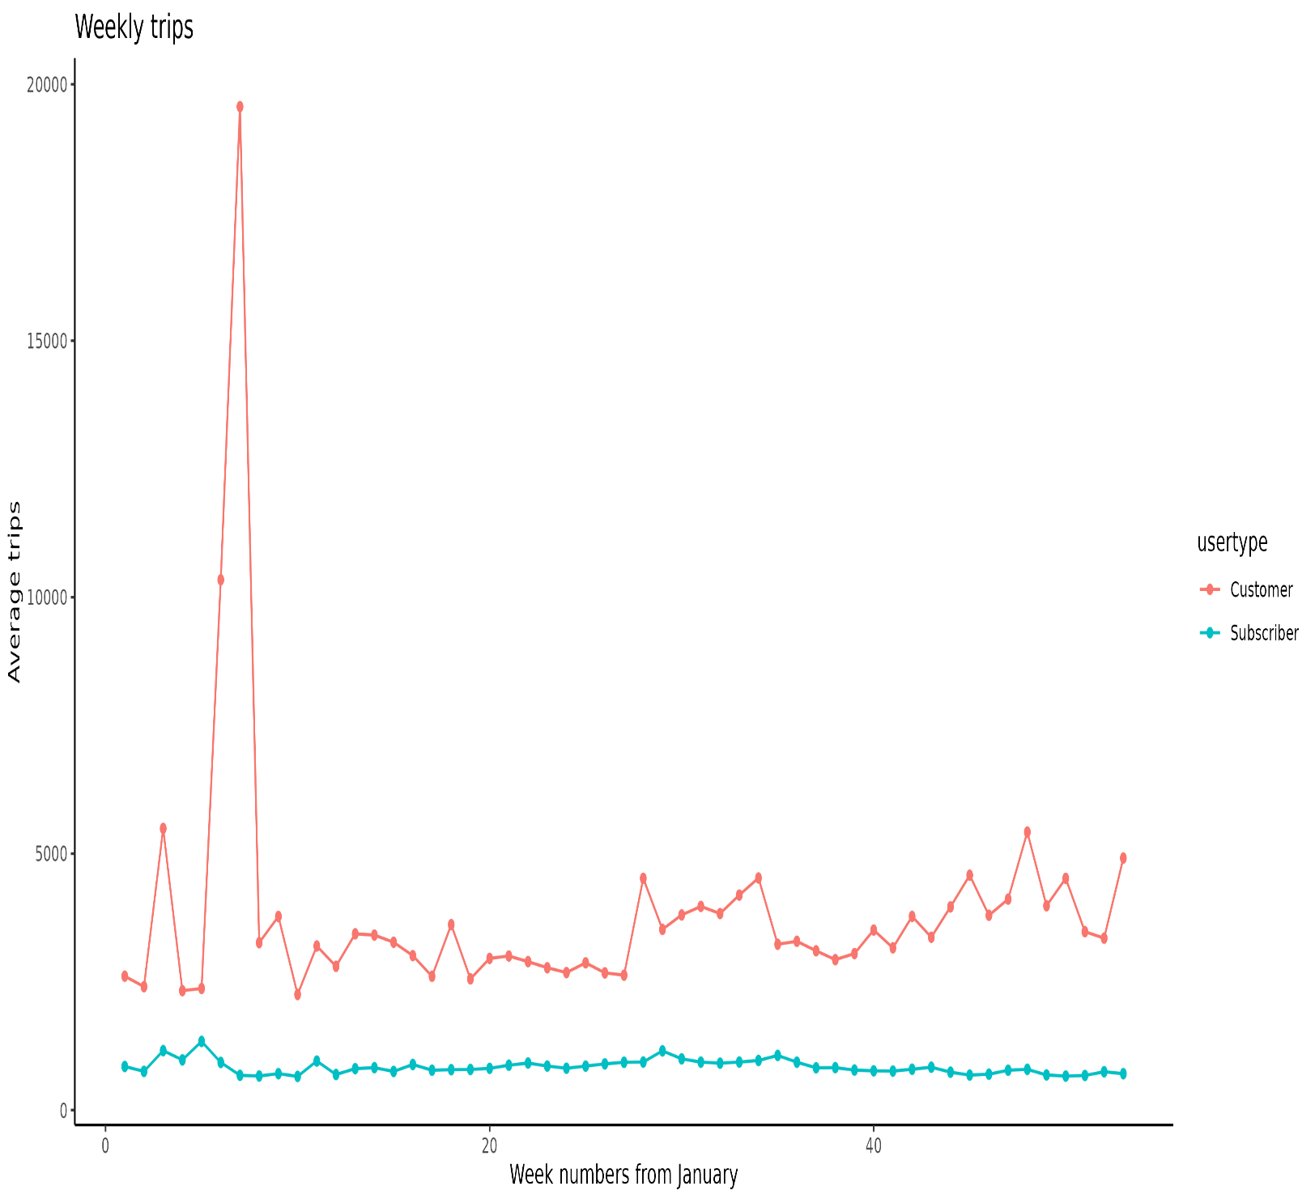
Trip duration
Average weekly trips for customer is always longer.
Surprisingly difference in trip duration is greater than 2X.

Slide 8
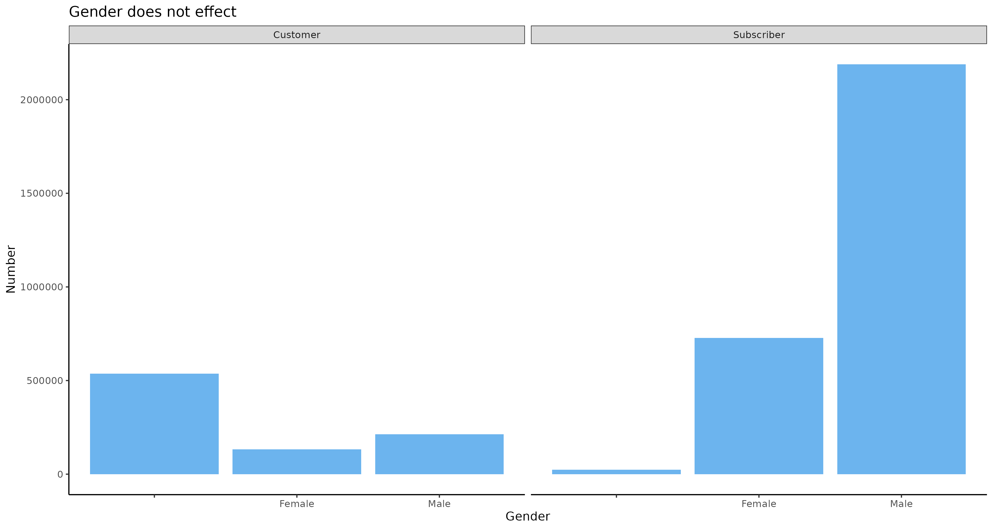
Gender
Our target audience does not depend upon gender.
It’s not possible to differentiate between them.

Slide 9
Recommendations and Hypothesis

Slide 10
It was clear that:
Subscribers were generally older than customers.
Customers always had greater trip duration.
Hypothesis:
Subscribers at older age want to live a healthier life while customers want to travel a lot as they are young.
Customers are mostly tourists and that’s why they have
longer trip durations.
However reason behind these observations require more data
related to customers like Are they tourist?
So we need some personal data in order to further test our hypothesis, but credentials are not needed.

Slide 11
Customers differ from subscriber in terms of location as well.

Slide 12
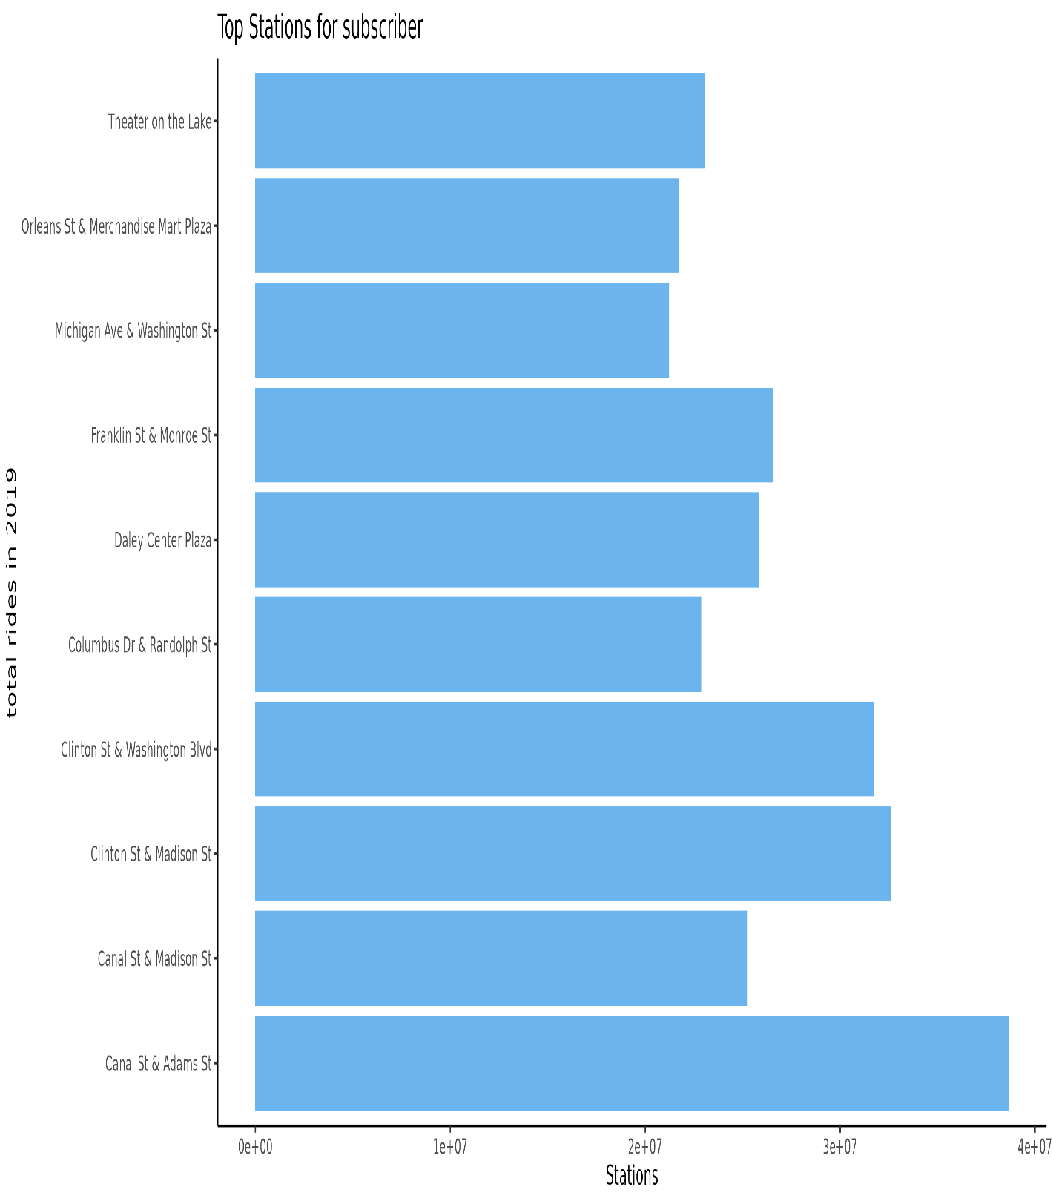
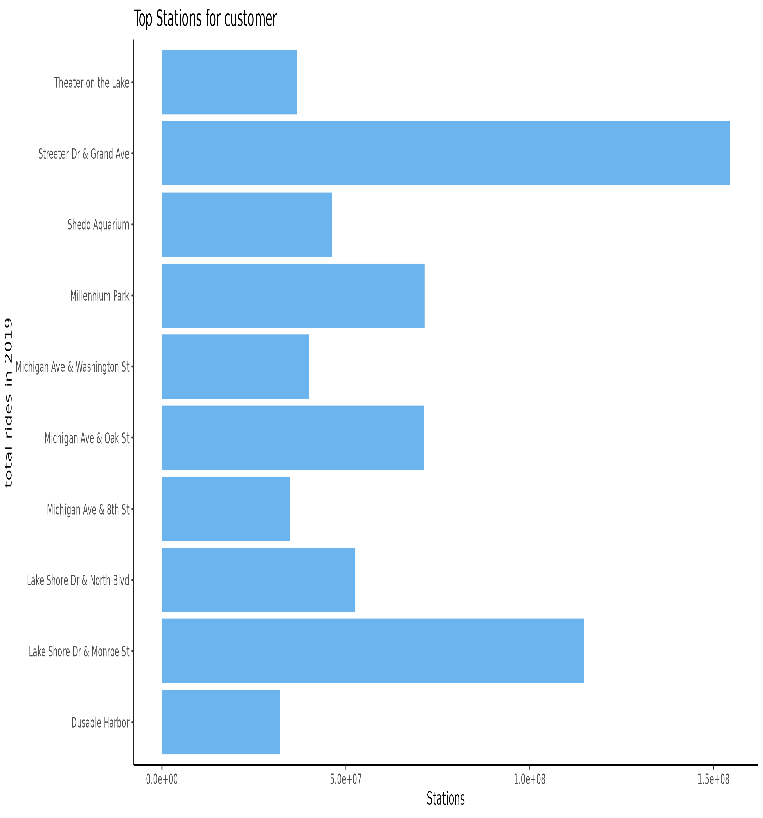

Slide 13
Location and Customers
Customer tends to have different location when compared to Subscribers. As we saw in top 3 stations where trips were more.
This could ensure the fact that customer are generally tourists coming mostly to visit some locations.
To confirm this we need map and tourism data to locate stations and compare them with places having increased tourism.
This means we would target are user on the basis of location where non-subscriber customers are more.

Slide 14
Conclusion

Slide 15
We saw that there are lots of difference between normal customers and subscribers.
We also saw location is also a factor that plays an important role
We have lots of insights yet we are not sure what are the cause of these insights as we don’t have sufficient data. We need more data!

Slide 16
Thank you for your time!
Any questions or suggestions?

