Slide 1
POWERBANK RENTAL SYSTEM
GROUP-1
ENGINEERING DESIGN

Slide 2
OUR MOTIVATION
1.Portable electronic devices, particularly cellular/mobile telephones, are widely used today.
2.It is difficult to recharge a battery in a public place or while traveling without access to a suitable power terminal. Further, such charging would require the user to also be traveling with a charger, which may be inconvenient or easily forgotten.
3.Thus a mobile power bank rental system (power bank vending machine) in public places can solve this problem.
4.This system allows a customer to rent the battery for a selected time period and return the power bank device at any different place where such types of power bank rental system unit has installed.
5.This very idea will be further expressed in the further slides and by our group members.

Slide 3
Primary reason we want to work on this project
Power banks are widely available nowadays but there is always a high chance of a person not carrying a power bank with them or what if the power bank is not charged or there is some problem with it.
People generally don’t realize that they need a power bank until they do, and it is not available to them at that point.
Hence, we want to provide a very widespread an easy way for people to avail power banks whenever they need it.
For this we want to create a very user friendly app and smooth distribution system.

Slide 4
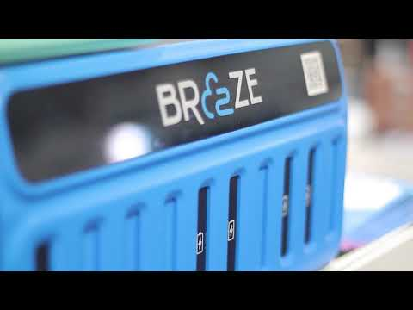
An idea about how we are planning to have an app

Slide 5
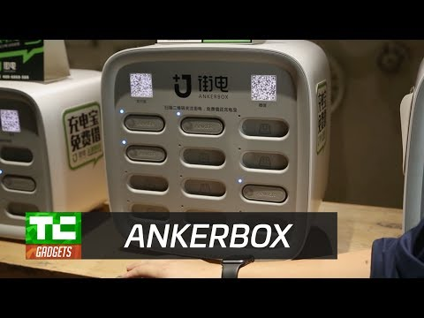
A basic idea of what we are trying to achieve

Slide 6
BACKGROUND RESEARCH

Slide 7
THE BREAKUP OF THE PROJECT
THIS PROJECT CONSISTS OF THREE PARTS-
1. A USER FRIENDLY AND INTUITIVE APP
2. AN EFFECTIVE AND SIMPLE DISTRIBUTION SYSTEM
3. THE DEVELOPMENT OF A MORE COST EFFECTIVE POWERBANK

Slide 8
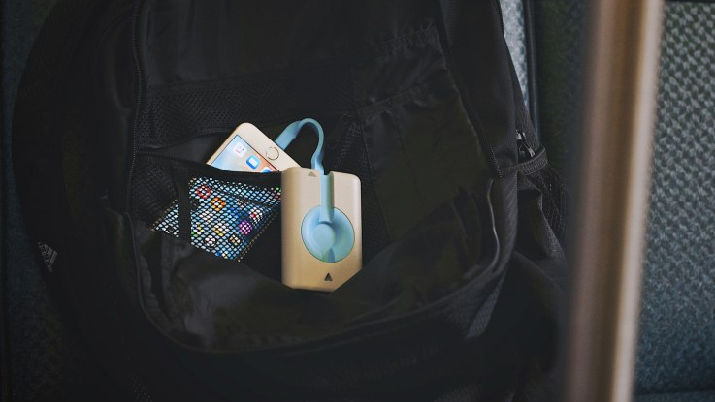
THE POWER BANK UNIT
The battery packs are relatively
high-capacity(5000mAh), which should be
enough to fully charge your phone
a couple of times and at the same time be of a comfortable and portable size.

Slide 9
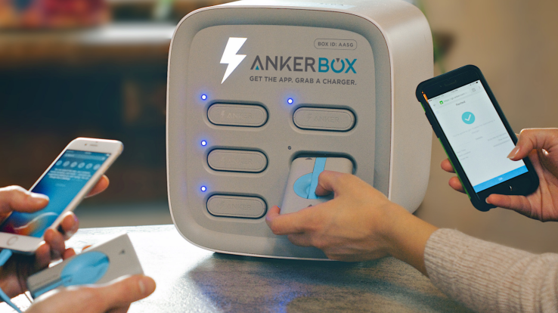
THE VENDING MACHINE
The vending machine will be the distributing unit for the power banks.
It will consists of pop up ports that shall dispense powerbanks easily to the users.
These units will be installed in public and frequently crowded locations.
The machine shall recharge and make the powerbanks ready to use.

Slide 10
ONGOING PROJECTS
1.Shenzhen Laidian Technology Co., Ltd.(Laidian Technology or Laidian):
A Chinese technology company dedicated to providing sharing power bank services to smart phone users.
FOUNDER: Yuan Bingsong
FOUNDED:2014
PATENTS:The company's self-developed self-service sharing power bank station has owned 32 patents and 7 international patents.

Slide 11
PRODUCTS:
1.Laidian station 12:
The small station can provide 12 power banks for renting and one recycle bin for returning.
There are also 2 bins for selling the charging cables and a screen for commercial.
The size of the station is 150cm*32.5cm*32.5cm, which can be placed in restaurant, gas station, KTV and pub.
2. Laidian station 40:
The large station can provide 40 power banks for renting and one recycle bin for returning.
There are 3 bins for selling the charging cables a screen for commercial.
The size of station is 180cm*80cm*50cm, which is provided for shopping mall, railway station, airport and hospital.

Slide 12
Constraints
Limited technical knowledge regarding the construction of Powerbank.
There is a need to design a hardware prototype and location for placing of vending machines.
Funds would be required.
We have already started our work for app development, but further assistance would be required.

Slide 13

WHAT DOES A POWERBANK GENERALLY CONSISTS OF?
IT CONSISTS OF-
LITHIUM ION BATTERY
LITHIUM ION CHARGER MODULE
ON/OFF SWITCH
DC-DC BOOST CONVERTER MODULE(USB OUT)

Slide 14
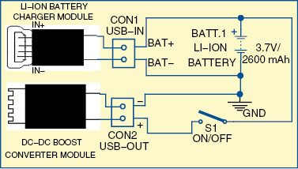
Internal research of the components of the power bank
Circuit diagram of the power bank is shown in Fig. 1. It consists of a USB lithium-ion charger module (USB-IN), 3.7V/5000mAh lithium-ion battery (BATT.1), on/off switch (S1) and DC-DC boost converter module (USB-OUT).
Here, a lithium-ion charger module based on TP4056 IC, rechargeable lithium-ion battery (Samsung type 18650) and DC-DC converter module based on pulse frequency modulation (PFM) technology are used.

Slide 15
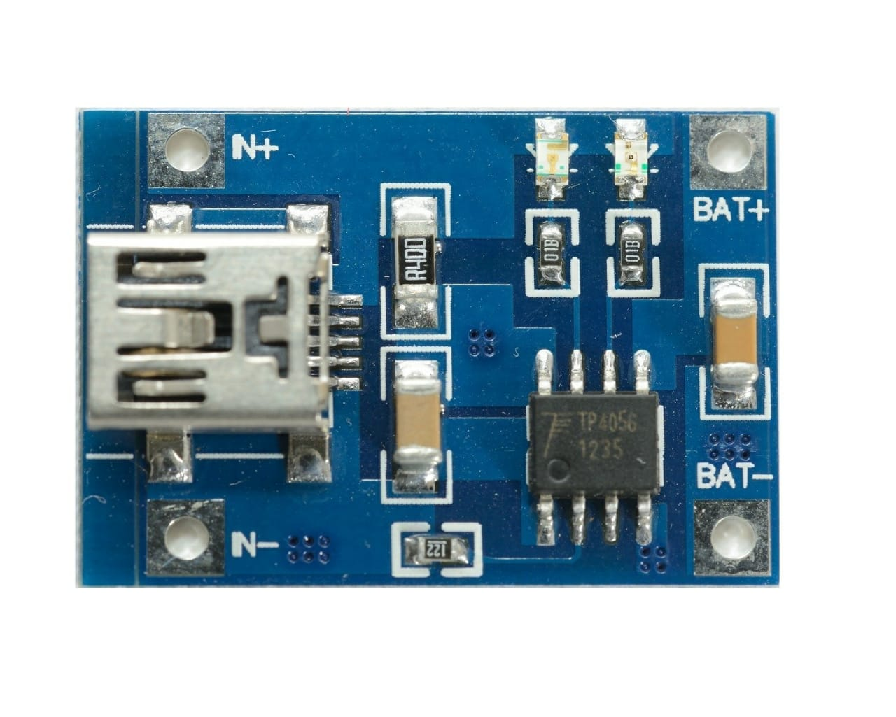
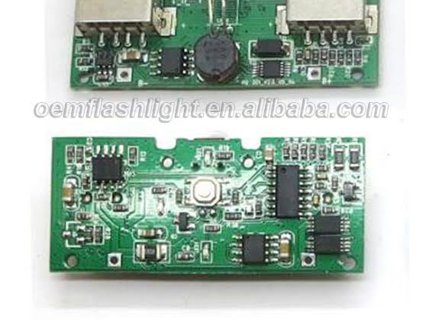
Basic Internal Circuitry

Slide 16
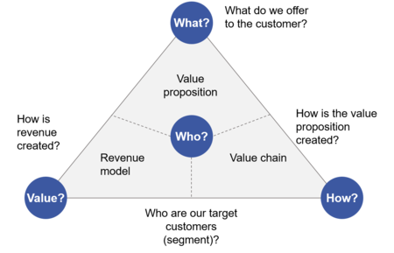
THE BUSINESS MODEL

Slide 17
WHAT TO DO WE OFFER TO THE CUSTOMER?
IN THIS PROJECT WE OFFER A POWERBANK TO THE CUSTOMER WHICH CAN BE ACCESSED FROM SEVERAL POWER BANK VENDING UNITS WHICH WILL BE INSTALLED AT FREQUENTLY CROWDED PLACES FOR STARTING PHASE PLACES SUCH AS LHC, CANTEEN,LIBRARY, INSIDE NEWLY BUILT SPORTS ARENA.
THE SERVICE WILL BE FREE FOR A LIMITED PERIOD OF TIME AND AFTER THAT NOMINAL CHARGES WILL BE APPLIED.

Slide 18
WHAT IS THE VALUE PREPOSITION CREATED?
A value proposition is a promise of value to be delivered, communicated, and acknowledged. It is also a belief from the customer about how value will be delivered, experienced and acquired.

Slide 19
WHAT IS THE VALUE PREPOSITION CREATED?
WE PROMISE TO PROVIDE A RELIABLE POWERBANK WHICH WILL HAVE SUFFICIENT CAPACITY TO CHARGE YOUR PHONE WITHOUT STOPPING YOUR WORK.
ANY UPDATES, MESSAGES AND NOTIFICATIONS WILL BE SEND TO RESPECTIVE USERS AS SOON AS THEY REGISTER THEMSELVES FOR THIS SERVICE.
WE RESPECT OUR CUSTOMER’S PRIVACY AND WE PROMISE THAT WE WILL NEVER SHARE THE INFORMATIONM THEY PROVIDE TO ANYONE.
ALSO WE HAVE TRIED TO KEEP OUR CHARGES AS NOMINAL AS WE CAN SO THAT IT IS AFFORDABLE TO OUR CUSTOMERS.

Slide 20
HOW IS REVENUE CREATED?
FOR THE FIRST INITIAL 30 MINUTES THE CUSTOMER CAN USE THE POWERBANK FOR FREE.
AFTER THAT WE CHARGE CUSTOMER A NOMINAL PRICE OF 20/- RUPEES PER 30 MINUTES.
AS SOON AS THE CUSTOMER REGISTERS WE PROMPT THEM TO ADD SOME MINIMUM AMOUT IN THE WALLET WHICH WILL HELP US TO RECOVER THE FINE FOR EXTRA USAGE.
IF THE CHARGE ADDS UP TO THE PRICE OF THE POWERBANK THE CUSTOMER HAS OPTION TO PAY THE FINE OR TO GIVE A ADDITIONAL 100/- RUPEES TO BUY THE POWERBANK.
THE CUSTOMER HAS TO RETURN TO POWERBANK WITHIN A SPECIFIED PERIOD OF TIME

Slide 21
WHO ARE OUR TARGET CUSTOMERS?
THIS IS A APPRECIABLE POINT OF OUR PROJECT THAT WE HAVE NOT FOCUSSED ON A PARTICULAR GROUP OF PEOPLE. THE SERVICE WE HAVE DEVELOPED CAN BE USED BY ANYONE HAVE A SMARTDEVICE SUCH AS SMARTWATCH, MOBILE PHONES AND FITBITS, IRRESPECTIVE OF AGE, CASTE, CREED, COLOUR,GENDER OR ANY OTHER SOCIAL DIFFERENCE.

Slide 22
Vending Machines
Places where it would be installed
6 slots for power bank in each vending machine.
Structure and dimension is shown in solidworks.
Mess
Community Center
Library
LHB
Badminton Court
CSE Department
All would be placed where security guard is there and Cameras are facing it for its security.
Each powerbank would have power capacity -5000 mAH

Slide 23
PROGRESS MADE SO FAR

Slide 24
Progress Made So Far
The idea has now been clearly thought of and well defined.
Numerous ppt’s have been made highlighting our problem statement and our aim.
We have now made a softcopy of our prototype using Solid works which has been made visible in the latter slides.
A financial model has also been talked about in the above slides regarding the revenue and the user experience.
We have also developed a basic application which is capable of registering, logging in and all the data is stored in the database. We have also tried implementing a QR code scanner in the application.

Slide 25
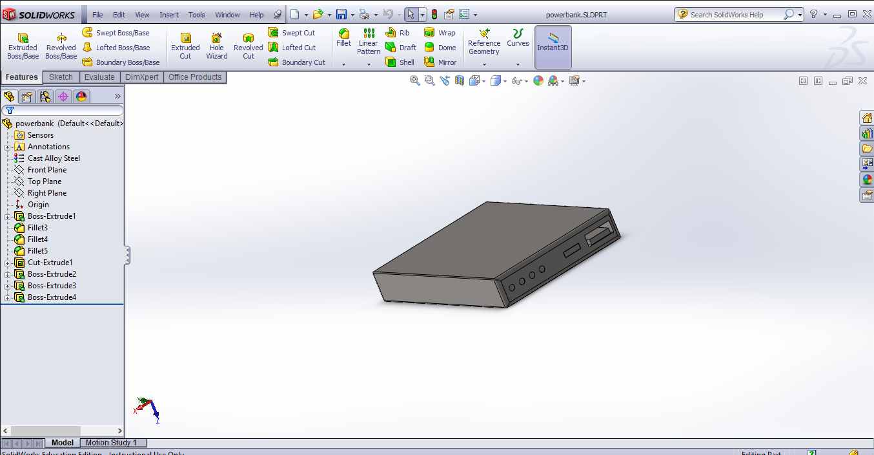

Slide 26
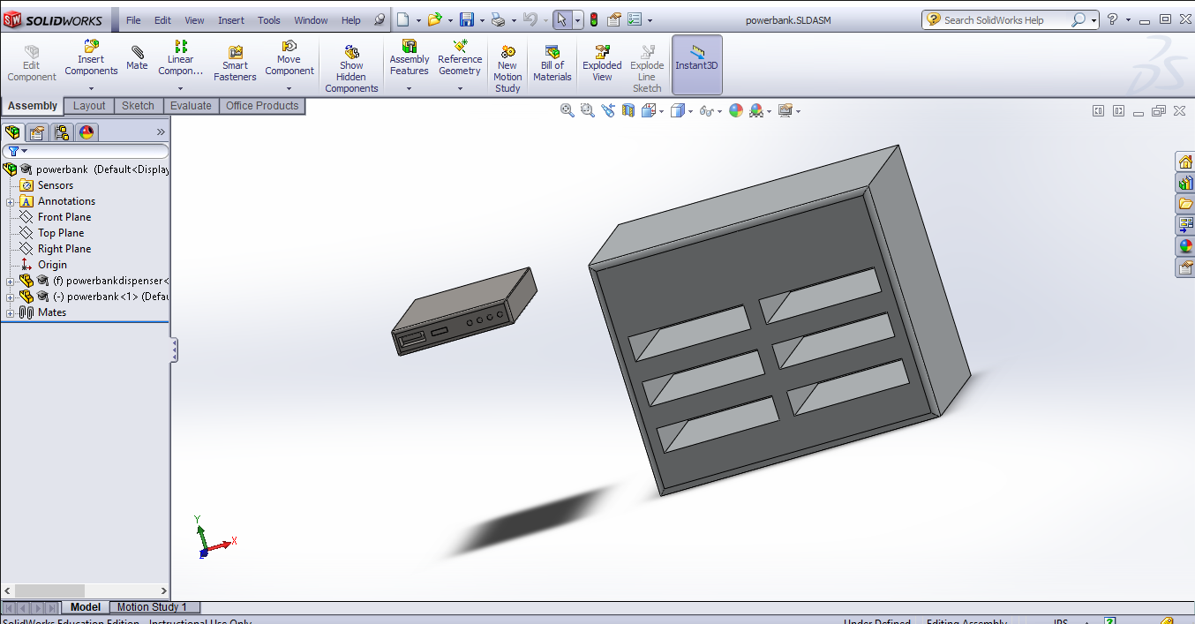

Slide 27
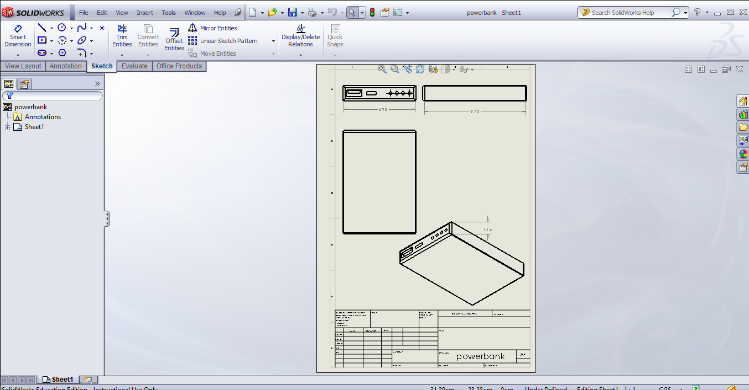

Slide 28
APP
SIGN UP
LOG IN
TEAM MEMBERS
GOOGLE FORM
Enter Username and Password
Displays list of all team members.
DETAILS
QR code of machine is scanned.
Scan
1.Name
2.Username
3.Password
4.Email
5.IIT Jodhpur 6.Roll No.
1.Type C
2.Type B
3.Apple
Dispense type c charger
Dispense type B charger
Dispense Apple charger

Slide 29
CONTRIBUTION OF GROUP MEMBERS

Slide 30
Sandesh - Conceived the main idea of the group project. Was active in presenting all the ideas and played a crucial role in making the app and PowerPoints.
Shivam-Major role in presenting the idea and did crucial work in app development and PowerPoints. Researched about the internal mechanism of the prototype.
Hard-Major role in presenting the idea and did crucial work in app development and PowerPoints.
Suyash-Actively supported and presented the idea. Crucial in app development and making the solidworks prototype of the design.
Vaibhav-Did extensive background research and helped in making PowerPoints Presentations.
Srijash-Did background research on the topic.
Shubh-Researched on topic and helped in discussion.
Shashi Prakash-Did background research on the topic.

Slide 31
Word Of Thanks
We would like to thank Sir and ma'am as well as everyone else present here for hearing us and our ideas out. We welcome any constructive criticism and any ideas which would help further realize our goals.
The Members:-
Sandesh Singh
Suyash Agnihotri
Shivam Sharma
Sreejash Aryan
Shashi Prakash
Shubh Doshi
Savani Hard
Vaibhav Meena

