Slide 1

HEALTHCARE ANALYTICS FOR DOCTOR VISITS_TIRTC
NAME : SRIJEETA DUTTA
AICTE STUDENT ID : STU6877ddd899afa1752686040
INTERNSHIP ID : INTERNSHIP_17830691666a4779eecfe8a
COLLEGE NAME : INSTITUTE OF ENGINEERING AND MANAGEMENT, KOLKATA

Slide 2

PROBLEM STATEMENT
Analyze patient visit data to identify which groups visit doctors more frequently. Explore how illness, health status, and chronic conditions rekate to visit patterns. provide data-driven insights to help hospital management improve healthcare services.

Slide 3
Project Description
Project uses Python, Pandas, and data visualization to analyze doctor visit patterns. It explores how illness, health status, age groups, and chronic conditions are associated with healthcare utilization. The insights help hospital management understand patient needs and identify opportunities to improve healthcare services.

Slide 4

WHO ARE THE END USERS?
  Hospital management and administrators.
  Doctors and healthcare professionals.
  Healthcare planners and data analysts.
  Public health organizations.

Slide 5

Technology Used
  Python
  Pandas
  Numpy
  Matplotlib
  Sea born

Slide 6
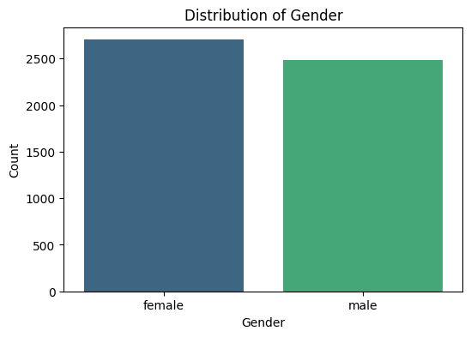
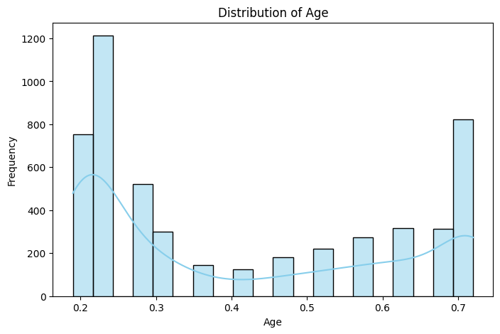
RESULTS
Demo Link : https://github.com/Srijeeta977/Edunet-AICTE-TIRTC-Data-Analytics-Internship.git

Slide 7
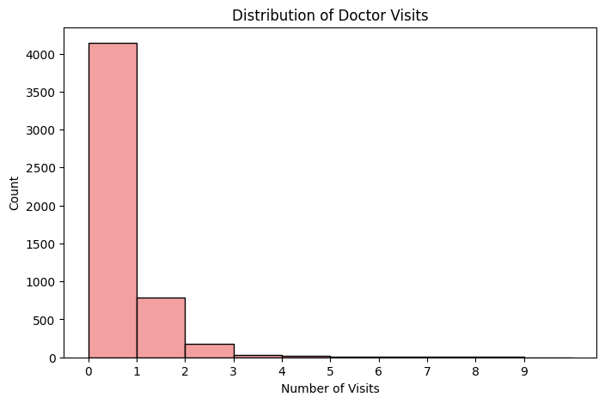

RESULTS
Demo Link : https://github.com/Srijeeta977/Edunet-AICTE-TIRTC-Data-Analytics-Internship.git

Slide 8

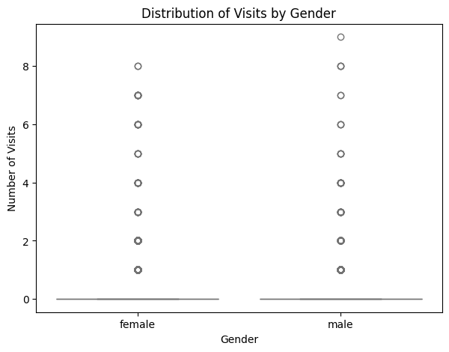
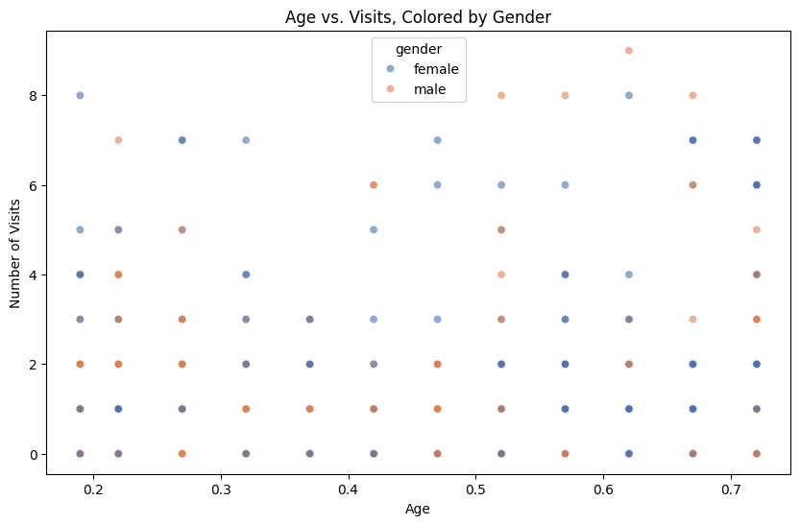
RESULTS
Demo Link : https://github.com/Srijeeta977/Edunet-AICTE-TIRTC-Data-Analytics-Internship.git

Slide 9
Thank you
.
.

