Slide 1

Project Title - Seasonal Agriculture Performance Analysis
STUDENT NAME - SRIJEETA DUTTA
COLLEGE NAME - INSTITUTE OF ENGINEERING AND MANAGEMENT , KOLKATA
AICTE STU ID : STU6877ddd899afa1752686040
INTERNSHIP ID : INTERNSHIP_17830691666a4779eecfe8a

Slide 2

PROBLEM STATEMENT
Agricultural activities are influenced by seasonal variations in environmental conditions, farming practices, resource availability and market conditions. As a result, agricultural performance may differ from one season to another.
However, raw agricultural data does not clearly explain how agricultural performance changes across seasons or what patterns can be observed in different seasonal conditions.
The problem is to analyze the given agricultural dataset and investigate seasonal differences in agricultural performance by identifying meaningful patterns, trends, relationships and variations within the available data.

Slide 3
Project Description Agricultural performance varies significantly with seasonal environmental conditions, farming practices, resource availability and market conditions. This project analyzes agricultural data collected across different seasons, geographical areas and farming conditions to understand how these factors influence crop production and overall agricultural performance. The analysis examines seasonal differences in crop yield, production, environmental conditions, resource utilization, water efficiency and economic outcomes. It also investigates relationships between environmental and farming factors and agricultural performance. Using data cleaning, statistical analysis and data visualization, the project identifies important seasonal patterns, trends, relationships, variations and unusual observations. The findings are used to develop evidence-based insights and recommendations for better seasonal agricultural planning.

Slide 4

WHO ARE THE END USERS?
Farmers
Compare agricultural performance across seasons.
Understand seasonal resource requirements.
Support better crop and farming decisions.
Agricultural Planners & Government Departments
Identify important seasonal trends.
Support evidence-based agricultural planning.
Identify regions or seasons requiring further investigation.
Irrigation & Resource Managers
Understand seasonal water requirements.
Compare water usage and water efficiency.
Support efficient resource allocation.
Agricultural Researchers
Study relationships between environmental conditions and agricultural outcomes.
Investigate unusual or significant seasonal patterns.
Agribusiness & Market Stakeholders
Understand seasonal production and economic outcomes.
Support planning based on production, revenue, cost and profit patterns.
The project converts raw agricultural data into understandable insights that can support data-driven seasonal planning.

Slide 5

Technology Used
Programming Language
Python - Used for data cleaning, analysis, statistical calculations and visualization.
Data Analysis Libraries
Pandas — Data loading, cleaning, transformation and analysis
NumPy — Numerical computations
SciPy — Statistical tests and significance analysis
Data Visualization
Matplotlib
Pandas Visualization
Used to create charts for seasonal comparisons, trends, relationships and distributions.
Development Environment
Google Colab / Jupyter Notebook -
Used to perform and document the complete data analysis workflow.
Analytical Techniques
Descriptive statistics
Group-wise seasonal comparison
Correlation analysis
Outlier detection using IQR
ANOVA
Kruskal-Wallis test
Data visualization
Overall Workflow
Raw Dataset → Data Cleaning → Exploratory Data Analysis → Statistical Analysis → Visualization → Insights → Recommendations

Slide 6
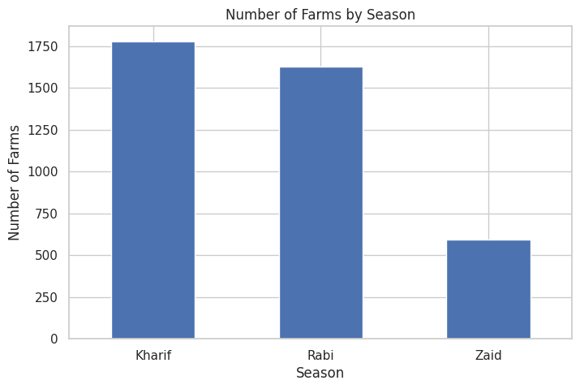
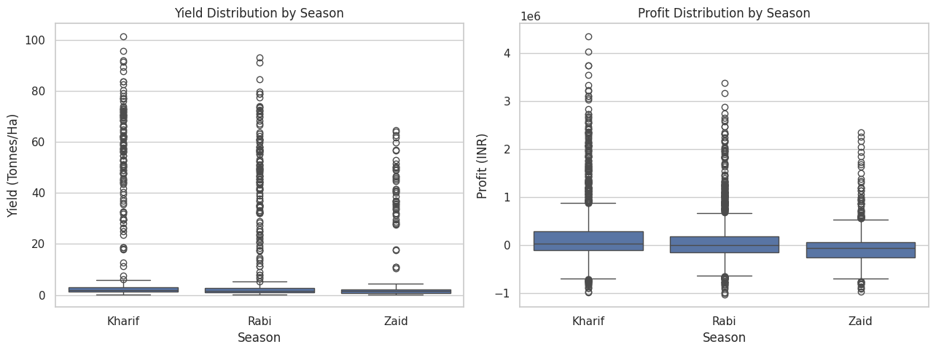
RESULTS - A
Fig 1: Average crop yield varies across Kharif, Rabi and Zaid seasons.
Fig 2 : Kharif records the highest average agricultural production among the three seasons.

Slide 7
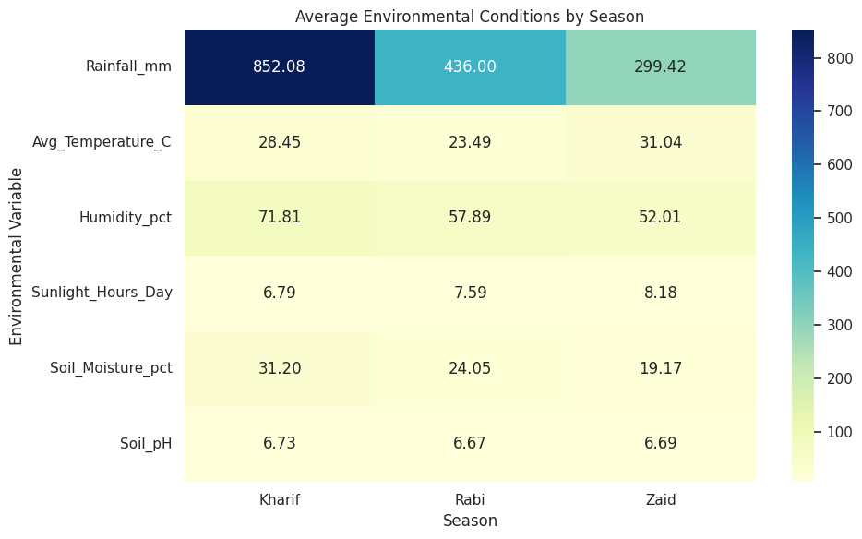
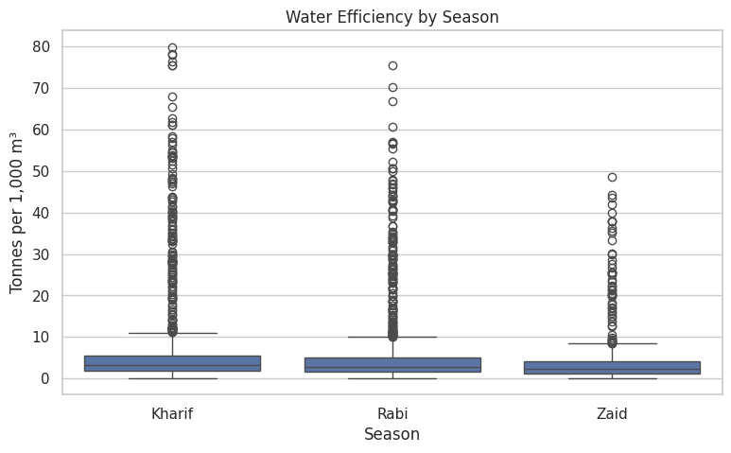
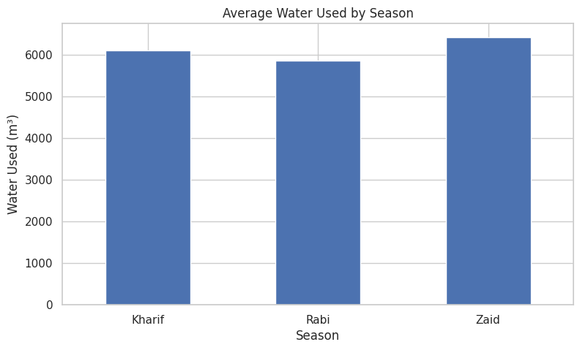
RESULTS - B
Fig 4 : Average water consumption differs across seasons, with Zaid showing the highest usage.
Fig 5 : Water-use efficiency varies across seasons, with Kharif showing the highest average efficiency.
Fig 3 : Environmental conditions show clear variation across agricultural seasons.

Slide 8
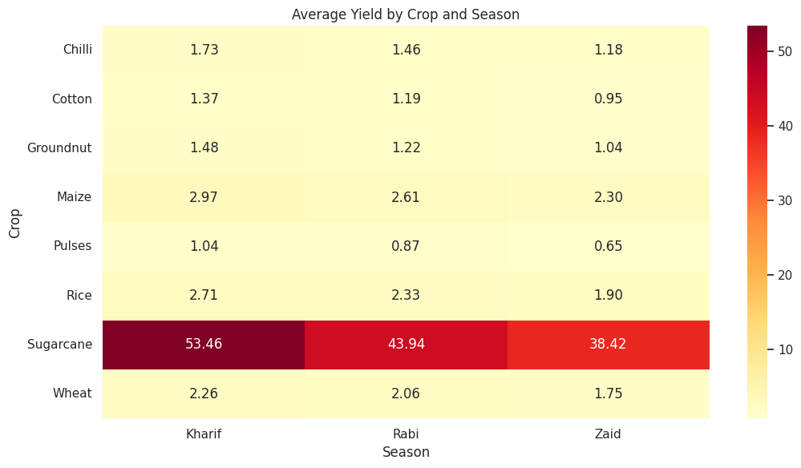
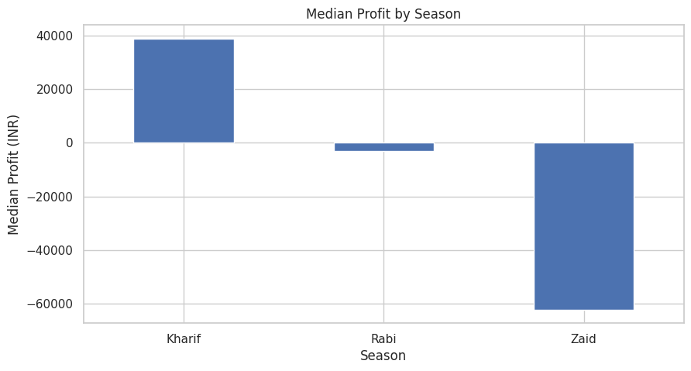
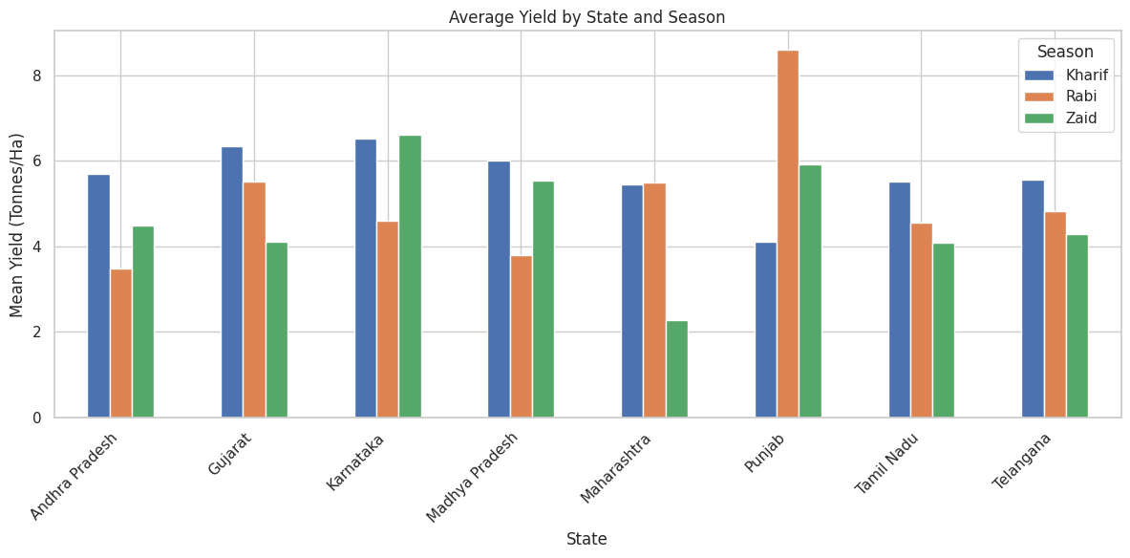
RESULTS - C
Fig 7 : Economic performance differs considerably across seasons, with Kharif showing the strongest average profitability.
Fig 8 : Profitability varies across crops, revealing differences in economic performance.
Fig 6 : Crop yield varies across seasons, highlighting differences in seasonal crop performance.

Slide 9
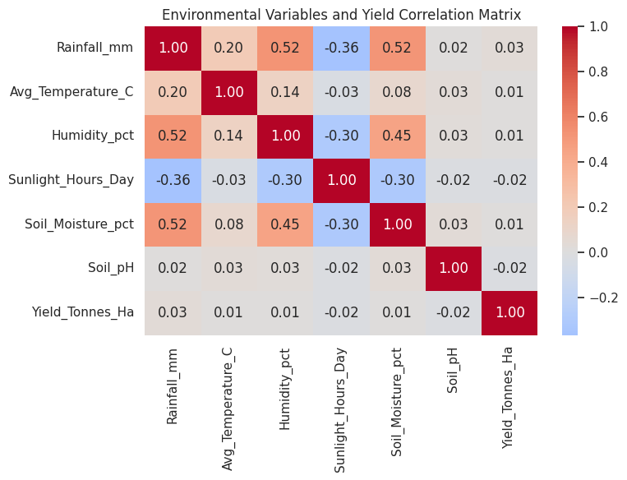
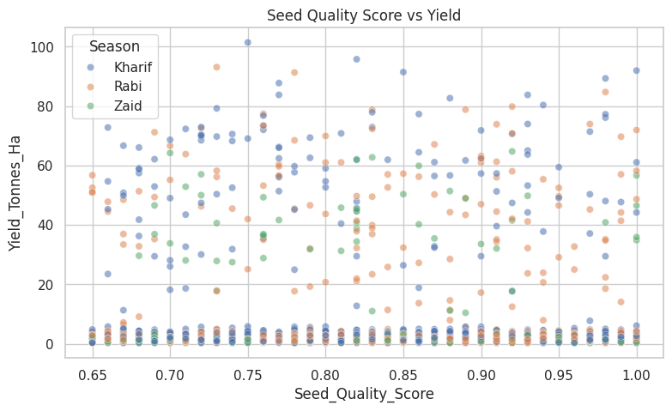
RESULTS - D
Fig 9 : The scatter plots examine relationships between environmental conditions and crop yield.
Fig 10 : Correlation analysis highlights relationships among farming inputs, environmental factors and agricultural outcomes.

Slide 10
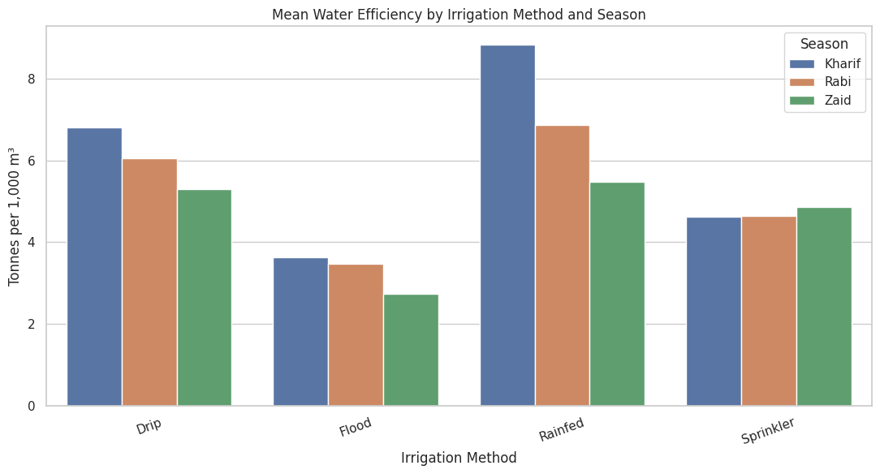
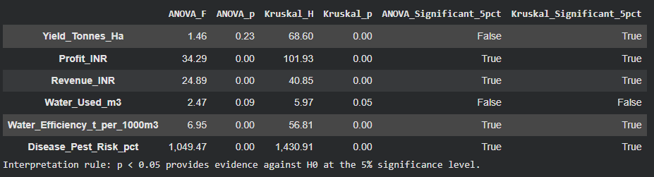
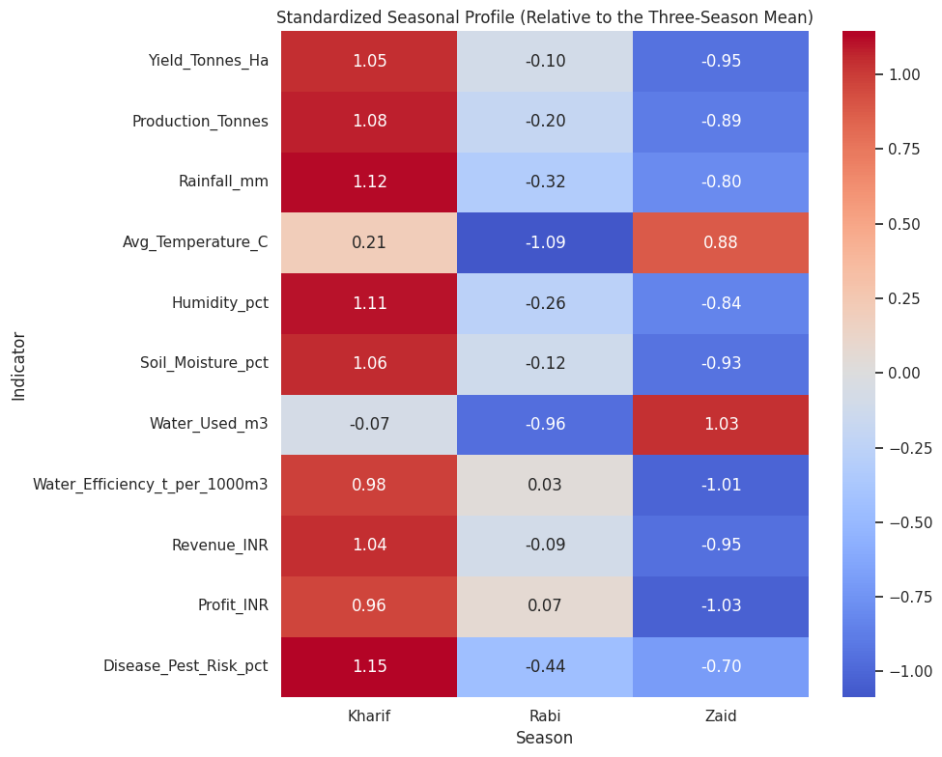
RESULTS - E
Fig 11 : Statistical tests evaluate whether observed differences between seasons are significant.
Fig 12 : Standardised Seasonal Profile (Relative to the three season mean
Fig 11 : Mean water efficiency by Irrigation Method and Season

Slide 11
Future scope
Real-Time Weather Integration
Integrate live weather information such as rainfall, temperature and humidity to monitor changing seasonal conditions.
Predictive Analytics
Develop machine-learning models to predict:
Crop yield
Production
Profitability
Disease/pest risk
Crop Recommendation
Recommend suitable crops based on:
Season
Soil conditions
Weather
Water availability
Historical performance
Smart Resource Optimization
Develop systems to recommend efficient irrigation and fertilizer usage based on crop and environmental conditions.
Regional-Level Analysis
Extend the analysis to identify high-performing and low-performing regions and understand geographical variations.
Decision-Support Dashboard
Develop an interactive dashboard that provides farmers and agricultural planners with real-time insights, comparisons and recommendations.
Transform the analytical model into an intelligent, data-driven agricultural decision-support system for better seasonal planning and resource management.

Slide 12
GitHub Link
https://github.com/Srijeeta977/Seasonal-Agriculture-Performance-Analysis-Edunet.git

Slide 13
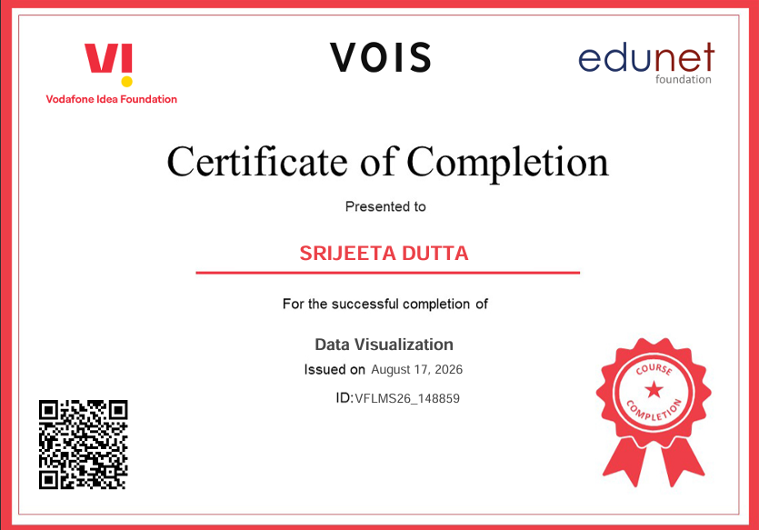
VOIS Course completion certificate - Course name- Data Visualization

Slide 14
Thank you
Seasonal Agriculture Performance Analysis
“Turning agricultural data into meaningful seasonal insights for better data-driven planning.”
This project demonstrates how data analytics can be used to understand seasonal agricultural performance, environmental variations, resource utilization and economic outcomes.
The analysis provides evidence-based insights that can help support better seasonal agricultural planning and decision-making.
Thank You!
Data Analytics Major Project
BY SRIJEETA DUTTA
AICTE STU ID : STU6877ddd899afa1752686040
INTERNSHIP ID : INTERNSHIP_17830691666a4779eecfe8a
.
.

