Slide 1
Pulse
Point
Modernizing Hospital Operations Through
Intelligent Digital Infrastructure

Slide 2
EXECUTIVE SUMMARY
The Case for PulsePoint
The Problem
Our Solution
The Outcome
82% of Indian hospitals still rely on disconnected, manual systems
PulsePoint is a unified, microservices-based Hospital Management System
40% reduction in administrative overhead from day one
Billing errors and data silos cost hospitals ₹10L+ annually per facility
9 integrated services covering every hospital workflow end-to-end
Zero manual billing handoffs — every charge auto-linked to invoice
Staff spend 35% of their shift on administrative tasks, not patient care
Role-aware access for 6 staff types — each seeing only what they need
Full ROI achieved within 90 days for a 100-bed hospital
2 / 12

Slide 3
THE PROBLEM
Hospitals Are Losing Time, Money,
and Lives to Outdated Systems
01
02
03
Financial Leakage
Operational Inefficiency
Dangerous Data Silos
Manual billing entries, missed charges, and untracked medicines drain revenue every single day. Insurance rejections multiply due to documentation errors.
Nurses and receptionists spend over a third of their workday on administrative tasks. Appointment scheduling still done via phone calls and physical registers.
Patient records, lab results, prescriptions, and billing exist in separate systems with no connection. Critical data is unavailable when clinicians need it most.
₹10L+
35%
6+
avg. annual loss per facility
of staff shift lost to paperwork
disconnected systems per hospital
3 / 12
"Over 86% of medical errors are caused by miscommunication during care transitions." — McKinsey Global Institute

Slide 4
MARKET OPPORTUNITY
A $50B Problem With
No Dominant Solution
Why Existing Solutions Fail
$50.6B
Global HMS market in 2024
Too Expensive
SAP, Oracle — ₹50L–1Cr+ implementation. Inaccessible to 90% of hospitals.
12.5%
Annual CAGR through 2030
Forced Bundling
Must purchase the entire suite. Hospitals pay for dozens of features they never use.
70,000+
Hospitals across India
Generic Design
Not built for Indian hospital workflows, local insurance, or regional compliance.
82%
Still on manual workflows
Slow Deployment
3–6 month implementation timelines and weeks of staff retraining required.
4 / 12

Slide 5
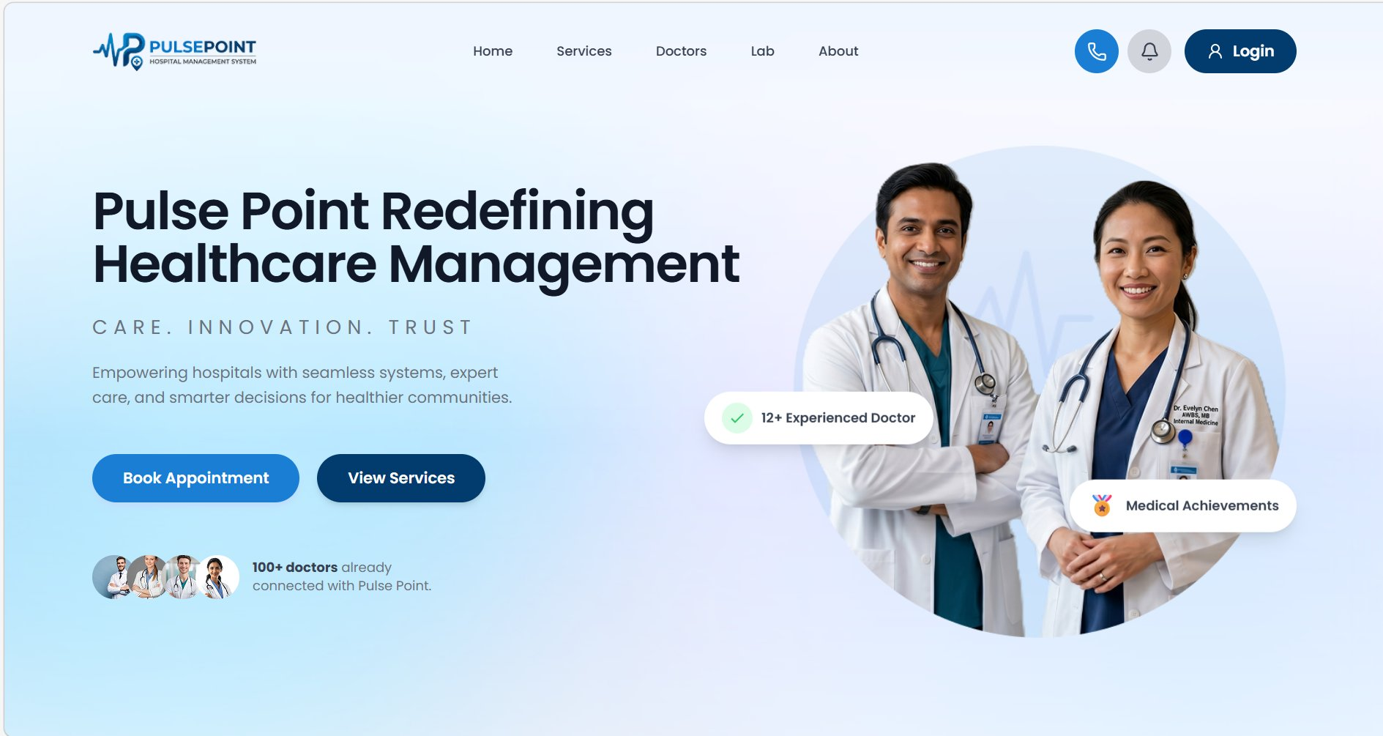
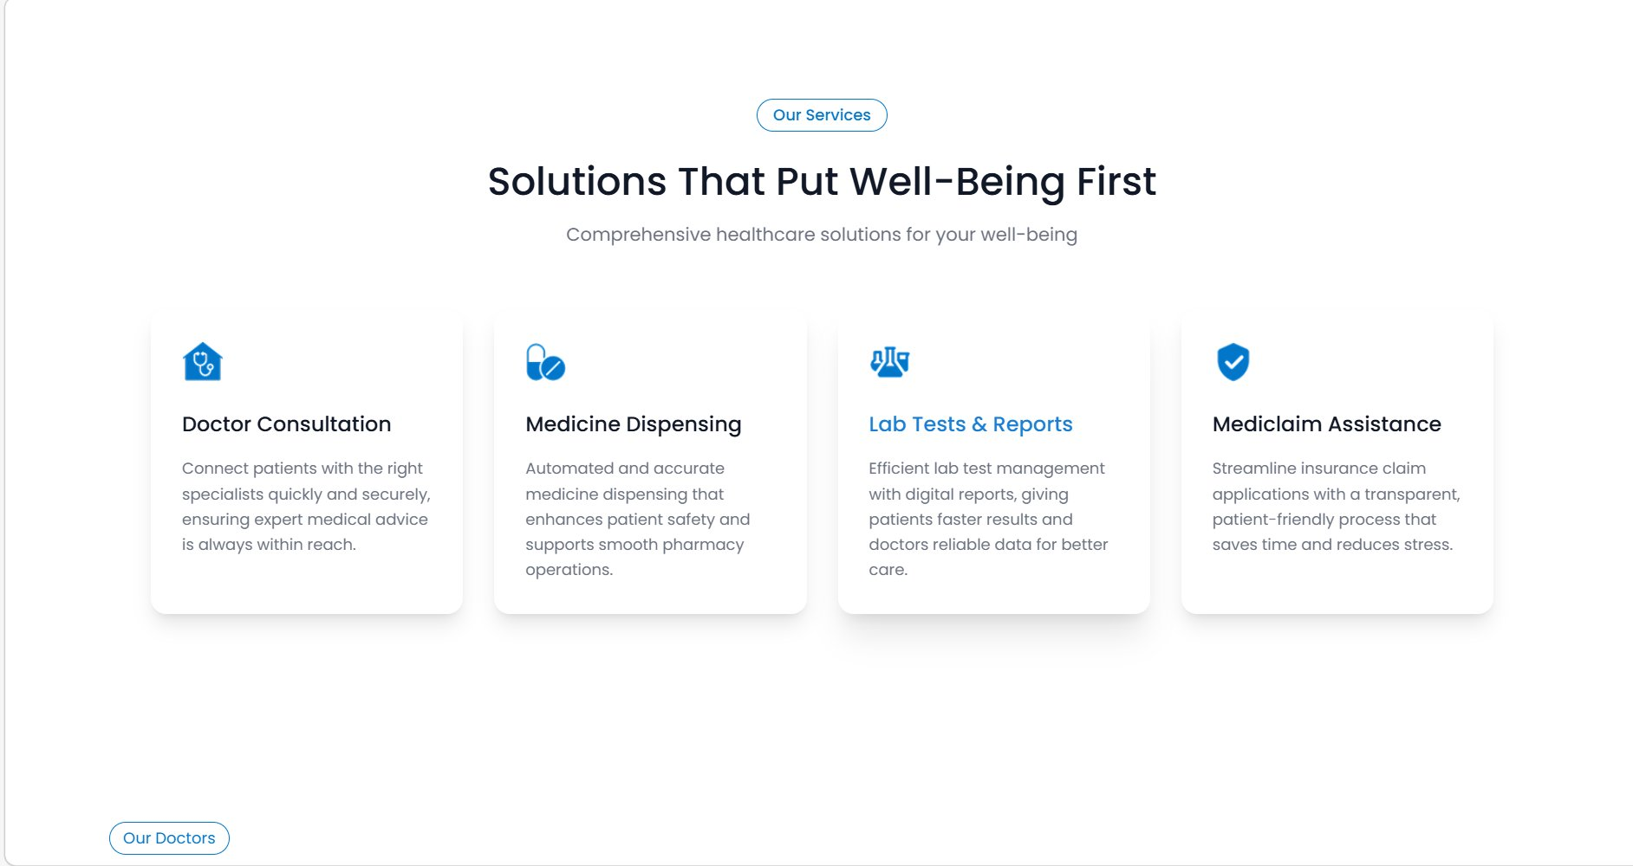

OUR SOLUTION
pulsepoint.hospital.com
Introducing PulsePoint
The Operating System for Your Hospital
A unified, role-aware platform connecting every hospital department — from reception to billing — in real time.
Smart Scheduling
Pharmacy Mgmt
Lab Management
Automated Billing
Role-based Access
Live Notifications
Live product — hero, services, and doctors sections
Built on enterprise-grade microservices architecture.
5 / 12

Slide 6
SYSTEM ARCHITECTURE
9 Services.
One Unified Platform.
Angular 21 Frontend
API Gateway :8090 — JWT Validation + Role Header Injection
Eureka Service Registry :8761
User
Patient
Prescription
Pharmacy
Lab
:8081
:8086
:8083
:8084
:8087
Billing
Notification
OpenFeign
Resilience4j
:8091
:8092
Inter-svc
Circuit Br.
6 / 12

Slide 7
CLINICAL WORKFLOW
One Workflow.
Zero Manual Handoffs.
01
02
03
04
05
Register & Book
Consult & Complete
Prescribe & Order
Dispense & Test
Pay & Claim
Receptionist registers patient and books appointment from available doctor slots.
Doctor completes appointment. Invoice is auto-generated instantly at this point.
Doctor writes prescription and orders lab tests. Invoice lab fee updated automatically.
Pharmacist dispenses medicines, lab runs tests and uploads results. Invoice updated.
Payment confirmed. Mediclaim submitted if applicable. Notifications sent throughout.
AUTO-TRIGGERED
AUTO-TRIGGERED
AUTO-TRIGGERED
"What used to take 3 departments, 6 handoffs, and 2 hours now happens in minutes — automatically."
7 / 12

Slide 8
ROLE-BASED ACCESS CONTROL
Every Role.
Purpose-Built Experience.
Administrator
Doctor
Receptionist
Full visibility across all departments. Manage staff, monitor workflows, access system-wide reports and analytics.
Focus on patients, not paperwork. Write prescriptions, order lab tests, manage schedule — in one place.
Run the front desk efficiently. Register patients, book appointments, manage invoices seamlessly.
Pharmacist
Lab Technician
Patient
Real-time queue of pending dispense requests. Live inventory management and instant invoice updates.
Manage test orders from sample collection to result upload. Track every test in the pipeline digitally.
Stay informed about your own care. View reports, track appointments, make payments, apply for mediclaim.
"Each role sees exactly what they need. Nothing more. Nothing less."
8 / 12

Slide 9
SECURITY ARCHITECTURE
Enterprise Security.
Zero Compromise.
1
Login
Zero Trust Architecture
Credentials verified over HTTPS
No microservice trusts another without full verification at the gateway on every request.
2
JWT Issued
Access: 15 min — Refresh: 8 hrs with rotation
Refresh Token Rotation
Stolen refresh tokens are detected and invalidated automatically on the next legitimate use.
3
Gateway Validates
Every request verified — invalid tokens rejected instantly
Per-Service Databases
4
Role Enforced
A lab data breach cannot expose billing or authentication data — fully isolated per service.
Doctors cannot access billing — siloed by design
Forgot Password Flow
5
Data Returned
Only if all security layers pass
Secure token-based password reset — time-limited, single-use, and fully encrypted.
"Your patient data is not just stored. It is protected at every layer."
9 / 12

Slide 10
COMPETITIVE ADVANTAGE
Built Different.
By Design.
Feature
Legacy Systems
PulsePoint
Deployment Time
3–6 months
Days ✔
Implementation Cost
₹50L – 1Cr+
Modular pricing ✔
Role-based Access
Basic login only
6 granular roles ✔
Inter-dept Automation
100% manual
Fully automated ✔
Billing Accuracy
Error-prone, manual
Auto-generated ✔
Security Model
Username / password
JWT + token rotation ✔
Deployment Model
Monolithic, inflexible
Microservices, modular ✔
"Not just better software — a fundamentally different approach to hospital management."
10 / 12

Slide 11
BUSINESS IMPACT & ROI
What Changes When You
Deploy PulsePoint
Reduce Administrative Cost
Increase Revenue Capture
Faster Patient Throughput
Automated billing eliminates manual data entry entirely
Every prescription, test, and medicine auto-linked to invoice
Appointment-to-discharge workflow reduced by 60%
Estimated 40% reduction in billing staff hours
Zero revenue leakage from missed charges
More patients served per day per doctor
Fewer errors means fewer insurance claim rejections
Real-time invoice status per appointment
Higher patient satisfaction and hospital reputation
40%
0
60%
reduction in admin overhead
manual billing handoffs
faster patient workflow
Week 1
Week 2
Month 1
Month 3
System deployed, all staff onboarded
All 6 departments fully live
Measurable drop in billing errors
Full ROI achieved
11 / 12

Slide 12
NEXT STEPS
Let Us Bring PulsePoint
to Your Hospital.
01
02
03
Pilot — Month 1–2
Full Deploy — Month 3–4
Scale — Month 5+
Deploy in one department
All 6 roles and 9 modules live
Multi-location support
Full staff training included
Integration with existing systems
Custom feature development
Zero disruption to existing flow
Dedicated onboarding support
Analytics and reporting suite
We measure results together
Live monitoring dashboard
Mobile app rollout
Schedule a 30-Minute Live Demo — See PulsePoint Running with Your Real Hospital Workflows
12 / 12

