Slide 1

Automated Helpdesk Support for Student Admission Department
~Gen AI Mini Project

Slide 2
Introduction
AI-powered chatbot for student admission queries.
Uses LLMs to simulate real-time helpdesk support.
Minimizes human workload in admission departments.
Provides 24x7 accessible support system.

Slide 3
Objective
Develop an interactive admission helpdesk bot.
Use Google AI Gemini for intelligent responses.
Simple, user-friendly frontend via Streamlit.
Quick, automated support system for students.

Slide 4
Technologies Used
Python for backend logic and API calls.
Streamlit for building frontend UI.
GeminiAPI for response generation.
VS Code as IDE, pip for dependency management.

Slide 5
System Architecture
User queries via Streamlit UI.
Python backend processes and forwards to Gemini API.
Model generates responses based on query context.
Responses sent back and displayed on UI.

Slide 6
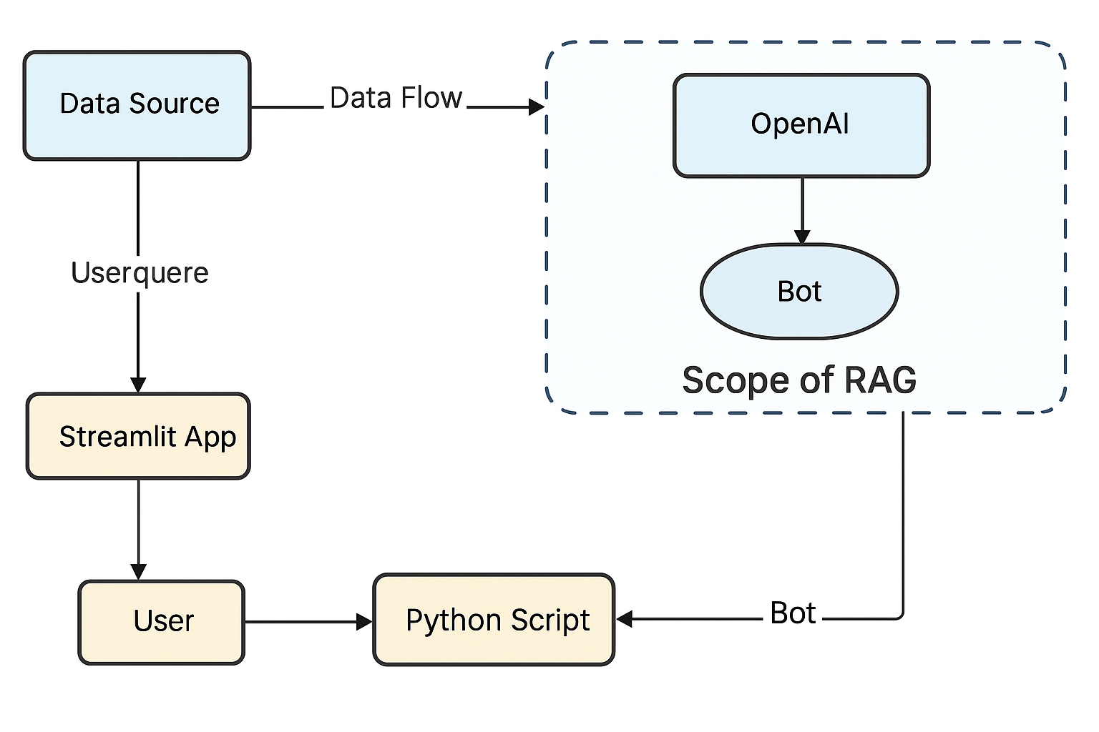
Flow Diagram with RAG Scope
Input captured via Streamlit frontend.
Query flows to backend via Python logic.
If RAG (Retrieval Augmented Generation) enabled: pulls relevant admission data.
Bot replies based on data and model reasoning.

Slide 7




Project Architecture & Tech Stack
Frontend: Streamlit web app.
Backend: Python APIs and GPT integration.
LLM: OpenAI GPT-3.5-turbo.
Toolchain: Python 3.11+, pip, VS Code.

Slide 8
Role of Each Agent
User : Inputs query to the bot.
Frontend Agent: Handles UI and data input.
Backend Agent: Connects with Gemini API.
All agents synchronize via Streamlit runtime.

Slide 9
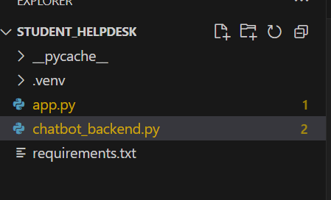
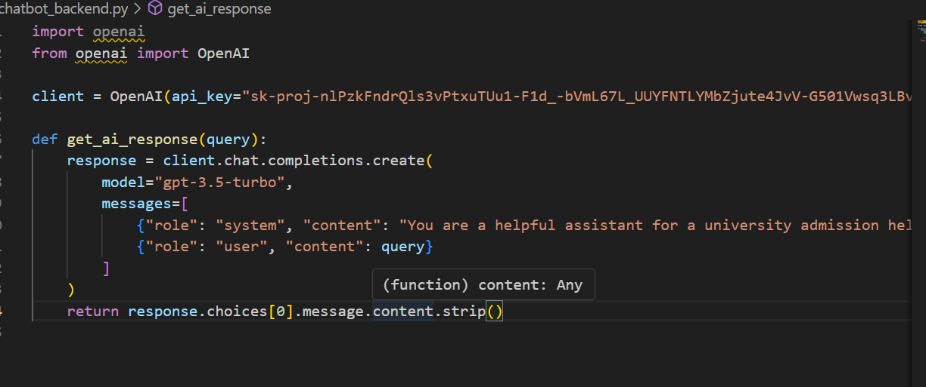
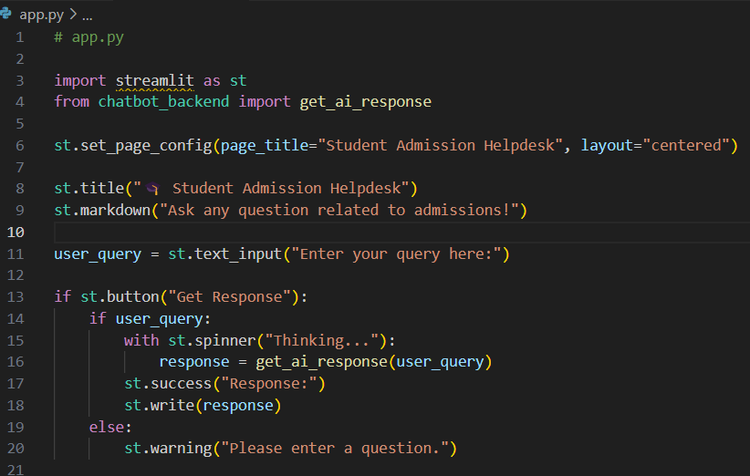
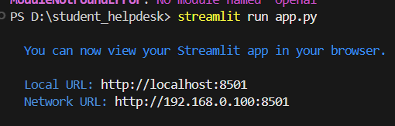
Use Case Screenshots
Students Helpdesk Folder
Chatbot backend.py
Frontend app.py
Streamlit running

Slide 10
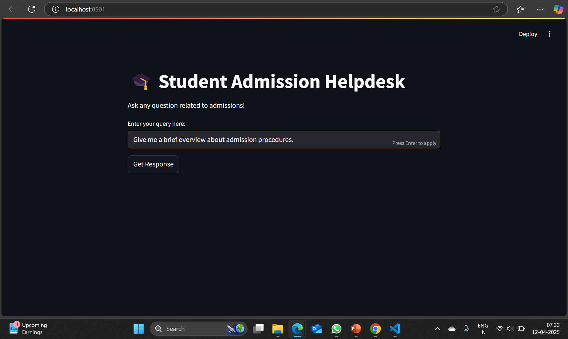
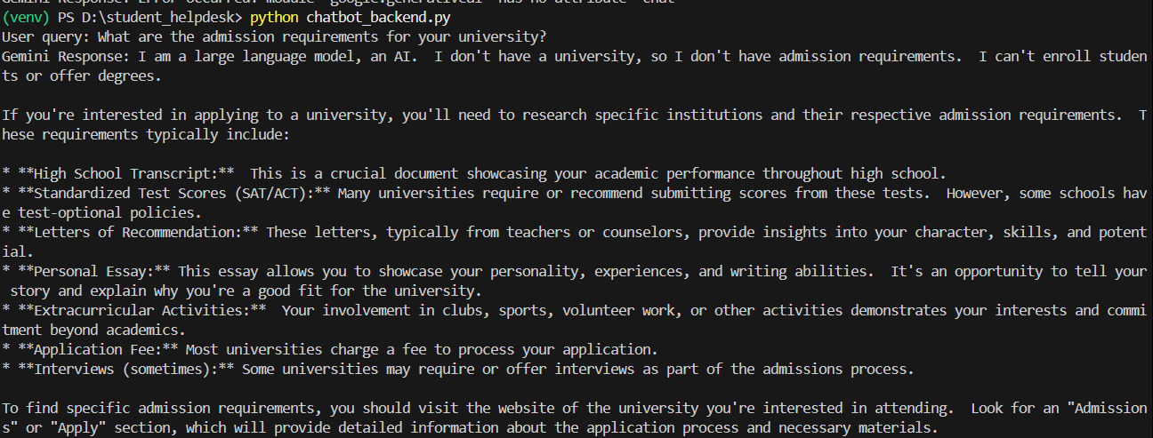
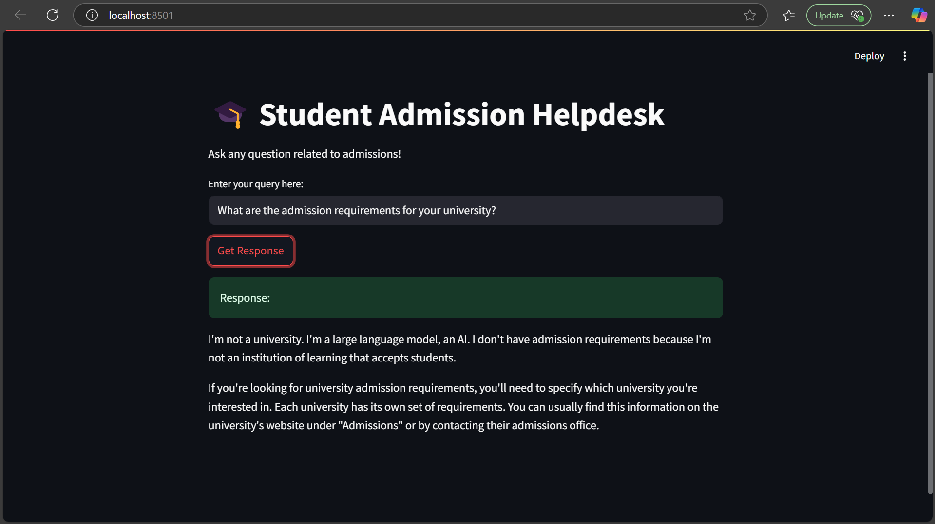
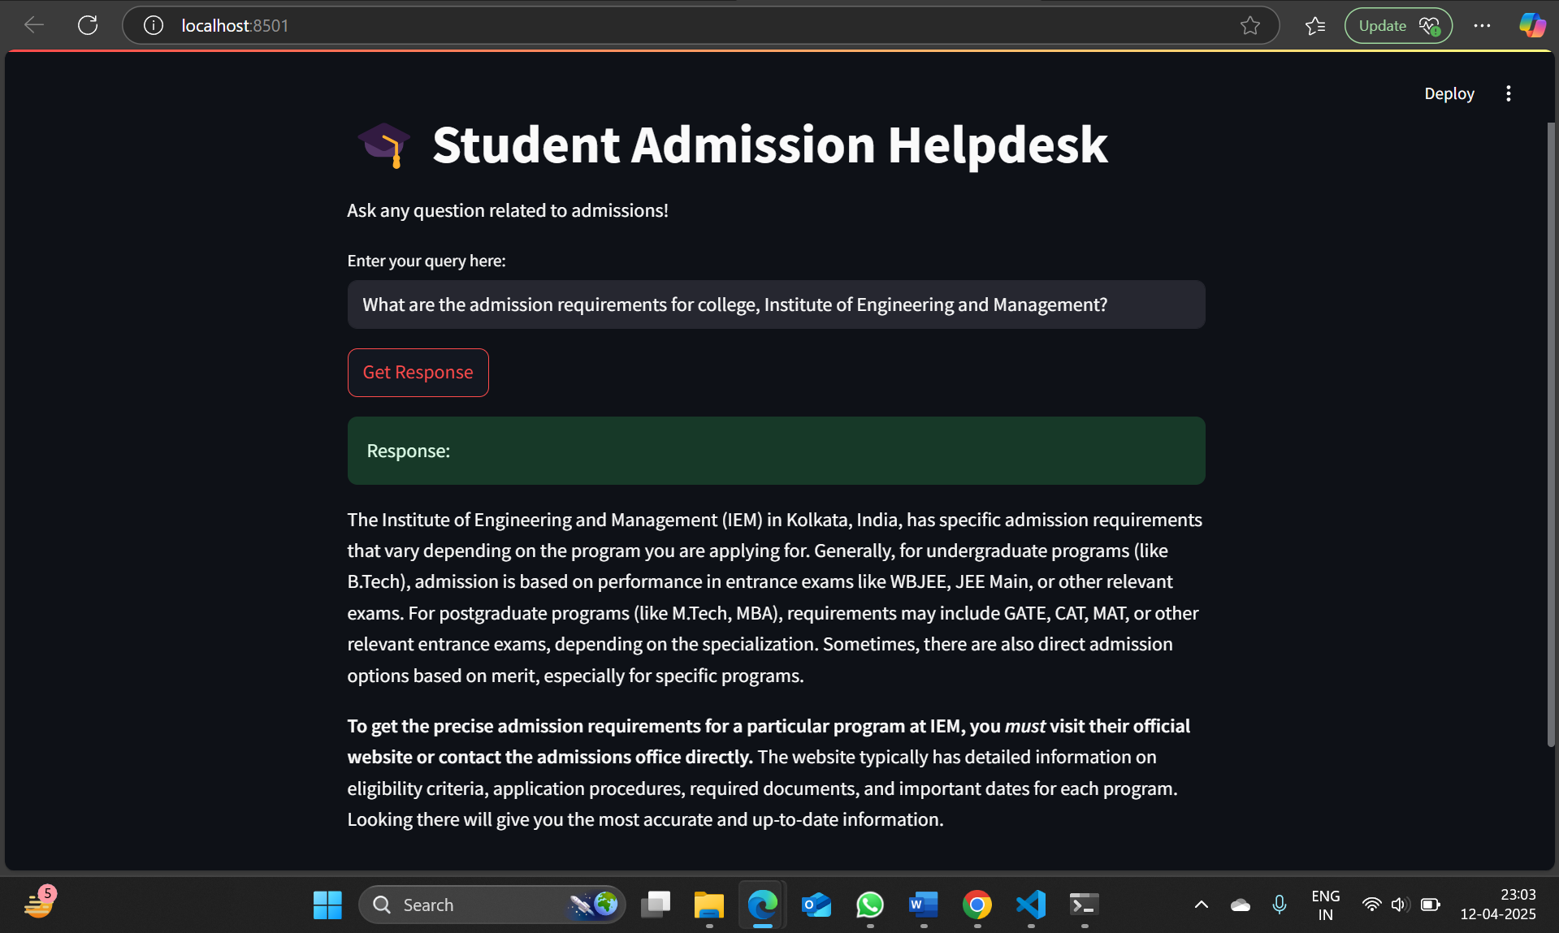
Output Screenshot
Final Website running at LocalHost 8501

Slide 11
Acknowledgement
I would like to express my heartfelt gratitude to everyone who supported me in the successful completion of this project. Special thanks to my teachers, and my team, for their invaluable guidance, constructive feedback, and encouragement throughout the development of the Automated helpdesk support for Student Admission Department.
Thank You

