Slide 1




POTENTIAL ACQUISITION OF PINTEREST BY MICROSOFT
SAISRIJITH MARAMREDDY

Slide 2
ROADMAP
ACTION | DEADLINE
Further Reading | May 31st
Data Collection | June 30th
Analysis: DCF, comparable analysis | July 10th
Final Report Submission | August 17th
WHY CORPORATE INVESTMENT?

Slide 3
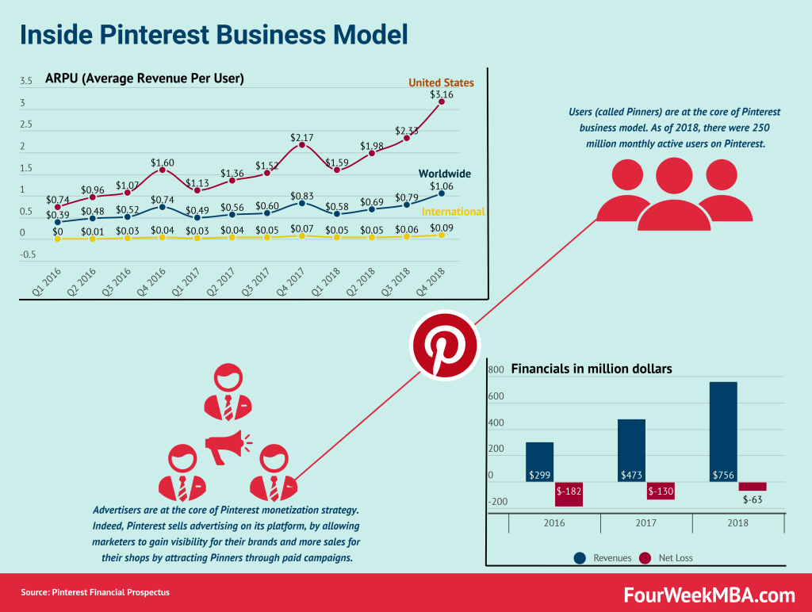
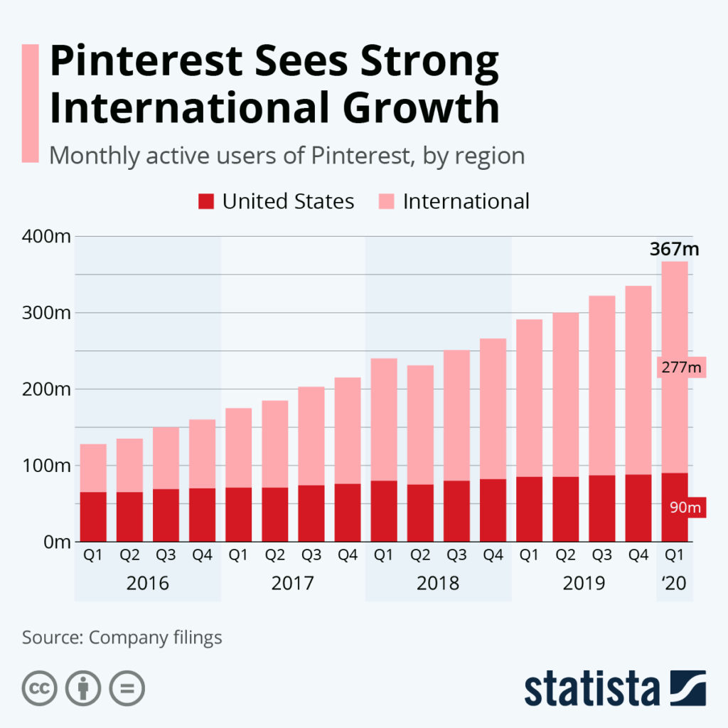
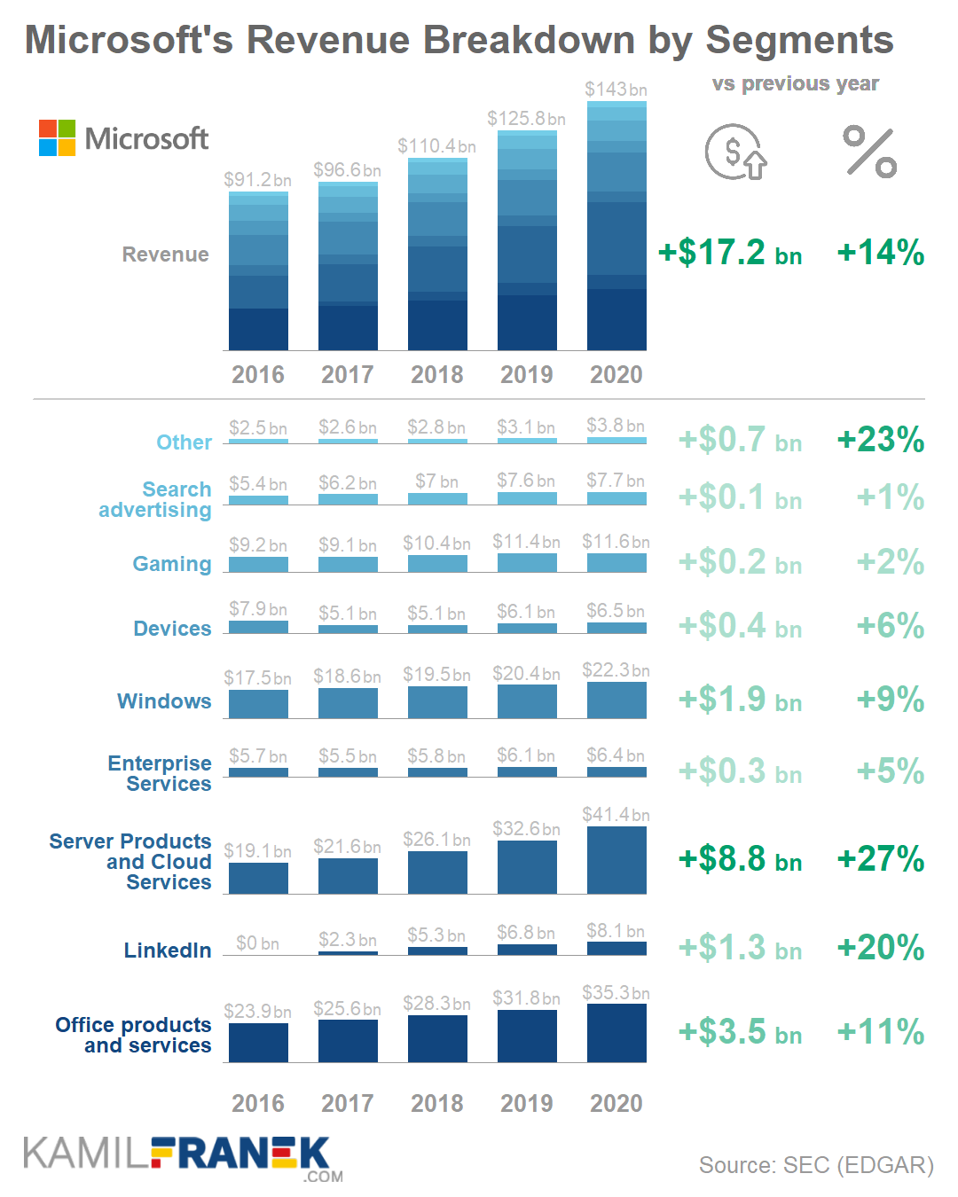

COMPANY PROFILE & FINANCIAL POSITION

Slide 4
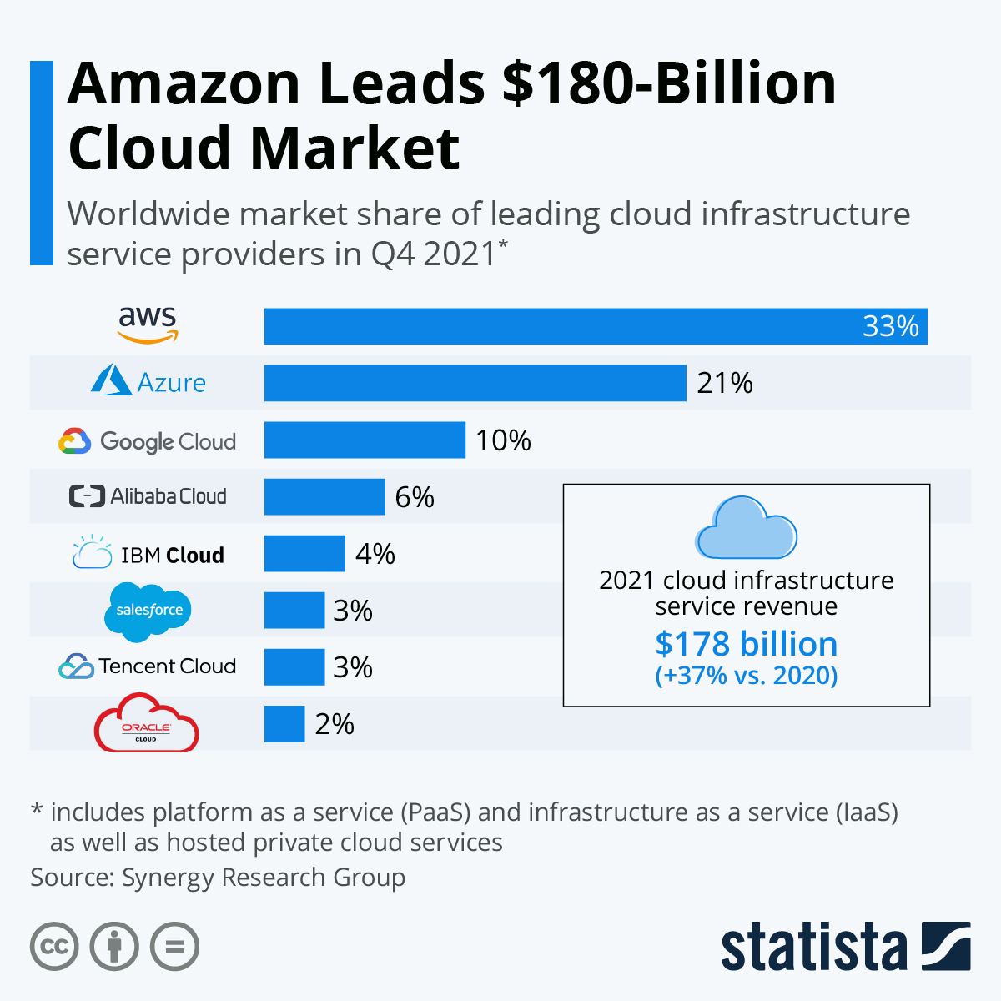
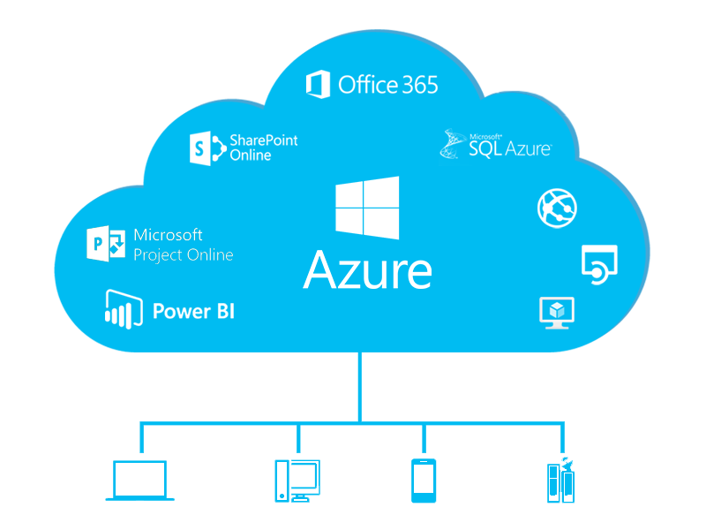
DEAL RATIONALE

