Slide 1
S.E.E – Smart Environment Explorer
maskVJ
Janagiraman, Aakash, Kishore, Viswanth, Sri Kabilan, Manogaran

Slide 2
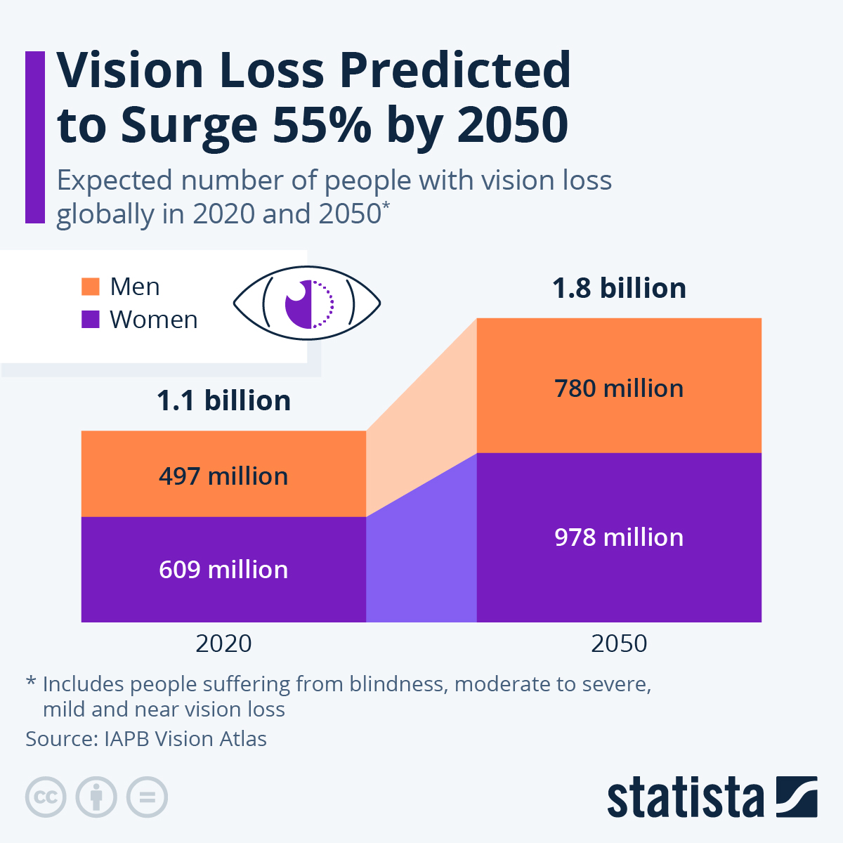
PROBLEM STATEMENT & SOLUTION
maskVJ
Problem We Are Solving :
• Traditional white canes detect only ground-level obstacles • Cannot detect hanging objects, stairs, people, or signboards • No information about what the object is or how far it is
Our Solution :
• Real-time object detection using AI • Distance estimation to warn users early • Audio feedback in local language (Tamil) • Works using devices users already own (Smartphones)

Slide 3
WHAT IS S.E.E?
maskVJ
“Giving independence back to the visually impaired, one frame at a time”
S.E.E is a real-time visual assistant designed for visually impaired people using a smartphone-based solution.
Instead of expensive smart glasses, the user wears a phone around the neck with the camera facing forward.
The system detects obstacles and objects and provides audio guidance such as:
“Chair, 2 meters ahead” “Stairs detected, stop”
This acts as a Third Eye, helping users navigate independently and safely.

Slide 4
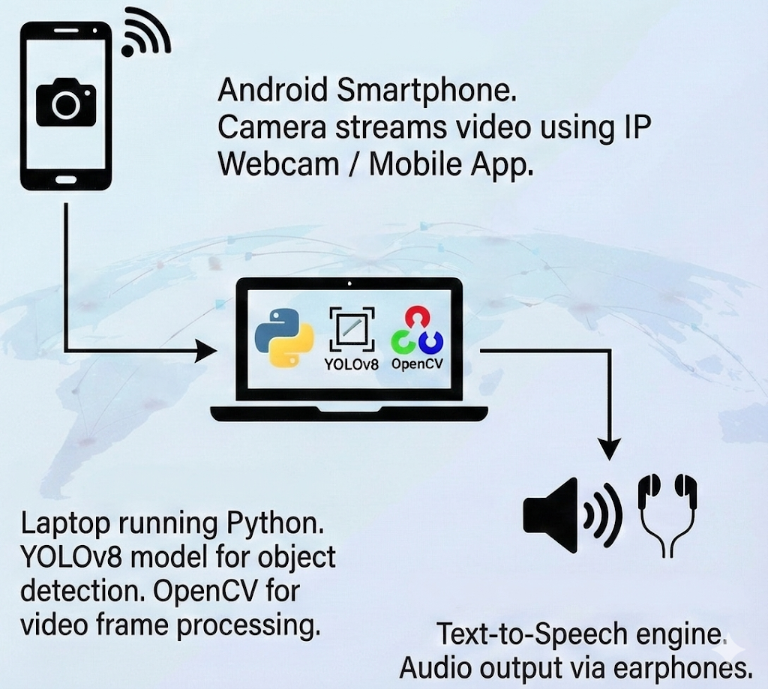
TECHNICAL APPROACH
maskVJ
System Architecture (Client–Server Model):
The Eye (Client): Android Smartphone. Camera streams video using IP Webcam / Mobile App.
The Brain (Server): Laptop running Python. YOLOv8 model for object detection. OpenCV for video frame processing.
The Voice (Feedback): Text-to-Speech engine. Audio output via earphones.

Slide 5
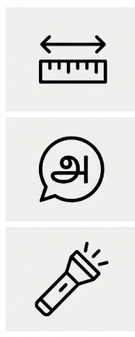
KEY FEATURES & INNOVATION
maskVJ
Feature 1: Intelligent Distance Estimation Calculates depth using bounding box size. Alerts based on distance. Example: “Person very close – Stop!”.
Feature 2: Local Language Support (Tamil) Spoken guidance in Tamil. Example: “Munnadi Naarkali Irukku”. Improves emotional connection & usability.
Feature 3: Low-Light Detection Detects poor lighting conditions. Automatically suggests or activates flashlight.

Slide 6
FEASIBILITY AND VIABILITY
maskVJ
Analysis of Feasibility :
Technical Feasibility: AI, Computer Vision, TTS already proven
Economic Feasibility: Uses existing smartphones (Low cost)
Social Feasibility: High acceptance for assistive technologies
Potential Risks :
Processing delay in real-time
Low-light accuracy issues
Battery consumption
Strategies to Overcome :
Model optimization
Low-light enhancement
Efficient frame processing

Slide 7
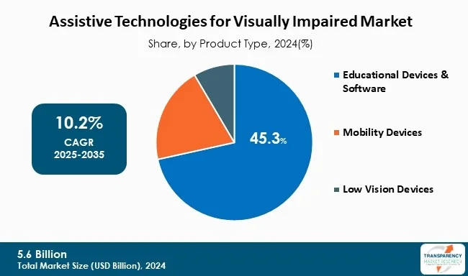
IMPACT AND BENEFITS
maskVJ
Potential Impact on target audience :
Increased independence for visually impaired
Reduced dependency on others
Improved safety in daily navigation
Confidence in public movement
Benefits of the solution :
Affordable alternative to smart glasses
Real-time intelligent guidance
Language-inclusive design
Scalable and future-ready

Slide 8
maskVJ
CONCLUSION
By fusing real-time safety with Generative AI understanding, S.E.E turns the common smartphone into a powerful 'Third Eye.’
This is the future of accessible tech: affordable, intelligent, and truly life-changing.
Thank you for giving us this opportunity.
“S.E.E is not just technology, it is empowerment.”

