Slide 1

TJS ENGINEERING COLLEGE
Approved by AICTE&Affiliated to Anna University Chennai & Accredited by NAAC) An ISO 9001 : 2015 Certified Institution
DEPARTMENT OF COMPUTER SCIENCE AND ENGINEERING
Project name : Smart Water Management
Phase-3.
Team name : Proj_112821_team_3
Team members :
Sathish Kumar.S(112821104063)
Sai Kumar.S(112821104056)
Venkatesh.M(112821104072)
Yogesh.S(112821104076)
Srikanth.K(112821104068)

Slide 2
Introduction:-
Water scarcity and water management topics are very closely related to each other. Improper water management leads to water scarcity and vice versa. Don’t assume that this project is also one of the 1000 similar projects based on water management issues.
I am confident that if a person goes through this documentation, he will get to know why this project is unique and smart from other projects! Not only this project solves the old traditional problem of water management in a new way but it also provides a smart way of interacting with robots

Slide 3
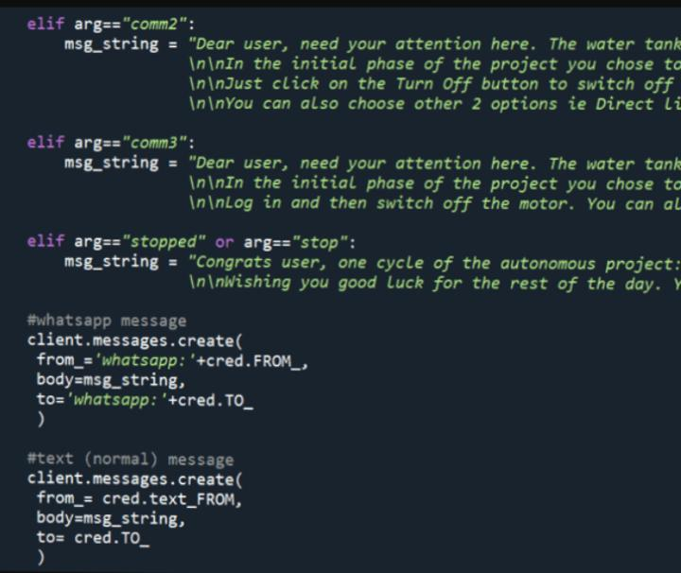
Twilio’s API
To make the project more active, I have used Twilio’s API to send Whatsapp updates for every major workflow.

Slide 4
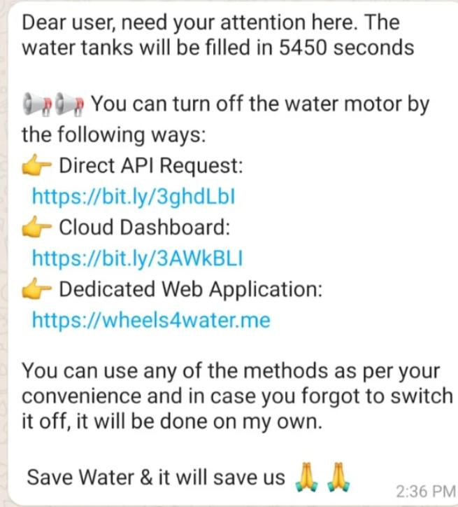
A total of 04 Whatsapp updates will be posted on the user’s registered number. But what if there is no Internet connectivity with the user? Then, in this case, 04 normal text SMS will be also sent which makes the project more relatable to the real world. Following is one of the snippet of the updates:

Slide 5
Python code:-
I dynamically add some code in the product code section to make a button live and thus users can interact with this one to turn off the water motor.
setChartLibrary('google-chart’);
setChartTitle('W4W Motor Stats’);
setChartType('area graph’);
setAxisName('Time','Motor'); plotChart('time_stamp','motor');
let anchor = document.createElement("a"); anchor.innerHTML = "Off Motor"; anchor.href="https://cloud.boltiot.com/remote/e719e4f0cc5d427ba0aa6b9d1ceb0f28/digitalWrite?pin=0&state=LOW&deviceName=BOLT8024008"; anchor.target = "_blank"; anchor.style = "display: block; width: 100px; text-align: center; margin-top: 20px; margin-left: 450px;border-radius: 10px; border: 2px solid #0000FF"; document.getElementBy id('drop').appendChild(anchor);

Slide 6
REAL-TIME TRANSIST INFORMATION PLATFORM:
The Smart Water Transit Information Platform (SWTIP) is a digital ecosystem that leverages real-time data and IoT technology to provide critical information and services related to water distribution and management
Real-Time Water Flow Monitoring: Provides real-time data on water flow rates, pressures, and distribution within the water network. Users can track the movement of water in pipes and pipelines.
Water Quality Monitoring: Monitors water quality parameters such as pH levels, turbidity, and contaminants in real time, with alerts for potential issues or breaches in quality standards.

Slide 7
INTEGRATION APPROACH:
1. Standardize Communication Protocols:
Ensure that all devices and software components use standardized communication protocols for seamless data exchange. Common IoT communication protocols include MQTT, CoAP, and HTTP/HTTPS.
2. Central Data Platform:
Establish a central data platform or data hub that serves as the backbone of the system. This platform should aggregate and store data from various sources and provide APIs for data access.
3. IoT Device Management:
Implement an IoT device management system to handle device provisioning, monitoring, and firmware updates. This ensures that all devices are functioning optimally.

Slide 8
INTEGRATION BENEFITS:
Seamless Data Flow: Integration ensures a smooth and continuous flow of data between various components of the system, allowing real-time information to be collected, processed, and acted upon promptly.
Improved Decision-Making: Integrated data from multiple sources provides a comprehensive view of the water system, enabling better-informed decision-making by utilities, operators, and other stakeholders.
Efficient Resource Allocation: Integration helps optimize resource allocation by providing insights into water usage patterns, enabling utilities to allocate water resources more efficiently and reduce wastage.

Slide 9
Conclusion:-
As already mentioned I will be creating 4 custom options for the project and I did that. I had created the website, incorporated the capacitive touch sensor, automated the voice control thing, and created the cloud dashboard.

Slide 10
Thank you

