Slide 1

TJS ENGINEERING COLLEGE (Approved by AICTE&Affiliated to Anna University Chennai & Accredited by NAAC) An ISO 9001 : 2015 Certified Institution
DEPARTMENT OF COMPUTER SCIENCE AND ENGINEERING
Project name : Smart Water Management
Phase-2.
Team name : Proj_112821_team_3
Team members :
Sathish Kumar.S(112821104063)
Sai Kumar.S(112821104056)
Venkatesh.M(112821104072)
Yogesh.S(112821104076)
Srikanth.K(112821104068)

Slide 2
PROBLEM DEFINITION:
The project involves implementing IoT sensors to monitor water consumption
in public places such as parks and gardens. The objective is to promote water
conservation by making real-time water consumption data publicly available.
This project includes defining objectives,designing IoT sensor system
developing the data sharing platform and integrating them using IoT
technology and python.

Slide 3
OBJECTIVES:
The smart water system using IoT is an innovative solution that leverages the
IoT for management and conservation of water resources.
Water management problems such as water usage ,overflow in water tank. To
overcome this problem by implementing proper monitoring.
Through a network of sensors, the system collects real-time data on water
quality and consumption. This data is processed in cloud based platform.
It highlights potential of IoT in revolutionizing water management practices,
ensuring sustainable access to clean water for current and future generations.

Slide 4
EXISTING SYSTEM:
Manual Meter Reading: Water consumption is often monitored through
traditional meters that require physical visits by utility personnel to read and
record usage. This can be time-consuming and prone to errors.
Water Quality Monitoring: Water quality monitoring is typically periodic and
may not detect issues until they have reached critical levels. Contaminants and
impurities may not be detected until after they have affected water quality.
Limited Data Analysis: Data collected from the existing system may not be
analyzed comprehensively to identify trends, predict maintenance needs, or
optimize resource allocation.

Slide 5
PROPOSED SYSTEM:
IoT Sensors and Devices:
Deploy a network of IoT sensors and devices throughout the water distribution
network, including water treatment plants, reservoirs, pipelines, and consumer
premises.
These sensors will continuously monitor parameters such as water flow rate,
pressure, temperature, pH levels, turbidity, and contaminants.
Real-time Data Collection:
Collect real-time data from the sensors and devices, providing a comprehensive
view of the entire water system's status.
Use wireless communication protocols (e.g., LoRaWAN, NB-IoT) to transmit
data securely and efficiently.

Slide 6
IoT SENSOR DESIGN:
There are several IoT sensors and components that are used in the smart water system
using IoT. Some of them are as follows.
1.Ultrasonic sensor
2.Temperature sensor
3.Water Flow sensor

Slide 7
1.Ultrasonic sensor:
1.Ultrasonic sensor:
It is used to indicate the level of water in real time. When the waterlevel falls below the threshold level the motor will automatically ON.
Ultrasonic sensors are electronic devices that calculate the target’s distance by emission of ultrasonic sound waves and convert those waves into electrical signals. The speed of emitted ultrasonic waves traveling speed is faster than the audible sound
Ultrasonic sensor working principle is either similar to sonar or radar which evaluates the target/object attributes by understanding the received echoes from sound/radio waves correspondingly. These sensors produce high-frequency sound waves and analyze the echo which is received from the sensor. The sensors measure the time interval between transmitted and received echoes so that the distance to the target is known.

Slide 8
2.Temperature sensor
It is used to sense the temperature of the water tank
Temperature sensors are devices that detect and measure coldness and heat and convert it into an electrical signal. Temperature sensors are utilized in our daily lives, be it in the form of domestic water heaters, thermometers, refrigerators, or microwaves.
A temperature sensor can also be defined as a simple instrument that measures the degree of coldness or hotness and then converts it into a readable unit. There are specialized temperature sensors used to measure the temperature of the boreholes, soil, huge concrete dams, or buildings.

Slide 9
3.Water flow sensor
Water flow sensors are installed at the water source or pipes to measure the rate of flow of water and calculate the amount of water flowed through the pipe.
The water flow sensor consists of a plastic valve body, a water rotor and a hall-effect sensor. When the water flows through the rotor, rotor rolls and the speed of it changes with a different rate of flow. The hall-effect sensor outputs the corresponding pulse signal.
A water flow sensor, on the other hand, measures the velocity of the fluid flow at a specific point in time. It is mainly used to monitor the flow rate in real-time, to detect any changes or irregularities in the flow, and to control or regulate the flow as needed.

Slide 10
Work flow of the system
This current proposed water management system focuses on the management of the water resources by monitoring the water level, temperature of the water and the flow of the water.
In this system, three sensors are used. Ultrasonic sensor is used to detect the level of the water, Temperature sensor is used to detect the temperature of the water and Water flow sensor is used to detect the flow of the water.
All these data which is derived from the sensors are stored and those data are used to analyse the condition of the water.
Hence the necessary action will be taken based on the condition of the water

Slide 11
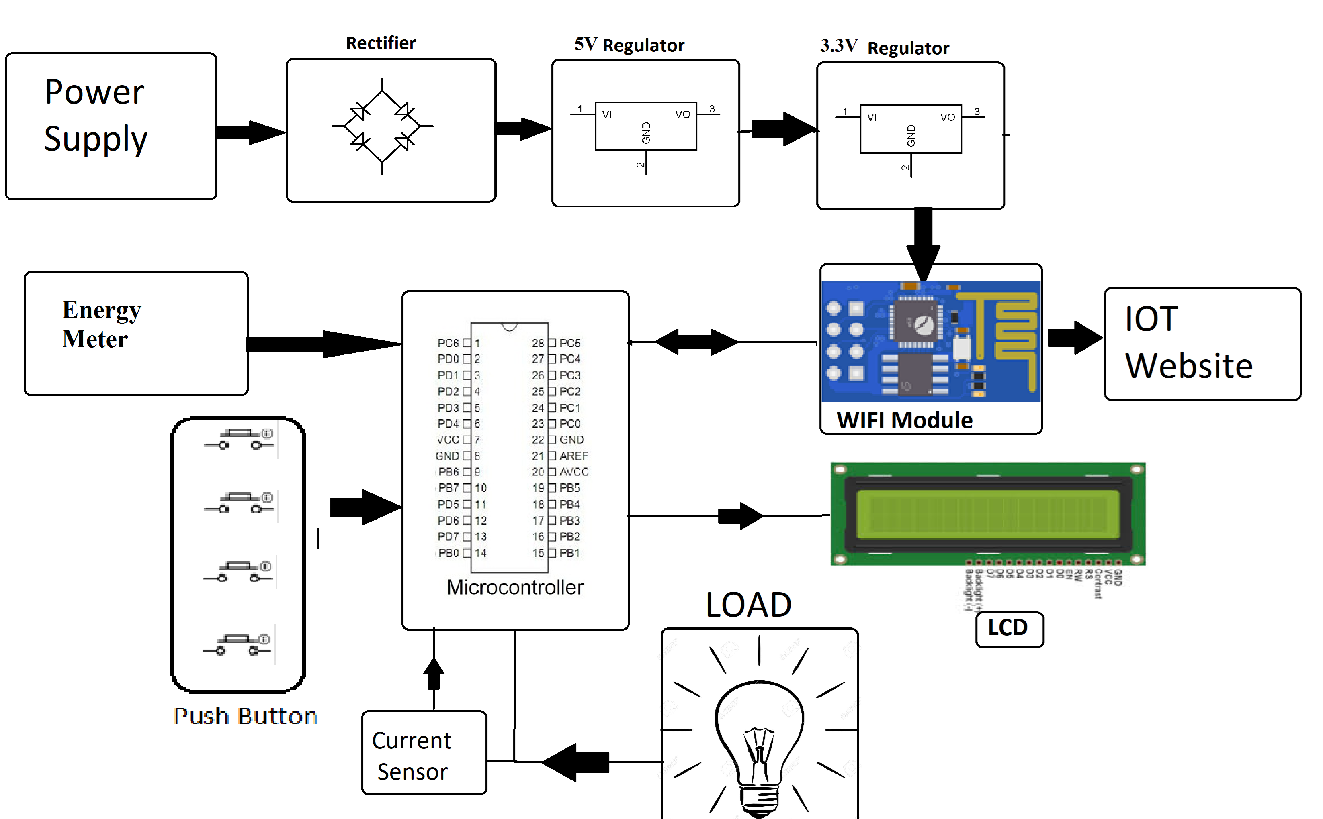

Slide 12
REAL-TIME TRANSIST INFORMATION PLATFORM:
The Smart Water Transit Information Platform (SWTIP) is a digital ecosystem that leverages real-time data and IoT technology to provide critical information and services related to water distribution and management
Real-Time Water Flow Monitoring: Provides real-time data on water flow rates, pressures, and distribution within the water network. Users can track the movement of water in pipes and pipelines.
Water Quality Monitoring: Monitors water quality parameters such as pH levels, turbidity, and contaminants in real time, with alerts for potential issues or breaches in quality standards.

Slide 13
INTEGRATION APPROACH:
1. Standardize Communication Protocols:
Ensure that all devices and software components use standardized communication protocols for seamless data exchange. Common IoT communication protocols include MQTT, CoAP, and HTTP/HTTPS.
2. Central Data Platform:
Establish a central data platform or data hub that serves as the backbone of the system. This platform should aggregate and store data from various sources and provide APIs for data access.
3. IoT Device Management:
Implement an IoT device management system to handle device provisioning, monitoring, and firmware updates. This ensures that all devices are functioning optimally.

Slide 14
INTEGRATION BENEFITS:
Seamless Data Flow: Integration ensures a smooth and continuous flow of data between various components of the system, allowing real-time information to be collected, processed, and acted upon promptly.
Improved Decision-Making: Integrated data from multiple sources provides a comprehensive view of the water system, enabling better-informed decision-making by utilities, operators, and other stakeholders.
Efficient Resource Allocation: Integration helps optimize resource allocation by providing insights into water usage patterns, enabling utilities to allocate water resources more efficiently and reduce wastage.

Slide 15
THANK YOU

