Slide 1
Calls tell you where to act.
TRANSCRIPT INTELLIGENCE · FINDINGS FOR PRODUCT AND ENGINEERING LEADERSHIP
The March outage showed up in every call type, competitors come up most in outage calls, and a short list of accounts needs follow-up.
Based on 100 call transcripts from February to April 2026
Notes:
[~1:00] Open with the thesis, then say how the slot runs. Total about 24.5 minutes of slides, leaving about 3.5 for questions in a 28-minute slot: this slide 1:00; what we were asked, the data and the pipeline 3:30; Task 1 themes, examples and checks 6:00; Task 2 sentiment, the March dip and the outage 6:00; Task 3 competitors, outage reach and the follow-up list 4:30; limits and recommendations 3:30. Say plainly that this is a pipeline that keeps running as calls arrive, not a one-off analysis, and that every number on a slide is traceable to a file. So what: one sentence the room can repeat: the calls tell you where to act. Likely question: is this real customer data? Answer: 100 transcripts of a fictional company, Aegis Cloud Security; treat the results as directional. Sources: dataset/ (100 meetings, 2026-02-03 to 2026-04-28); DECISIONS.md section B.

Slide 2
Three tasks, 100 calls, four stakeholders
WHAT WE WERE ASKED, AND THE DATA
Task 1
Task 2
Task 3
Sort calls into themes
Read sentiment by call type
Find what is not obvious
Build a pipeline, show the categories, explain why, and show examples.
Compare support, external and internal calls over time, and say why it matters.
Two or three more insights for a support lead, sales manager, product manager or engineering lead.
100
4,313
30
call transcripts, Feb 3 to Apr 28, 2026
sentences, 141,357 words
calls with no outside attendee, so certainly internal
Call type is not a field. We assign it in Stage 0.
Each call ships with an upstream AI summary, topics and sentiment score. We never feed them in; we only compare against them.
The data looks synthetic, so every finding is directional. Every choice was weighed as a recurring pipeline step.
Source: the assignment brief; 100 calls
Notes:
[~2:00] Restate the three tasks in one breath, then the reading that drove every later choice: the end product is a tool that keeps running and serves four stakeholders, so each decision was tested against eight criteria (stable as new calls arrive, owned by someone who can act, evidence on every output, no hidden dependence on upstream AI output, validation that scales, one method over time, defined for every call, few moving parts). This is why we freeze a taxonomy and cache raw answers instead of re-clustering each time. Then three facts about the data. One: 100 calls and 4,313 sentences (141,357 words) over three months; 30 calls have no outside attendee. Two: nothing says whether a call is support, external or internal, so classifying them is the first pipeline stage rather than an assumption. Three: each call arrives with a summary, topics and a sentiment score produced upstream by an AI. We treat those as a baseline to compare against, not as input, because plotting them would be shallow and would inherit their framing. So what: the pipeline has to earn its labels; nothing is handed to it. Likely question: why not just use the provided summaries and scores? Answer: they are an upstream AI output; we compare against them but never feed them in. How do you know the data is synthetic? One fictional company, repeated score values, and call dates that sometimes disagree with content; we say so and do not claim statistical certainty. Footer sources (files): assignment.md; DECISIONS.md section B2 (decision criteria) and section B; docs/quotable_numbers.py N1, N3. Counts: DECISIONS.md B (100 meetings, 4,313 sentences, 141,357 words, 30 meetings with no external attendee).

Slide 3

One decision made once, three stages that run on every new call
THE PIPELINE
Stage 0
Stage 1
Stage 2
Insights
Call type
Themes
Sentiment
Stakeholder views
Internal by metadata. Otherwise an LLM reads the opening and picks support or external.
One of eight themes, a product area and an incident flag, with an evidence quote.
Call and customer scores from 1 to 5, per-turn labels and a trend, with a quote.
Competitors, outage reach and an account follow-up list.
Once
On every call
Replayable
Discover themes, then freeze a versioned taxonomy and the scoring anchors.
Classify and score against the frozen version; any change re-runs the stage.
Raw model answers are cached, so notebooks re-run offline without a key.
Source: 100 calls, our pipeline
Notes:
[~1:30] Walk left to right, briefly. Stage 0 gives every call a type: calls with no outside attendee are internal by metadata; for the 70 calls with a customer an LLM reads attendee counts and the opening turns, without seeing the title. Stage 1 assigns one of eight themes plus a product area and an incident flag. Stage 2 scores tone. Insights read the structured fields. Bottom row, for engineering: theme discovery is one-time and the taxonomy is frozen and versioned; only classification runs per call; every LLM answer is cached, so results replay (temperature 0 does not guarantee identical output; see the model slide in the appendix). So what: a system you can run on next week's calls, not a notebook you read once. Likely question: what if new themes appear? Answer: an Other bucket above 10 percent triggers a taxonomy revision and a full re-run. Caveat: Other was never used in this sample, so that alarm is untested. Sources: DECISIONS.md D1, D3, D5, D7, D8; README.md. Footer sources (files): DECISIONS.md D1, D3, D5, D7, D8; README.md

Slide 4
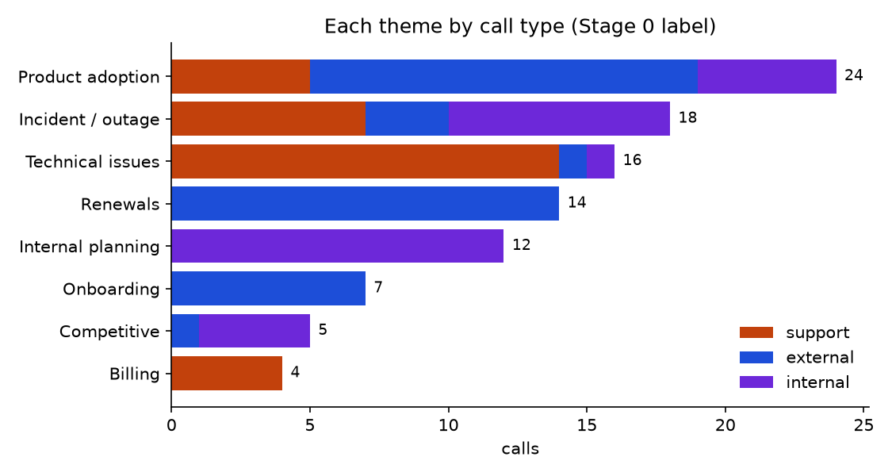
Eight themes, each with an owner who can act on it
TASK 1 · THEMES
Theme | Calls | Owner who can act
Product adoption | 24 | Product manager, customer success
Incident and outage | 18 | Engineering and support leads
Technical issues | 16 | Support lead, engineering
Renewals | 14 | Account and sales managers
Internal planning | 12 | Engineering leads
Onboarding | 7 | Customer success, solutions
Competitive | 5 | Sales leadership, product
Billing | 4 | Support lead, finance operations
Source: 100 calls, our pipeline
Notes:
[~2:00] Eight themes plus a product-area field and an incident flag, and no call fell into Other. The chart shows how each theme splits across call types: renewals are all external, internal planning is all internal, technical issues are almost all support, incident and outage cuts across all three. The table names who owns each theme, because a category nobody can act on is decoration. So what: a leader can open one theme and see calls, tone and owner together; the theme-by-type chart already shows the cross-type nature of the outage. Likely question: who chose these eight? Answer: an LLM proposed candidates from the transcripts (two runs, only partly overlapping), and the analyst finalised the list with AI assistance, merging module-named themes into the product-area field and adding an internal-cadence theme. Say it plainly: the taxonomy is a judgment, frozen and versioned (taxonomy v1). Sources: docs/analysis-themes.md table (counts by type recomputed from outputs/stage1/stage1_final.csv and outputs/stage0_final.csv); owners from DECISIONS.md D8; figure outputs/analysis/themes/fig1_theme_by_call_type.png. Footer sources (files): docs/analysis-themes.md (recomputed from outputs/stage1 and stage0); owners from DECISIONS.md D8. Chart: outputs/analysis/themes/fig1.

Slide 5
One real sentence from a call in each theme
TASK 1 · EXAMPLES
Billing · Support Case #9279 - Summit Trust Billing Inquiry
Incident and outage · INCIDENT: Detect Pipeline Failure - War Room
“Yeah so, uh, we received our January invoice last week and there's a line item on there that doesn't quite match what we expected based on our contract.”
“So, uh, at approximately 9:14 AM Pacific we started seeing alerts — or rather, the absence of alerts — from the Detect event processing pipeline.”
Renewals · Aegis / Crestline Wealth - Account Review
Internal planning · Weekly Engineering Standup
“Okay so your current contract runs through, let's see, end of March 2026, so we've got about six weeks before that comes up. I want to make sure we're not scrambling at the last minute on this.”
“Okay, so usual format — let's do a quick status round, then I want to spend some time on the Detect pipeline work and the Comply v2 timeline.”
Competitive · Competitive Threat Assessment - Post Outage
Product adoption · Aegis / Bridgeport Health - Compliance Review
“So, let's talk competitive positioning because that's really why we're on this call.”
“And then honestly, the third thing I'd say is — let's get you a sandbox look at some of the Comply v2 features before they go GA”
Onboarding · Aegis / Frostbyte AI - Identity Module Setup
Technical issues · Support Case #6977 - Brightpath Commerce Slow Backup Performance
“and she's going to be your main technical point of contact through the onboarding process.”
“So you're seeing slow backup performance with Aegis Protect — can you walk me through what you're experiencing?”
Source: 100 calls, our pipeline
Notes:
[~1:30] One short verbatim evidence quote per theme, with the call title. Read two or three aloud, not all eight. These are the evidence quotes the pipeline stores, so every label can be traced to a sentence. Most are clear cases; the incident example (Detect Pipeline Failure war room) was marked borderline by the example picker because the clear incident quotes were too long for a slide. So what: this is what each category looks like in the words of the call. Likely question: are these cherry-picked? Answer: they are drawn from the examples file the theme analysis produced, which holds clear and borderline cases for every theme; the explorer lets you read any call. Footer sources (files): outputs/analysis/themes/examples.json (quotes copied exactly; titles as in the data).

Slide 6
The themes pass four sanity checks, and we know where they are weakest
TASK 1 · WHY WE TRUST IT
4 of 4
14 of 14
76 of 100 calls get the same theme back from the data’s own topics. That is consistency, not accuracy.
billing calls are support
renewal calls are external
Weakest boundary: 7 of 16 technical calls look like incidents to those topics.
12 of 12
14 of 16
planning calls are internal
technical-issue calls are support
Other was never used (0 of 100), so the drift alarm is untested.
The four checks were written alongside the theme definitions, so they pass partly by construction. The taxonomy was proposed by an LLM and finalised with AI assistance under my delegation.
Source: 100 calls, our pipeline
Notes:
[~1:30] Four checks that should hold if the themes mean what they say. All four hold. Then be candid about their limits: we wrote the expectations alongside the definitions, so passing is partly by construction. The more honest signal is recoverability: a simple model trained on the dataset’s own 351 topic strings recovers our theme for 76 of 100 calls. That is agreement with an upstream AI output, not accuracy. The biggest disagreement is the technical-versus-incident boundary. Disclose directly that Other was never used and that the taxonomy was LLM-proposed and finalised with AI assistance under delegation (DECISIONS.md D8). My own check on the next slide is the main validation, and it is small. So what: use the themes as a working map with a known soft edge between technical issues and incidents. Likely question: why is Other at zero a problem? Answer: models rarely use an Other bucket, so we cannot show that our drift alarm works. Sources: docs/analysis-themes.md sanity checks and provided-topic comparison (the 76 of 100 and recall figures come from analysis code, not a one-liner); DECISIONS.md D8 and A20. Footer sources (files): docs/analysis-themes.md (checks recomputed; 76 of 100 from analysis code); DECISIONS.md D8, A20

Slide 7
My own review agrees with the pipeline on all three stages. The one weak spot is the incident flag.
MY OWN CHECK
Stage 0 · call type · done
Stage 2 · sentiment · 15 calls
15 of 15
Within half a point on 15 of 15, exact on 9. Mean gap 0.20, rank correlation 0.91. The model scored higher than me on 5 of the 6 calls we differed on, so it runs slightly high.
of my verdicts match the model. 12 of 15 match the title rule.
The three escalation calls (Blackridge, Cobalt, Northstar) are support. Both calls where two models disagreed are external. Caveat: 15 items, and only 10 of the 55 agreements were checked.
Stage 1 · themes · 20 calls
Theme 20 of 20, product area 19 of 20, incident flag 17 of 20. All 3 incident misses are calls I flagged and the model did not, so the flag is under-inclusive there.
Source: 100 calls, our pipeline
Notes:
[~1:00] Three checks, all mine, all small. Stage 0: 15 of 15 agree with the model, 12 of 15 with the title rule. Stage 2: 15 calls scored against the frozen anchors; every score within half a point of the model, 9 exact, rank correlation 0.91. Stage 1: 20 calls; theme 20 of 20, product area 19 of 20, incident flag 17 of 20. Be precise: samples of 15 and 20 cannot rule out error rates of 10 to 15 percent; this is my own review, and I can't confirm I stayed blind to the model's answers; I saw the two disputed Stage 0 calls discussed beforehand; the taxonomy and anchors were finalised under delegation, so agreement with them is partly agreement with my own definitions. So what: the incident flag is the weakest field. All three misses are under-flags (Weekly Engineering Standup, Trailhead Detect alerts case, Nova Retail renewal), which contradicts the earlier worry that the flag over-flags. Use the core 18 and touches 42 counts as a range, and treat touches 42 as a floor. Likely question: why trust the other 80 percent? Answer: the sample is small; the pipeline is replayable and every label carries an evidence quote, so any call can be re-read in the explorer. Sources: eval/stage0_review_verdicts.json, eval/stage1_review_verdicts.json, eval/stage2_review_verdicts.json; DECISIONS.md A18, A23. Footer sources (files): eval/stage0_review_verdicts.json; DECISIONS.md A18. eval/stage1_review_verdicts.json; eval/stage2_review_verdicts.json; DECISIONS.md A23.

Slide 8
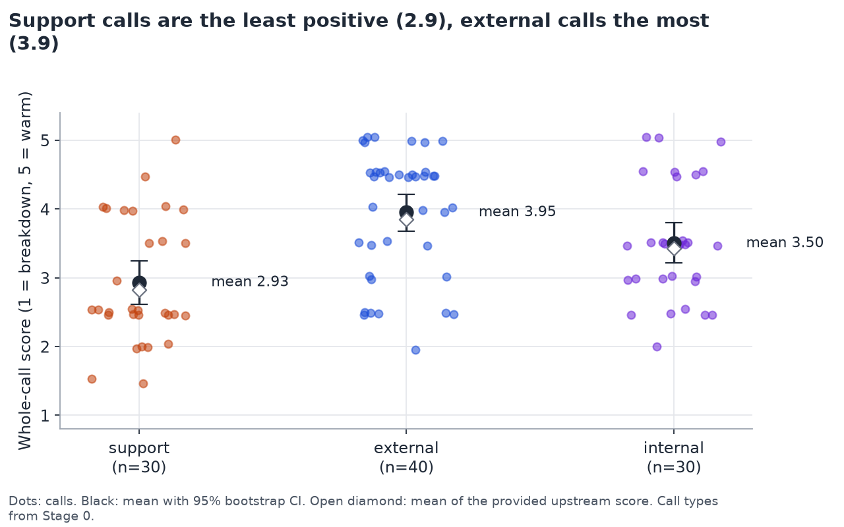
Support calls are the least positive, and customers carry the negativity
TASK 2 · SENTIMENT BY CALL TYPE
−1.02
support minus external, 95% interval −1.43 to −0.59. Still −0.75 with the title-rule labels.
35% vs 2%
of customer and staff turns are negative in support calls. The customer is more negative in 22 of 30.
Track the customer-side score, not the call average.
Source: 100 calls, our pipeline
Notes:
[~2:00] Whole-call score on a 1 to 5 scale, defined for all 100 calls: support 2.93, external 3.95, internal 3.50. The gap between support and external is a full point and survives the sensitivity check where we use the title-rule call types instead of ours. Inside support calls, customers are negative on about 35 percent of their turns against about 2 percent for staff. So what for the support lead: the customer-side score, not the call average, is the signal, and each call type should be compared only with its own baseline. Honest limit: support calls exist because something went wrong, so low sentiment partly describes what the call is for, not how well it was handled. The internal-versus-other-type differences are fragile and we do not claim them. Likely question: how do you know your sentiment scorer is any good? Answer: it tracks the provided score at 0.96 correlation and agrees with provided sentence labels on 79.6 percent of turns, which is consistency with an upstream AI output; my own check is a hand-scoring of 15 calls (small; I can't confirm I stayed blind to the model's answers): all within half a point of the model, 9 exact (my-own-check slide). Sources: docs/analysis-sentiment.md finding 1 (means R); findings.json H1 (intervals, p-values, gap: analysis code, bootstrap 10,000 resamples, seed 20261029); fig1_by_type.png. Footer sources (files): docs/analysis-sentiment.md (means and gap recomputed; intervals and the 35% vs 2% from analysis code); outputs/analysis/sentiment/fig1

Slide 9
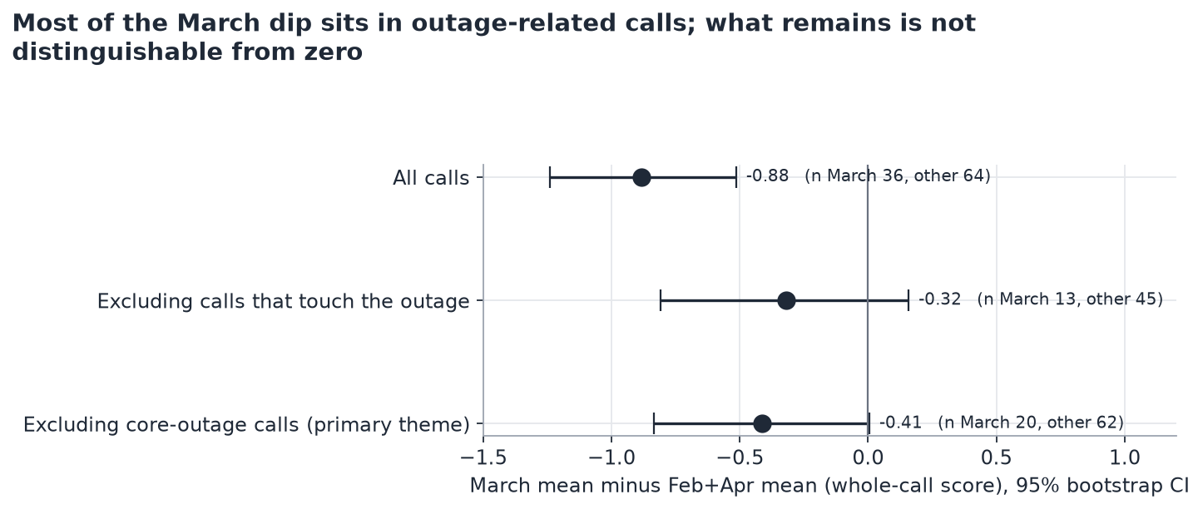
The March dip sits in the outage: calls that touch it score 2.57, the rest 3.62
TASK 2 · THE MARCH DIP
Feb
Mar
Apr
3.71
2.94
3.91
Inside March, the 23 outage-touching calls average 2.57 and the other 13 average 3.62.
Remove the outage calls and the dip shrinks to −0.32, with an interval (−0.81 to +0.16) that includes zero.
Mostly the outage, but 13 calls cannot rule out more.
Why it matters: the outage, not a general slide, explains most of the dip, and the cost shows across call types.
Source: 100 calls, our pipeline
Notes:
[~2:00] Monthly mean whole-call score: February 3.71 over 26 calls, March 2.94 over 36, April 3.91 over 38. Within March the outage-touching calls average 2.57 against 3.62 for the rest. The chart shows March minus the other months: minus 0.88 for all calls; once we remove the calls that touch the outage the estimate shrinks to minus 0.32 and its interval spans zero. So what for engineering and support leadership: the outage, not a general slide, explains most of the dip, and the cost shows up as a quantifiable tone drop across call types, not only in support. Caveats to say out loud: the incident flag is an LLM judgment, partly definitional; in my 20-call check it missed 3 (never over-flagged), so 42 is probably a floor (it covers 64 percent of March calls), so the explanation is partly definitional, since a call about an outage is tense. Only 13 March calls remain after exclusion, so a residual dip cannot be ruled out. Call dates are partly inconsistent with content, so we do not do date-based before/after on accounts. Likely question: is the outage the cause? Answer: we say mostly explains, not caused. Sources: docs/analysis-sentiment.md finding 2 (Feb 3.71, Mar 2.94, Apr 3.91 and 2.57 vs 3.62 recomputed); findings.json H2 for the intervals; fig3_dip.png. Footer sources (files): docs/analysis-sentiment.md finding 2 (monthly means and March split recomputed; intervals from analysis code); outputs/analysis/sentiment/fig3

Slide 10
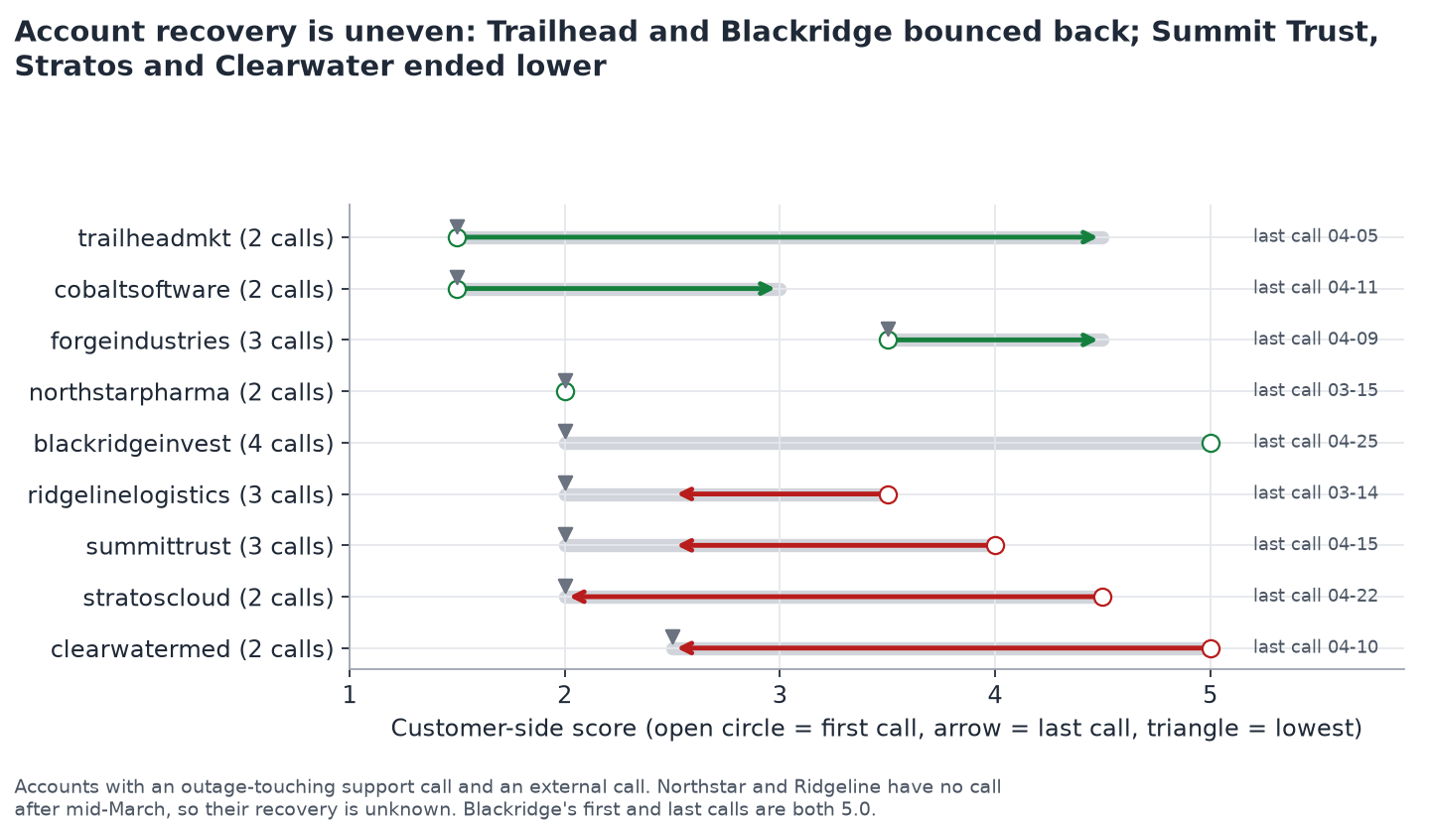
The outage touched all three call types, and account recovery was uneven
TASK 2 · THE OUTAGE ACROSS CALL TYPES
42 calls touch it
10 support, 18 external, 14 internal. It peaks the week of March 9.
4.37 → 2.63 → 4.21
external call score before, during and after the acute weeks.
Four accounts ended lower and three higher. Northstar and Ridgeline have no call after mid-March, so their recovery is unknown.
Why it matters: averages hide accounts; these nine ended in different places and need different follow-up.
Source: 100 calls, our pipeline
Notes:
[~2:00] The outage is not a support-only story. Forty-two calls touch it: 10 support, 18 external, 14 internal. External calls before March 10 average 4.37, during the acute weeks 2.63, and in April 4.21, so on average the external relationship recovered. The chart zooms into nine accounts that had both an outage-touching support call and an external call: Trailhead, Cobalt and Forge ended higher; Summit Trust, Stratos, Clearwater and Ridgeline ended lower; Blackridge is flat with a dip; Northstar and Ridgeline have no call after mid-March (Northstar is on the 11-call risk list; Ridgeline fell from 3.5 to 2.5 but is not on it). So what for account managers: averages hide accounts; these nine ended in different places and need different follow-up. Caveats: each account has only 2 to 4 calls with different purposes, so these are leads, not conclusions. Call dates are partly inconsistent with content (a March 9 call already discusses the outage), so we use March 10 as the boundary and avoid account-level date comparisons beyond this chart. Likely question: does recovery mean the customer is happy? Answer: it means the tone of the last call, nothing about renewal. Sources: docs/analysis-sentiment.md finding 3 (analysis code, not recomputed by hand); findings.json q3_outage; fig5_accounts.png. Footer sources (files): docs/analysis-sentiment.md finding 3 (all figures from analysis code; 2 to 4 calls per account); outputs/analysis/sentiment/fig5

Slide 11
Competitors come up most in outage calls (74% vs 42%), and the March spike reverted in April
TASK 3 · COMPETITIVE INTELLIGENCE
31 of 100
Calls naming each competitor
SentinelShield
22
calls name a competitor: 17 external, 10 internal, 4 support.
VaultEdge
12
CyberNova
8
74% of those calls are outage-related, against 42% of all calls. By month: 6 of 26 in Feb, 16 of 36 in Mar, 9 of 38 in Apr.
Fortiguard
3
“VaultEdge was on our shortlist for a while, and we did a pretty deep evaluation of CyberNova too, but honestly their backup restore times were just... not great for our use case.”
Why it matters: product and sales can see which capabilities customers compare (here, backup restore times) when an incident strains the relationship.
Source: 100 calls, our pipeline
Notes:
[~1:30] Nobody asked for this one. Thirty-one of 100 calls name a competitor: SentinelShield in 22, VaultEdge in 12, CyberNova in 8, Fortiguard in 3. The calls that mention a competitor are much more likely to be outage-related, 74 percent against 42 percent for all calls, and by month the share of calls naming a competitor rises from 6 of 26 in February to 16 of 36 in March and 9 of 38 in April. So what for product managers and sales leadership: competitors come up most in outage-related calls, and the March spike reverted in April, so treat it as a lead, not proof of lasting damage. The customer quote on the slide is a verbatim sentence from an external call. Caveat: the competitor names came from a proper-noun scan plus a manual check, not from a given list, so a missed competitor is possible. A mention is not a loss. Likely question: is this not just the outage? Answer: it is connected to it, which is the point; this view tells product which capabilities customers compare (here, backup restore times). Sources: docs/analysis-candidates.md E; competitor counts recomputed by string count (31 calls; SentinelShield 22, VaultEdge 12, CyberNova 8, Fortiguard 3; split by type 17/10/4); 74 percent vs 42 percent and monthly counts from analysis code. Footer sources (files): docs/analysis-candidates.md candidate E (counts recomputed; 74% vs 42% from analysis code). Competitor names found by a proper-noun scan plus a manual check.

Slide 12
Outage-touching calls score about a point lower in every call type
TASK 3 · OUTAGE BLAST RADIUS
■ Touches the outage
■ Does not
11 of 14
renewal calls involve the outage
External
3.36
9 of 11
4.43
Detect support cases involve it
Internal
3.14
2.35
3.81
weekly mean in the week of March 9: 13 calls, all outage-related
Support
2.25
3.28
Mean whole-call score, 1 to 5. 22 of 32 customer accounts had at least one outage-related call.
Source: 100 calls, our pipeline
Notes:
[~1:30] This view puts the outage on one page for engineering, support and executives. Twenty-two of 32 customer accounts had at least one outage-related call, and the calls are spread across all three types. Within each call type, calls that touch the outage score about a point lower: external 3.36 against 4.43, internal 3.14 against 3.81, support 2.25 against 3.28. Eleven of 14 renewal-theme calls and 9 of 11 Detect support cases involve the outage. So what: the commercial and operational cost of an incident can be read from calls without waiting for a survey. Caveats: figures come from analysis code and the flag is an LLM judgment, partly definitional; in my 20-call check it missed 3 (never over-flagged), so 42 is probably a floor; calls about an outage are tense by definition, so the lower scores are partly definitional and not shown to be caused by the outage. We deliberately do not show the per-account date-based before and after (3.88 to 3.40), because the outage call is itself the after, which biases it. Likely question: is a point on this scale a lot? Answer: it is one level of the anchor scale, roughly the difference between strained and neutral or constructive. Sources: docs/analysis-candidates.md A (22 of 32 accounts; tone by type; 11 of 14; 9 of 11; week of March 9 at 2.35 with 13 calls); docs/analysis-themes.md (11 of 14 renewals recomputed). Footer sources (files): docs/analysis-candidates.md candidate A (figures from analysis code, not recomputed by hand); renewals 11 of 14 recomputed in docs/analysis-themes.md

Slide 13
A list of external accounts for a person to follow up, not a prediction
TASK 3 · ACCOUNT FOLLOW-UP LIST
11 of 40 external calls score 3 or more out of 4 (in no particular order)
One point for each signal
Northstar
Meridian
Helix Data
Quantum Edge
Low customer tone
Tone falling during the call
The customer raises a competitor
The call concerns the outage
Summit Trust
Ironworks
Nova Retail
Ironclad
Brightpath
Steelpoint
Cobalt
“If I don’t have something substantially better to bring to my CISO before that renewal conversation, I don’t know that we’re going to be renewing.” Northstar
No churn outcome exists to check this against. The signals overlap. The tone of the top calls mostly recovers by the end of the call.
Source: 100 calls, our pipeline
Notes:
[~1:30] This is the action list, built from the same fields as the last two slides. For the 40 external calls we count four signals, one point each: low customer tone, tone falling within the call, the customer raising a competitor, and the call concerning the outage. Eleven calls score 3 or more. They are listed with no ranking implied. Northstar is on the list; Ridgeline fell from 3.5 to 2.5 across its calls but is not on it. All eleven also carry a churn-signal moment in the upstream data, which we use only as a comparison. So what for sales managers: this is a place to start conversations this week, not a forecast. Caveats on screen: there is no churn or renewal outcome in the data, so we cannot validate it; the signals overlap, since the competitor flag fires on 24 of the 40 calls; and in the highest-risk calls the tone mostly recovers by the end. Likely question: why not a model? Answer: with 40 calls and no outcome label a transparent index you can audit beats a model you cannot. Sources: docs/analysis-candidates.md B (40 calls, 11 at 3 or more, names listed, Northstar quote); analysis code. Footer sources (files): docs/analysis-candidates.md candidate B (index and list from analysis code; not recomputed by hand)

Slide 14
What we would not claim from 100 calls
LIMITATIONS
We would not claim | Because
Sentiment predicts churn | There are no outcome labels, so nothing can be validated.
The outage caused the whole dip | The flag is an LLM judgment, partly definitional; in my 20-call check it missed 3 (never over-flagged), so 42 is probably a floor; only 13 March calls remain once outage calls are removed.
Internal calls differ from the others | The gap is fragile under the title-rule labels.
Calls ending warmer means satisfied | The calls follow a script, and the rubric rewards relief after a fix.
Anything about one account | Each has only 2 to 4 calls with different purposes.
Agreement with the upstream score is accuracy | It is an AI output, so agreement shows consistency only.
Also: the data appears synthetic, some call dates disagree with their content, and there is no ground truth beyond our own review.
Source: 100 calls, our pipeline
Notes:
[~1:30] Six claims we deliberately do not make, each with the reason. This slide is credibility, not apology: we would rather lose a headline than defend a number the data cannot support. Add the three data caveats: the data appears synthetic, call dates sometimes disagree with content (for example a March 9 call discussing the outage in the past tense), and we have no ground truth beyond my own review (small; I can't confirm I stayed blind to the model's answers). So what: it tells leadership which findings to act on now (customer-side score, the outage reach, competitor mentions) and which to validate first (churn, individual accounts). Likely question: what would make you more confident? Answer: outcome data (renewals, churn) and a larger hand-checked sample. Sources: docs/analysis-sentiment.md section “What I would not claim”; docs/analysis-candidates.md data caveats; DECISIONS.md A20 caveats. Footer sources (files): docs/analysis-sentiment.md (“What I would not claim”); docs/analysis-candidates.md data caveats

Slide 15
One action for each stakeholder, and a path to run this for real
RECOMMENDATIONS
Support lead
Sales manager
Track the customer-side score per call type, and review the 16 calls that still end at 2.5 or below.
Work the follow-up list of 11 external calls, and start with accounts that have no call after mid-March.
Product manager
Engineering lead
Review the 31 calls that name a competitor, starting with SentinelShield, named in 22.
Use the 42 outage-touching calls as the customer-impact record for the postmortem.
To run it for real: version the taxonomy and anchors, watch the share of calls in Other and the score distribution for drift, re-run a stage whenever a prompt or model changes, and keep tracing available (a hook is built in, off by default).
Source: 100 calls, our pipeline
Notes:
[~2:00] One concrete action per stakeholder, each tied to a number you have just seen. Support lead: customer-side score by call type; 16 calls still end at 2.5 or below, which is the unresolved-at-the-end list. Sales manager: the follow-up list, beginning with accounts with no call after mid-March (Northstar is on the 11-call list; Ridgeline fell from 3.5 to 2.5 but is not on it). Product manager: the 31 competitor-mentioning calls, SentinelShield first. Engineering lead: the 42 outage-touching calls are a ready customer-impact record for the postmortem. Then the production path in one breath: the taxonomy and the anchors are versioned, a growing Other bucket or shifting score distribution signals drift, any prompt or model change re-runs that stage for all calls, and tracing is a hook that is off by default. So what: decisions for each role, plus the controls that stop the system silently changing meaning. Likely question: what would you build next? Answer: validate the follow-up list against real renewal outcomes, and add the drift monitor. Sources: docs/analysis-sentiment.md finding 4 (16 calls at 2.5 or below: 10 support, 4 external, 2 internal; analysis code); docs/analysis-candidates.md B, E, A (11, 31 and 22, 42); DECISIONS.md D5 (tracing hook, replay), D8. Footer sources (files): docs/analysis-sentiment.md (16 calls), docs/analysis-candidates.md (11, 31, 22), DECISIONS.md D5, D8

Slide 16
Four models tested on our data, one flawed rule caught, and a cache for reproducibility
HOW WE CHOSE THE MODEL AND CHECKED OURSELVES
The bake-off
The choice
The catch
475 calls, $1.63
One model for every stage
Temperature 0 is not deterministic
Our decision rule scored format, not correctness, so it picked the cheapest model. We caught that and overrode it.
Gemini 3.8 Flash with a pinned provider. It was the only candidate that lists temperature and seed as supported.
Identical output on 0 of 3 transcripts for two models and 2 of 3 for Gemini. So reproducibility comes from the committed cache.
Run-to-run on 20 calls: primary theme identical on 20 of 20; call score differs by 0.075 on average.
Source: docs/bakeoff-report.md; DECISIONS.md D7, A17, A20
Notes:
Appendix, for questions. How we picked the model and how we checked ourselves. We ran four models on our own data: Stage 0 on all 70 customer calls and Stages 1 and 2 on a 15-call sample, 475 calls in total for $1.63. We had written a decision rule in advance; it scored format validity, quote validity and stability, never correctness, so every model passed and the rule reduced to cheapest. We noticed that, looked at the two calls where models disagreed, and overrode the rule. Say it as a design flaw found and fixed, not hidden. Then the finding that shapes the system: setting temperature to 0 did not make outputs identical. Two of the models gave identical output on none of three test transcripts at Stage 2; Gemini on two of three. So we cannot promise that a re-run reproduces a run exactly. Reproducibility comes from the committed cache of raw answers, plus pinned model, provider and prompt versions. The 20-call re-run shows the practical stability: primary theme identical on 20 of 20 and call scores 0.075 apart on average. So what: the system is auditable (every answer cached with its quote) rather than bit-exact reproducible by re-querying. Likely question: why not Claude? Answer: on this task the sample could not separate the strongest candidates on quality, so we chose on measured format and determinism features and cost; Sonnet remains the hedge if final prompts separate models more. Sources: docs/bakeoff-report.md (475 calls, $1.63, determinism probe); DECISIONS.md D7 and A17 (override), A20 (stability: theme 20 of 20, MAD 0.075).

Slide 17
Every choice is logged with its reason and its rejected alternatives
APPENDIX · DECISION LOG
ID | Decision | In one line
D1 | Call type | Metadata for internal; an LLM reads the opening for the rest; title withheld.
D2 | Sentiment | LLM score 1 to 5, whole call for all 100 plus customer side, transcript only.
D3 | Themes | Discover once, freeze a versioned taxonomy, classify every call with a quote.
D4 | Synthetic data | None generated.
D5 | Stack | Python, OpenRouter, committed cache, replay mode, tracing hook off by default.
D6 | Bonus insights | Competitors, outage reach, account follow-up list; commitment tracking described only.
D7 | Model | Gemini 3.8 Flash for every stage, provider pinned; our own rule overridden.
D8 | Taxonomy and anchors v1 | LLM-proposed, finalised with AI assistance under my delegation; frozen.
Source: DECISIONS.md section C (D1 to D8); the full log records actions A1 to A21
Notes:
Appendix, for questions. Each row is a locked decision in DECISIONS.md with its reasoning, the alternatives we rejected and the known weakness. Two revisions are worth knowing: D1 was first a title-only rule and was rewritten as a pipeline stage after a challenge that manual overrides are not a pipeline step; D3 originally said embed and cluster, and was revised because clustering is a one-time discovery technique, not a recurring stage. D8 is disclosed as finalised with AI assistance. Sources: DECISIONS.md D1 to D8 and actions A1 to A21.

Slide 18
My review of 15 Stage 0 calls agreed with the model on all 15
APPENDIX · STAGE 0 REVIEW
Group | Items | Agree with model | Agree with title rule
Model and title rule disagreed (Blackridge, Cobalt, Northstar escalations) | 3 | 3 (all support) | 0
Two models disagreed (Northstar “Urgent”, Quantum Edge “Renewal Concerns”) | 2 | 2 (both external) | 2
Seeded sample of agreements | 10 | 10 | 10
Total | 15 | 15 | 12
The title rule is wrong on 3 of 70 customer calls (4.3%). Final labels: 30 support, 40 external, 30 internal.
Caveats: 15 items is small; only 10 of 55 agreements were checked; I had seen the two disputed calls discussed before reviewing them.
Source: eval/stage0_review_verdicts.json; outputs/stage0_final.csv; DECISIONS.md A18
Notes:
Appendix. The three groups, the totals and the caveats from DECISIONS.md A18. The seeded sample of 10 agreements was drawn by the pipeline, not chosen by hand. Verdicts were captured in the Review Console (blind mode is on by default, but I can't confirm I stayed blind to the model's answers). Sources: eval/stage0_review_verdicts.json (n=15; 15 agree with model; 12 agree with title rule); outputs/stage0_final.csv (support 30, external 40, internal 30). Caveat to say aloud: this is my own review (small; I can't confirm I stayed blind to the model's answers), and I had already seen the assistant's reading of the two calls where the models disagreed, so those two are not clean; only 10 of the 55 agreeing calls were checked.

Slide 19
Every stage returned valid output; agreement with upstream labels is consistency, not accuracy
APPENDIX · VALIDATION METRICS
Stage | Measure | Result
Stage 0 | Schema-valid, exact quote, run-to-run label agreement | 100%, 98.6% (2 of 140), 100%
Stage 1 | Valid output; quote exact; 20-call re-run, primary theme | 100 of 100; 99 of 100; 20 of 20 identical
Stage 2 | Valid first attempt; 20-call re-run, call-score difference | 100 of 100; 0.075 on average
Stage 2 | Per-turn label agreement between runs | 92.9% over 860 turns
Stage 2 | Sentence-level agreement with provided labels | 79.6% over 4,313 turns
Stage 2 | Correlation with the provided call score | 0.963; mean difference 0.23
Discovery | Theme overlap between two separate runs | 0.37 average; 4 themes above 0.5
Source: DECISIONS.md A17, A20; docs/bakeoff-report.md; outputs/stage12_metrics.json. Hand-check results for Stages 1 and 2: DECISIONS.md A23.
Notes:
Appendix. Rows come from DECISIONS.md A17 and A20 (eval/stage12_report.py into outputs/stage12_metrics.json; discovery overlap from outputs/stage1/stability.json). Emphasise: discovery was unstable across runs, which is why a human-level judgment froze the taxonomy; and agreement with provided labels is consistency with an upstream AI, not accuracy. The provided labels are an upstream AI output; the model labels 68.1% of turns neutral against 56.3% provided. Hand-check results for Stages 1 and 2 are on the my-own-check slide (DECISIONS.md A23).

Slide 20
The 1 to 5 scale rests on 13 design choices, each with a known risk
APPENDIX · SCORING ANCHORS
A whole-call score exists for all 100 calls.
Each level is defined by checkable cues.
Tone, not topic.
Courtesy is neutral; it may under-read warm staff.
Half steps; tie goes lower if a problem is open at the end.
A stated risk of leaving is a 2; an ultimatum is a 1.
The end of the call matters.
Trajectory counts turns, not minutes.
Every turn gets a label.
Reasoning is allowed; the quote must be verbatim.
The scorer sees transcript, speakers and sides only.
Anchors were not tuned on the provided scores.
Changing the anchors means re-scoring every call.
Biggest risk: the tie-break pulls borderline calls down and mixes tone with outcome. We disclose it.
Source: prompts/stage2_v1.md (design choices); DECISIONS.md D8
Notes:
Appendix. The 13 design choices abbreviated from prompts/stage2_v1.md. Defend three: the tie-break toward the lower level, courtesy counted as neutral (444 turns the provided labels call positive we call neutral, 380 of them staff turns; docs/analysis-sentiment.md finding 5), and a stated risk of leaving scoring a 2 rather than a 1.

Slide 21
Terms used in this deck
APPENDIX · GLOSSARY
Term | Meaning
Call score | Tone of the whole call on a 1 to 5 scale, defined for all 100 calls.
Customer score | The same scale on customer turns only; 70 calls have a customer.
Touches the outage | Incident flag: the March Detect outage is a major part of the call (42 calls).
Core outage | The outage is the primary theme (18 calls).
Title rule | Baseline: titles starting “Support Case” are support. Used as a cross-check only.
Frozen taxonomy | The versioned theme list (v1); changing it re-runs every call.
Replay | Re-running from cached raw model answers, with no API key.
Upstream AI output | The summary, topics and scores shipped with the data; comparison only.
Source: DECISIONS.md D1, D3, D8, A20; docs/analysis-themes.md
Notes:
Appendix reference. Definitions as used in DECISIONS.md and the analysis docs.

