Slide 1

Dynamic Beamforming Optimization Using Genetic Algorithm for Mobile Devices, Fleets, and Drones in Multi-Antenna Systems
ITU WTSA-24
Hackathon
Srikanth Saravanan
Prasanna Karthikeyan
Syed Azim
Kaythry P (Mentor)

Slide 2
Introduction
Context
Dynamic environments (mobile devices, fleets, drones) challenge traditional beamforming methods.
Maintaining strong, uninterrupted wireless connectivity is critical.
Objectives
Optimize beamforming in real time using a genetic algorithm.
Adjust antenna configurations dynamically to ensure consistent signal strength.
Key Approach
Use historical antenna weight values and signal strength data.
Predict optimal weight adjustments for continuous monitoring and connectivity.

Slide 3
Problem Statement
Current Challenges
Traditional static or slow-adaptive beamforming methods struggle to maintain optimal connectivity when devices (e.g., mobile devices, fleets, drones) are in motion.
Impact
Signal degradation and dropped connections in dynamic environments.
Reduced communication efficiency, especially in real-time applications like transportation fleets and drone operations.
Use Case
Scenario: In operations involving fleets or drones, real-time beamforming adjustments are critical to maintaining strong, uninterrupted connectivity.

Slide 4
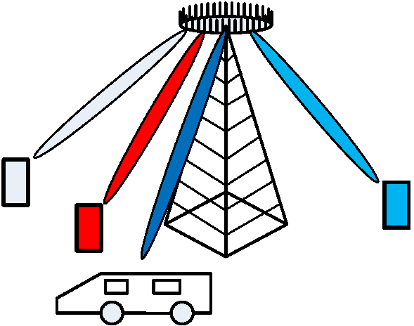
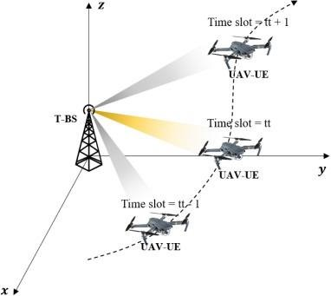
Problem Statement
Illustration:​
Dynamic Beam forming for moving vehicle
Dynamic Beam forming for Drones
Proposed Solution:​
Implement a genetic algorithm to dynamically adjust antenna weights based on signal strength.​
Ensure continuous optimization of beamforming as the device moves, without relying on exact positional data, enhancing connectivity in real-time.

Slide 5
Beamforming with URA Antenna
Uniform Rectangular Array (URA):
Antennas arranged in a grid, enabling 2D beam steering (azimuth and elevation).
Beamforming Concept:
Directs signals by adjusting the phase and amplitude of each antenna element.
URA allows better signal coverage by steering beams in two dimensions.
Real-Time Adjustments:
Algorithms (e.g., genetic algorithms) adjust beam directions dynamically to track moving targets (e.g., drones, vehicles).
Antenna Weight Formula for URA (Nx, Ny):
w(x, y) = exp(-j * (k * d_x * x * sin(θ) * cos(φ) + k * d_y * y * sin(θ) * sin(φ)))
θ: Elevation angle
φ: Azimuth angle
k: Wave number
d_x, d_y: Spacing between antenna elements in x and y

Slide 6
Reasons for Using Ackley function as fitness function and model for drone antenna beamforming
Global Minima & Antenna Orientation:
Ackley function's minima represent optimal antenna orientations for best signal reception/transmission.
Movement in Space:
Dynamic changes in Ackley function mirror a drone moving through varying conditions (signal strength, obstacles).
Complex Landscape:
Both involve navigating complex terrains (e.g., interference, multipath propagation).
Optimization:
Ackley seeks energy minima; the antenna system finds the best configuration for real-time adaptation to environmental changes.

Slide 7
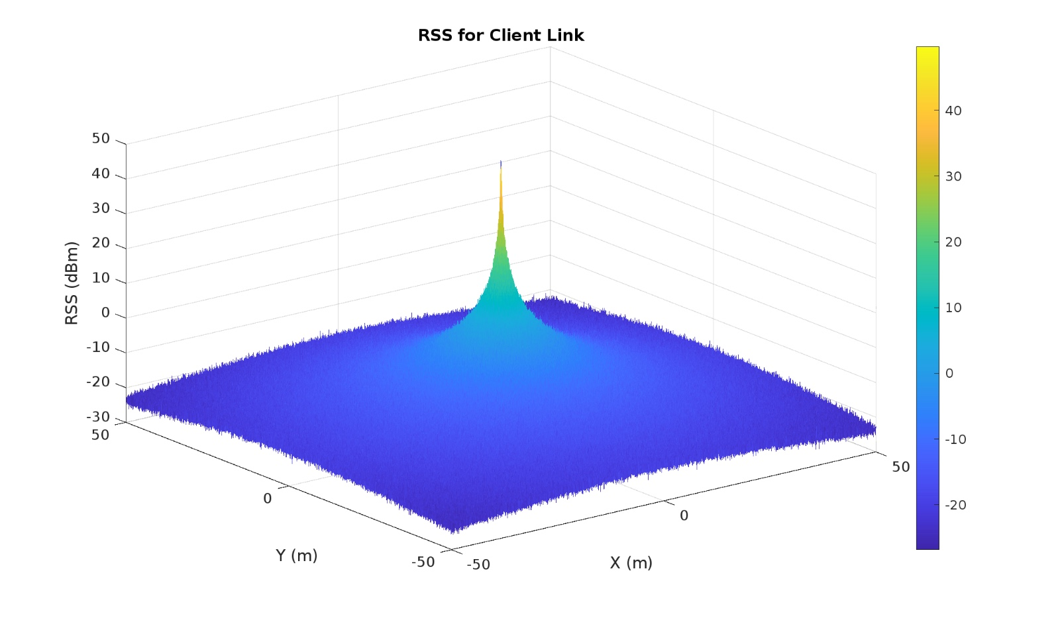
Proof that Ackley Function can be used for modelling RSS
An intuition from Free space Path loss model

Slide 8
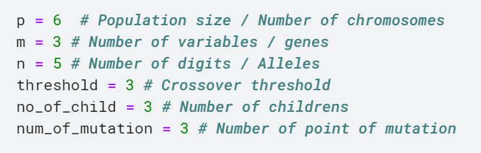
Genetic Algorithm Overview
Initialization:
The GA starts by initializing a population of potential solutions (antenna weight values). These solutions are initialized near the previous optimal weight configuration to ensure the search starts from a reasonable point in the solution space. If the previous optimal weight configuration is unavailable, then the search begins at a random point.

Slide 9
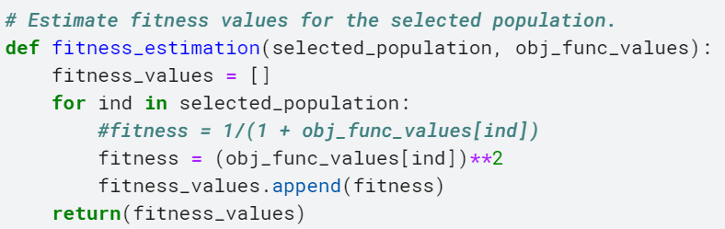
Genetic Algorithm Overview
2. Fitness Function:
The fitness of each solution is evaluated based on the signal strength obtained from the antenna configuration. Higher RSS (Received Signal Strength) signal strength results in higher fitness scores. This metric ensures that the algorithm is always optimizing toward the best connectivity for mobile devices, fleets, and drones. Here we use, the dynamic time-varying Ackley function to effectively model the challenges faced by a drone's antenna system as it navigates through different spatial and temporal conditions.

Slide 10
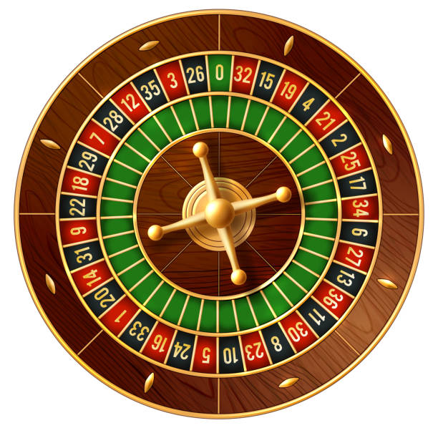
Genetic Algorithm Overview
3. Selection:
Individuals with better fitness (stronger signal strength) have a higher probability of being selected for reproduction. Rank based Roulette wheel approach is used for selection.

Slide 11

Genetic Algorithm Overview
RL Procedures
Exploit
4. Crossover: Portions of the antenna weight values from two-parent solutions are combined to create a new solution. This encourages the exploration of new configurations while regaining the properties of the parent.
Explore
5. Mutation: Mutation introduces small random changes to individual solutions. This step is crucial for maintaining diversity within the population and avoiding premature convergence on suboptimal solutions. Since vehicle motion can be abrupt and random, introducing some amount of randomness in the search process could prove to be beneficial.

Slide 12

Genetic Algorithm Overview
6. Adaptive Learning: As the GA operates, it learns from the historical weight values and signal strengths, enabling it to predict the next optimal weight configurations when the device, fleet, or drone moves again.
7. Error function: The Euclidean distance between the estimated genetic algorithm and the actual point of maximum signal strength is used as an error function

Slide 13


Relation to SDG
SDG 9: Industry, Innovation, and Infrastructure
• Develop efficient and reliable communication infrastructure (Target 9.1).
• Enhance technological capabilities for industrial diversification (Target 9.4).
• Foster innovation and entrepreneurship (Target 9.5).
SDG 11: Sustainable Cities and Communities
• Develop and implement sustainable transportation systems (Target 11.2).
• Enhance public transportation efficiency and accessibility (Target 11.2).
• Reduce the environmental impact of urbanization (Target 11.6).

Slide 14


Relation to SDG
SDG 12: Responsible Consumption and Production
• Implement efficient resource utilization and management (Target 12.2).
• Reduce electronic waste through optimized device performance (Target 12.5).
SDG 13: Climate Action
• Mitigate climate change through reduced energy consumption (Target 13.2).
• Promote sustainable technologies and practices (Target 13.3)

Slide 15
Relation to Standards
According to ITU Y.3601 – Autonomous Networks
An intelligent solution based on automatically optimized beam forming - providing seamless connectivity services for fast-moving mobile devices. Reinforcement modelling and inference, facilities parameters control policies decision, facilities adjustment actions implementation, result evaluation, and continuous optimization.
Optimal adjustment of antenna beamforming parameters with AI-enabled multi-dimensional analysis and prediction
The proposed solution aligns with ITU Y.3601 in several aspects:
Dynamic Beamforming: The recommendation emphasizes the importance of dynamic beamforming in wireless access systems.
Optimization Methods: ITU Y.3601 mentions optimization techniques, including genetic algorithms, for beamforming.
Multi-Antenna Systems: The recommendation addresses multi-antenna systems, which are crucial for dynamic beamforming.
Mobile Devices, Fleets, and Drones: ITU Y.3601 considers various wireless devices, including mobile devices, fleets, and drones.

Slide 16
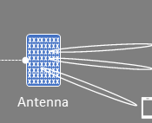
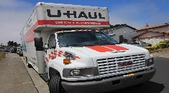
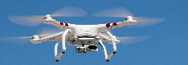

Near Real Time RAN Intelligent Controller (RIC)
Beamforming
Non Real Time RIC
AI/ML/GA
xApp
5G Core
A1
E2-CP
E2-DU
O-CU
O-DU
O-RU
This Photo by Unknown Author is licensed under CC BY-SA

Slide 17
Progress up to Demo 1
Ideation
Beamforming in URA antenna and codebook-based beamforming
Genetic Algorithm implementation for motion in a straight-line path with constant velocity in 3D space using a time-varying inverse Ackley function for a population size of 6.
Work to be done for upcoming Demo
Genetic Algorithm implementation with time-varying Ackley function with channel impairments
Analysis using real-time dataset
Working with varying motion, different velocities, accelerated, circular, helical motions.

Slide 18
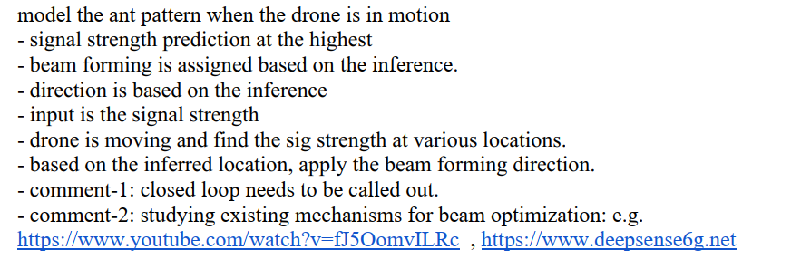
Feedbacks Addressed During Midnight Marathon

Slide 19
Feedbacks by mentors
ITU Y.3061 Framework
Rank-based Roulette Wheel approach for Genetic Algorithm Selection procedure
Emphasis on Ackley Function as Dataset
Why Genetic Algorithm? Why not other techniques?
What is the fitness function? How is RSS used in the fitness function of Genetic Algorithm
Assumption of feedback mechanism in existing structure
Assumption that direction of arrival of signal is known

Slide 20
DEMO 2

Slide 21
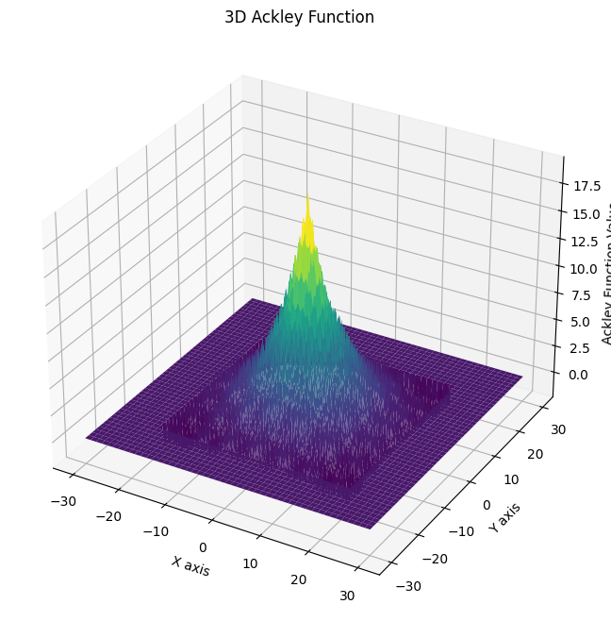
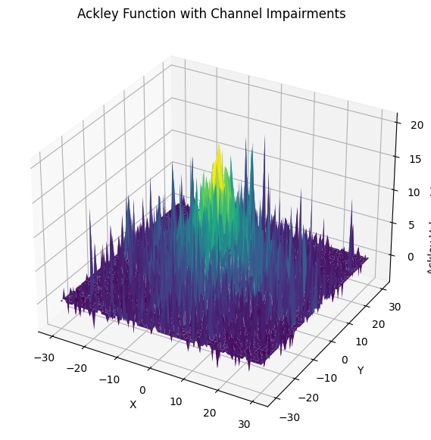
Time-Varying Inverse Ackley Function with channel impairments
Additive White Gaussian Noise (AWGN),
Rayleigh,
Rician,
Nakagami-m fading,
Co-channel interference
Modifications done
Time-Varying Inverse Ackley Function

Slide 22
Progress for Demo 2
Ideation
Beamforming in URA antenna and codebook-based beamforming
Genetic Algorithm implementation for motion in a straight-line path with constant velocity in 3D space using a time-varying inverse Ackley function for a population size of 6.
Genetic Algorithm implementation with time-varying Ackley function with channel impairments
Work to be done for Upcoming Demo
Analysis using real-time dataset
Working with varying motion, different velocities, accelerated, circular, helical motions.

Slide 23
Feedbacks given during Demo
Why use Genetic Algorithm?
Is Ackley function sufficient to model real environment channel impairments?
Considerations distance between multiantenna system
Consideration of cost function?

Slide 24
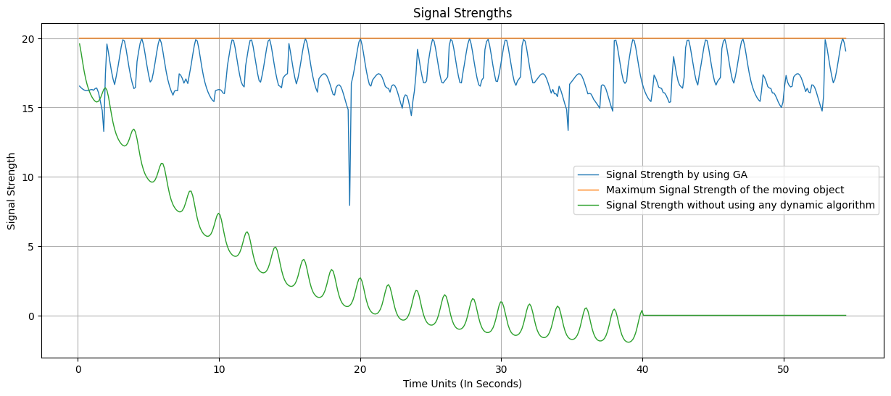
Constant Velocity 0.5 units/s – Signal Strengths Output

Slide 25
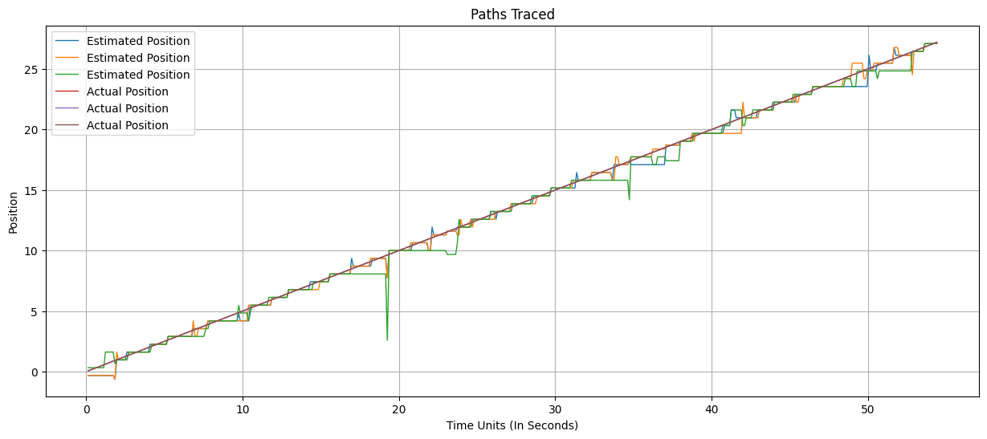
Constant Velocity 0.5 units/s - Path Traced Output

Slide 26
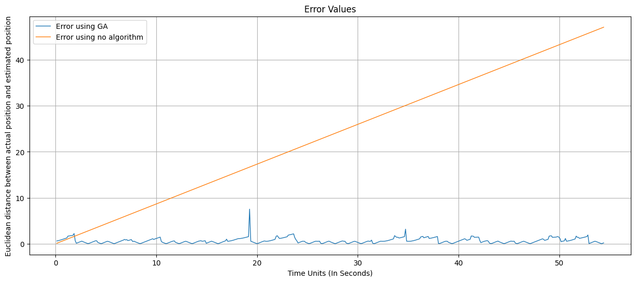
Constant Velocity 0.5 units/s - Error Values

Slide 27
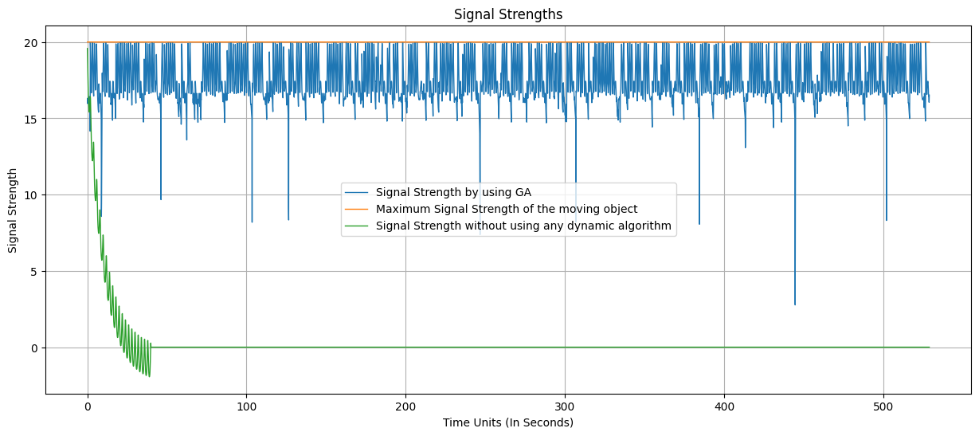
Constant Velocity 0.5 unit/s - Signal Strength for 500s

Slide 28
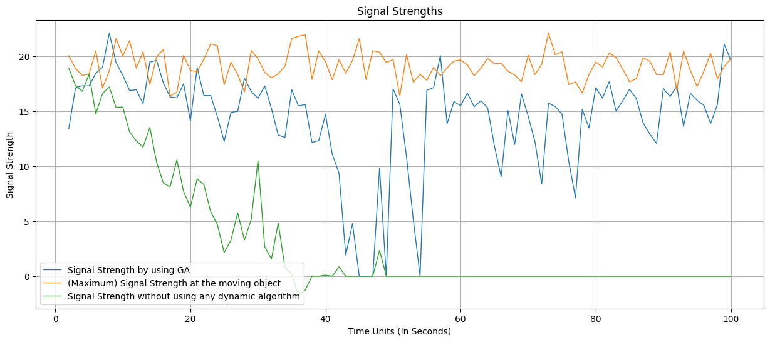
Accelerated Motion 0.1unit/s² – Signal Strengths Output

Slide 29
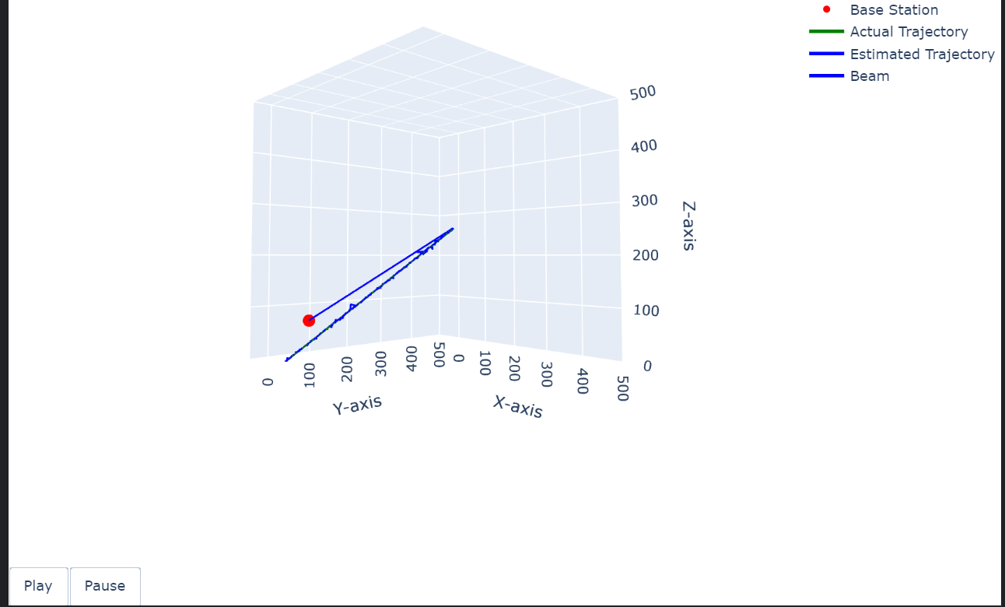
Accelerated Motion 0.1unit/s² – Signal Strengths Output

Slide 30
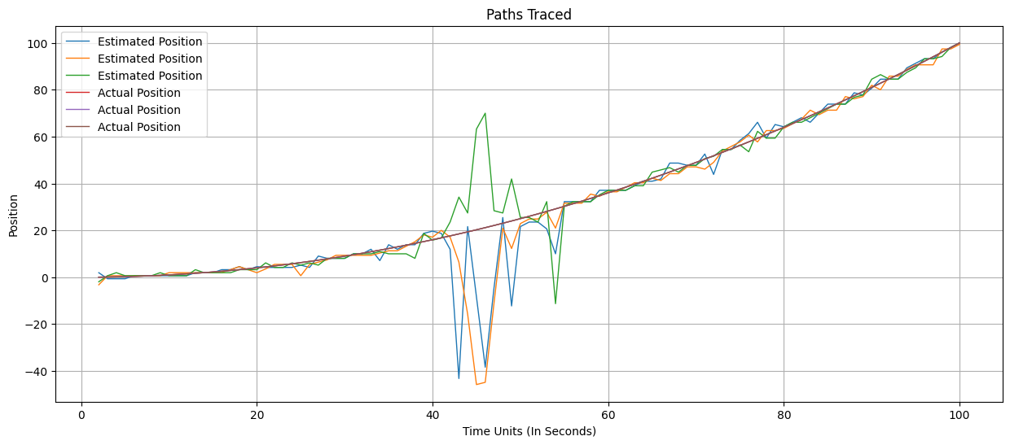
Accelerated Motion 0.1unit/s² - Path Traced Output
Interesting Note: Although the GA loses track of function at time t=37 and t=57, it can track it back within the next 2-3 seconds. This is because of the magical properties of dynamic range and mutation. If population size is increased, this property can be mitigated.

Slide 31
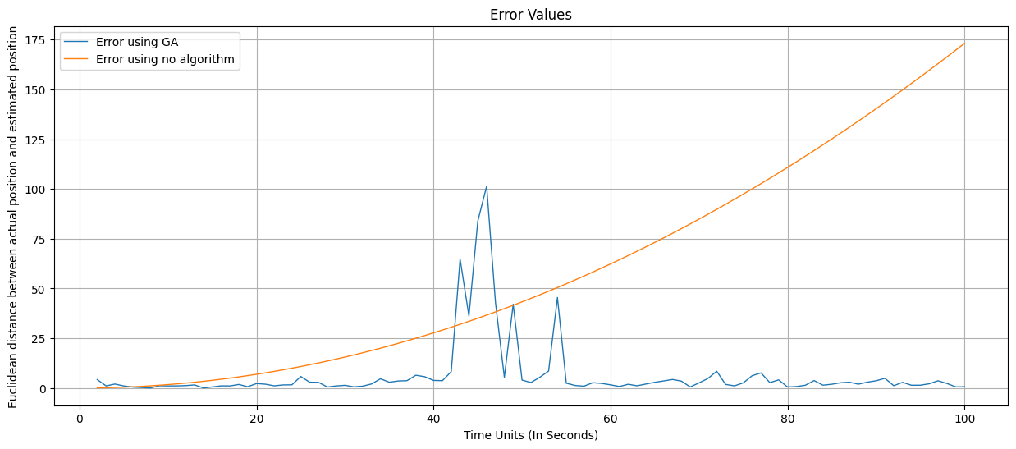
Accelerated Motion 0.1unit/s² - Error Values

Slide 32
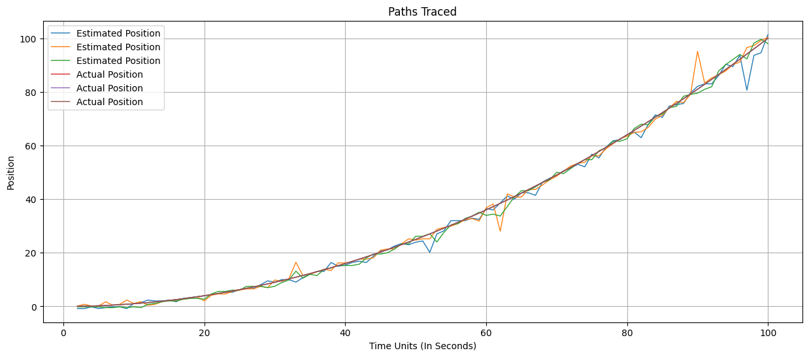
Accelerated Motion 0.1unit/s² - Path Traced Output
(Population size increased from 6 to 10)

Slide 33
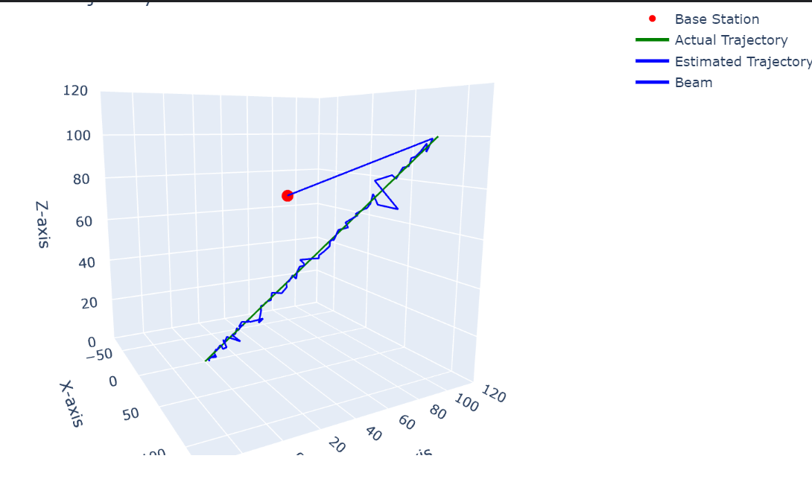
Accelerated Motion 0.1unit/s² - Path Traced using Genetic Algorithm
(Population size increased from 6 to 10)

Slide 34
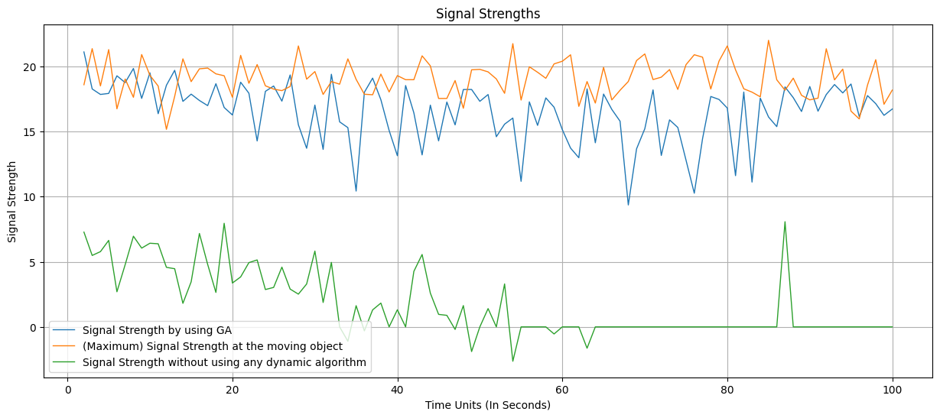
Helical Motion – Signal Strengths Output Radius: 10 units, Velocity: 0.2 unit/s

Slide 35
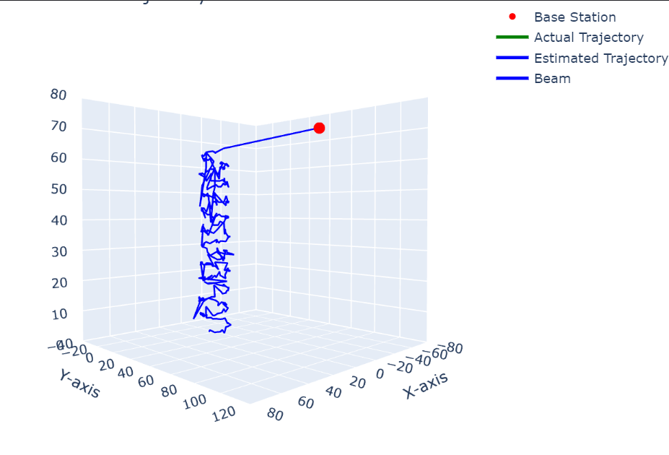
Helical Motion – Paths Traced Using Genetic Algorithm Radius: 10 units, Velocity: 0.2 unit/s

Slide 36
DEMO 3

Slide 37

Objectives Completed
Use Case
Dynamic environments (mobile devices, fleets, drones) challenge traditional beamforming methods.
Maintaining strong, uninterrupted wireless connectivity is critical.
Objectives
Optimize beamforming in real time using a genetic algorithm.
Adjust antenna configurations dynamically to ensure consistent signal strength.
Key Approach
Use historical antenna weight values and signal strength data.
Predict optimal weight adjustments for continuous monitoring and connectivity.

Slide 38
Progress Completed
Ideation
Beamforming in URA antenna and codebook-based beamforming
Genetic Algorithm implementation for motion in a straight-line path with constant velocity in 3D space using a time-varying inverse Ackley function for a population size of 6.
Genetic Algorithm implementation with time-varying Ackley function with channel impairments
Working with varying motion, different velocities, accelerated, circular, helical motions.
Work to be done
Analysis using real-time dataset

Slide 39
THANK YOU !

