Slide 1

Library Services

Slide 2
Introduction
Full Stack Application – Library Services .
A library management system is an application that is designed to manage all the functions of a library. It helps librarians to maintain the database of new books and the books that are borrowed by members. This system completely automates all your library's activities.
The basic functions of library management include overseeing all library operations and managing data.

Slide 3
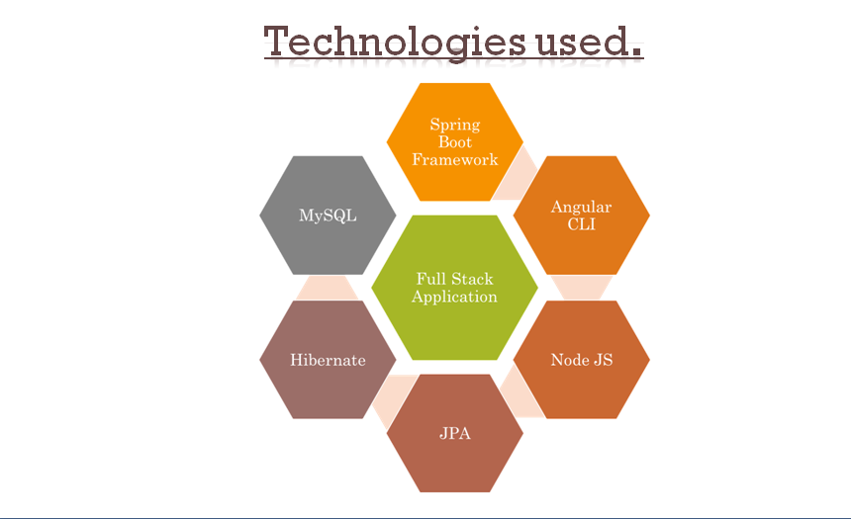
Technologies Is Used

Slide 4
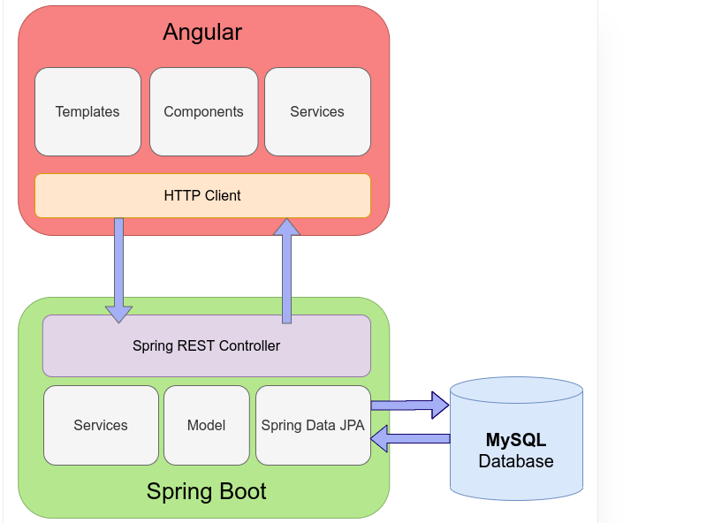
The Architecture of Angular, Spring & MySQL

Slide 5
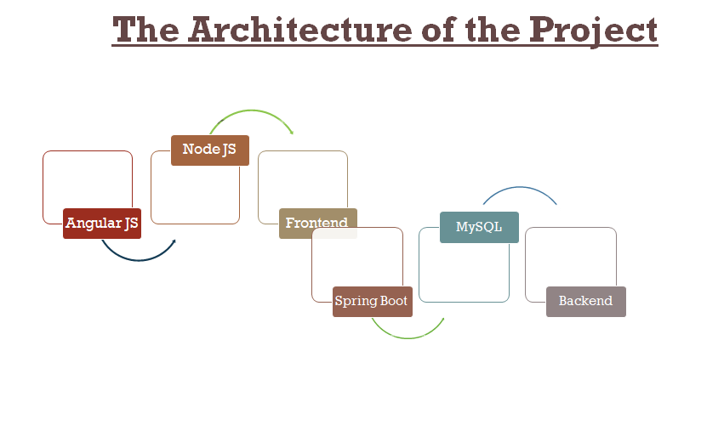

Slide 6
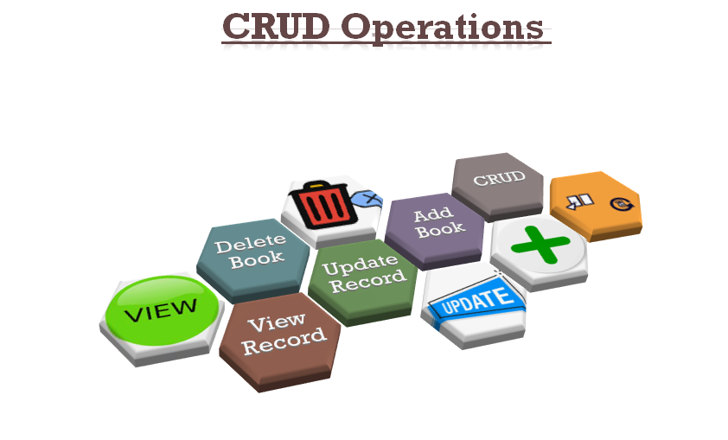

Slide 7
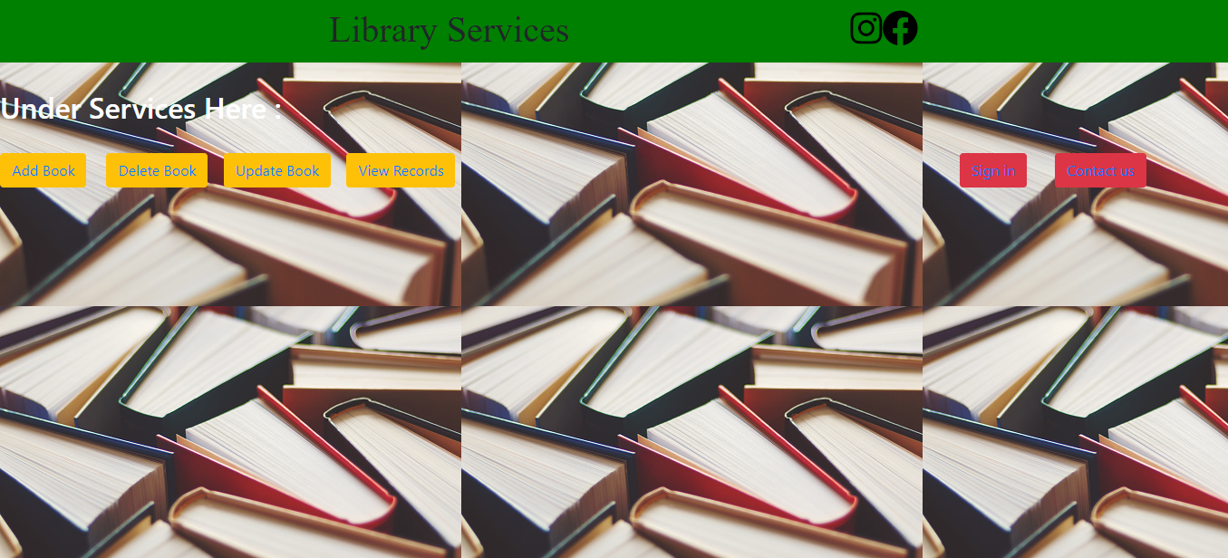
Home Page

Slide 8

Services Page

Slide 9


Add And Delete Page

Slide 10
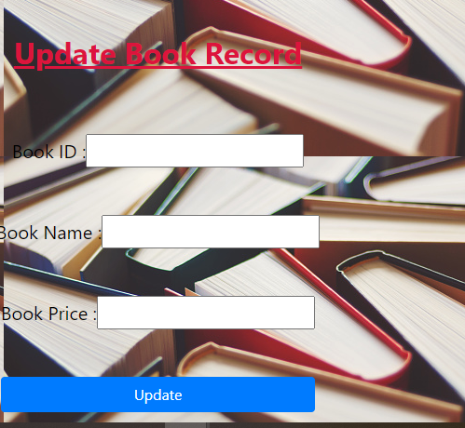
Update Page

Slide 11
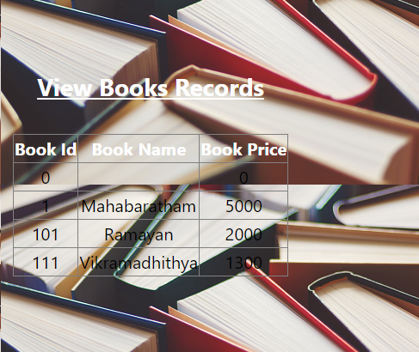
View Details Page

Slide 12


Contact Page And Log In Page

Slide 13
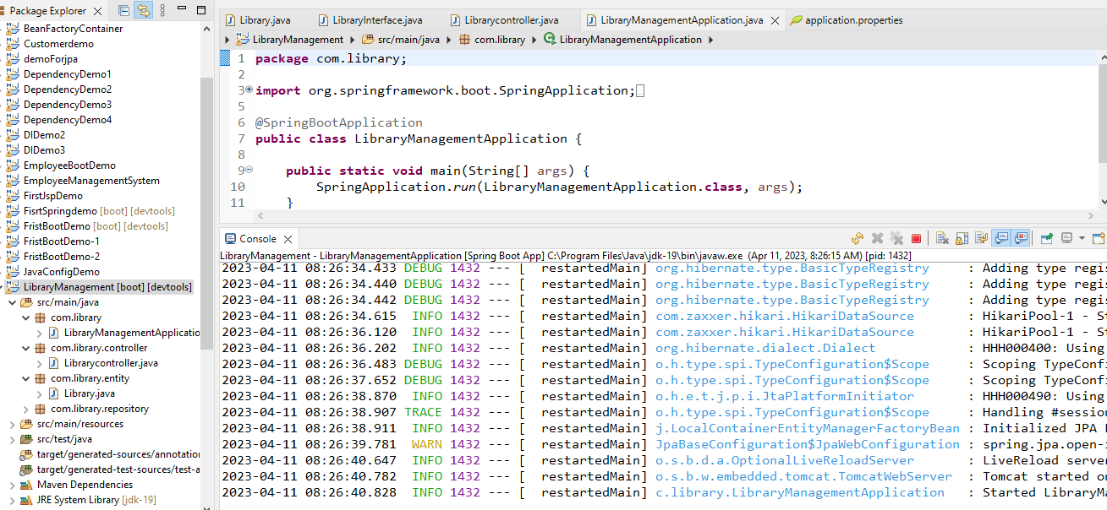
Spring Boot Application

Slide 14
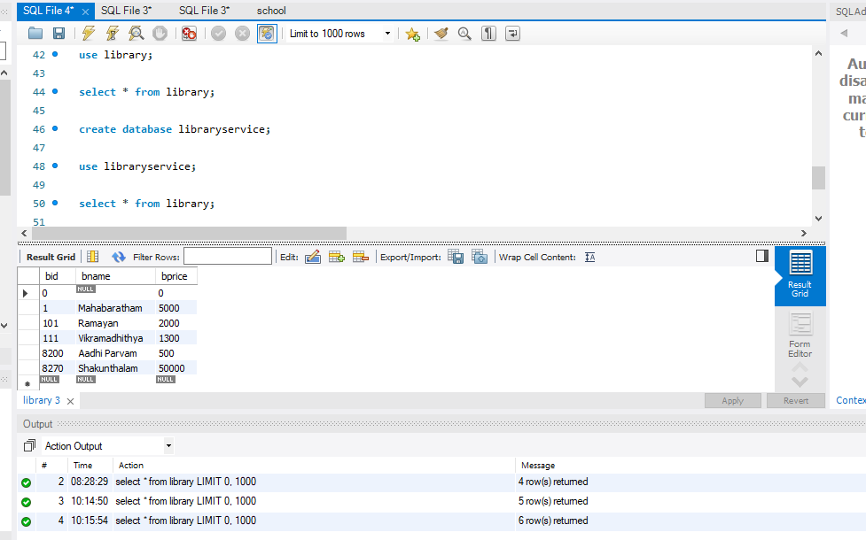
My SQL Code

Slide 15
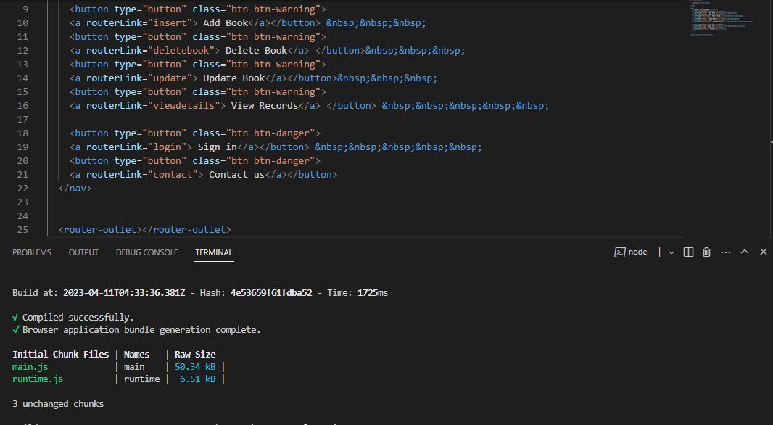
VS Code

Slide 16
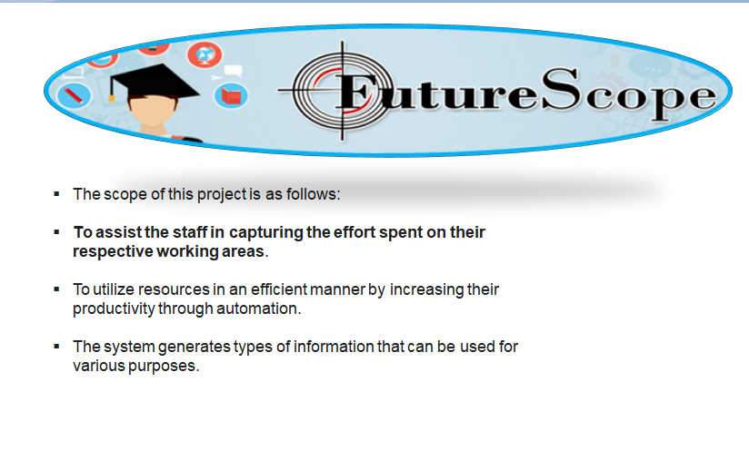

Slide 17
Git HUB LINK
https://github.com/Srikanth0101/Library-Services.git

Slide 18
Thank You

