Slide 1

Data Visualization on Covid-19 Deaths
Presented By:
Jasleen Kaur Kukreja (C0861810)
Srikanth Macharla (C0859761)
Venkateswara Rao Konamki (C0860523)
Venkata Vishnu Vardhan Nalli (C0858701)

Slide 2

Agenda
• Introduction
• Chart & Graphs
• Dashboard

Slide 3
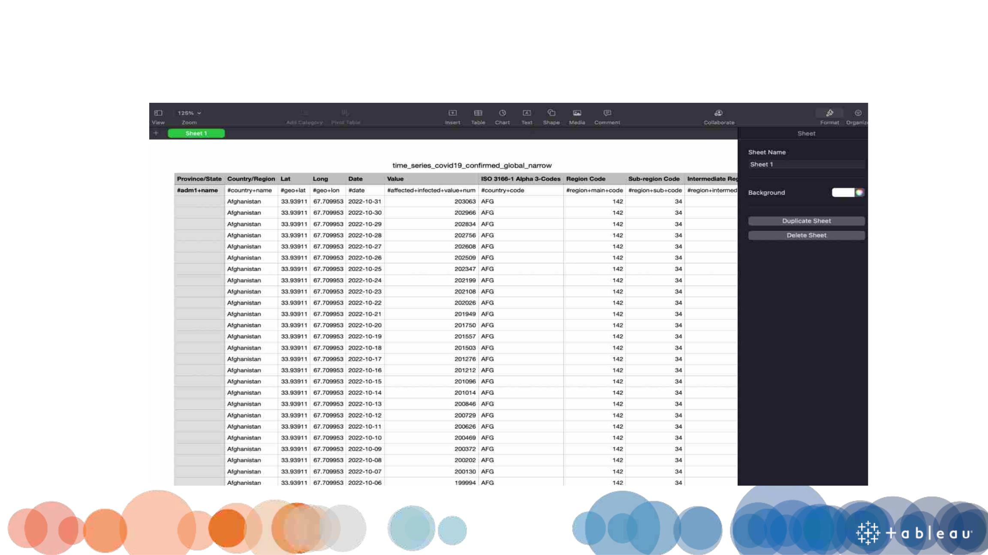
Introduction

Slide 4
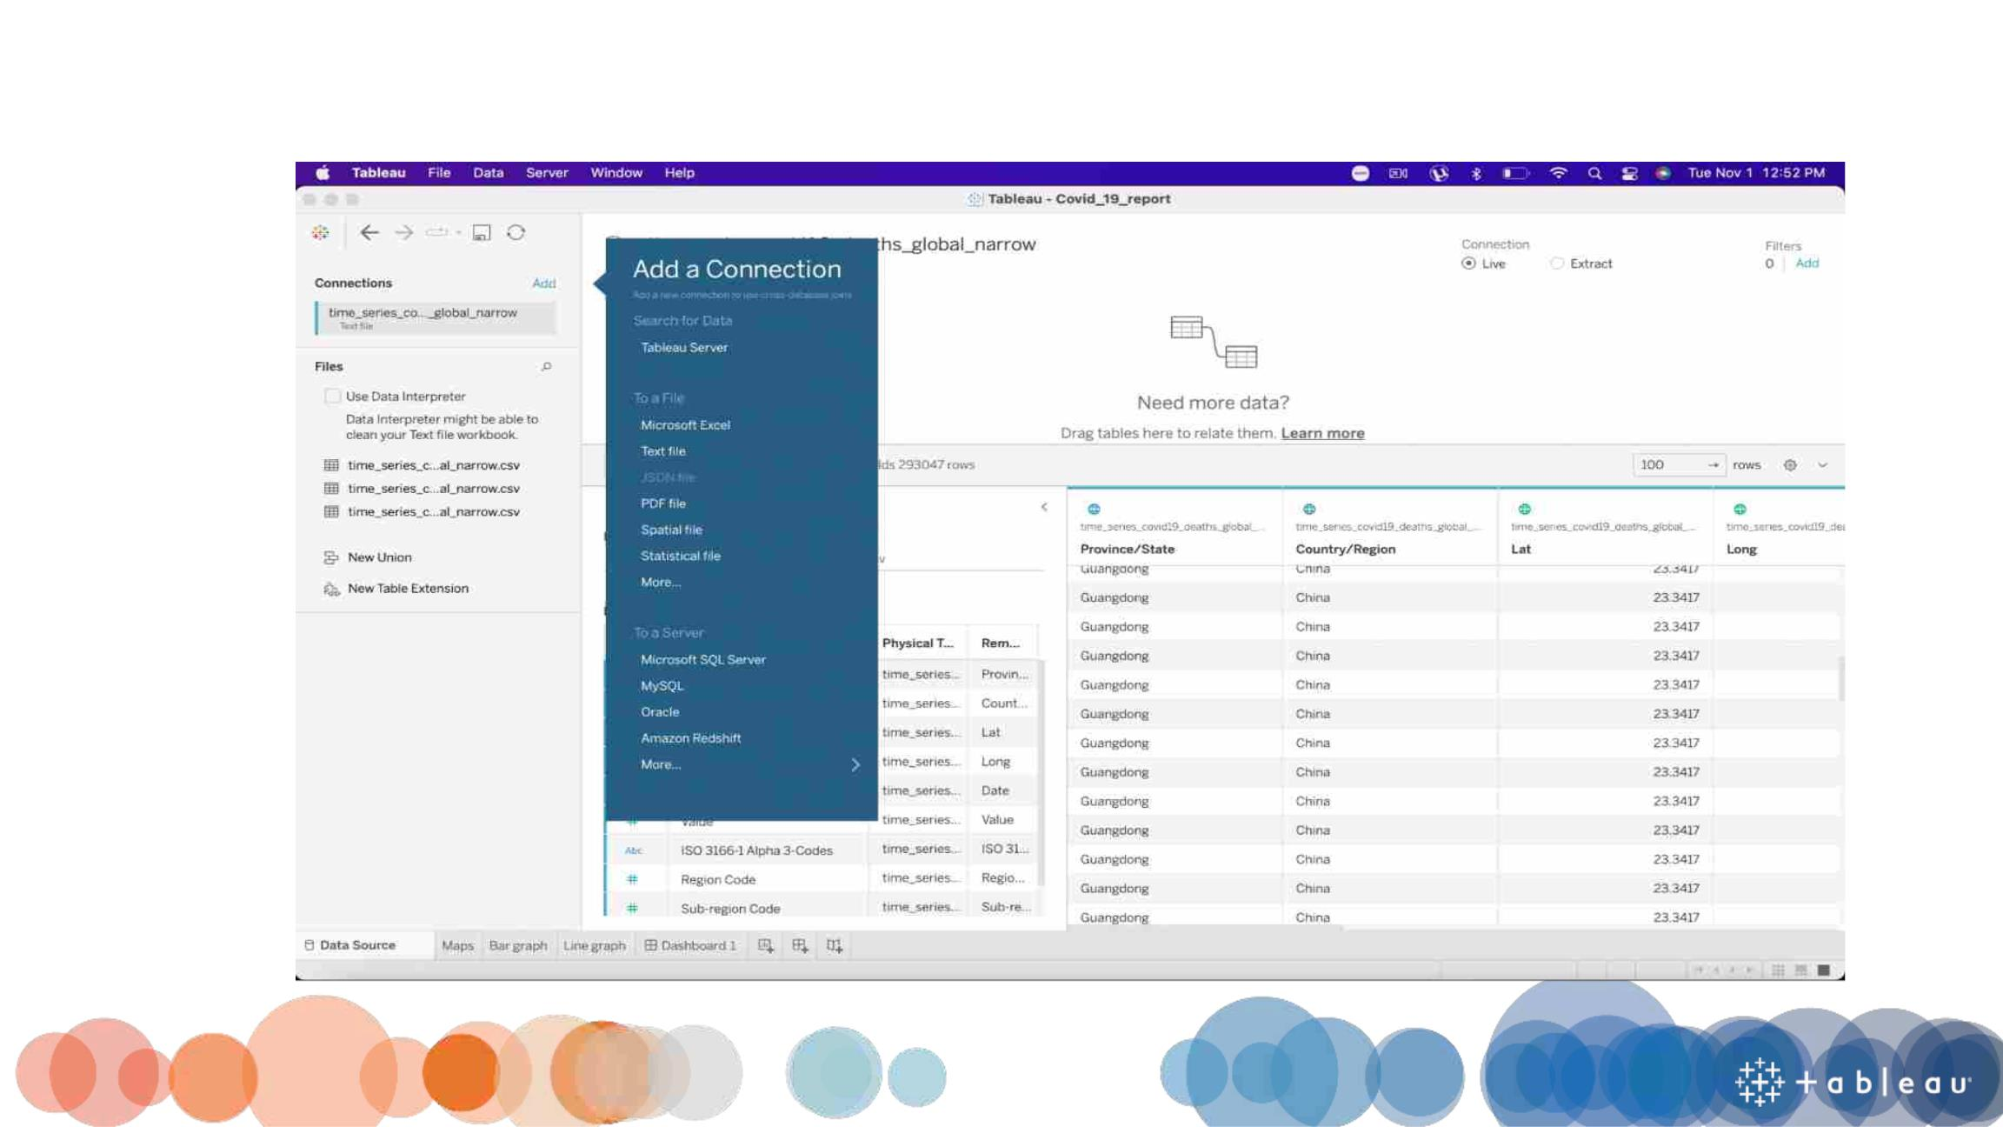
How to load dataset

Slide 5
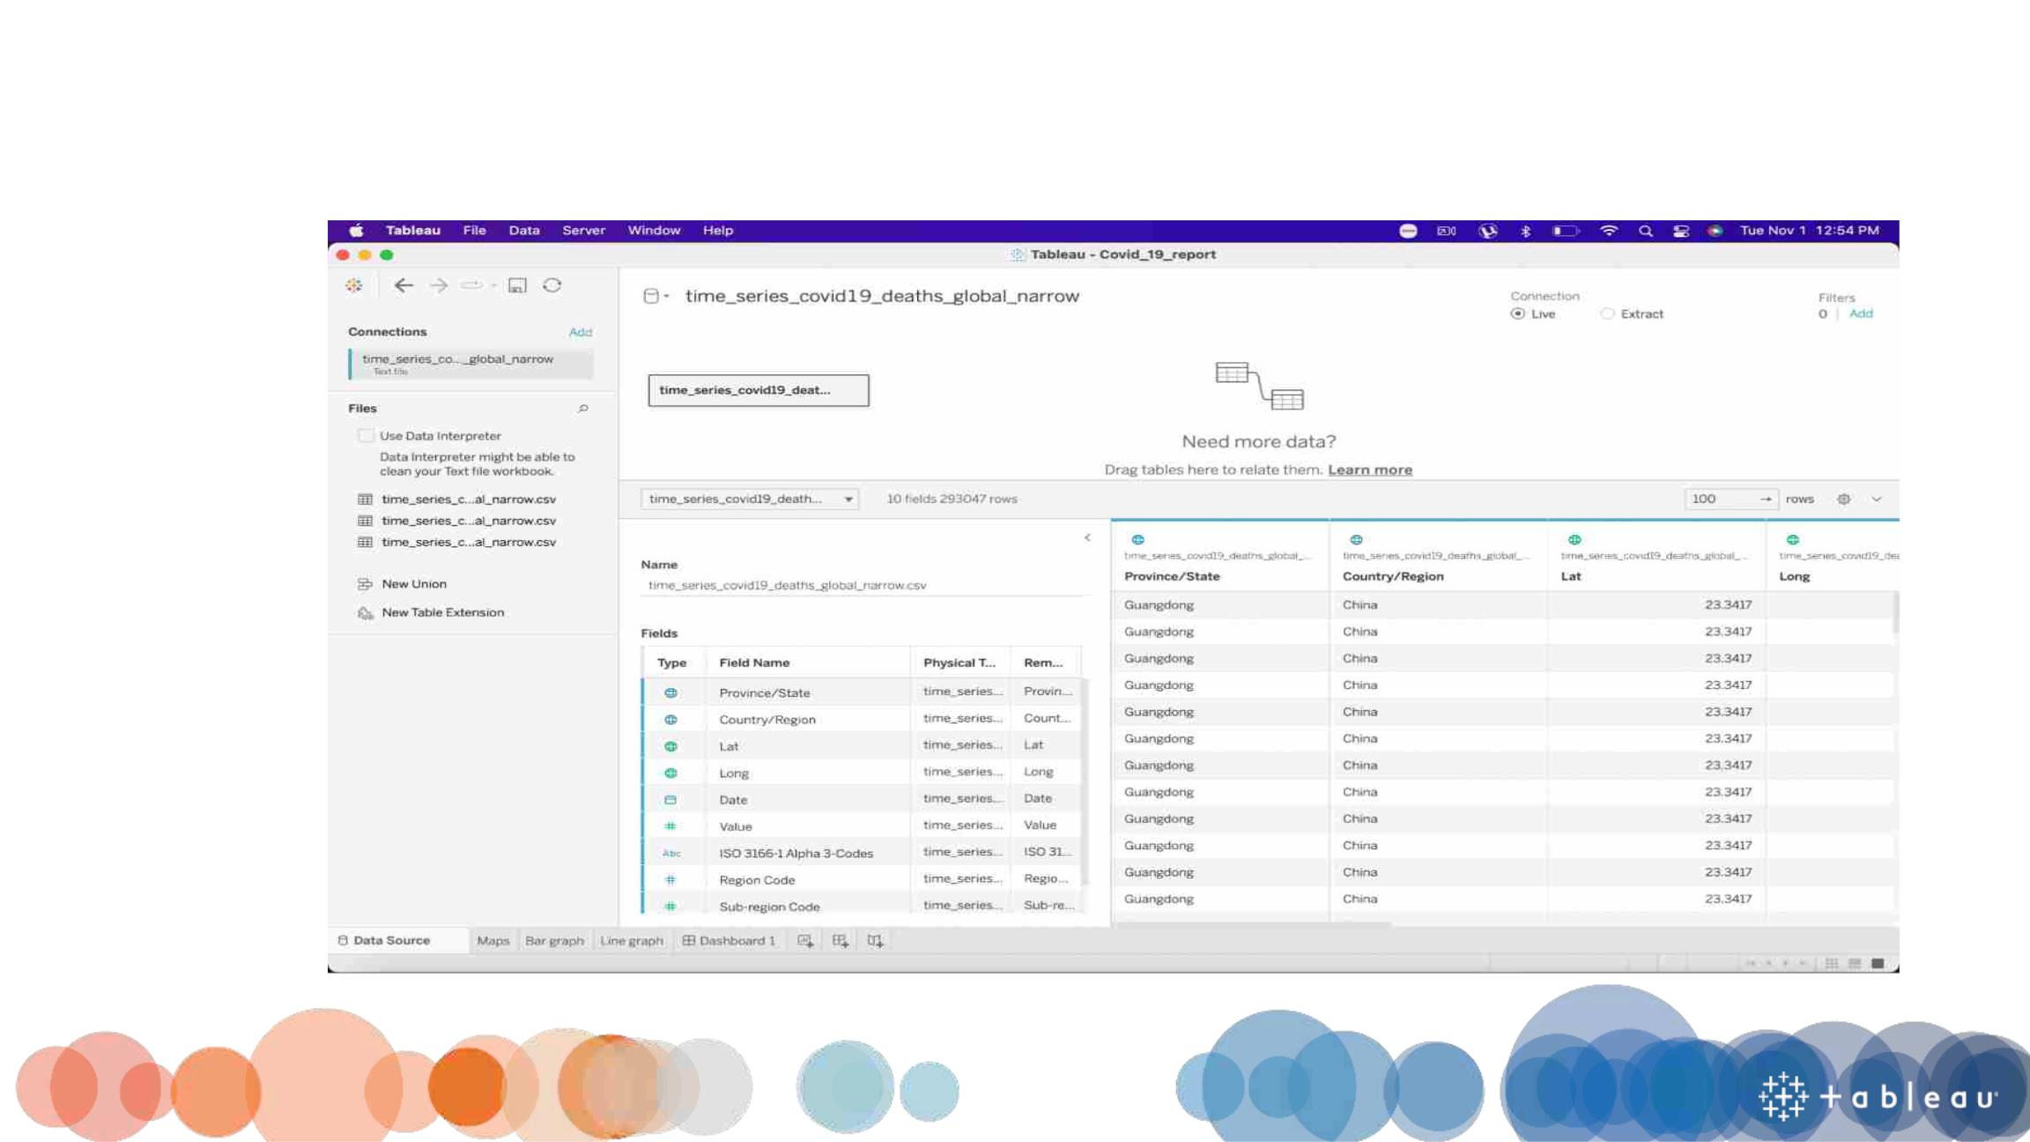
After loading a dataset to the tab|eau

Slide 6

The Creative Process

Slide 7
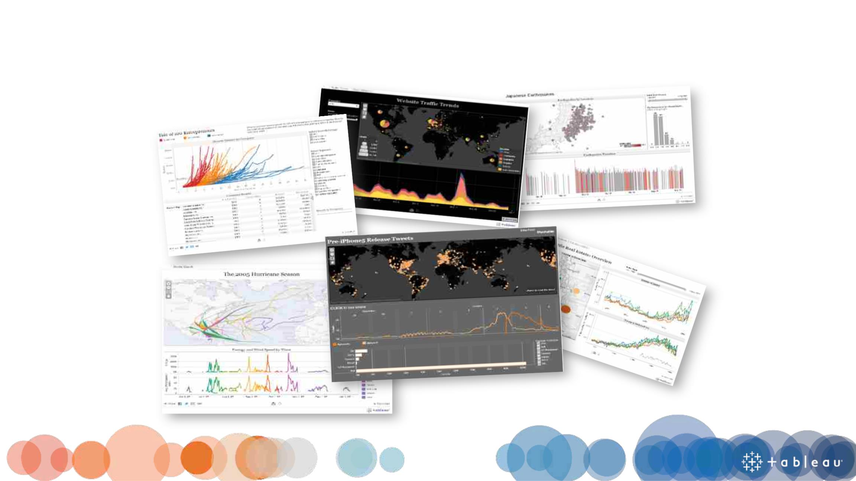
What question are you trying to answer?

Slide 8
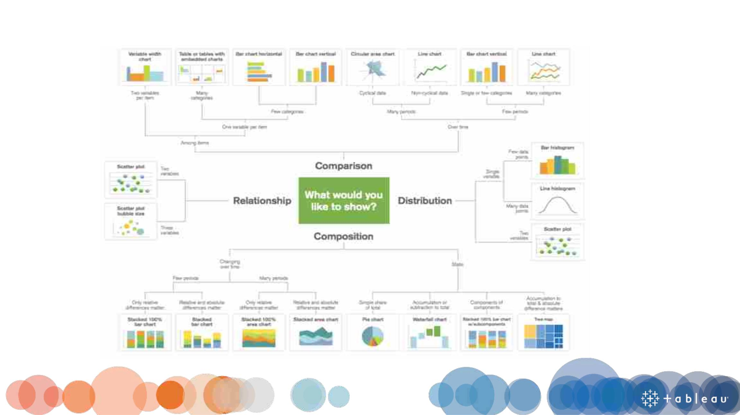
Do I have the right chart?

Slide 9
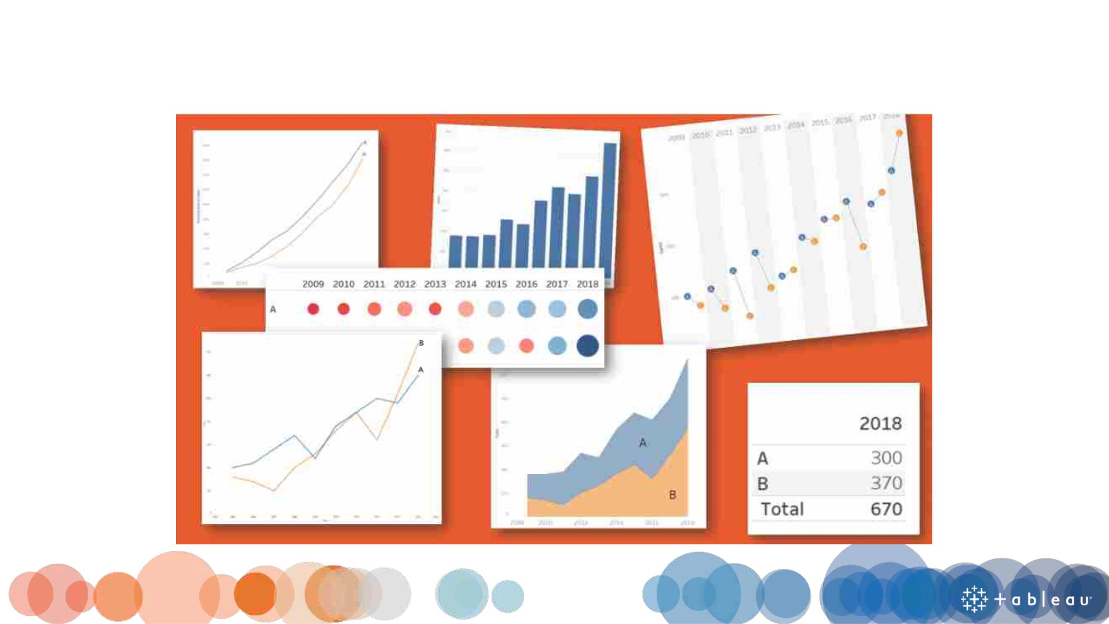
Choosing a Chart Type

Slide 10
The Creative Process
• Maps
• Bar graph
• Line Graph
• Dashboard

Slide 11

Maps

Slide 12
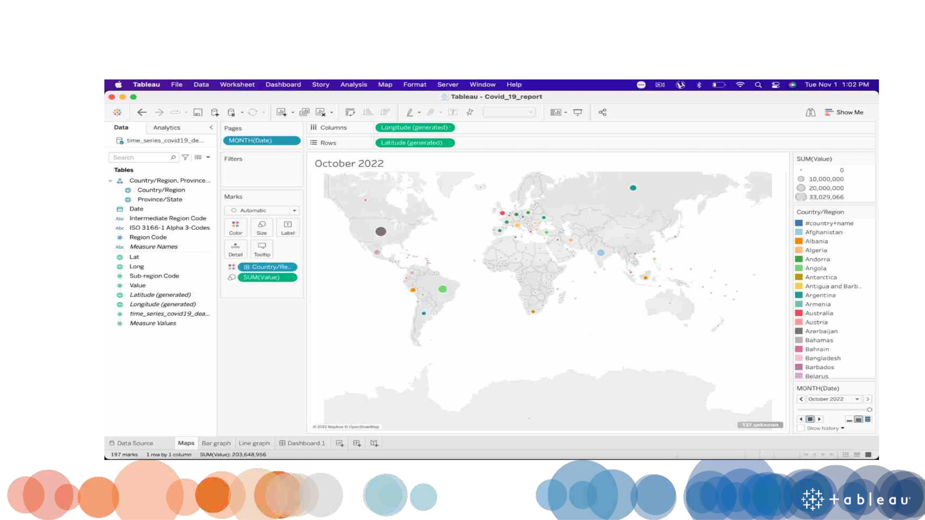
Maps

Slide 13
Bar Graph

Slide 14
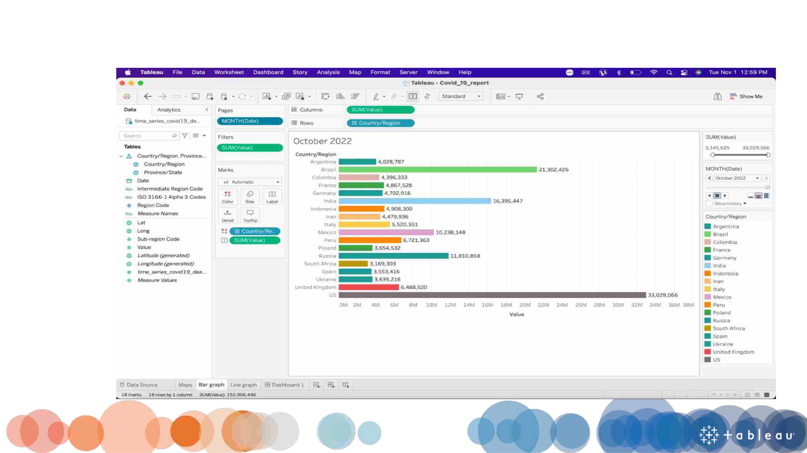
Bar Graph

Slide 15
Line graph

Slide 16
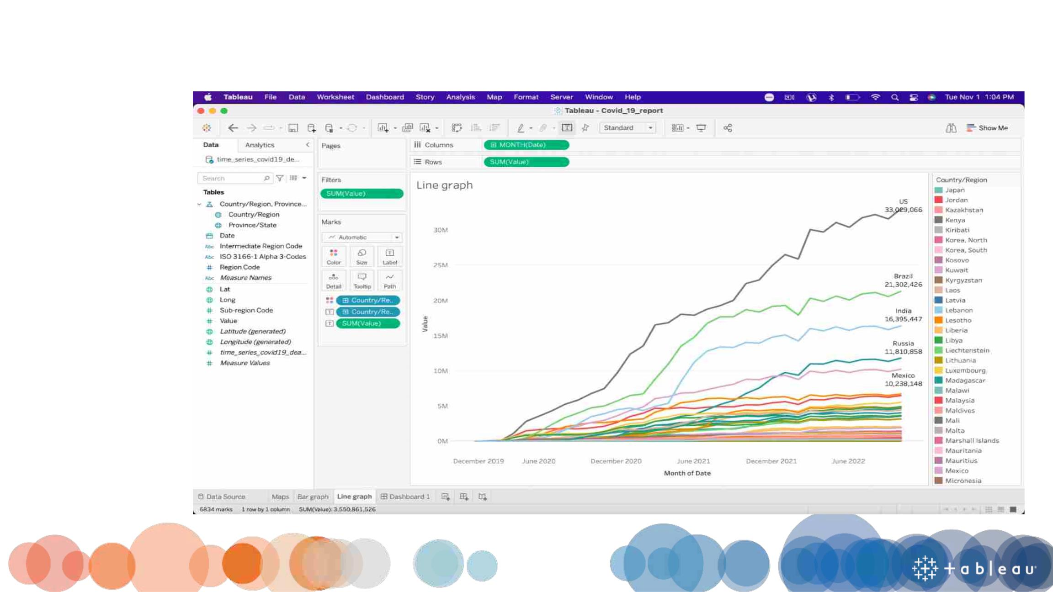
Line Graph

Slide 17
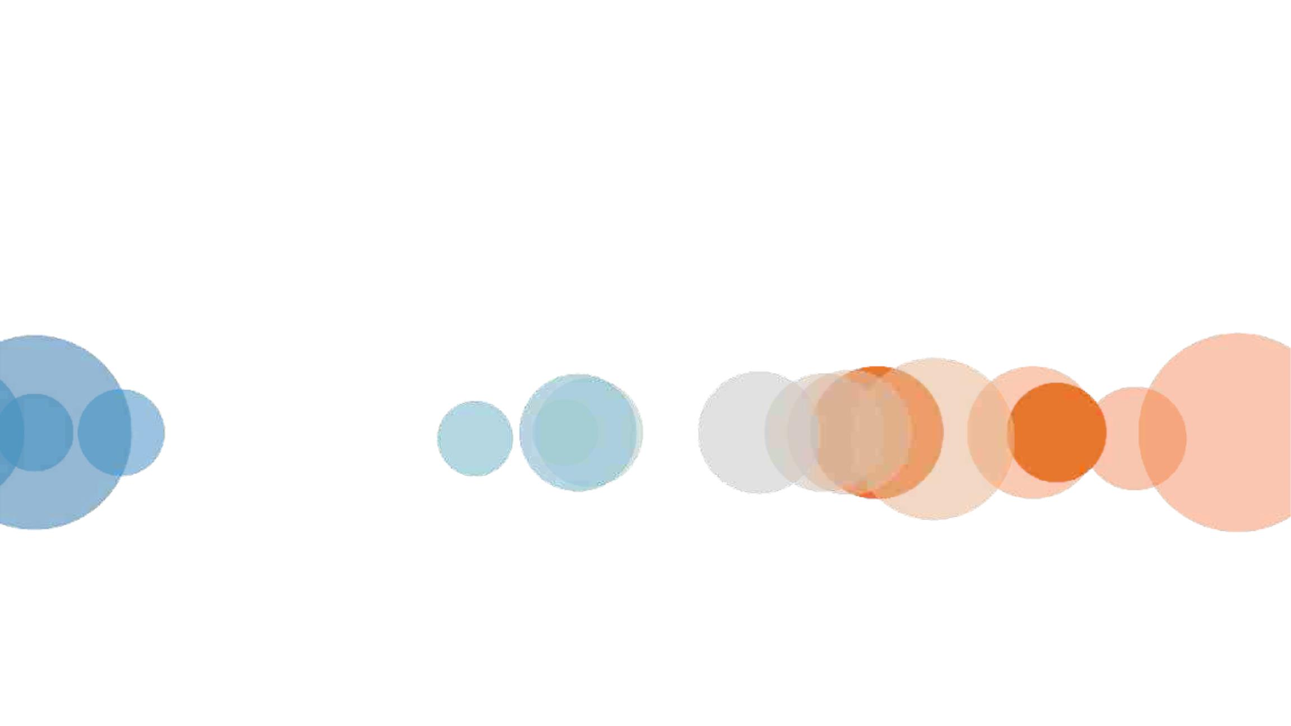
Dashboard Flow

Slide 18
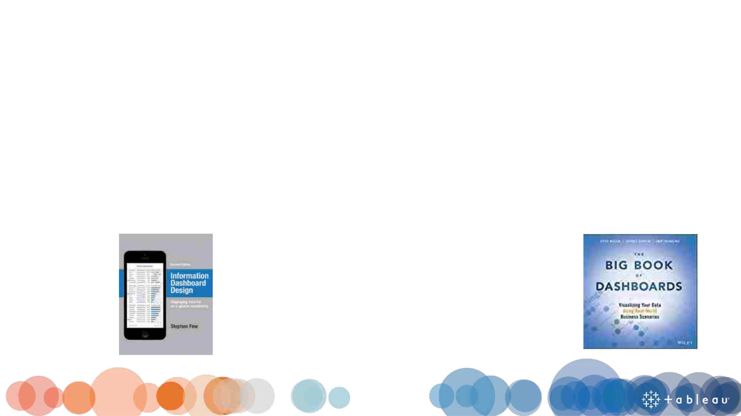
What is a dashboard?
“A dashboard is a visual
display of data used to
monitor conditions
and/or facilitate
understanding”
Big Book of Dashboards
(2017)
“A dashboard is a visual display of
the most important information
needed to achieve one or more
objectives; consolidated and
arranged on a single screen so the
information can be monitored at a
glance.”
Stephen Few
(2004)

Slide 19

What makes a good dashboard?
• Answers a set of questions
• Follows a flow and invites interactivity
• Condensed; primarily in the form of summaries and
exceptions
• Specific to and customized for the dashboard’s
audience and objectives
• Provides appropriate text for clarity and direction, if
needed
• Makes strategic use of color

Slide 20
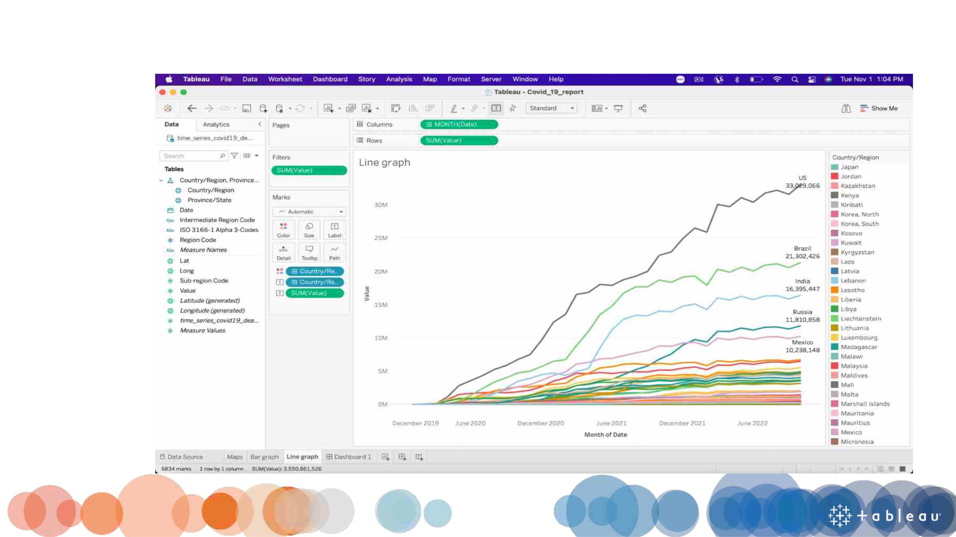
Dashboard

Slide 21
Demo

Slide 22


Slide 23

THANK YOU!

Slide 24

Presented By:
Team Sunrisers

