Slide 1
CareCircle
AI Care Coordination for India's Aging Parents
Built on ABDM · Powered by Claude AI · Delivered via Telegram
140M+
5+ Meds
0 Apps
Indians over 60
avg per elderly patient
needed — just Telegram

Slide 2
THE PROBLEM
Your parent is sick. You're 500 km away.
140M+ Indians over 60. Most are managed remotely by working children who live far away.
Fragmented Records
Invisible Drug Interactions
Caregiver Blindspot
Prescriptions on paper. Lab reports in WhatsApp. Caregiver updates via voice note. Nobody has the full picture at any point in time.
Average elderly patient takes 5+ daily medications prescribed by 2-3 different doctors. No system checks for conflicts. Until something goes wrong.
You find out about a hospitalization hours later. No proactive alerts. No daily health summary. Just anxiety every time the phone rings.
Today's healthcare system was designed for patients who walk in — not families who call in.
CareCircle
— Problem Statement
carecercle.vercel.app

Slide 3
THE SOLUTION
CareCircle
One AI-powered platform. Three layers that work together.
01
02
03
AI Analysis
ABDM Rails
Telegram Interface
Claude AI + Gemini Flash
India's digital health highway
Zero app install required
OCR: extract meds from prescription photos
Drug interaction check across all active meds
Daily briefing: one paragraph, what matters most
Abnormal lab flag with clinical context
ABHA ID links patient to national health records
UHI protocol: discover doctors, book appointments
FHIR-based PHR: structured, machine-readable
Consent-gated: patient owns their own data
/summary: AI health snapshot in seconds
/addappointment: book via conversation
Works on any phone, any data plan
India's most-used messaging platform
CareCircle
— Solution Overview
carecercle.vercel.app

Slide 4
INDIA'S HEALTH STACK
ABDM: Ayushman Bharat Digital Mission
India's national digital health highway — like GSTN for taxes, ONDC for commerce, now for healthcare.
ABHA
Ayushman Bharat Health Account
Why this matters
14-digit health ID for every Indian citizen. Permanent, portable, interoperable.
30+ crore ABHA IDs issued — India's health identity layer is live
2,000+ hospitals on ABDM network and growing
Records are portable — follow the patient, not the hospital
Zero data lock-in — patient can revoke consent anytime
Govt mandate: all new digital health apps must be ABDM-compliant
CareCircle doesn't store health records — ABHA does. We read, analyze, alert.
PHR
Personal Health Record
Longitudinal health record. FHIR R4 standard. Linked to ABHA. Owned by patient.
HIU/HIP
Health Information User & Provider
HIU = apps that request records (CareCircle). HIP = hospitals/labs that provide them.
Locker
ABDM Health Locker
Federated record storage. Patient consents to share. No central government database.
HCX
Health Claims Exchange
Open insurance claims protocol. Automates the entire claim cycle without paper forms.
CareCircle
— ABDM Background
carecercle.vercel.app

Slide 5
UHI DEEP DIVE
UHI: Unified Health Interface
Open protocol for health service discovery and delivery — the BECKN layer on top of ABDM.
Think UPI for payments, ONDC for commerce — UHI does the same for healthcare services.
EUA
Gateway
HSP
EUA → Gateway → HSP
End User Application
UHI Gateway
Health Service Provider
Patient-facing apps. CareCircle registers as an EUA. Sends health service requests on behalf of the caregiver or patient.
Routes requests between EUAs and HSPs. Operated by NHA. Handles service discovery, matching, and routing — invisible to users.
Any doctor, hospital, lab, or pharmacy registered on UHI. Public or private. Apollo to a local clinic — all discoverable via the same API.
e.g. CareCircle, ABHA App, Practo
e.g. gateway.abdm.gov.in (NHA)
e.g. Apollo, AIIMS, SRL Diagnostics
What transacts over UHI
Doctor & specialist discovery by location, specialty, language
PHR request & share (FHIR R4, consent-gated)
Appointment booking (standardized, open protocol)
Prescription digitization to ABHA locker post-consult
Teleconsultation (video / audio)
Lab report delivery direct to patient's health record
CareCircle
— UHI Protocol — Deep Dive
carecercle.vercel.app

Slide 6
HOW WE USE IT
CareCircle rides ABDM rails.
Like Paytm rides UPI rails — we don't build health infrastructure. We build the AI and UX layer on top.
What ABDM gives us — for free
What CareCircle builds on top
Patient Identity
AI Analysis Layer
ABHA ID = no user health database to build or secure
Claude briefings + Gemini OCR — no ABDM app has this yet
Record Storage
Caregiver-First UX
ABHA Locker = zero infrastructure; records stay with patient
Designed for the adult child 500 km away, not just the patient
Provider Directory
Telegram Interface
UHI Gateway = 2,000+ providers auto-discoverable via API
WhatsApp-like familiarity. Zero install friction. Any phone.
Consent Management
Proactive Alerting
ABDM framework = DPDP-compliant, patient-controlled access
Abnormal labs, drug interactions, missed meds — pushed, not pulled
Record Portability
Family Coordination
FHIR R4 = records from Apollo, AIIMS, local clinic — same format
Multiple caregivers share one health view across distance
CareCircle
— CareCircle Architecture Position
carecercle.vercel.app

Slide 7
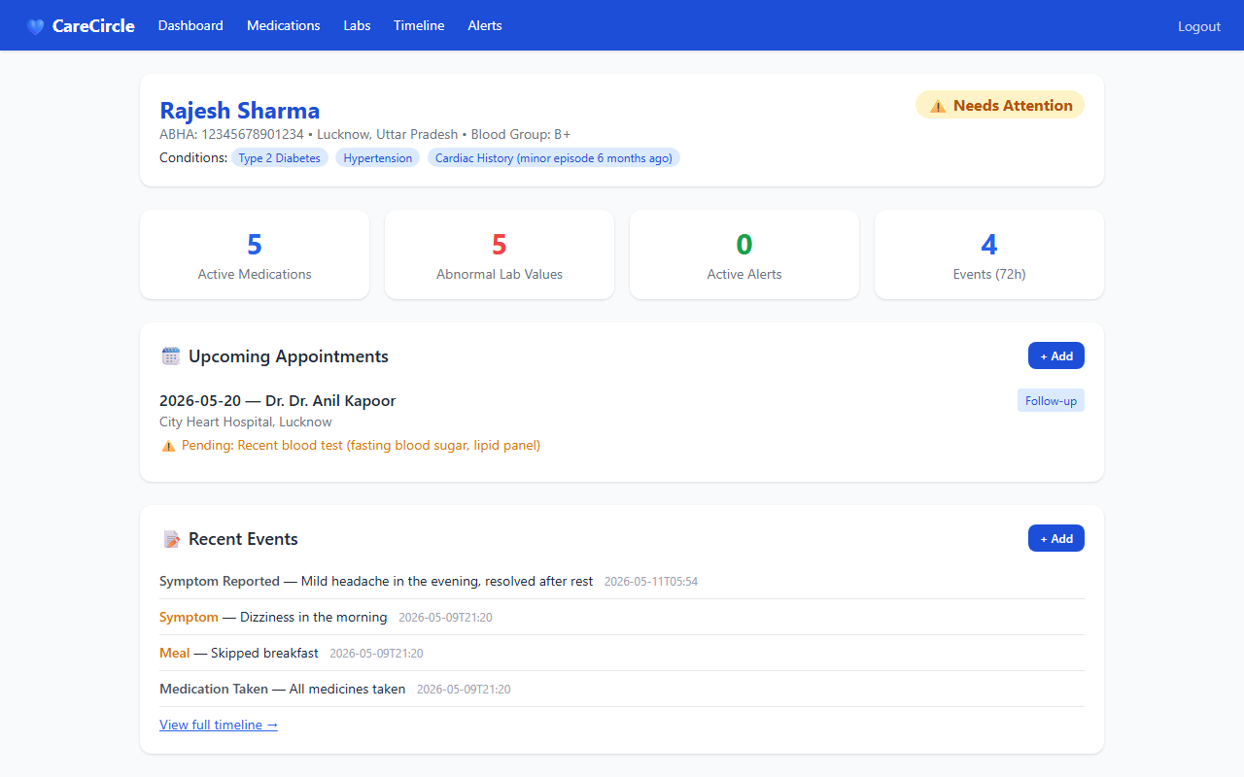
PRODUCT DEMO
Web Dashboard
Full caregiver view — medications, labs, appointments, AI briefing.
carecercle.vercel.app/dashboard
1
Login
srikanthkarkampally01@gmail.com
2
Patient Profile
Rajesh Sharma — B+, Nellore AP. Conditions: Type 2 Diabetes, Hypertension.
3
Lab Flags
3 abnormal results: BP 150/95 mmHg, FBS 180 mg/dL — all flagged in amber/red.
4
Medications
5 active meds: Metformin, Glimepiride, Amlodipine, Aspirin, Atorvastatin.
5
AI Briefing
Claude reads all data → one-paragraph morning summary at 7 AM IST.
CareCircle
— Product Demo — Web Dashboard
carecercle.vercel.app

Slide 8
PRODUCT DEMO
Telegram Bot: @CarCercle_Bot
CarCercle_Bot
online
Zero app install. Works on any smartphone. India's most-used messaging platform.
/summary
Summary — Rajesh Sharma
5 meds | 3 abnormal labs
0 alerts | 0 events in 24h
STATUS: WARNING
BP elevated: 150/95 mmHg
FBS elevated: 180 mg/dL
All 5 meds logged.
/connect
Links your Telegram to your CareCircle account. One-time setup.
/summary
AI-generated health snapshot. Patient data + Claude analysis in seconds.
/addappointment
/addappointment
Conversational booking flow. Bot asks date, doctor, reason — stores in DB.
Sure. What date is the appointment?
/addlab
20 May, Dr. Reddy - Cardiology
Log lab values in chat. Flags abnormal results automatically.
Appointment saved for May 20.
CareCircle
— Product Demo — Telegram Bot
carecercle.vercel.app

Slide 9
ROADMAP
Telegram as the ABDM Interface
The bot you see today will be the front door to India's entire digital health network.
Phase 1
Phase 2
Phase 3
Now — Live Today
Q3 2026 — ABDM Integration
Q4 2026 — Full UHI EUA
Standalone health record management
Claude AI daily briefings at 7AM IST
Gemini Flash OCR: prescription scanning
/summary, /addappointment via Telegram
Supabase + Vercel — fully deployed
/sync command: pull PHR from ABHA locker
ABHA ID linking inside /connect flow
Register CareCircle as a HIU with NHA
/book command: UHI appointment booking
Consent-gated record access via ABDM API
Full UHI EUA registration with NHA
Live doctor/lab discovery via UHI gateway
Prescriptions pushed to ABHA locker post-consult
HCX: insurance claim initiation via Telegram
Multi-family, multi-patient coordinator mode
End goal: caregiver in Bangalore books a specialist in Chennai for a parent in Nellore — from Telegram, in 2 messages, via UHI.
CareCircle
— Roadmap — Telegram + ABDM
carecercle.vercel.app

Slide 10
The Opportunity
India's aging-care gap is a
₹50,000 crore problem waiting
for the right infrastructure.
ABDM gives us the rails. Claude gives us the intelligence. Telegram gives us the reach.
Pilot Families
Hospital / Clinic Partners
Investor Interest
10 families with an aging parent. Free for 6 months. Help us tune AI, UX, and ABDM consent flows.
ABDM-registered HIPs to pilot UHI appointment booking and PHR sharing. Public or private.
Pre-seed round opening Q3 2026. Focus: ABDM HIU registration, UHI EUA build-out, engineering team.
Demo: carecercle.vercel.app · Bot: @CarCercle_Bot · srikanthkarkampally01@gmail.com

