Slide 1

MENTAL HEALTH AT WORK PLACE
A Project Report submitted to
EduBridge Learning Pvt. Ltd.
SUBMITTED BY,
Mr. Praveen
Mr. Srikanth
Ms. Surekha
Ms. Srujana
Under the guidance of
Mrs. Amruta Kedar Chimote

Slide 2
DOMAIN KNOWLEDGE
What exactly Mental Health at workplace is?
In general : emotional, psychological, social well-being how we think, feel, and act.
It also helps determine how we handle stress, relate to others, and make choices.
The impact of mental health can decrease in productivity and engagement.

Slide 3
What can employer’s & employee’s do ?
Employers can offer benefit packages to support employees who go through mental health issues. That includes Employee Assistance Programs, Wellness programs that focus on mental and physical health
Research shows that employees who go through Mental Health wellness programs have an increased awareness of mental health among themselves and their co-workers.

Slide 4
INTRODUCTION
Open Sourcing Mental Illness is a non-profit, corporation dedicated to raising awareness, educating, and providing resources to support mental wellness in the tech and open source communities.
Every year, OSMI came out with a new survey to see how employees want to get mental health treatment in tech companies around the world and I pick the survey from 2014.
This survey is filled by respondents who suffer from mental health disorders in tech companies and see if any factors can affect the employee to get treatment or not.

Slide 5
UNDERSTANDING THE COLUMNS IN DATASET:
Timestamp
Age
Gender
Country
state: If you live in the United States, which state or territory do you live in?
self_employed: Are you self-employed?
family_history: Do you have a family history of mental illness?
treatment: Have you sought treatment for a mental health condition?
work_interfere: If you have a mental health condition, do you feel that it interferes with your work?
no_employees: How many employees does your company or organization have?
remote_work: Do you work remotely (outside of an office) at least 50% of the time?

Slide 6
tech_company: Is your employer primarily a tech company/organization?
benefits: Does your employer provide mental health benefits?
care_options: Do you know the options for mental health care your employer provides?
wellness_program: Has your employer ever discussed mental health as part of an employee wellness program?
seek_help: Does your employer provide resources to learn more about mental health issues and how to seek help?
anonymity: Is your anonymity protected if you choose to take advantage of mental health or substance abuse treatment resources?
leave: How easy is it for you to take medical leave for a mental health condition?
mentalhealthconsequence: Do you think that discussing a mental health issue with your employer would have negative consequences?
physhealthconsequence: Do you think that discussing a physical health issue with your employer would have negative consequences?

Slide 7
coworkers: Would you be willing to discuss a mental health issue with your coworkers?
physhealthinterview: Would you bring up a physical health issue with a potential employer in an interview?
mentalvsphysical: Do you feel that your employer takes mental health as seriously as physical health?
obs_consequence: Have you heard of or observed negative consequences for coworkers with mental health conditions in your workplace?
comments: Any additional notes or comments

Slide 8
OBJECTIVES OF THE PROJECT
To find the distribution of male and female in survey
To Experiment Data Imputation (Handling Missing Values)
To perform Feature Engineering (manipulating values in Age, Gender)
To Analyse data using various machine learning models & compare their Model Accuracies (Logistic Regression, Neighbors Classifier, Support Vector Machine)
To predict Treatment history of a person.

Slide 9
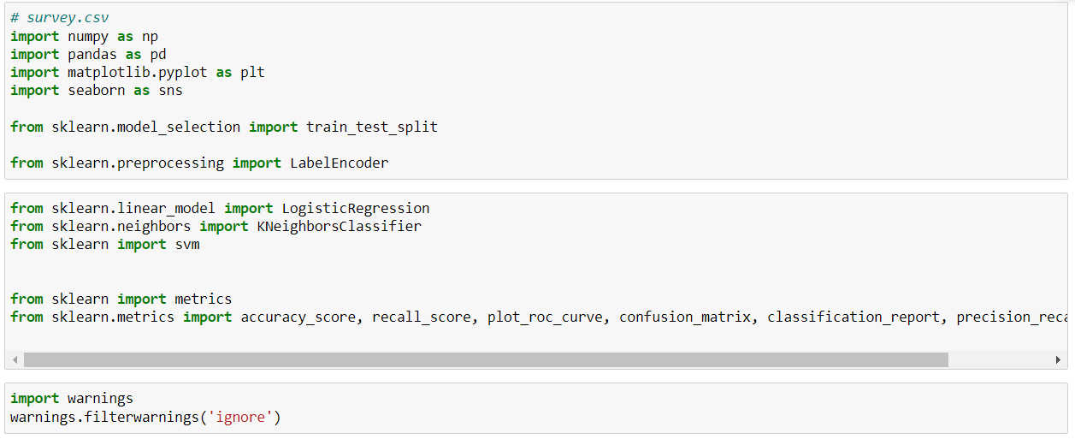
Libraries We Worked

Slide 10
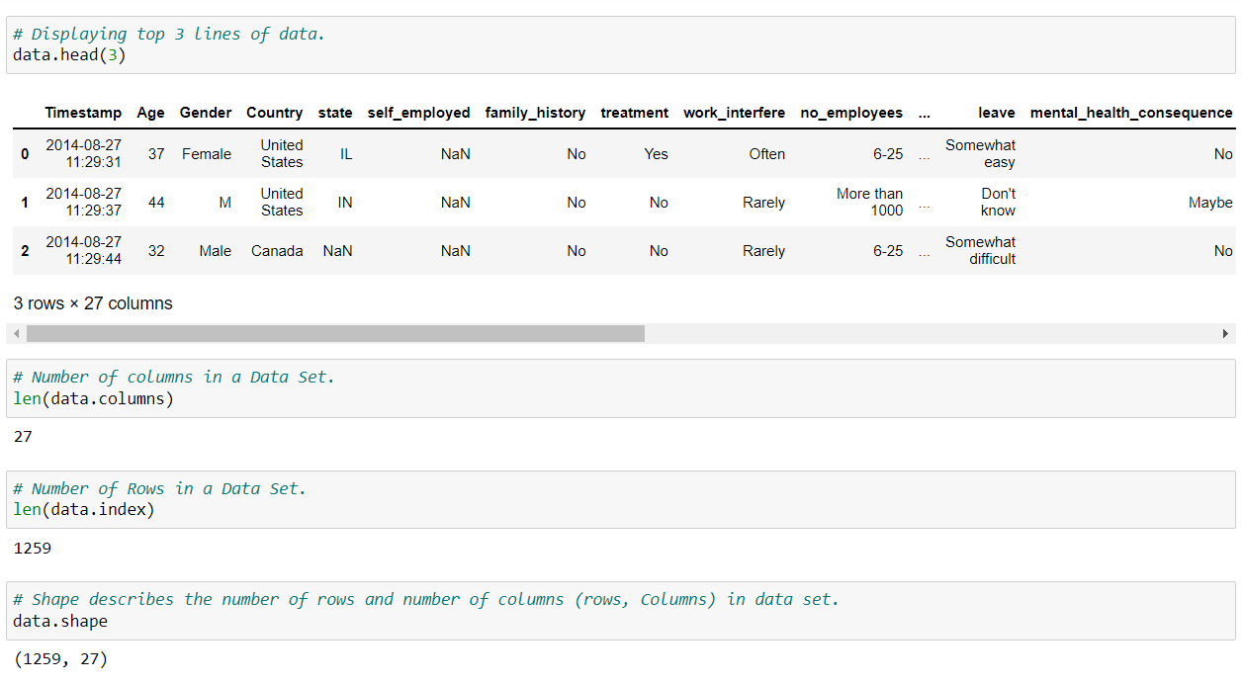

Slide 11
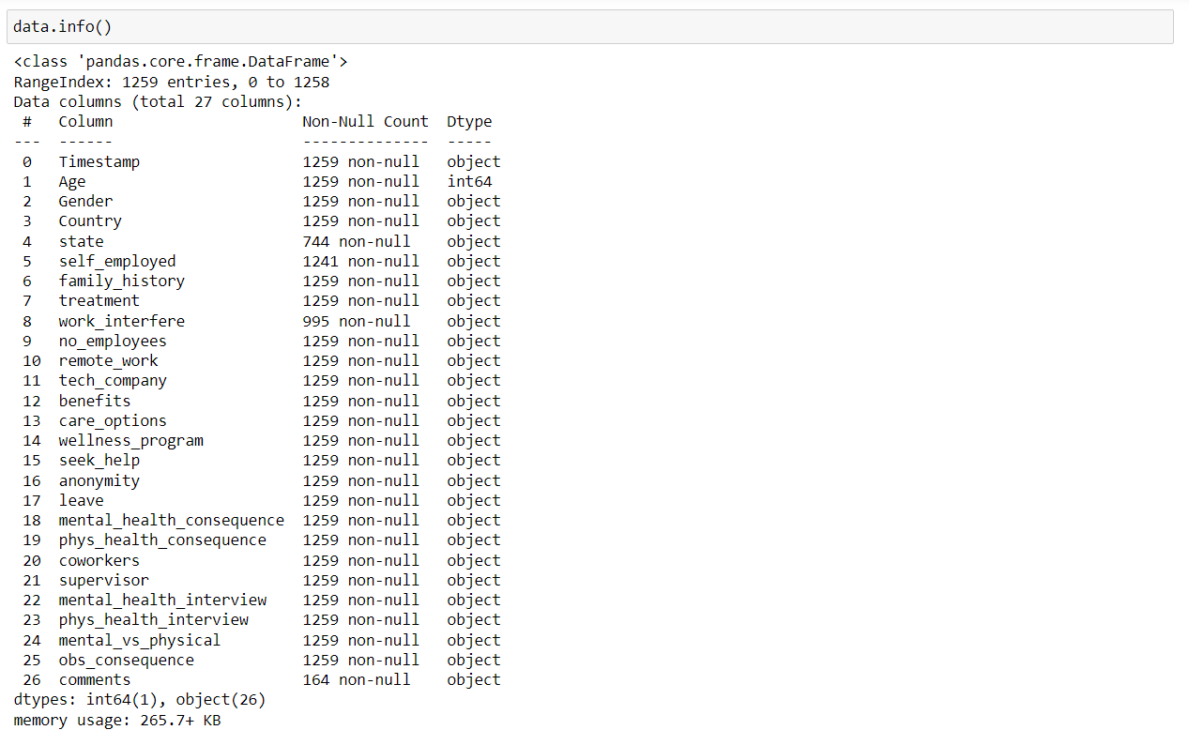

Slide 12
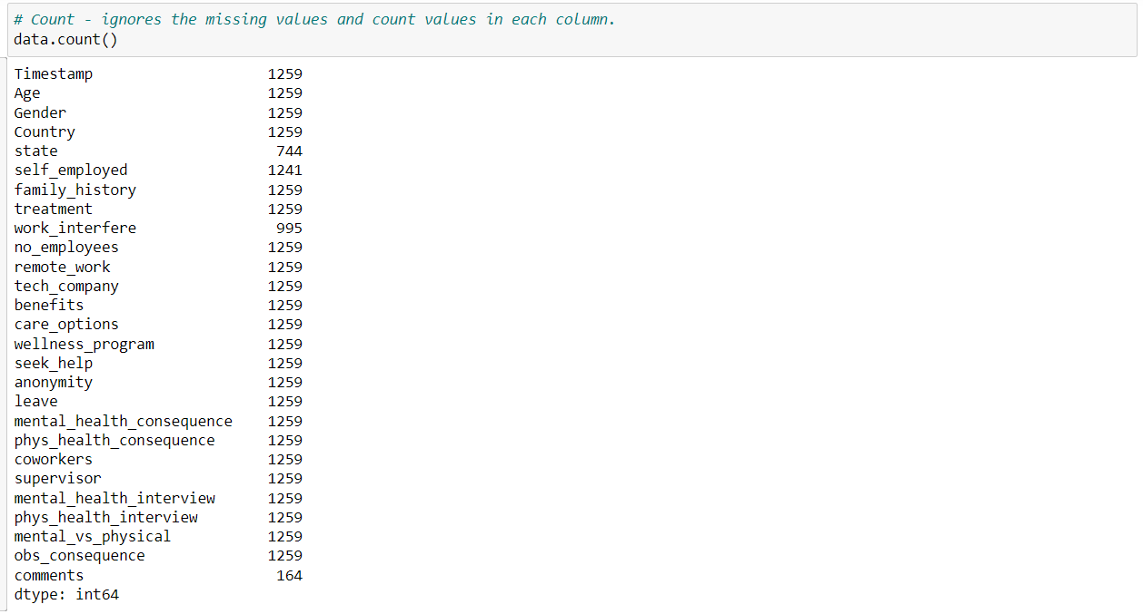

Slide 13
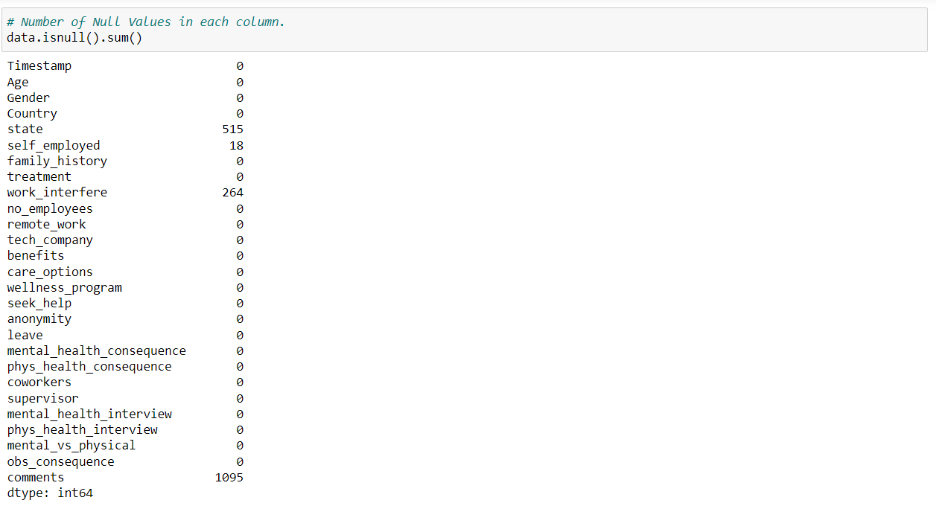

Slide 14
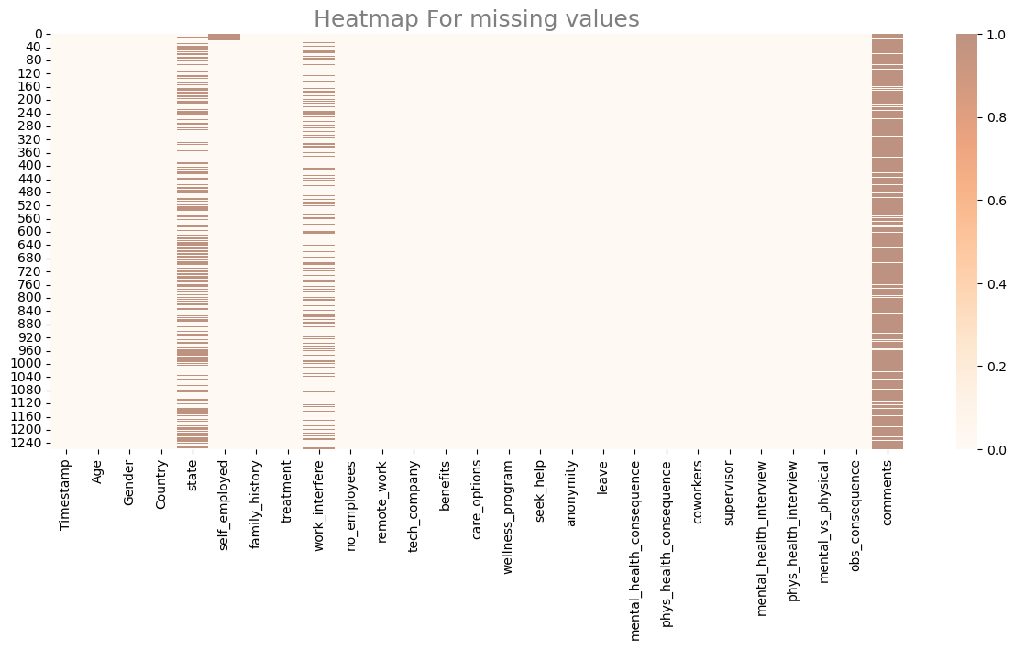

Slide 15
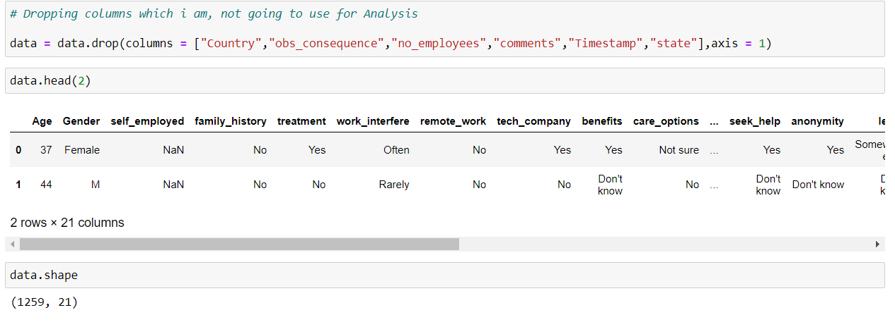

Slide 16
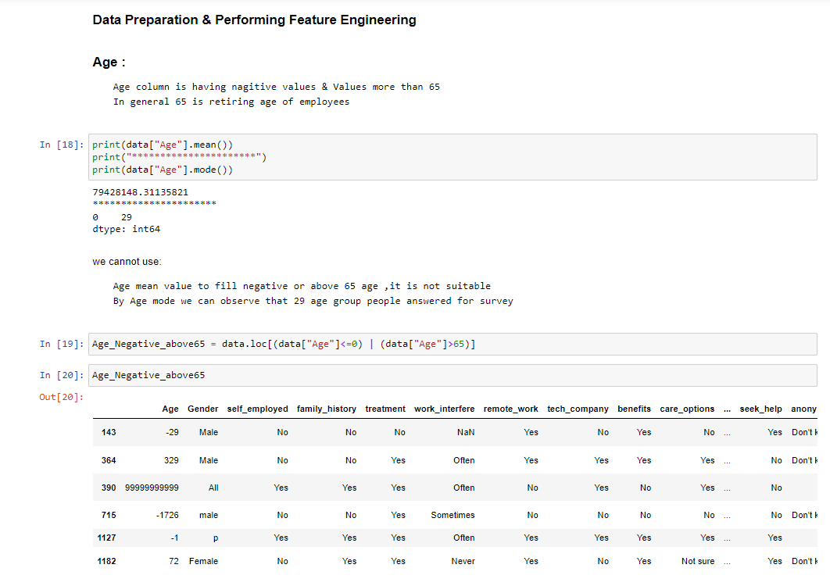
Feature Engineering

Slide 17
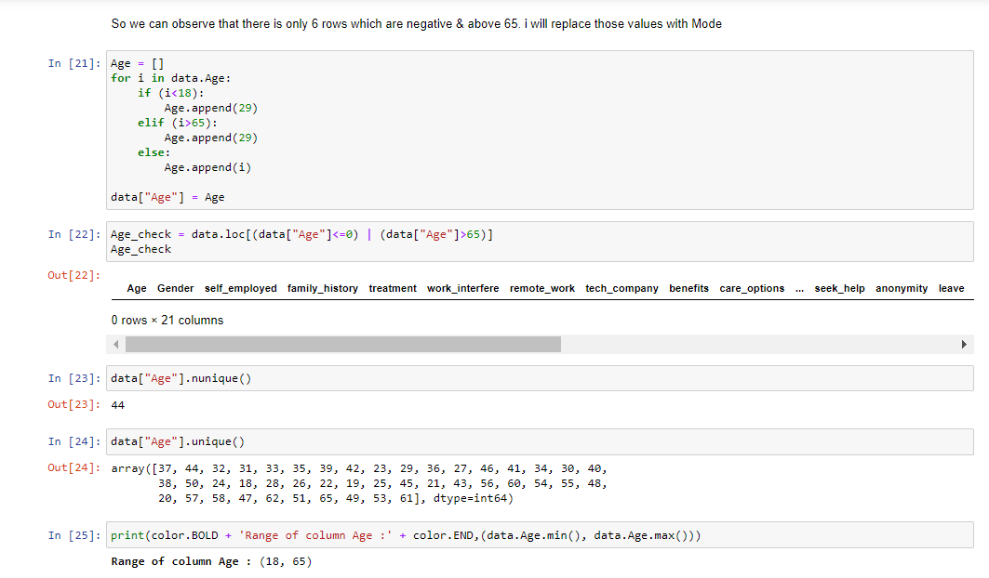

Slide 18
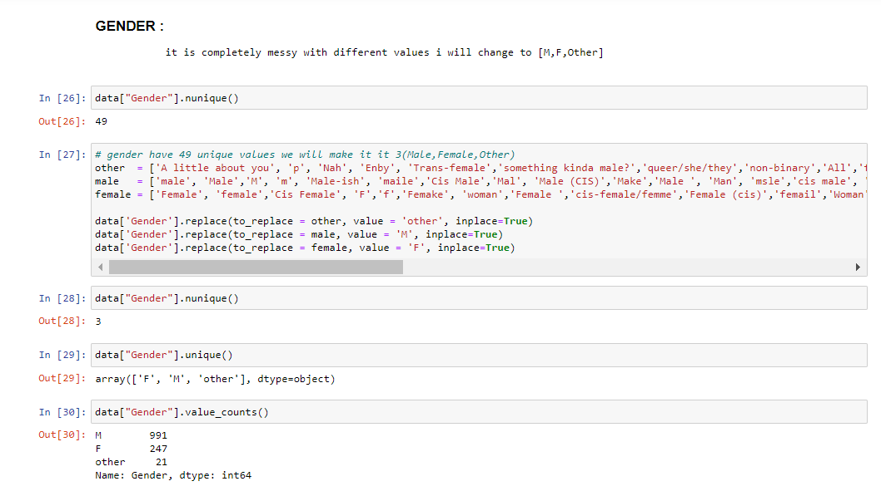

Slide 19
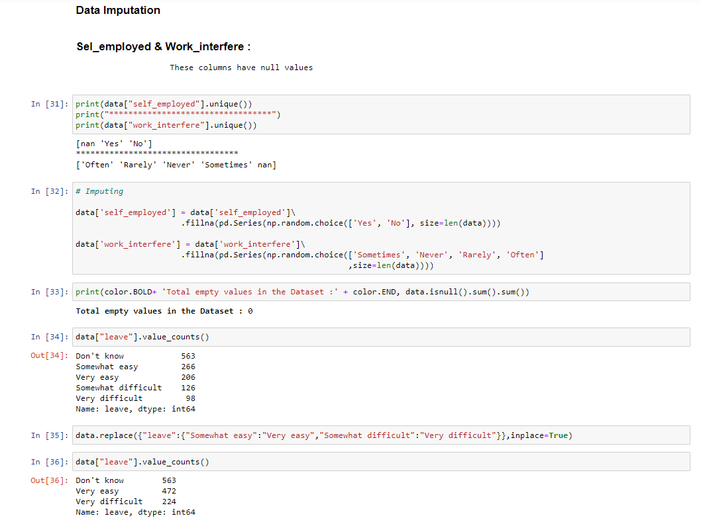
Data Imputation

Slide 20
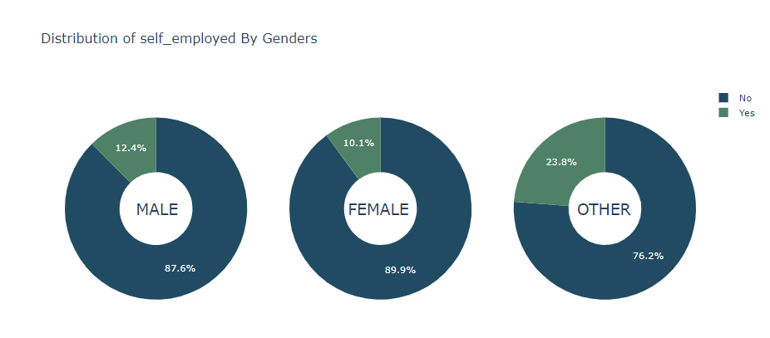
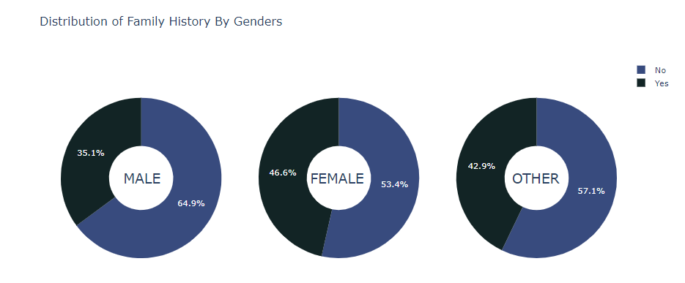
DATA VISUALIZATION

Slide 21
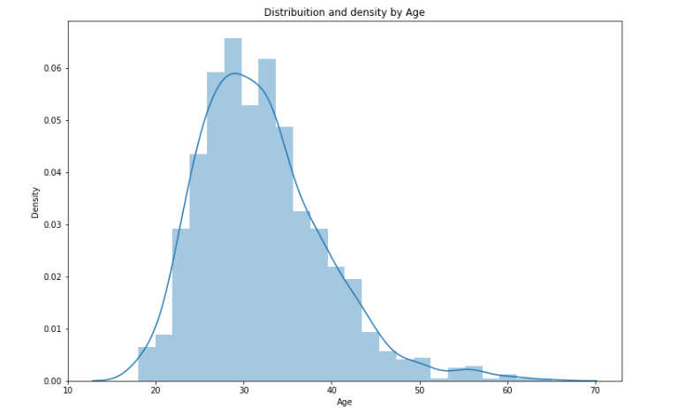
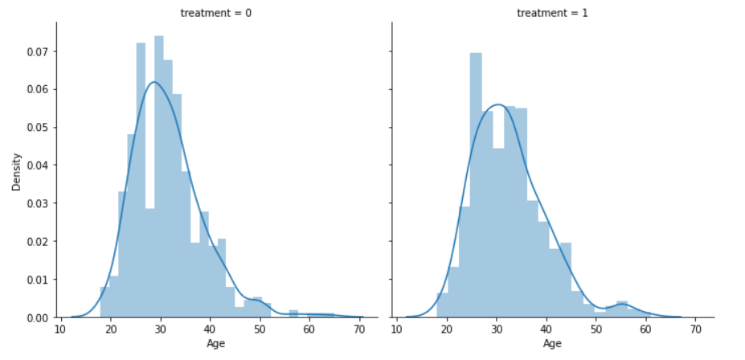

Slide 22
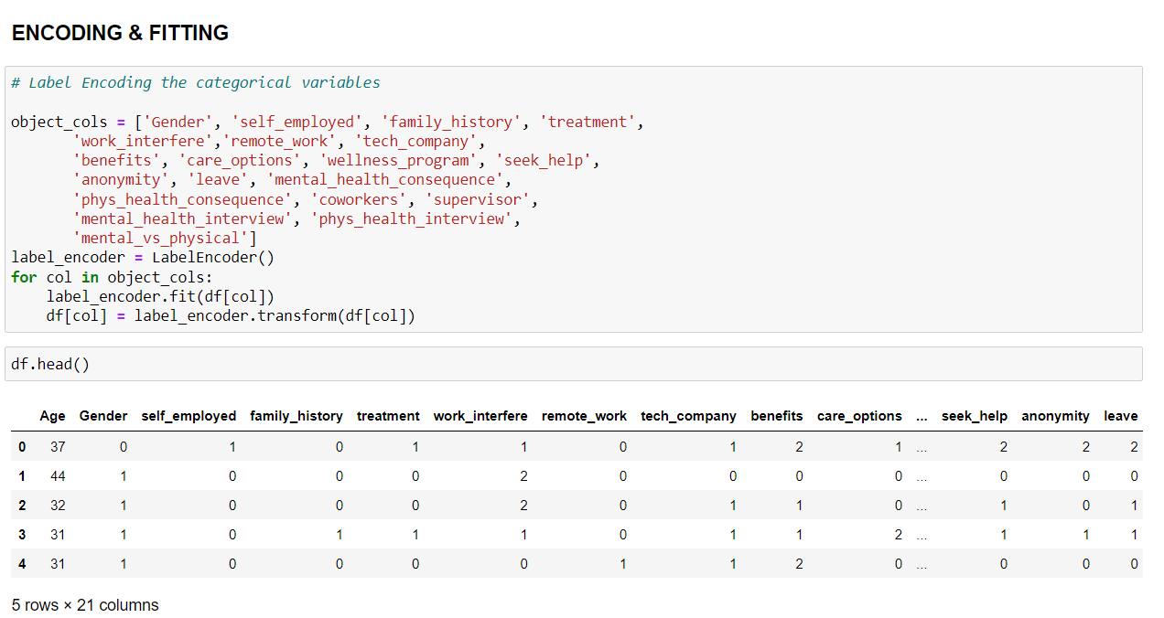
ENCODING & FITTING

Slide 23
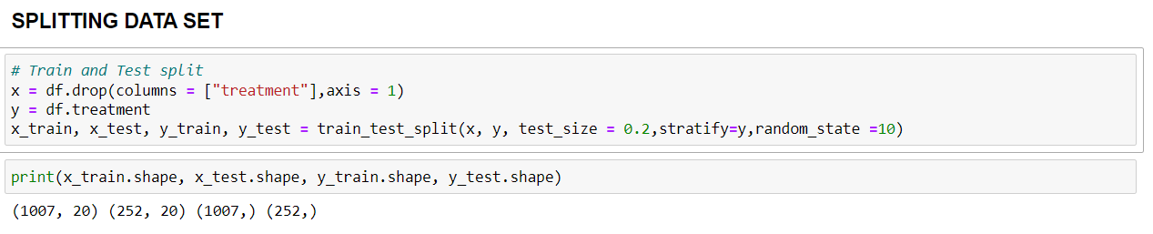
SPLITTING DATA SET

Slide 24
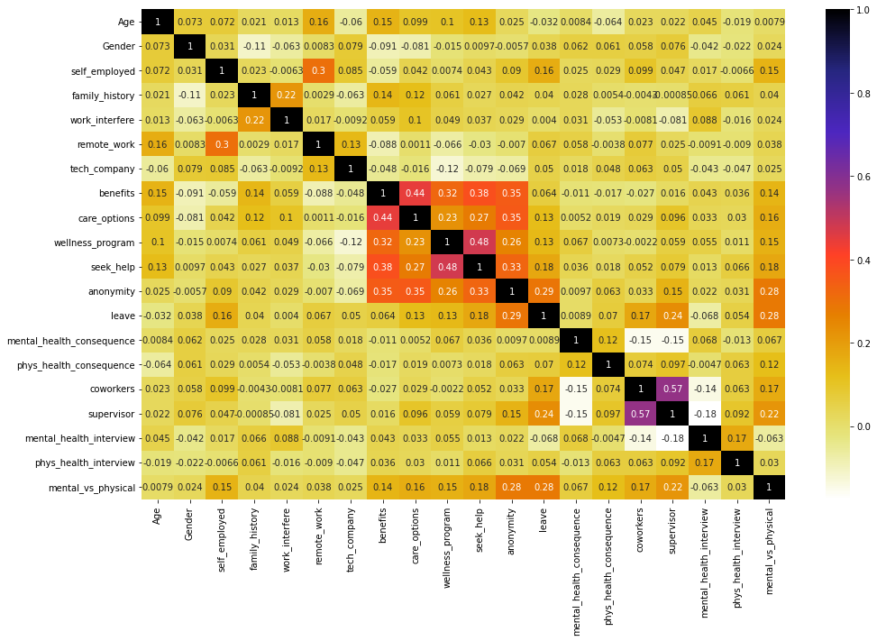
HEAT MAP

Slide 25
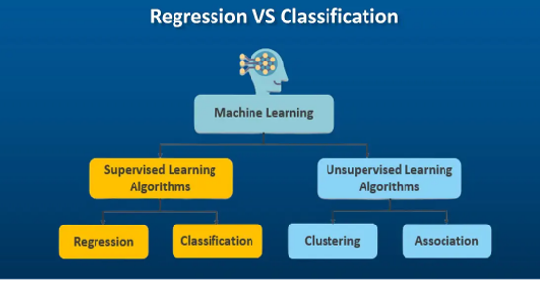
EVALUATING MODELS

Slide 26
Regression & Classification Algorithms
Regression | Classification
Simple Linear Regression | Logistic Regression
Multiple Linear Regression | K-Nearest Neighbours
Polynomial Regression | Support Vector Machines
Support Vector Regression (SVR) | Kernel SVM
Decision Tree Regression | Naïve Bayes
Random Forest Regression | Decision Tree Classification
 | Random Forest Classification

Slide 27
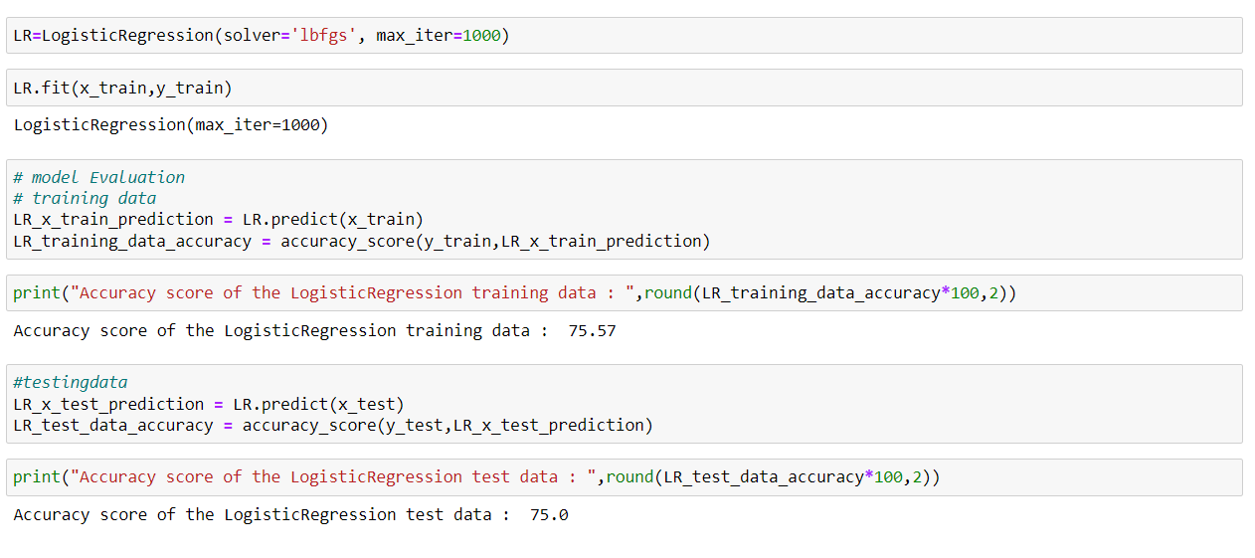
Evaluating With Classification Algorithms
LOGISTIC REGRESSION

Slide 28
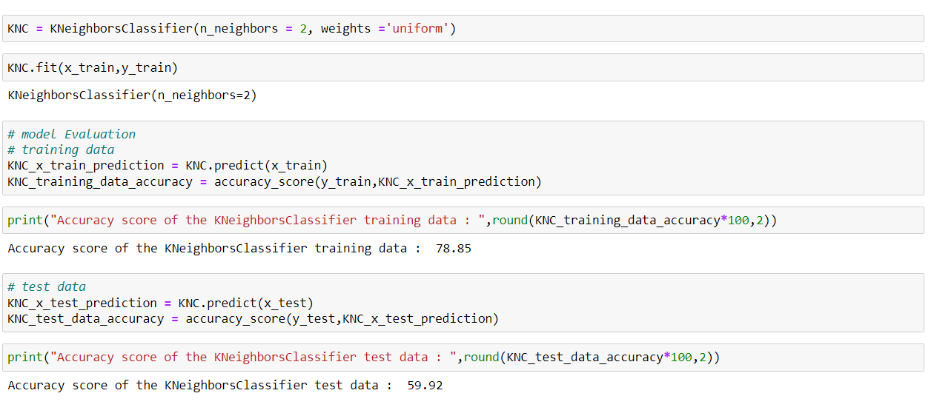
Kneighbors Classifier

Slide 29
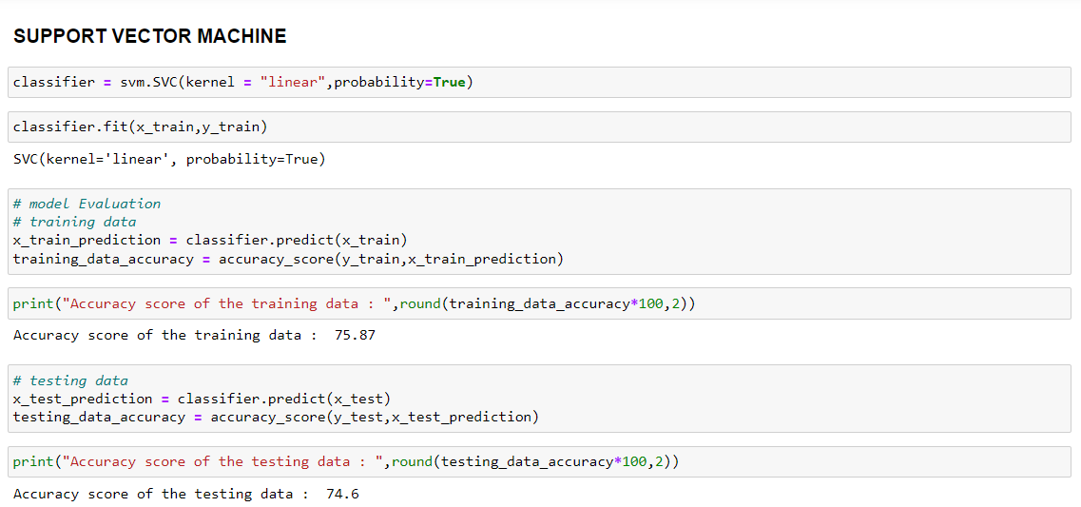
SUPPORT VECTOR MACHINE

Slide 30
Why I choose Classification ? Why Not Regression ?
Regression:
Few more examples of regression problems –
Price of a liter of petrol
Value of a stock
The popularity of a newly released album
Sales revenue generated by a business
Classification
Few more examples of classification problems –
Spam texts/e-mails
Segregation of waste
Cancer detection
Churn Prediction

Slide 31
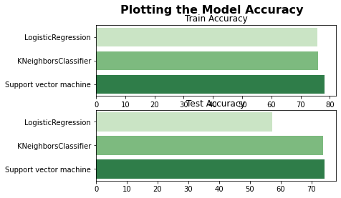
COMPARING MODEL ACCURACY
Models | Accuracy
Logistic Regression
Kneighbors Classifier
Support Vector Machine
Models | Accuracy
Logistic Regression
Kneighbors Classifier
Support Vector Machine

Slide 32
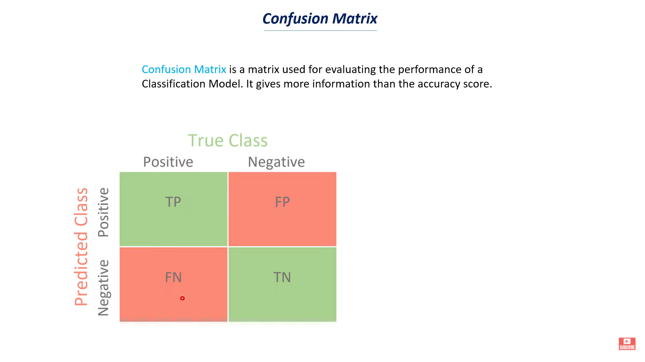
CONFUSION MATRIX
TRUE POSITIVE | Correct Prediction
FALSE POSITIVE | Wrong Prediction
FALSE NEGATIVE | Wrong Prediction
TRUE NEGATIVE | Correct Prediction

Slide 33
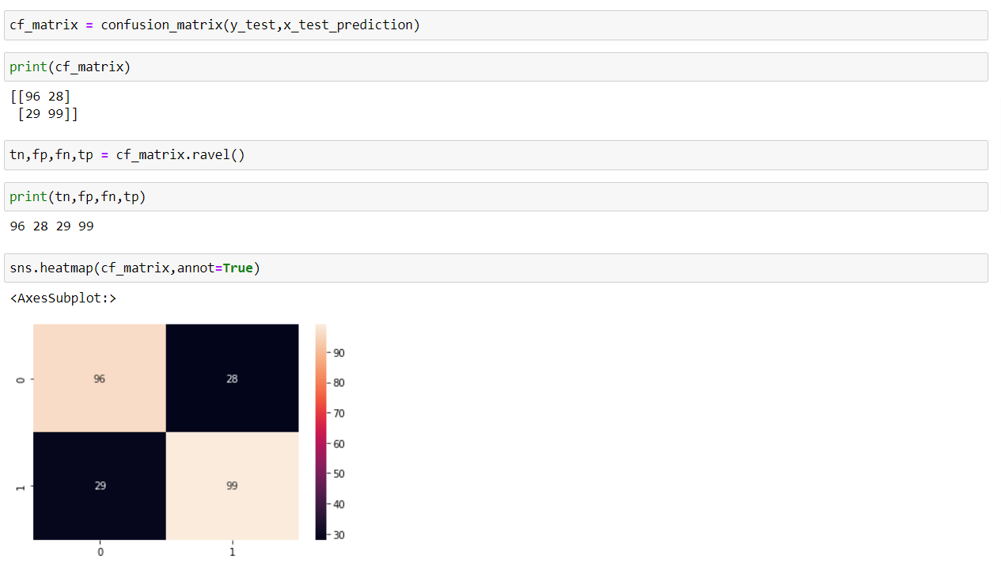
Confusion Matrix (SVM)

Slide 34
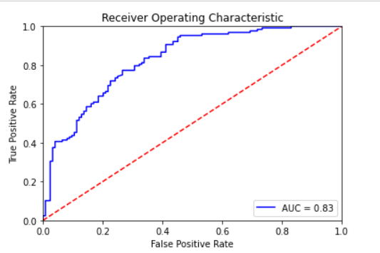
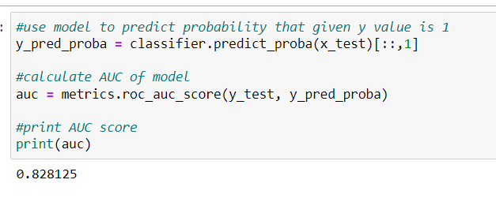
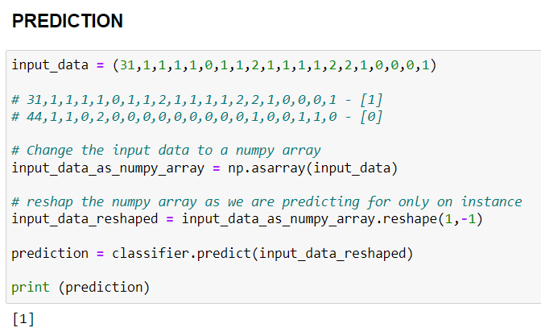
Receiver Operating Characteristic curve (ROC)
Area Under The ROC Curve (AUC)

