Slide 1
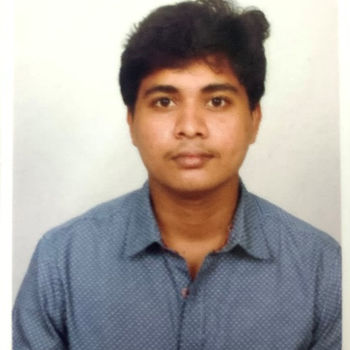

LEELA SRIKANTH D
Analyst/Software Engineer
Bachelor of Civil Engineering
: 2017 - 2021
Hyderabad
Skills
leela-srikanth.dokku@capgemini.com
TECHNICAL | Core Java, Spring Boot, AWS
DATABASE | SQL database – Oracle, MySQL No SQL database – MongoDB
UI Tech | HTML 5 & CSS 3,JavaScript, Bootstrap, React, Angular
Tools | Git
Add On skills | Peer learning, Github, Postman.
Additional Skills: | Project Management, Team Building, Project Management, Team Leader, Strategic/Tactical Planning, Business Analysis and Development, Excellent Communication and Interpretation skills
+91 6304047464
A4
Trained On OUTSYSTEMS and POWERAPPS
I am an A4 Analyst who has successfully completed learning and development training of JavaScript FullStack 2.0 with React. I would be glad to obtain a responsible position in organization and serve it with my determination and honesty and to enhance my skills to achieve the goals of the company.
Hands on experience in developing web pages using HTML5, CSS3, Object Oriented Java script, React and Angular.
AWS Certified Cloud Practitioner
Agile Software Development by Coursera(March-2022)
Movie Ticket Booking Application
Completed end to end case study of Movie ticket booking application System. Swagger,Postman, responsive UI with HTML5, CSS, Bootstrap and React used as User Interface.

