Slide 1
Practical 5
Session Topic:Simple ANN Model To Classify Into Multiple Classes
Deep Learning
(Course code: 18CS3074P)

Slide 2
Practical 5
Design a Simple ANN Model to Classify Multiple Classes that Contains one Input Layer, 3-4 Hidden Layers, and one Output Layer.
And Make Sure That Hidden Layers Should use Relu function
And Output Layer Should Use SoftMax Function.

Slide 3
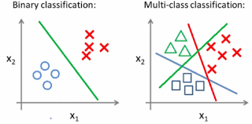

Slide 4
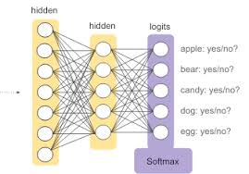

Slide 5
Important Packages Required
Keras
Sequential
Dense
load_model
Dense
Dropout
Activation

Slide 6
Importing of Required Packages
import keras
from keras.models import Sequential
from keras.layers import Dense
from keras.models import Sequential, load_model
from keras.layers.core import Dense, Dropout, Activation
from keras.utils import np_utils

Slide 7
Model Creation
Syntax for Creating Simple Model
# model = Sequential ()
# model.add(Dense(392, input_shape=(784,)))
Syntax for Adding Activation Function in Hidden Layers
#model.add(Activation('relu'))
Syntax for Adding Hidden Layers
# model.add(Dense(392))
Syntax for Adding Softmax in Final Layers
# model.add(Activation('softmax'))

Slide 8
Syntax To Compile & Run The Model
# model. compile(optimizer='adam’, loss='categorical_crossentropy',metrics=['accuracy’])
# model.fit(x_train,y_train,batch_size=64,nb_epoch=100)

Slide 9
Recap

