Slide 1
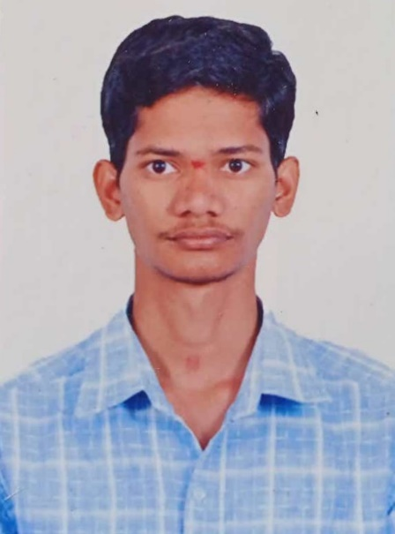

JUJJUVARAPU SRIKANTH
PROFILE | Proficient in Core Java Basic Knowledge of C,C++,HTML5,CSS,React,NestJS,MySQL,PL/SQL, Informatica Practical Knowledge in Spring, SpringBoot and MVC Hands on Experience on MYSQL DB, NestJS, Informatica
EXPERIENCE | Implementation of projects on using Java . Implementation of JavaScript with Bootstrap. Implementation of NestJS using TYPEORM. Implementation of projects on Informatica using Transformations and PL/SQL.
HIGHLIGHTS & SKILLS | Programming languages: HTML5, CSS, JAVA8,Informatica. Frameworks: Spring, Spring Boot, MVC, NestJS, React. J2EE Technologies: Servlets, Hibernate, JDBC. Data bases : Oracle, MySQL, PL/SQL.
Jujjuvarapu Srikanth

