Slide 1
DESIGN THINKING ASSIGNMENT
LOST AND FOUND

Slide 2
PROBLEM STATEMENT
• Students often loose their belongings in the vast college campus
• Finding it again takes quite the effort
• Brute force searching is not always a preferable option
• Therefore, there must exist a system where students can report items they find in random places, while the person who lost it can get to know about it through the same system, in a much more reliable manner

Slide 3
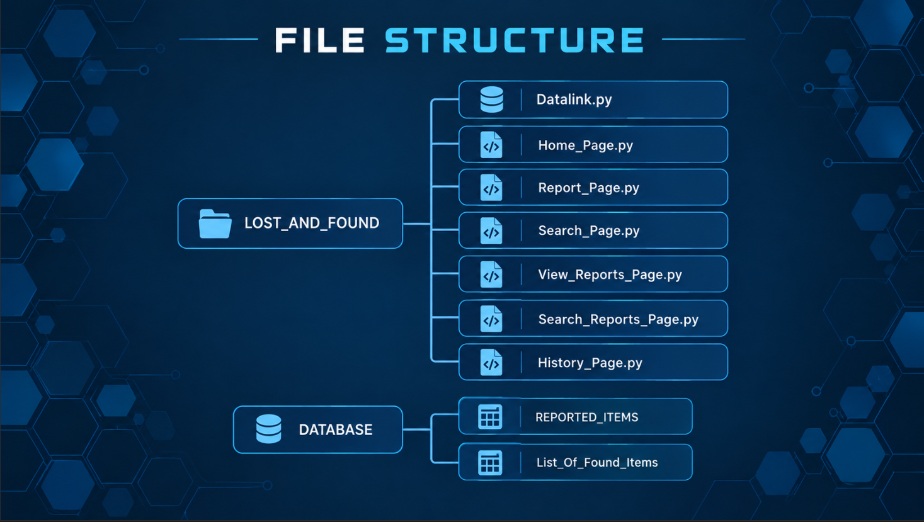

Slide 4
FRONT END

Slide 5
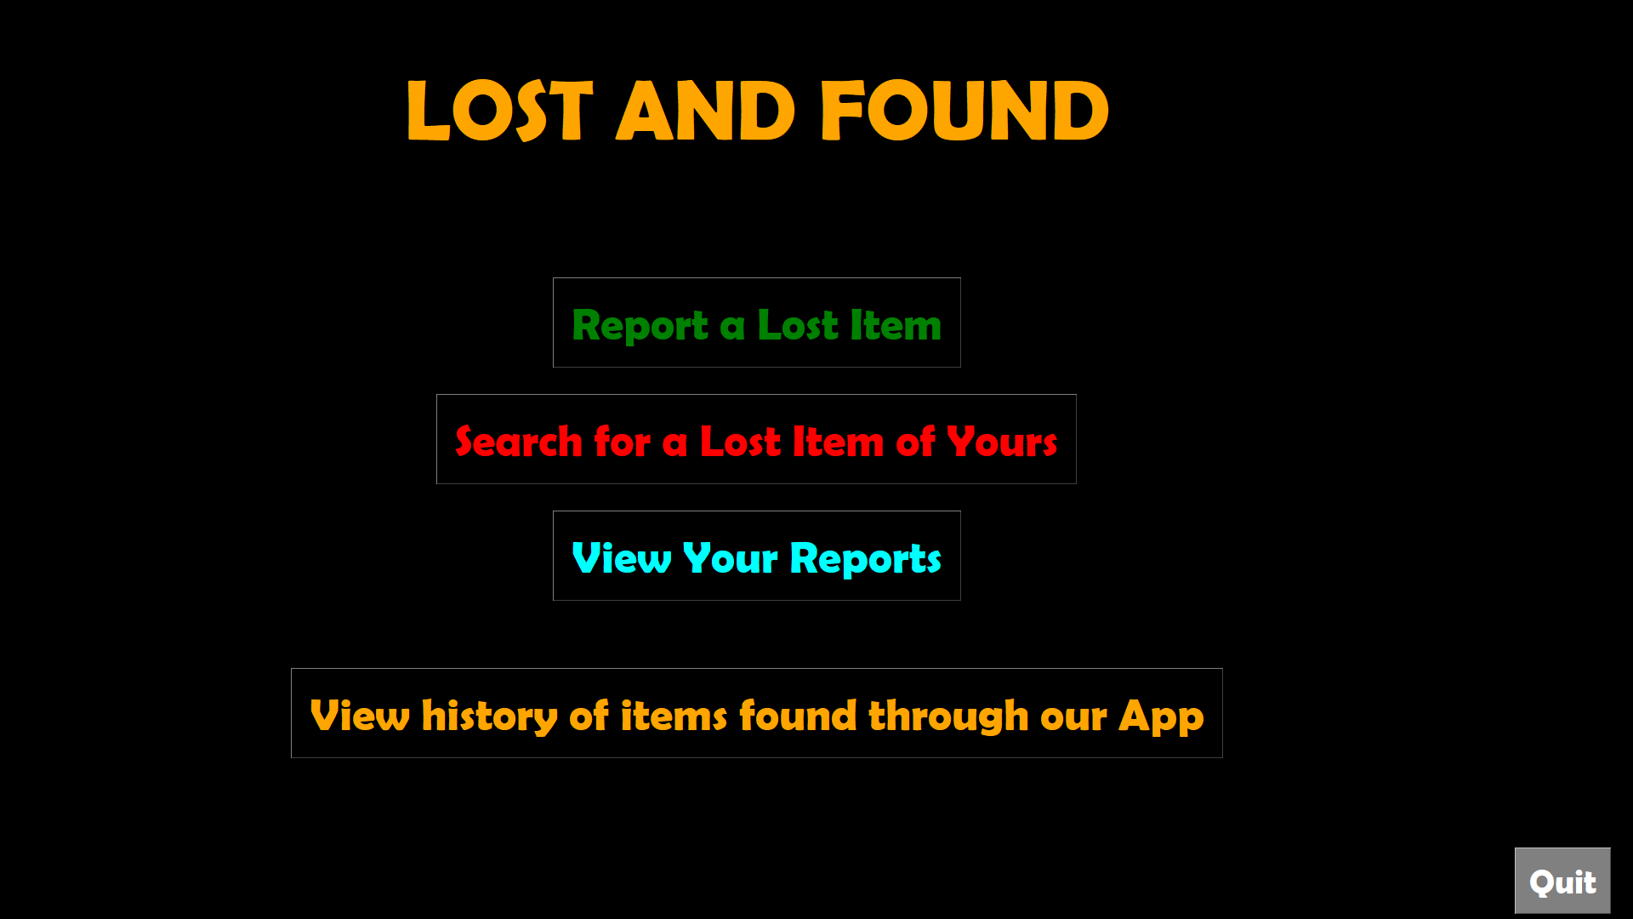

Slide 6
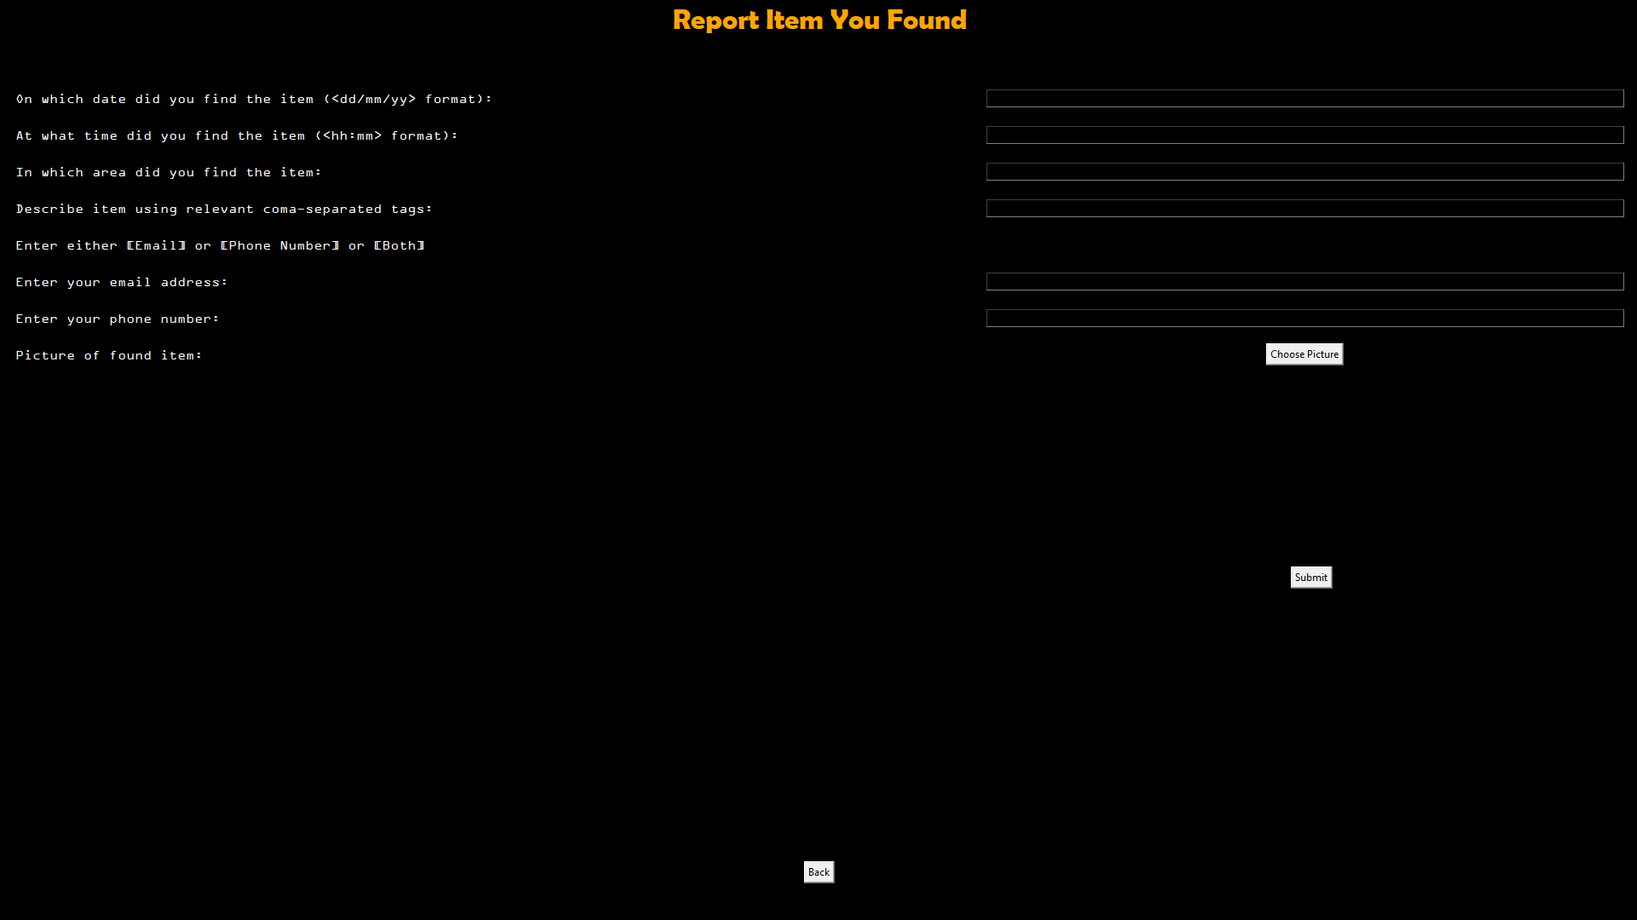

Slide 7
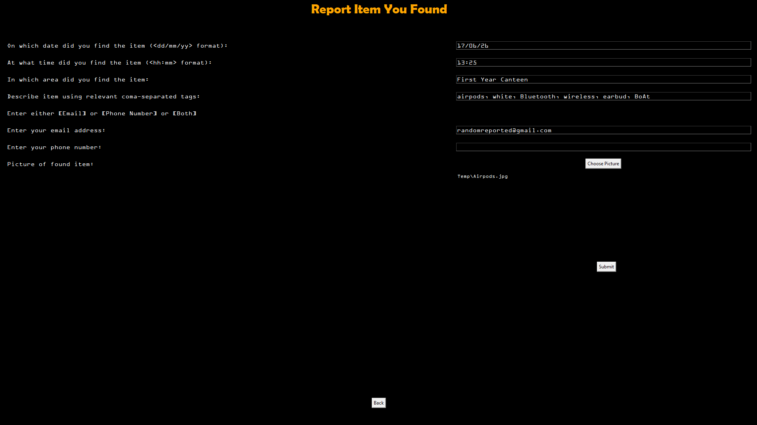

Slide 8
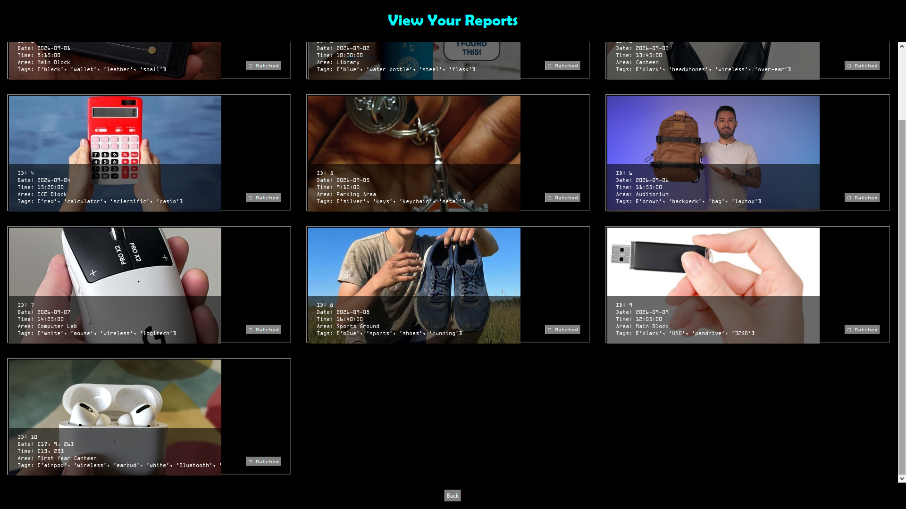

Slide 10
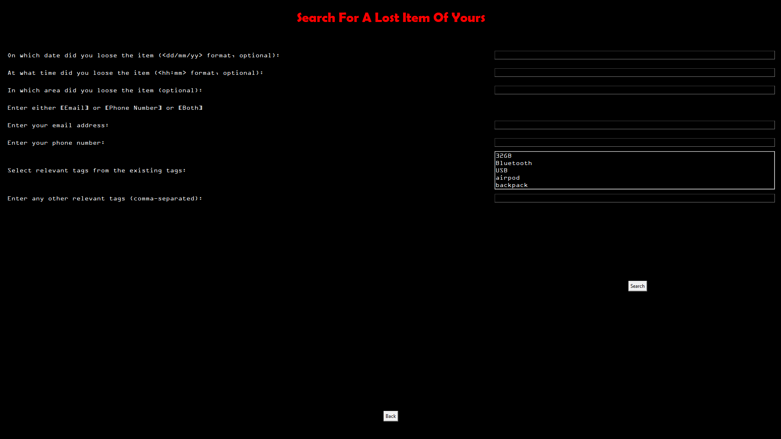

Slide 11
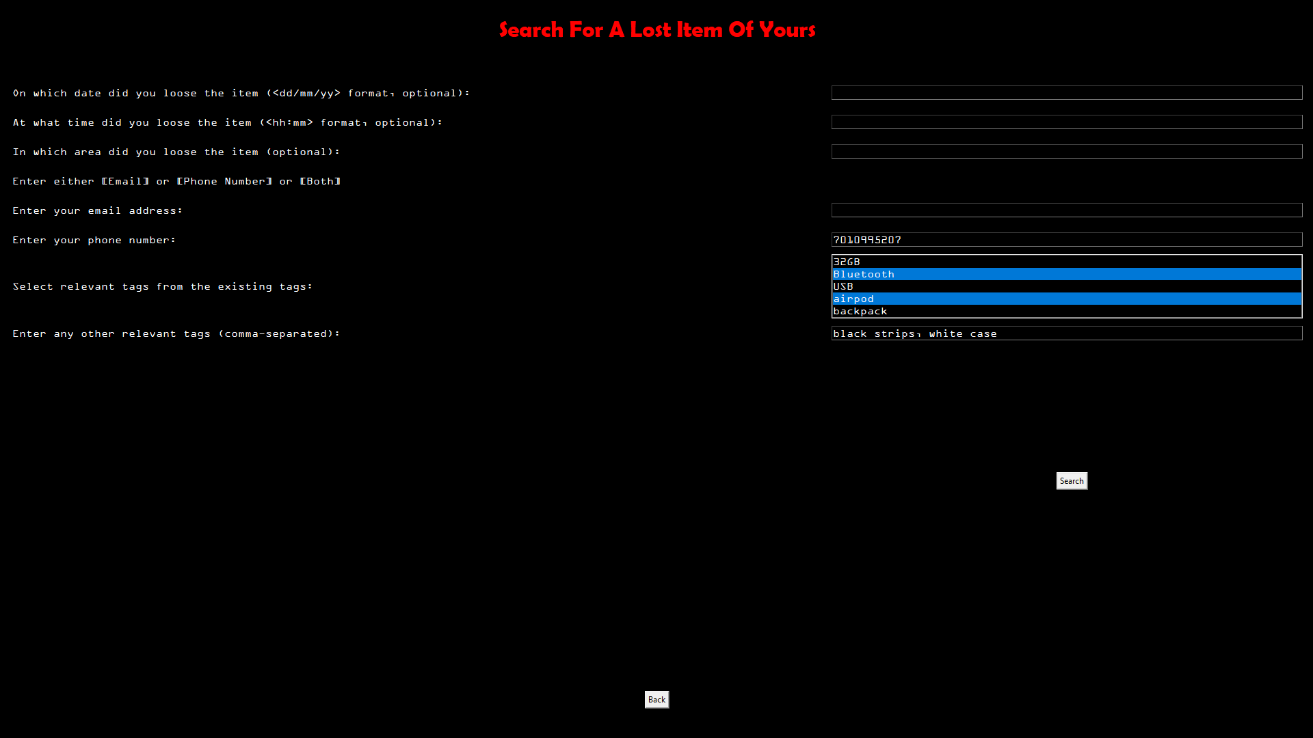

Slide 12


Slide 13
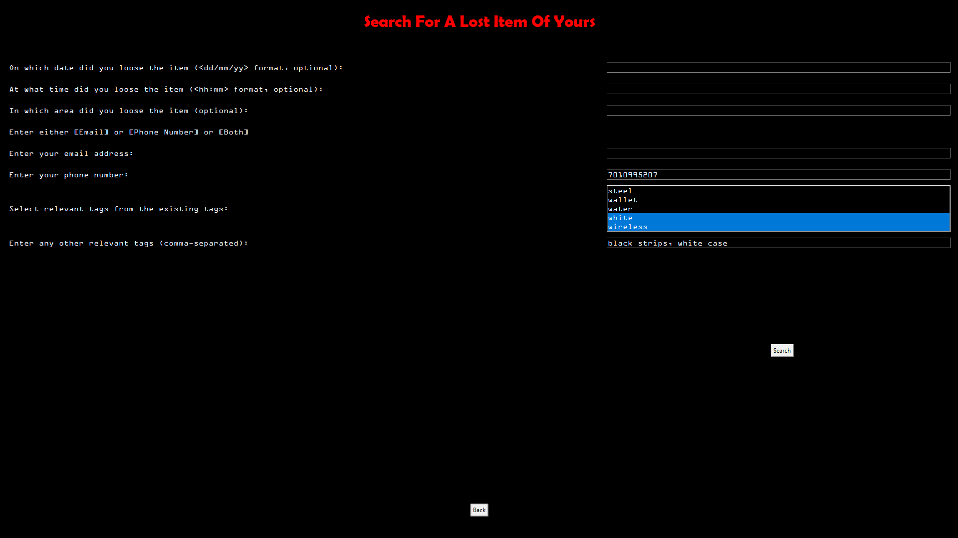

Slide 14
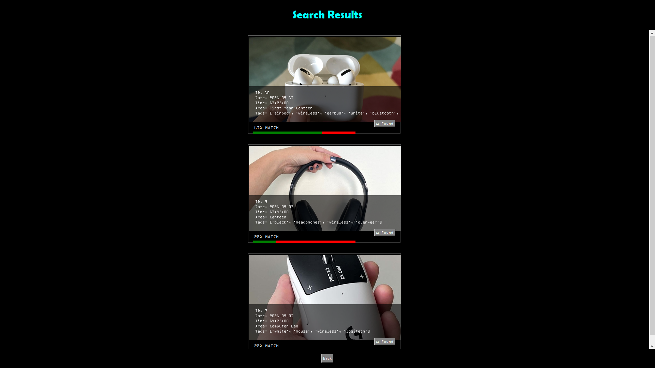

Slide 16
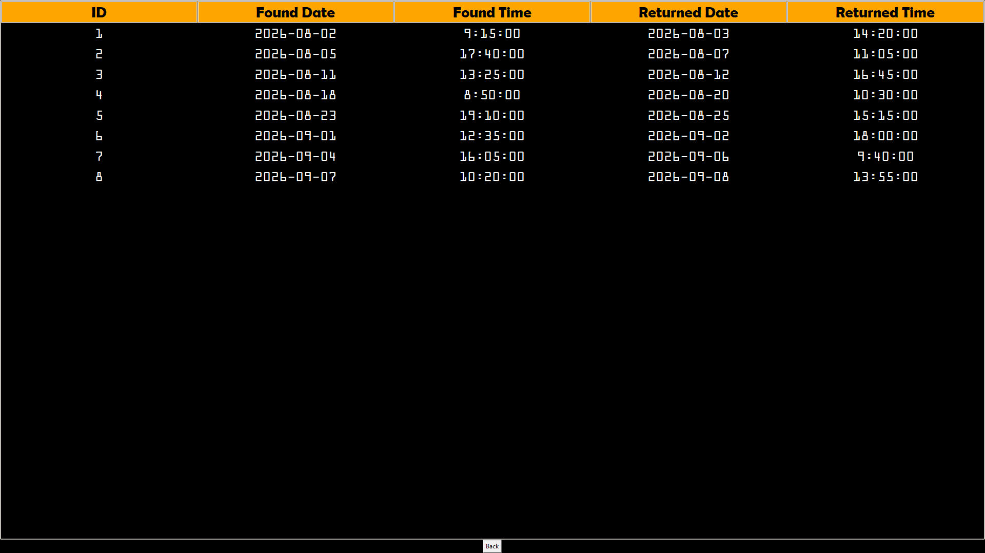

Slide 17
BACK END

Slide 18
Home_Page.py

Slide 19
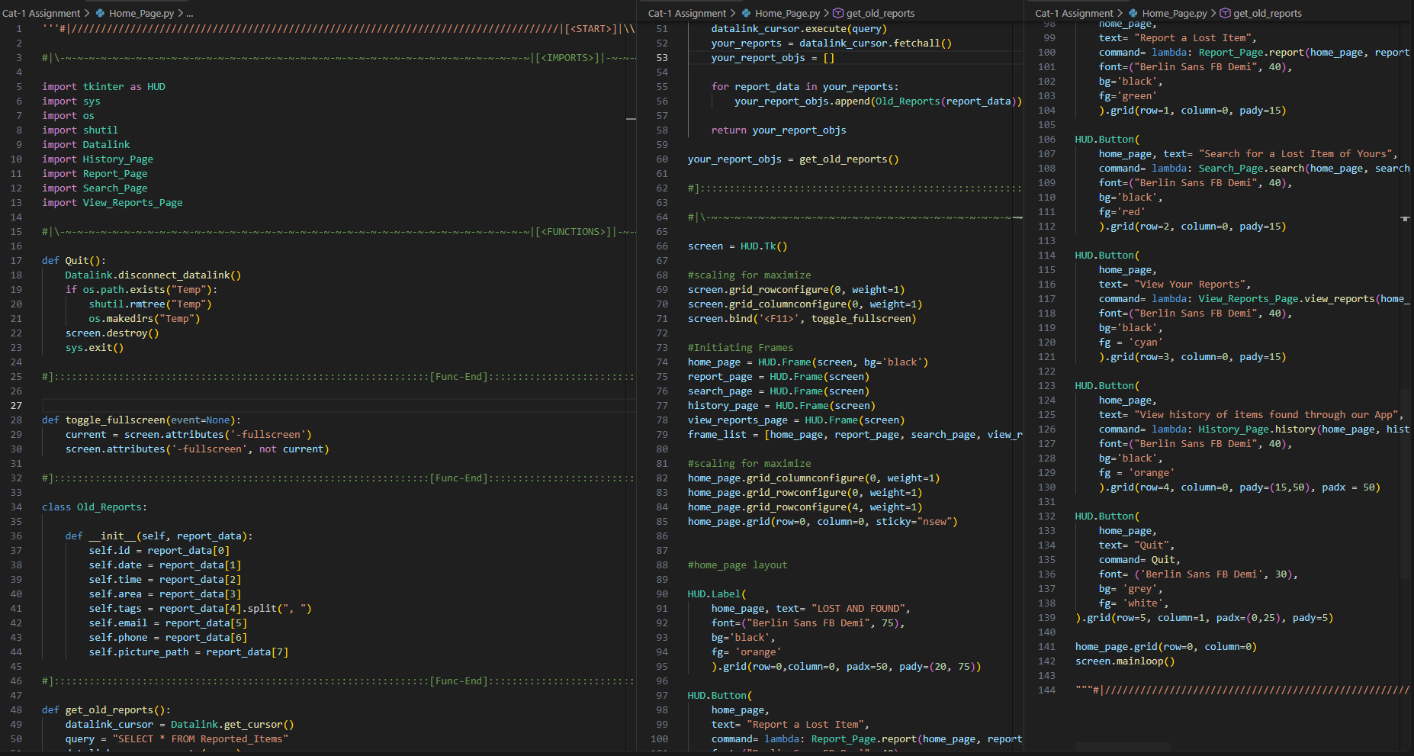

Slide 20
Report_Page.py

Slide 21
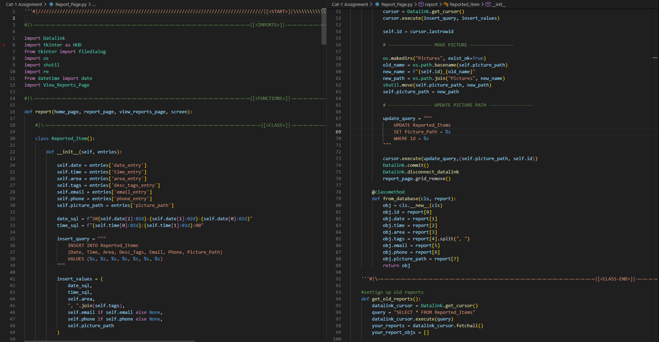

Slide 22
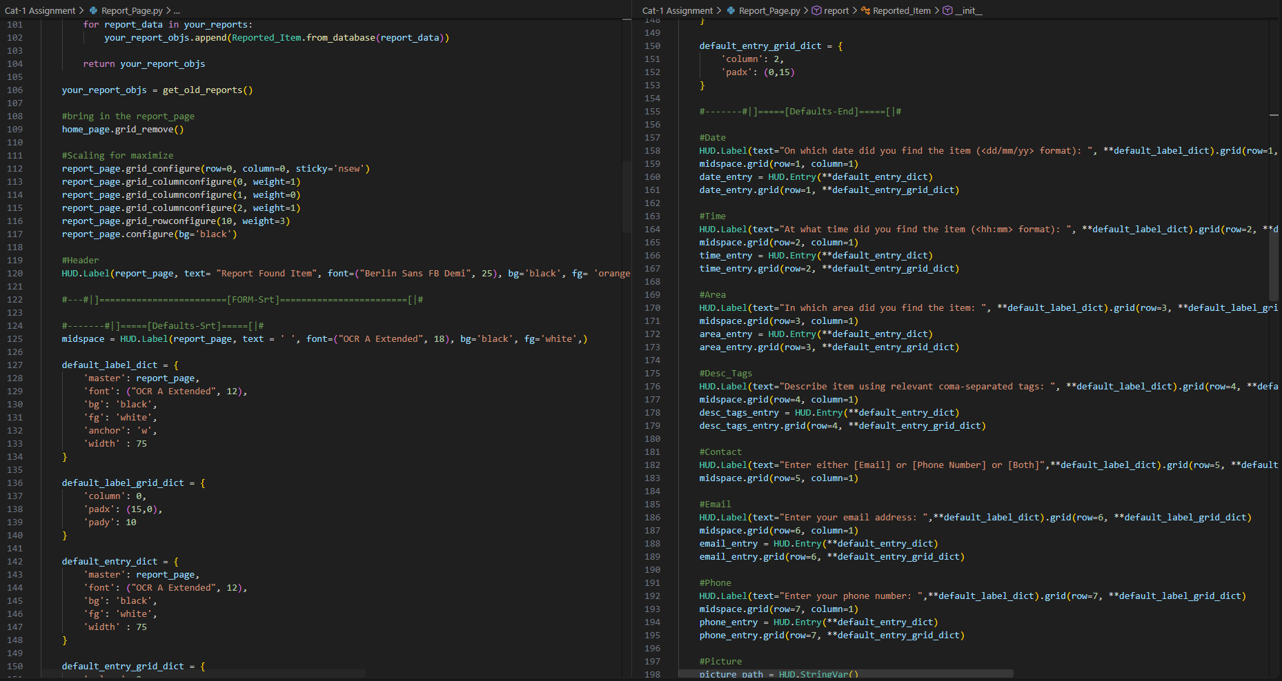

Slide 23
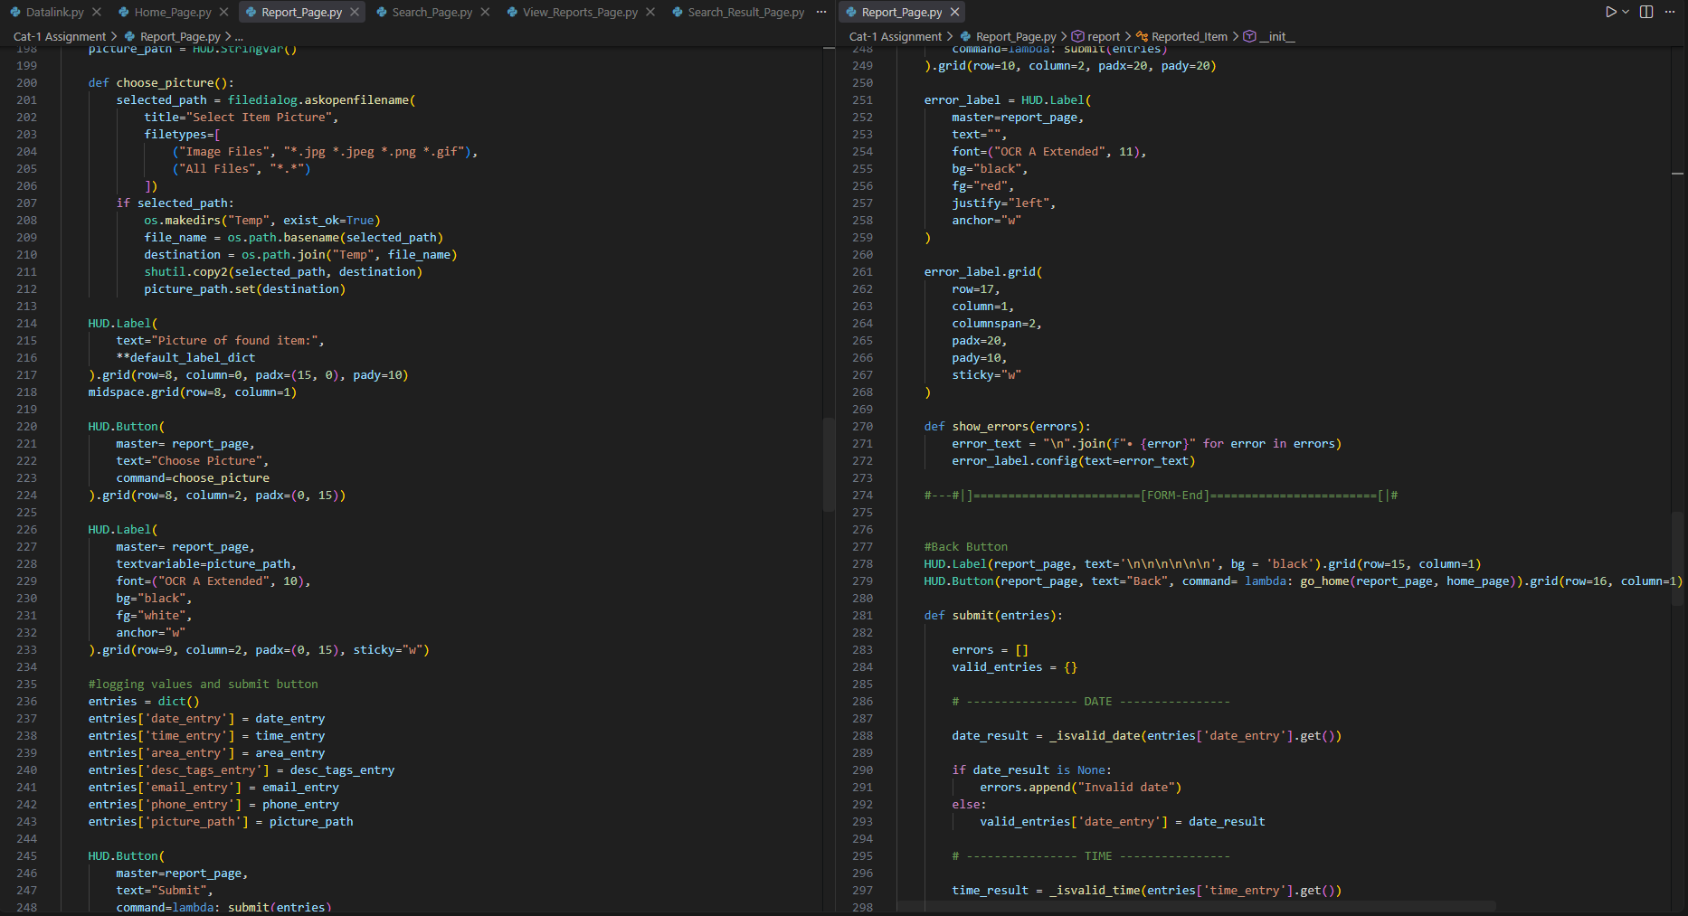

Slide 24
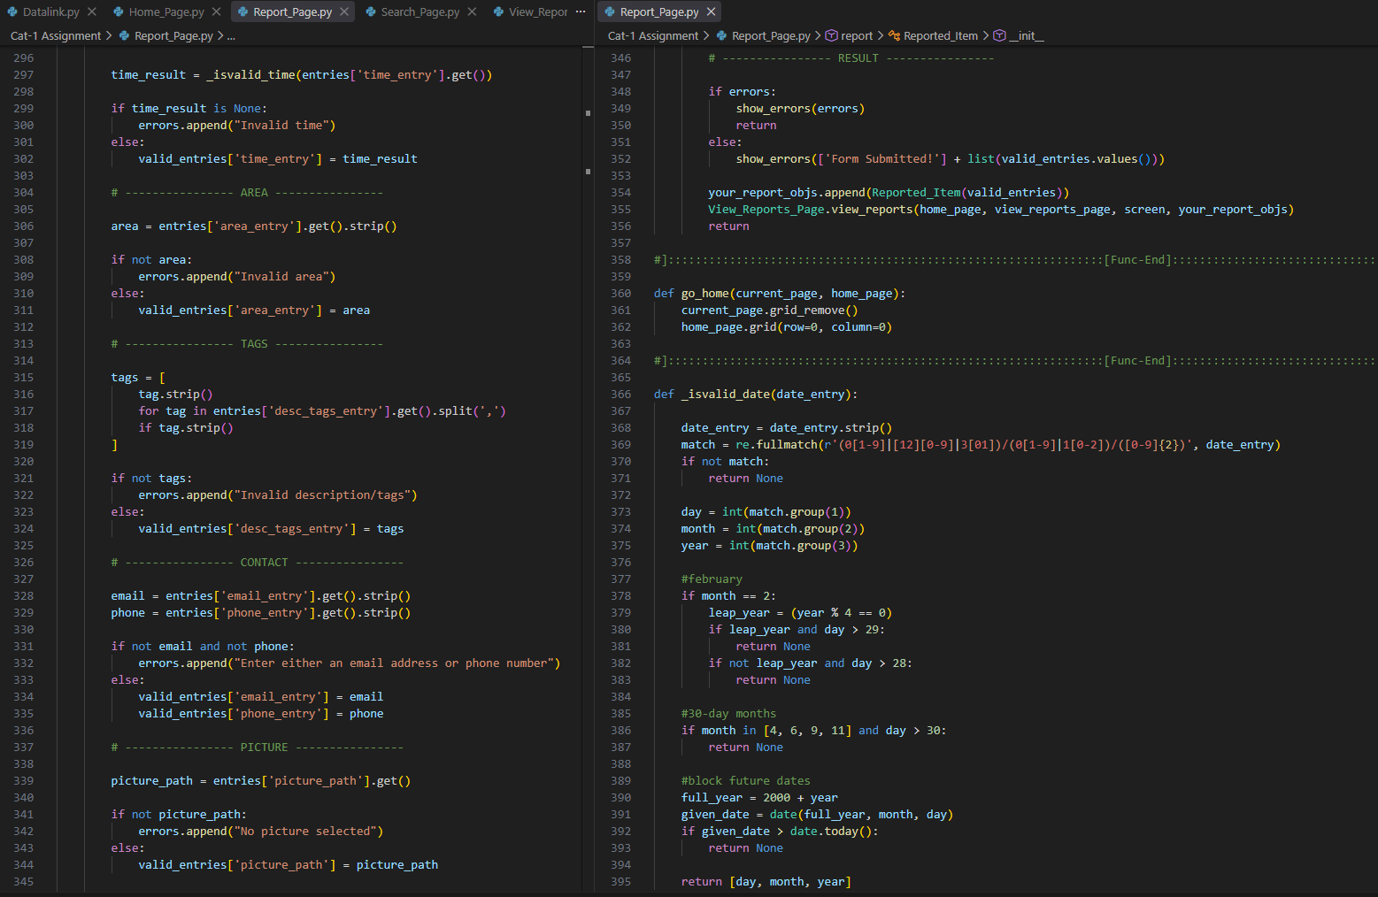
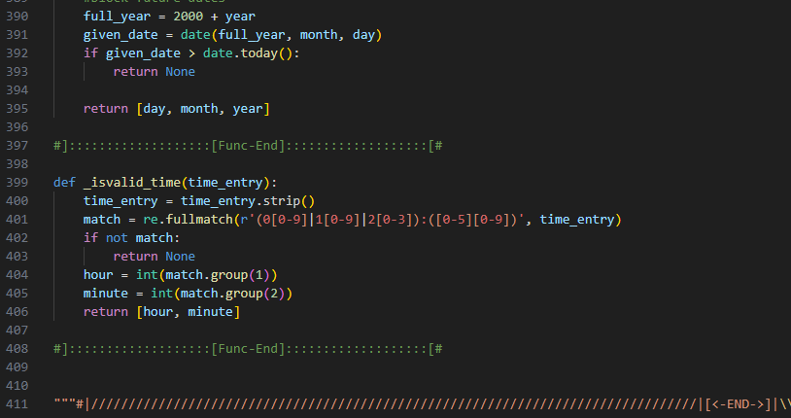

Slide 25
Search_Page.py

Slide 26
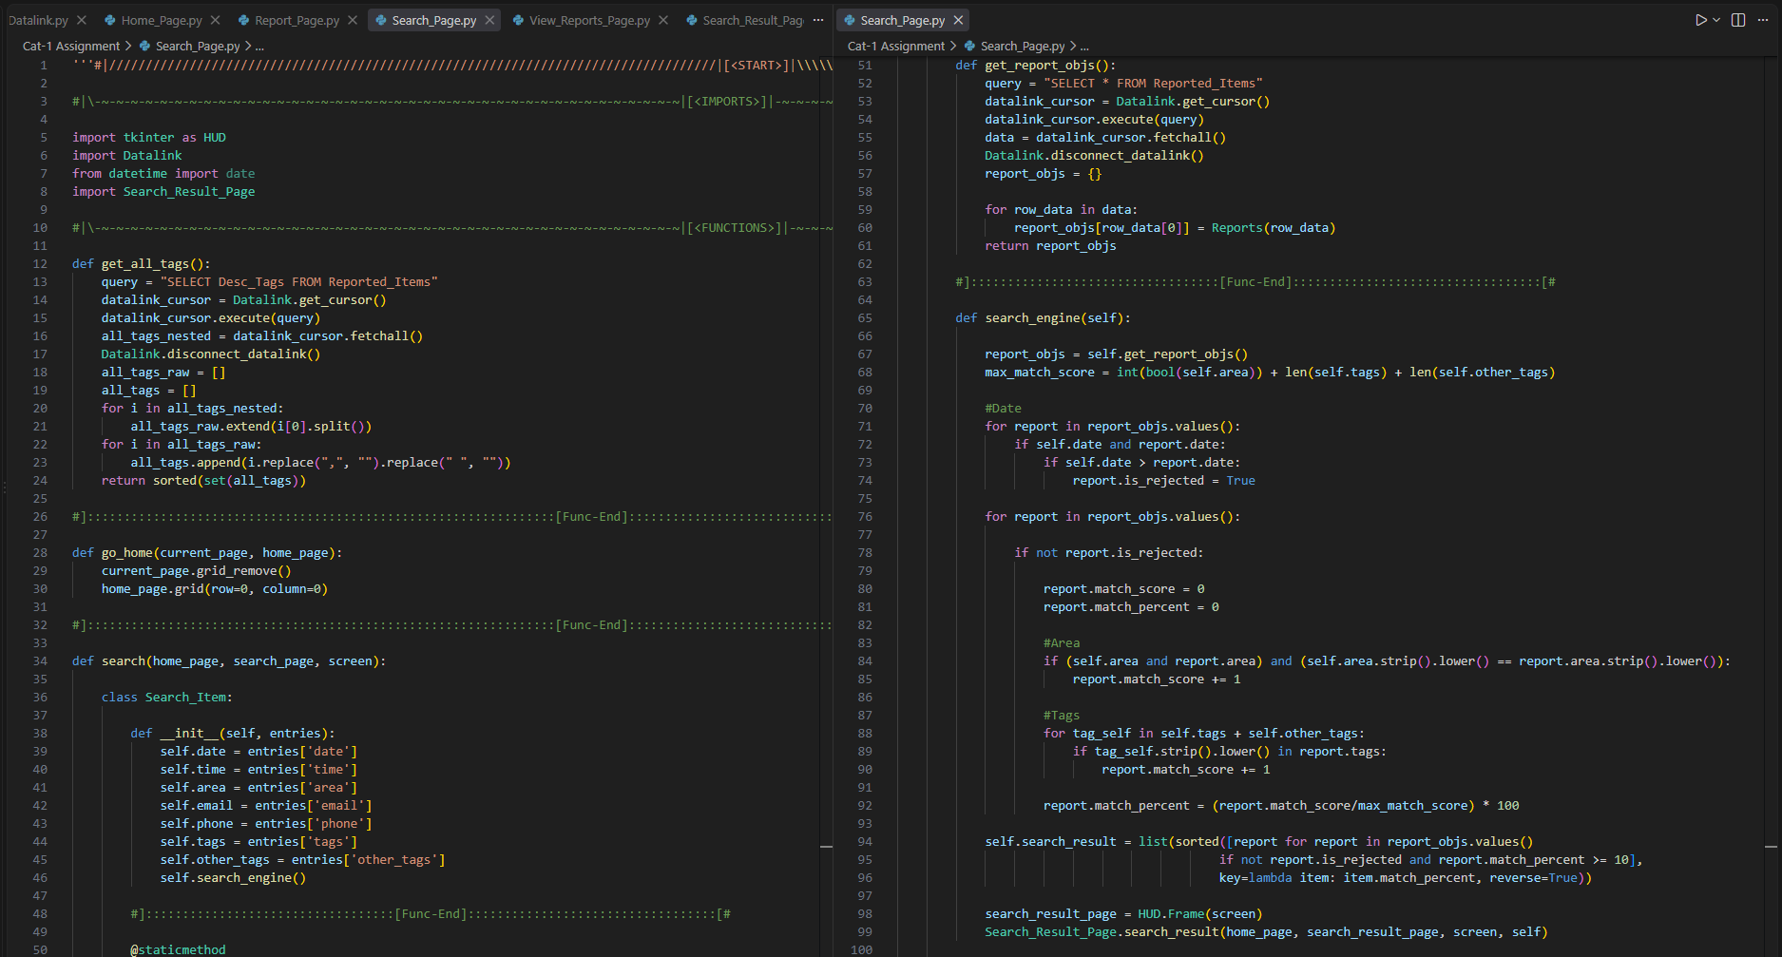

Slide 27
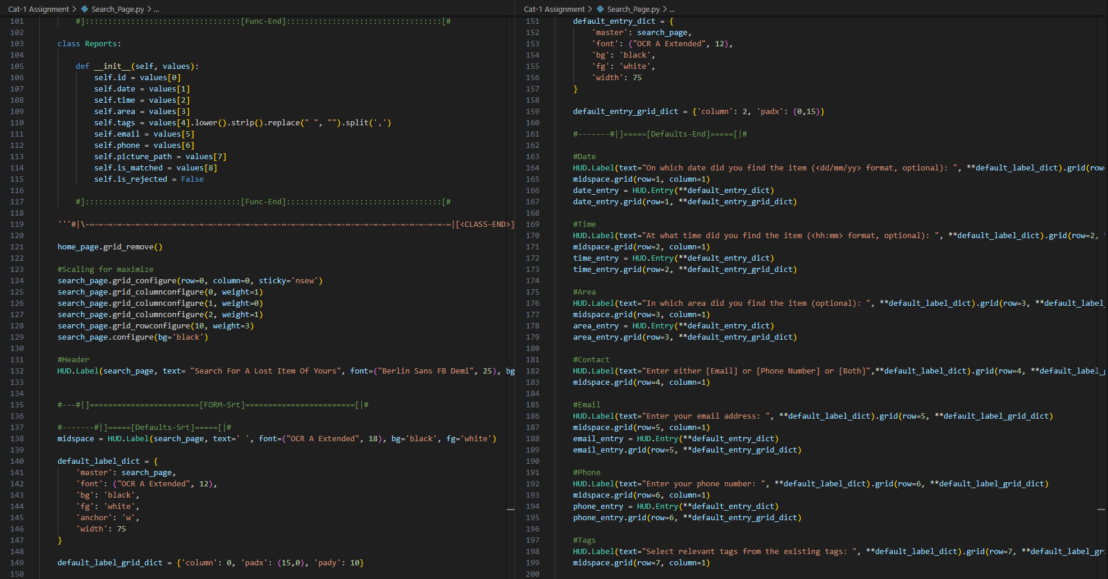

Slide 28
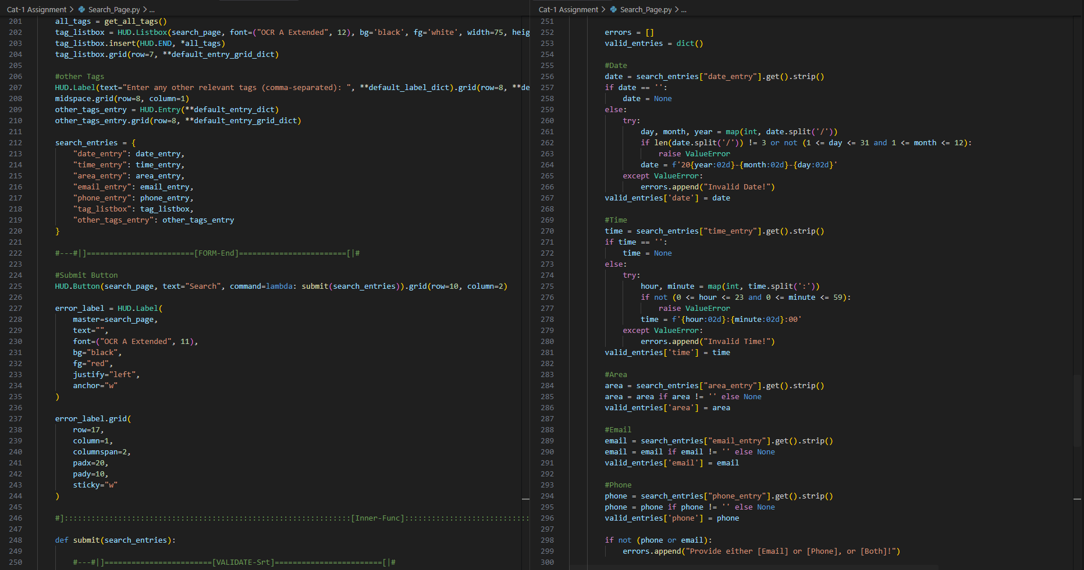

Slide 29
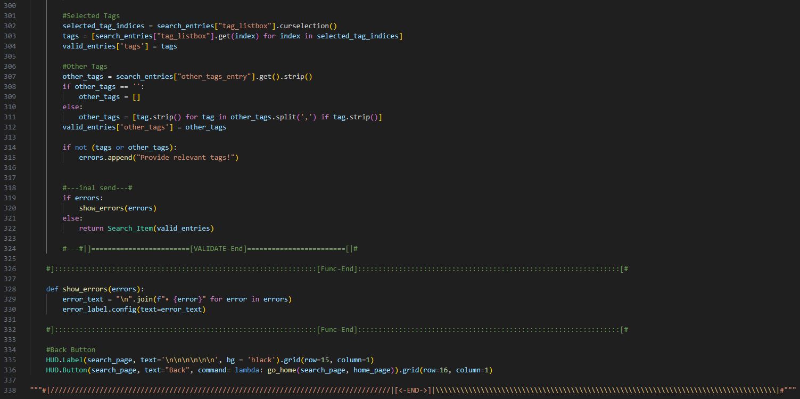

Slide 30
View_Reports_Page.py

Slide 31
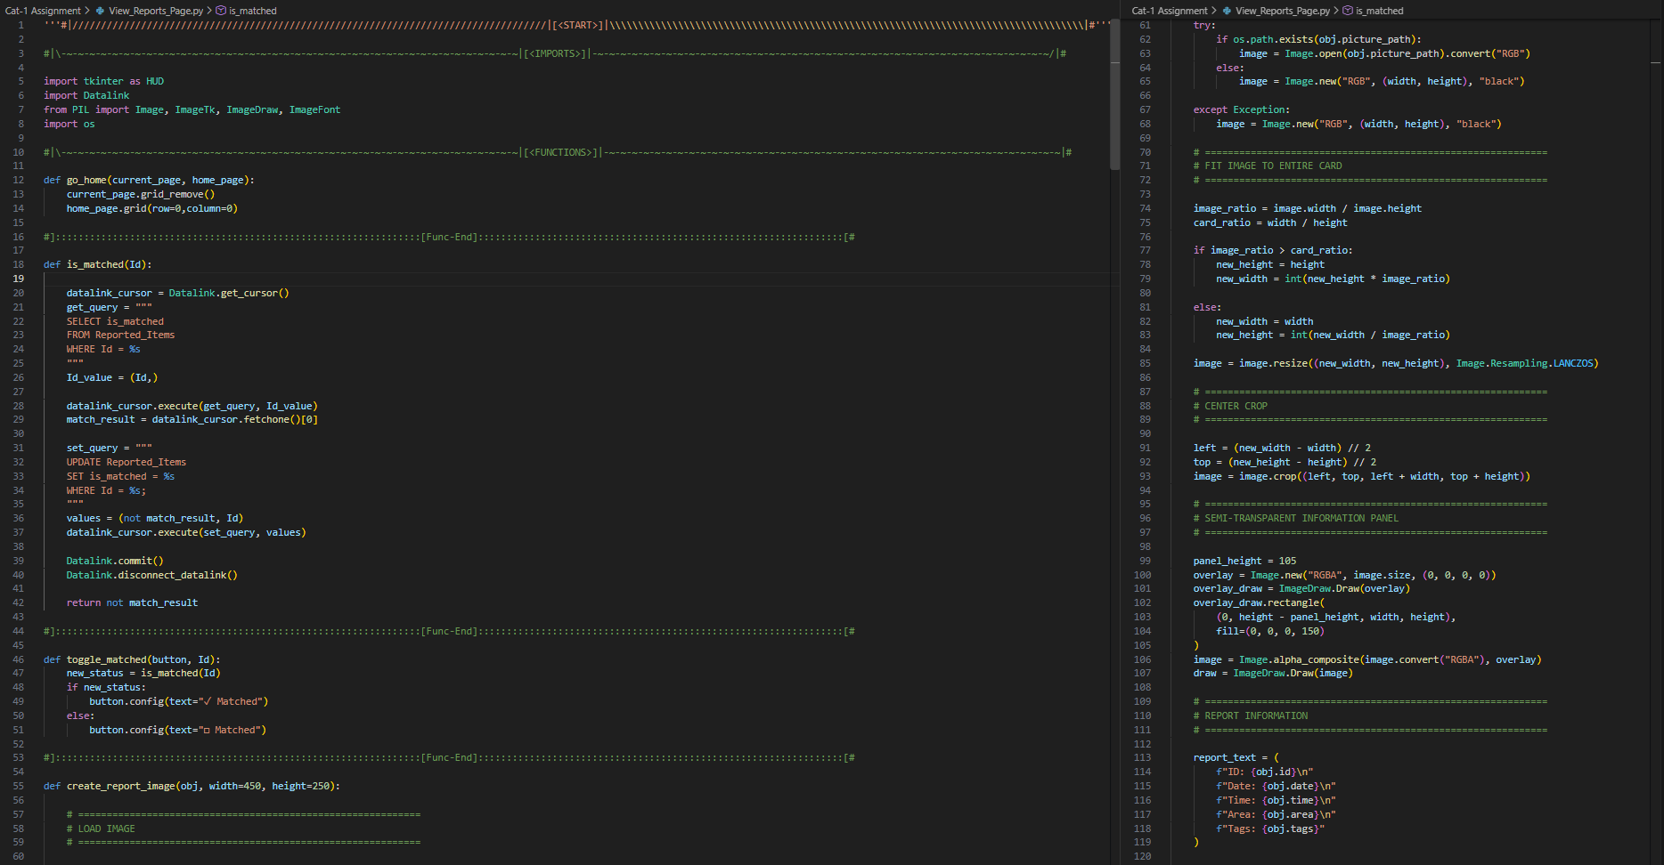

Slide 32
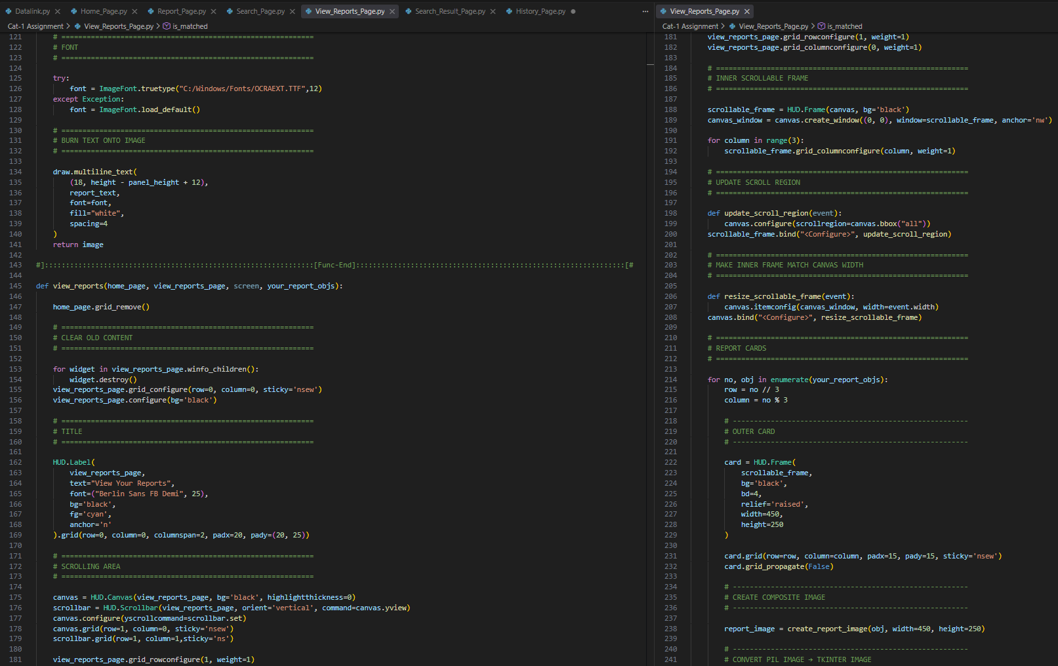

Slide 33
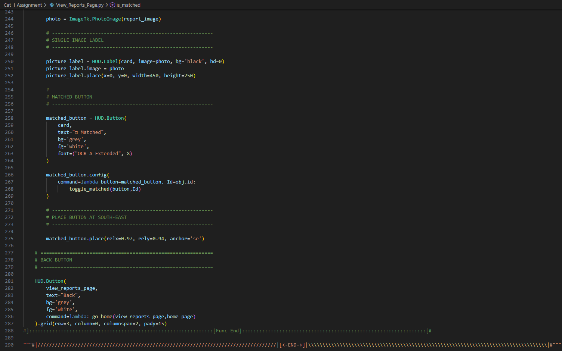

Slide 34
Search_Results_Page.py

Slide 35
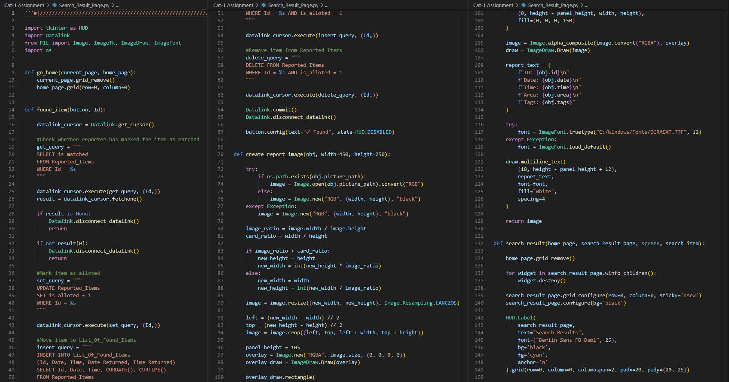

Slide 36
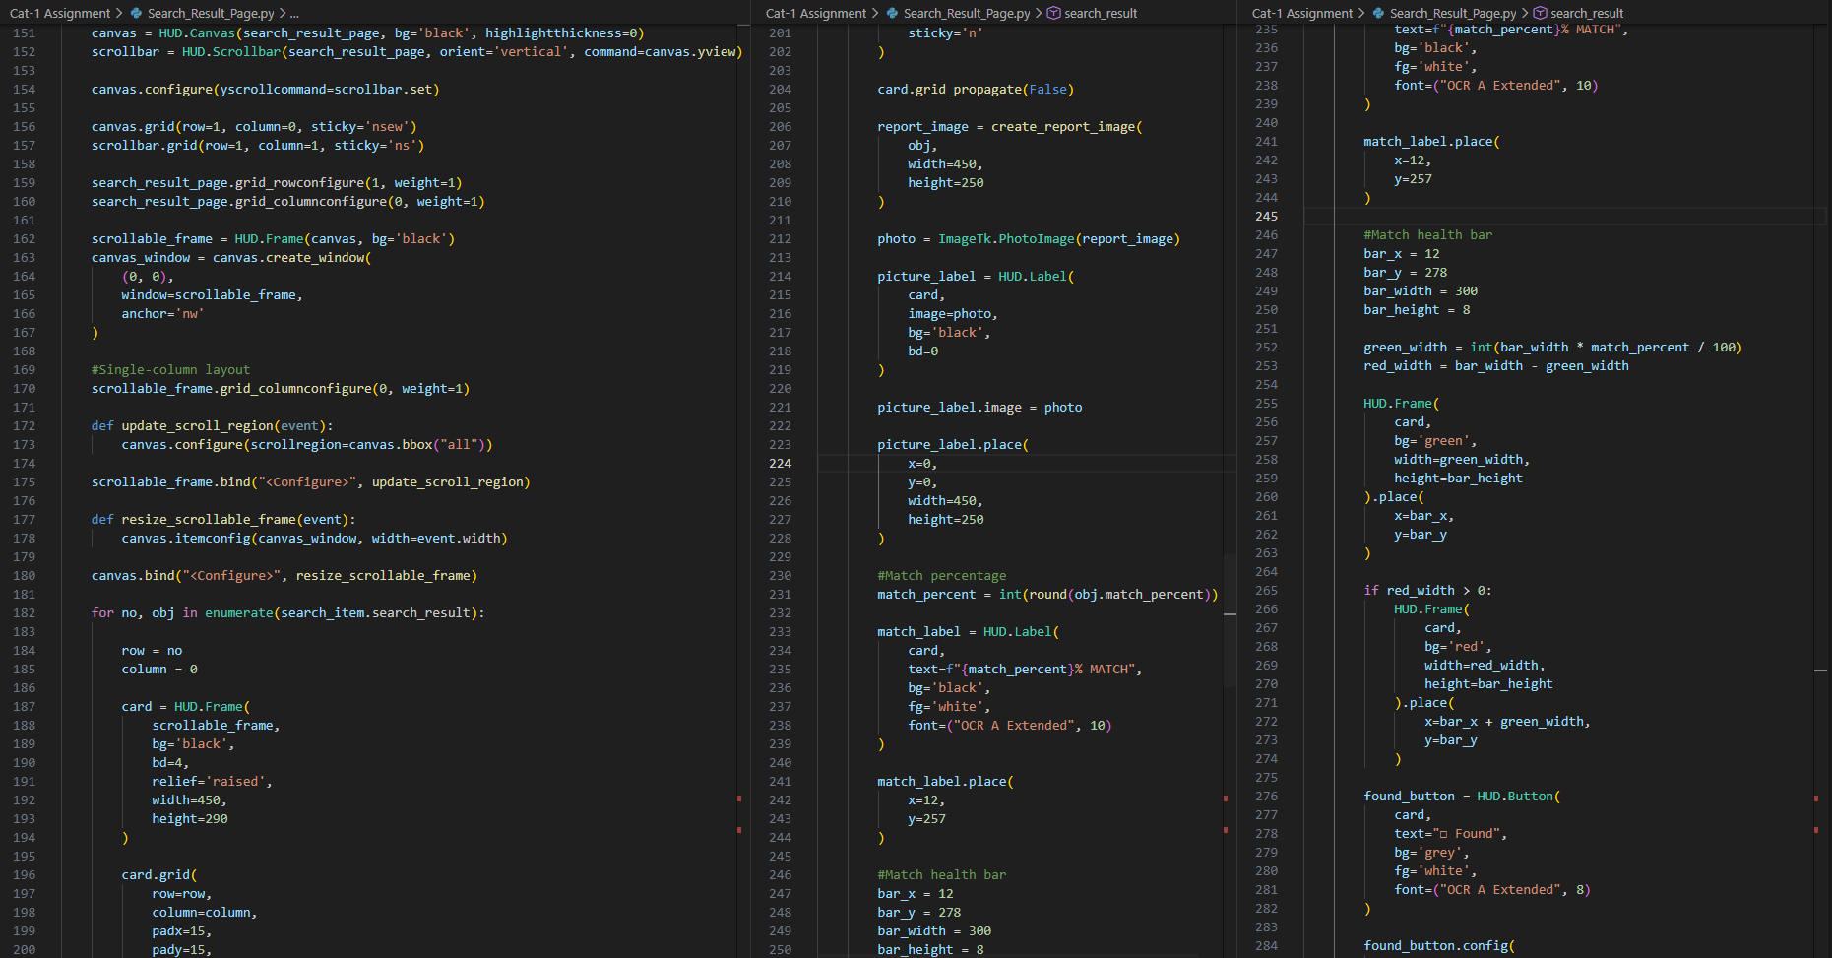

Slide 37
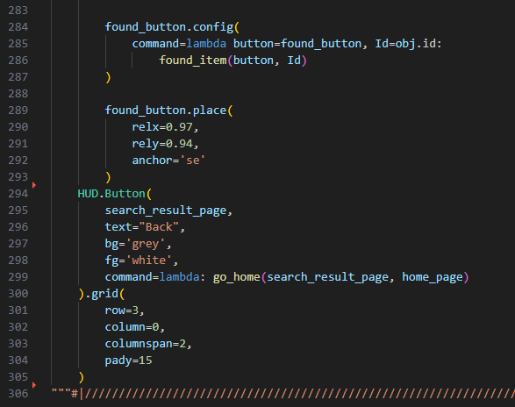

Slide 38
History_Page.py

Slide 39
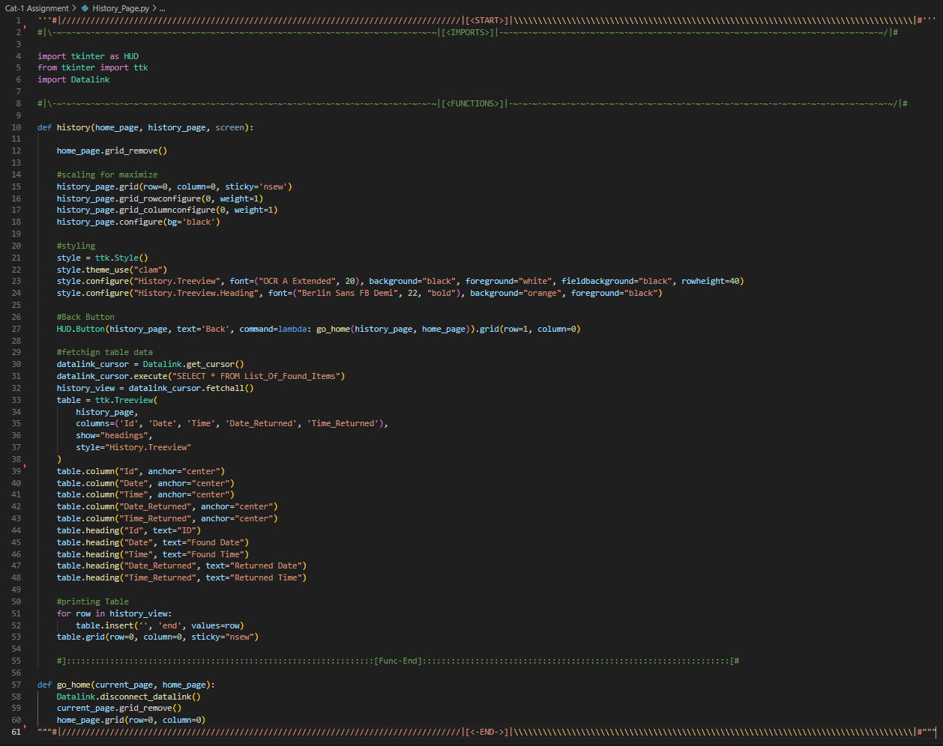

Slide 40
Datalink.py

Slide 41
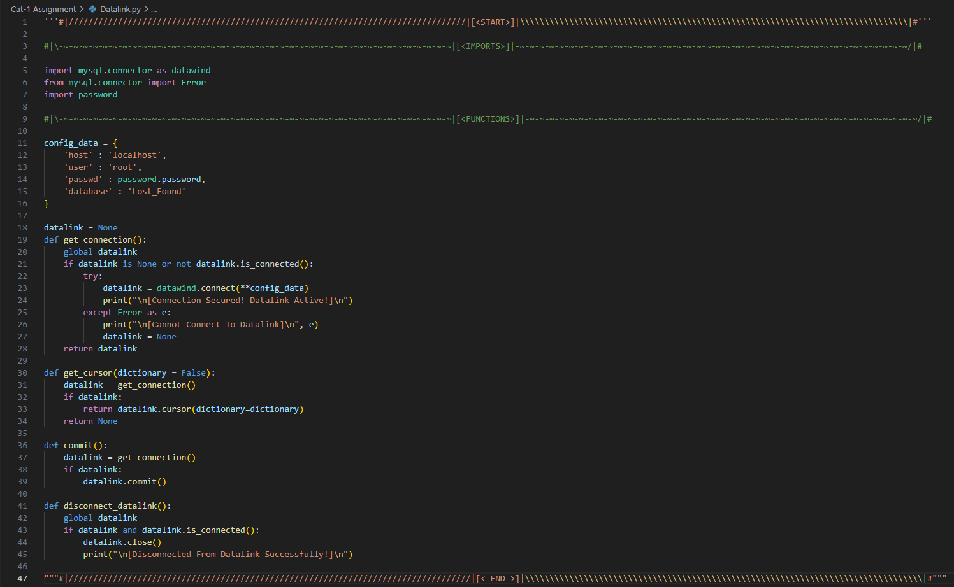

Slide 42
Future Enhancements
The application can be developed into a web or mobile application for easier access across different devices.
An advanced image-matching system can be implemented to compare uploaded pictures and improve the accuracy of search results.
Notifications can be added to alert users when a potential match for their lost or found item is identified.
Location-based searching can be introduced using maps and GPS to improve the accuracy of area-based matching.
User authentication can be added to provide secure accounts and protect user information.
The search algorithm can be further enhanced using machine learning to provide more accurate and intelligent matching.

Slide 43
THANK YOU

