Slide 1
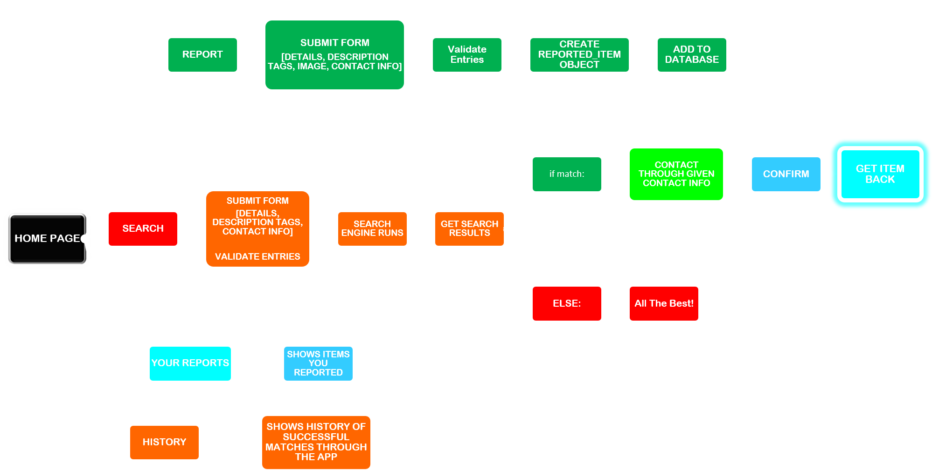
HOW OUR PROGRAM WORKS

Slide 2
FILE STRUCTURE
LOST_AND_FOUND
Datalink.py
Home_Page.py
Report_Page.py
Search_Page.py
View_Reports_Page.py
Search_Reports_Page.py
History_Page.py
DATABASE
REPORTED_ITEMS
List_Of_Found_Items

Slide 3
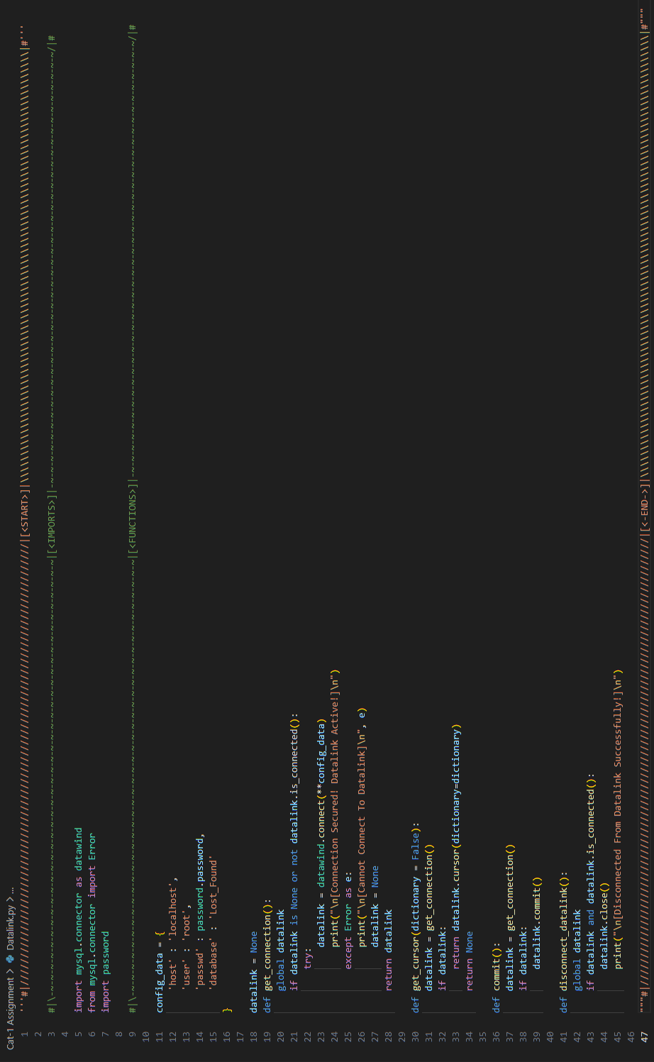
Datalink.py

Slide 4
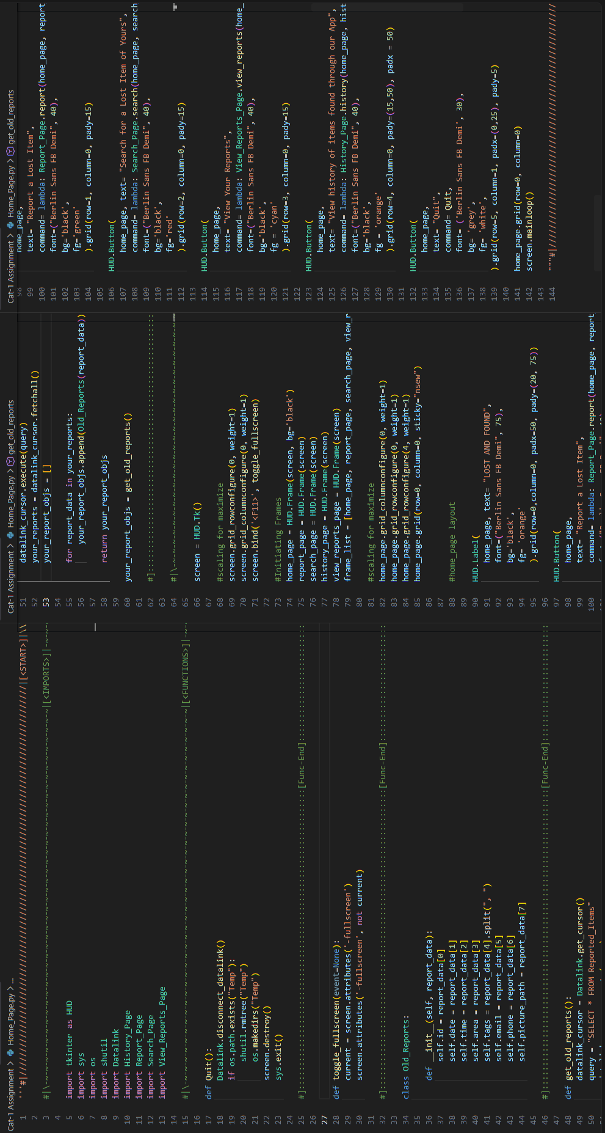
Home_Page.py

Slide 5
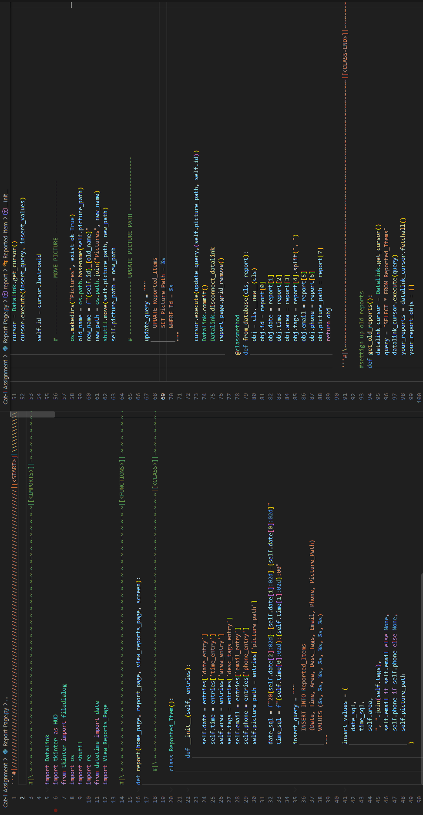
Report_Page.py

Slide 6
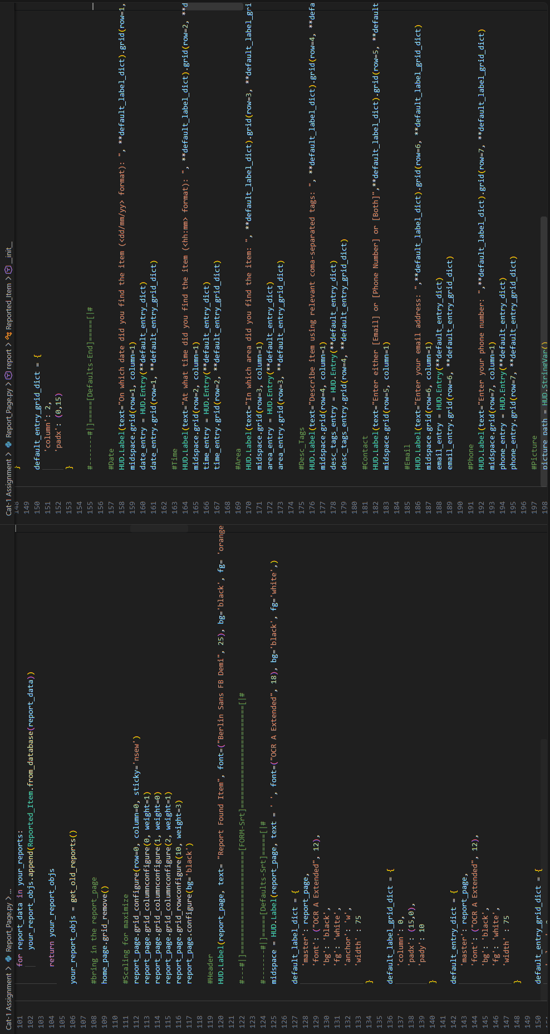
Report_Page.py

Slide 7
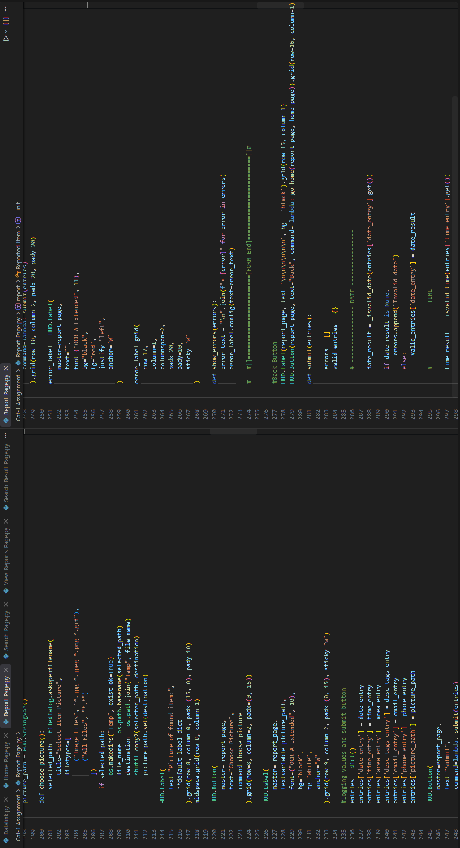
Report_Page.py

Slide 8
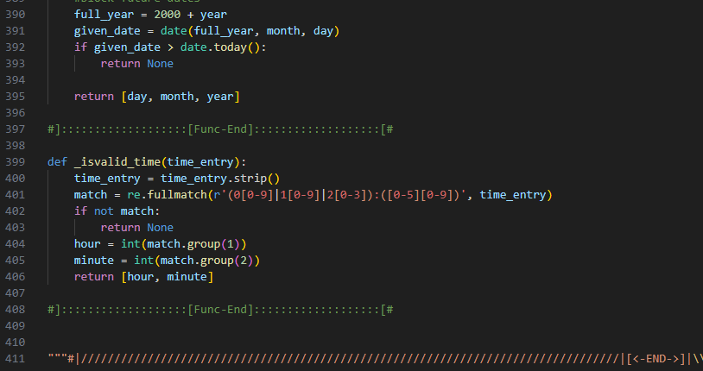
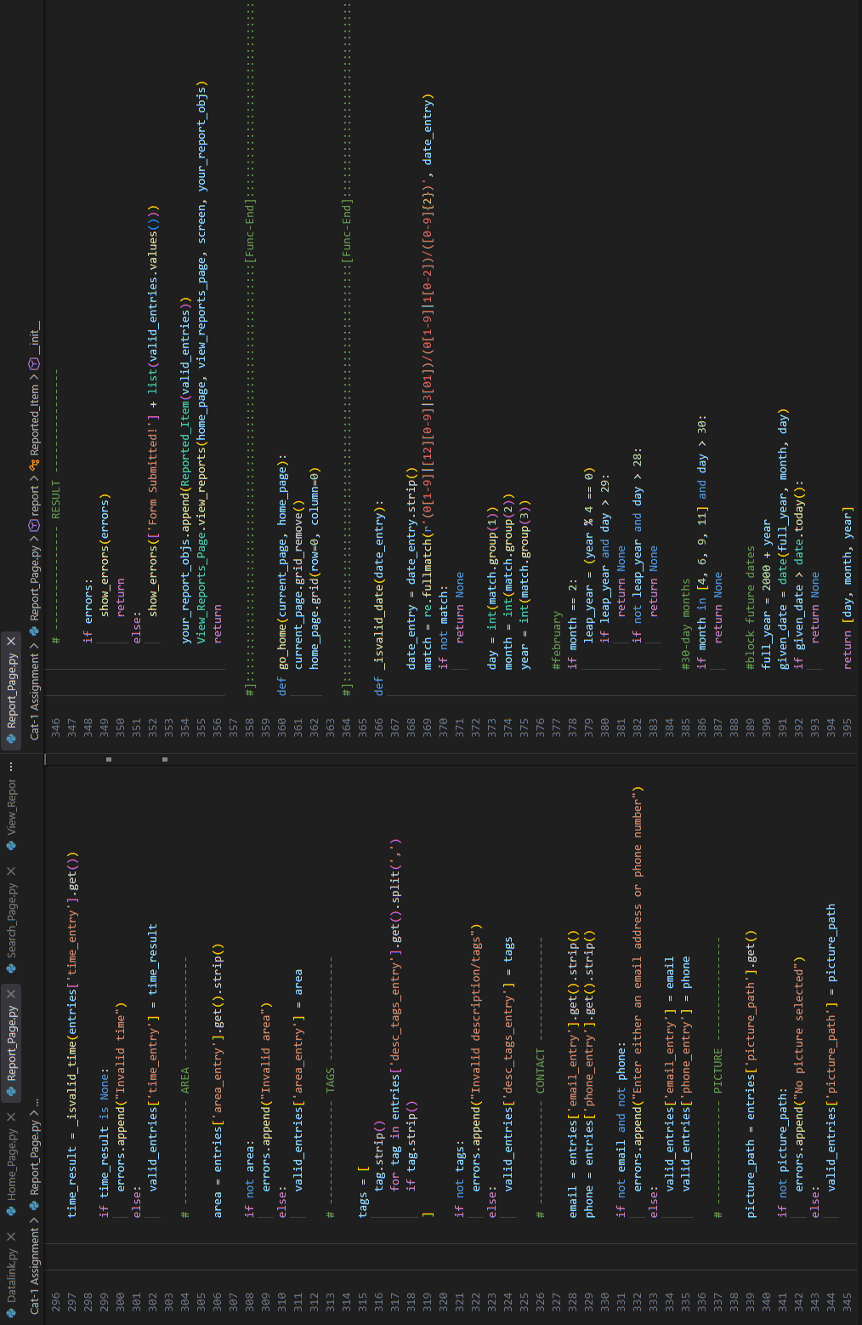
Report_Page.py

Slide 9
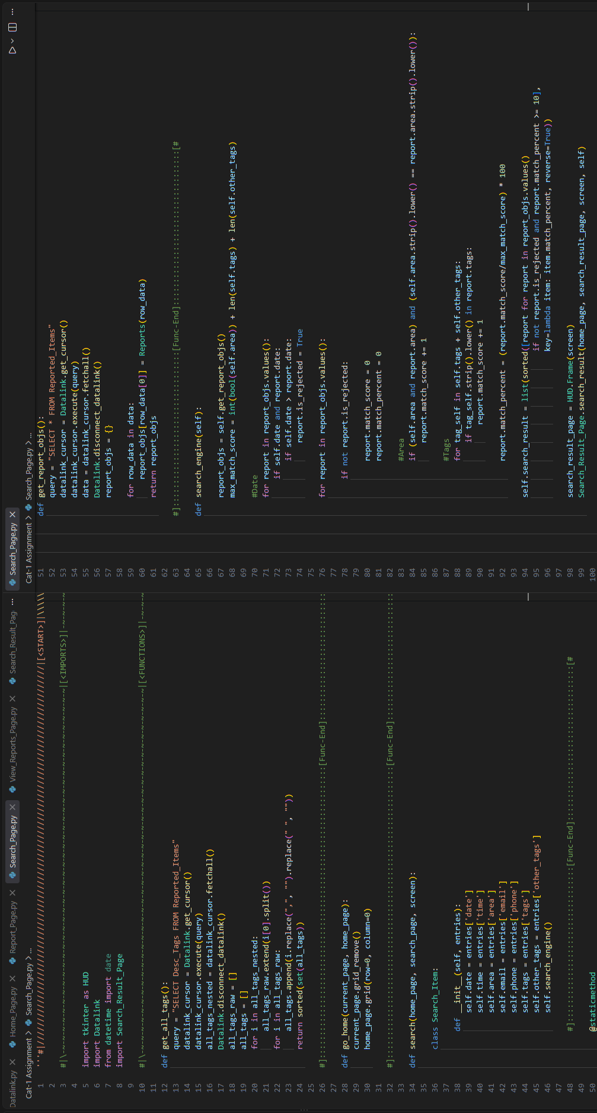
Search_Page.py

Slide 10
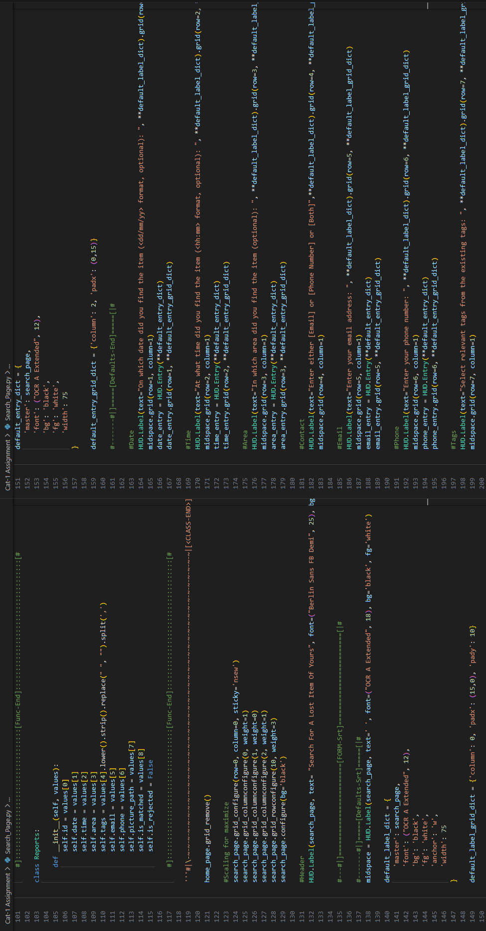
Search_Page.py

Slide 11
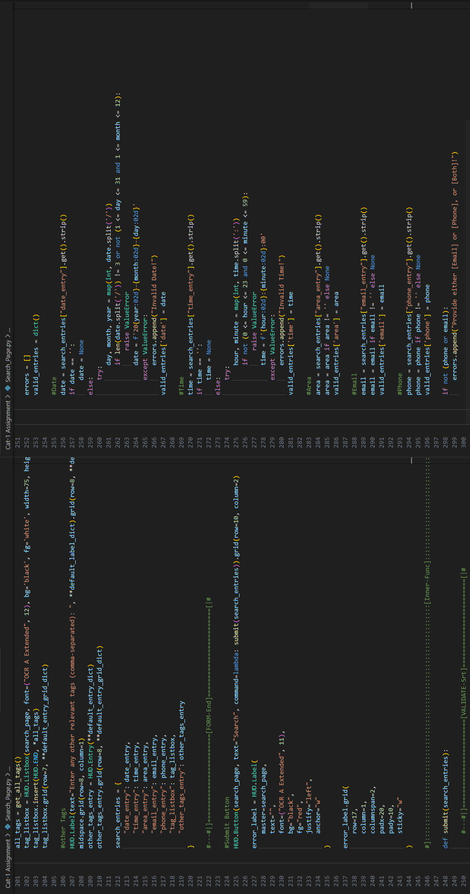
Search_Page.py

Slide 12
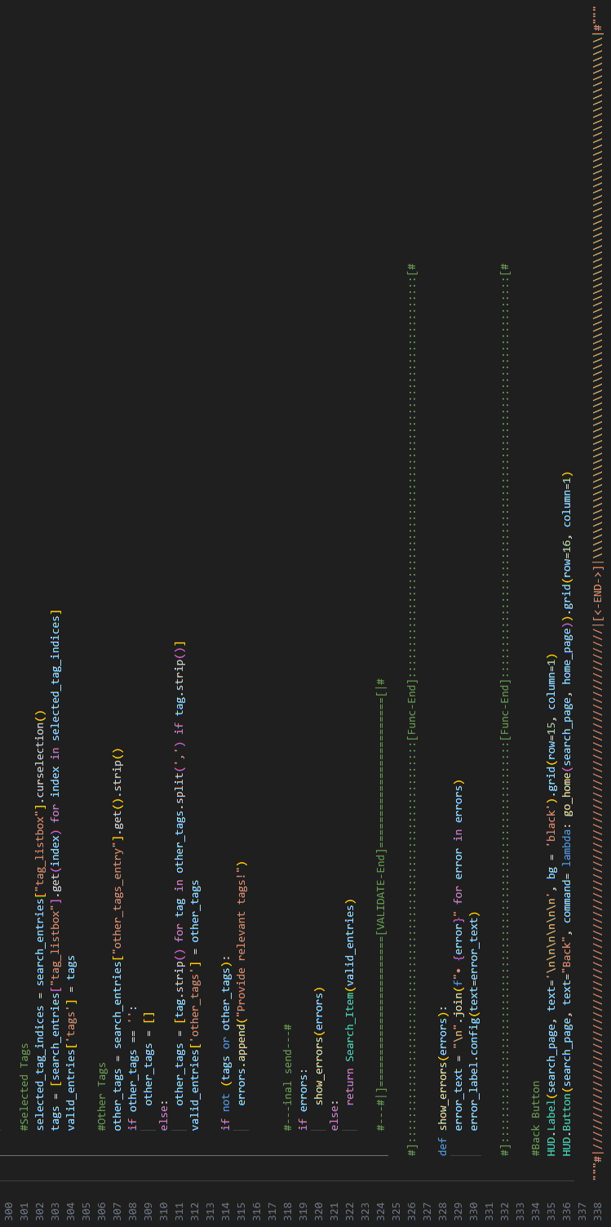
Search_Page.py

Slide 13
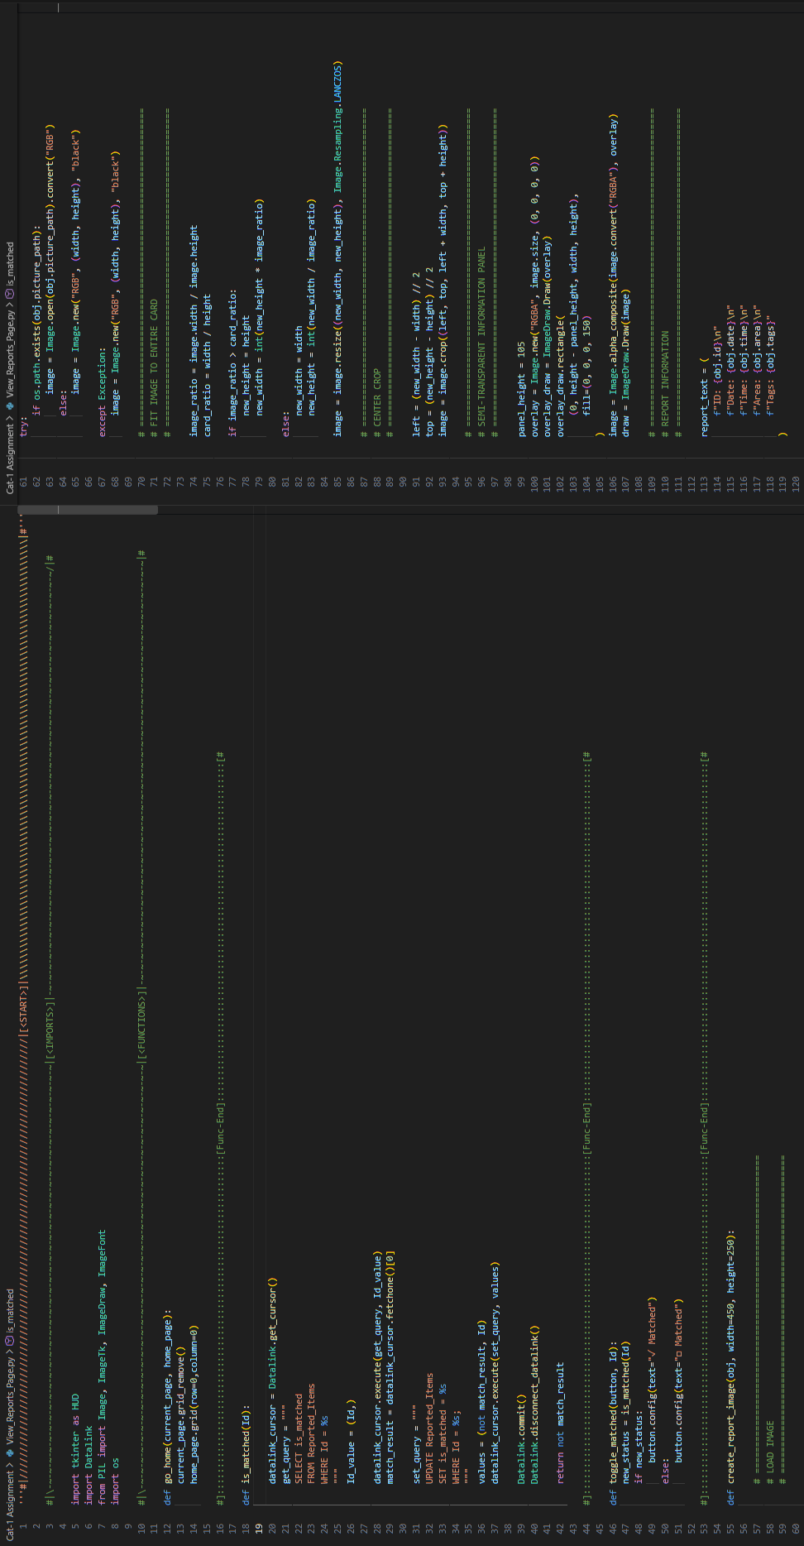
View_Reports_Page.py

Slide 14
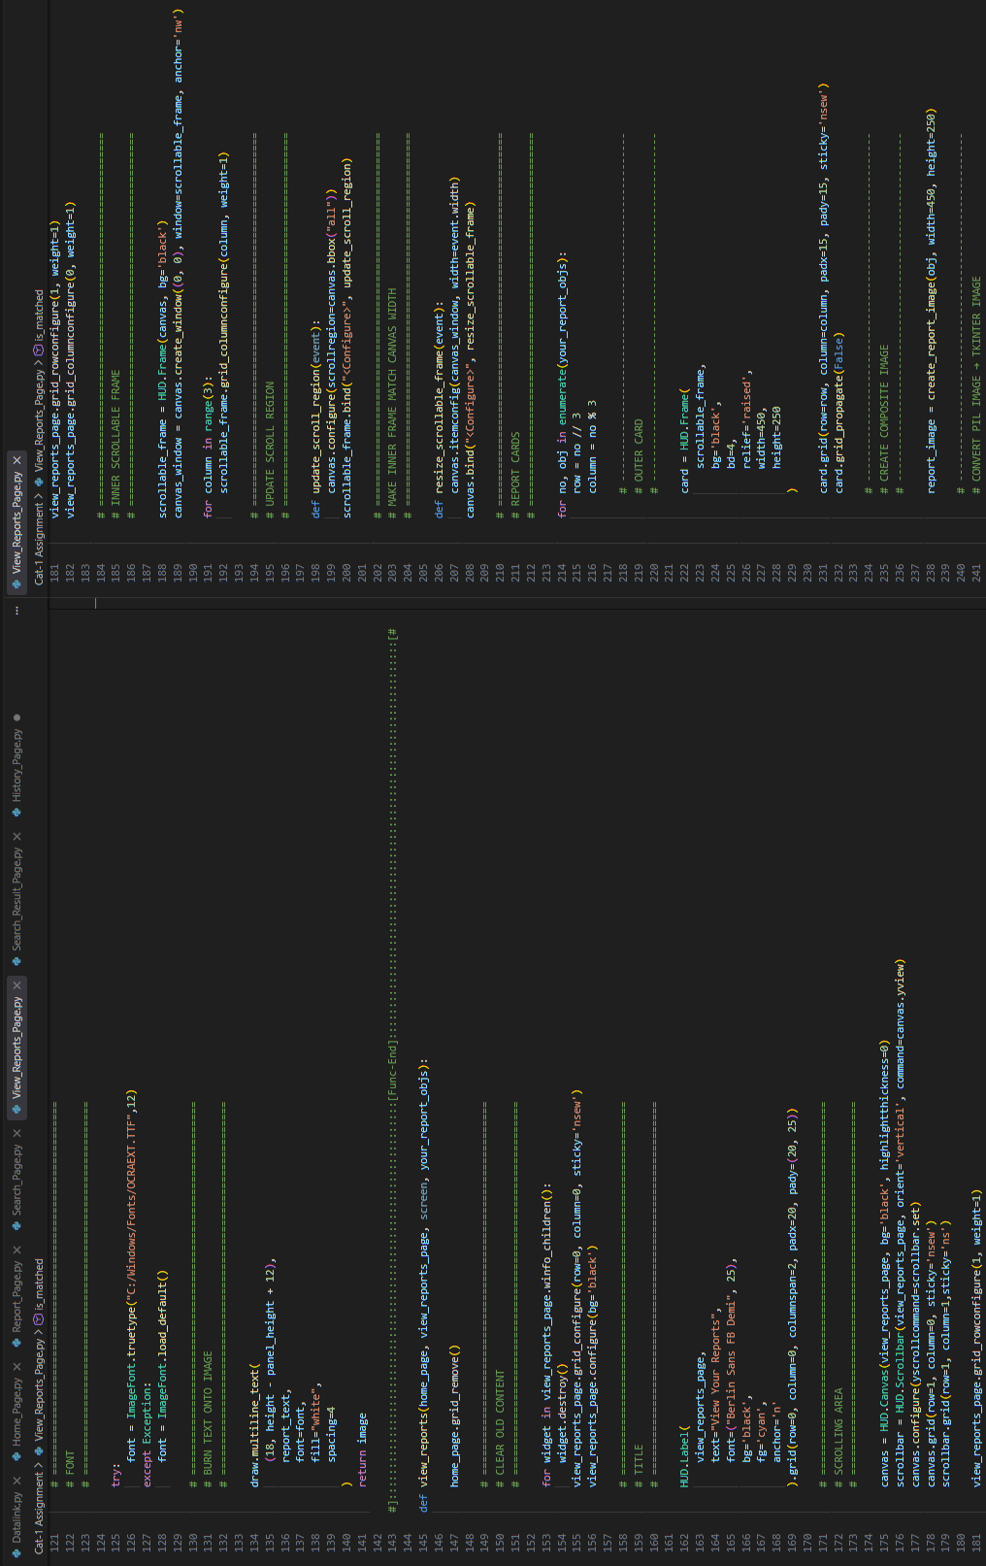
View_Reports_Page.py

Slide 15
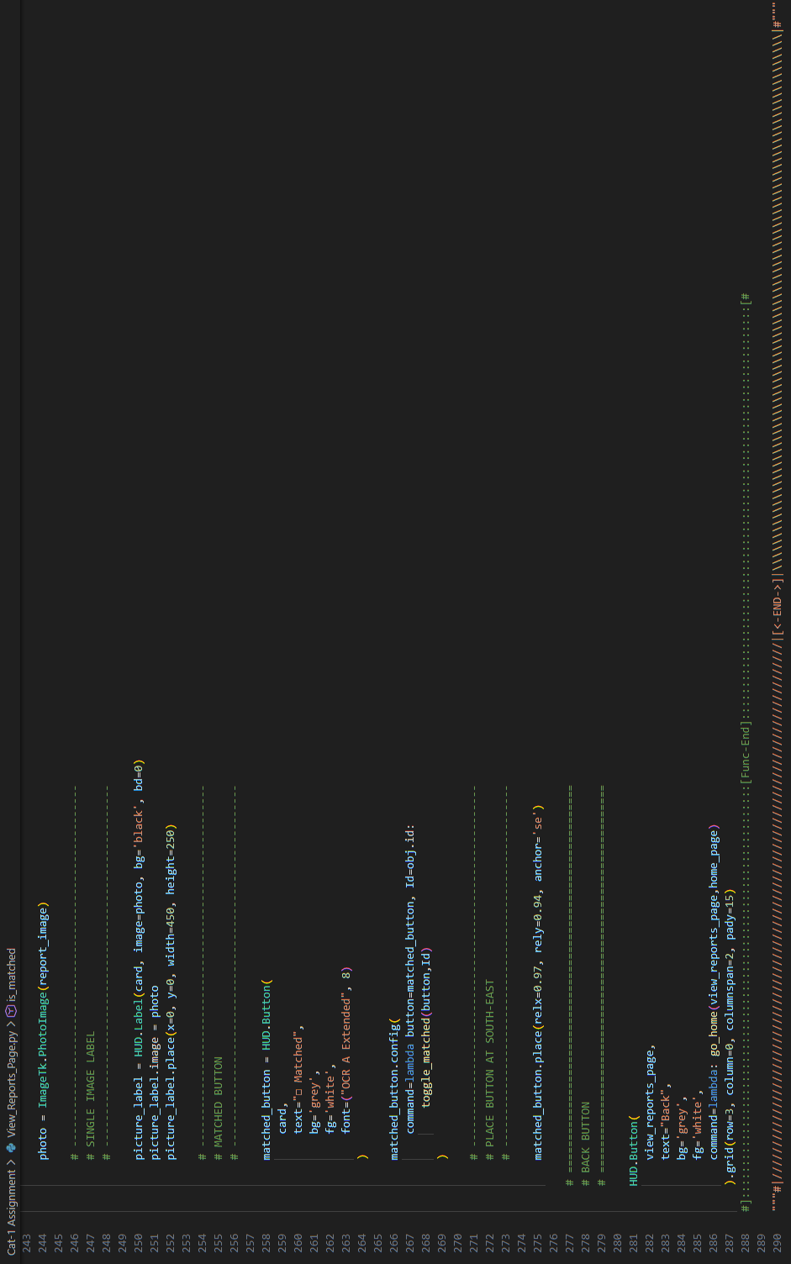
View_Reports_Page.py

Slide 16
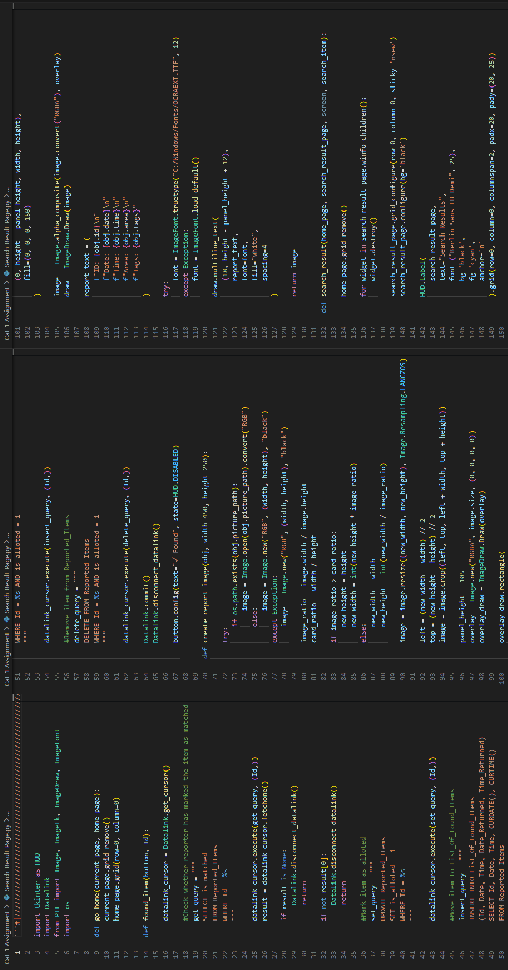
Search_Result_Page.py

Slide 17
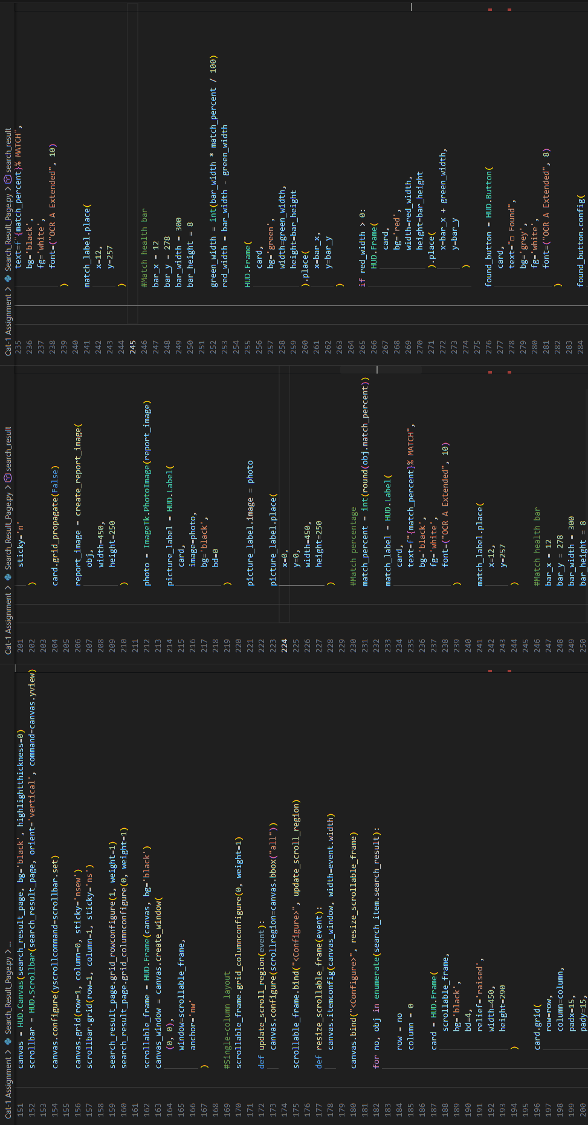
Search_Result_Page.py

Slide 18
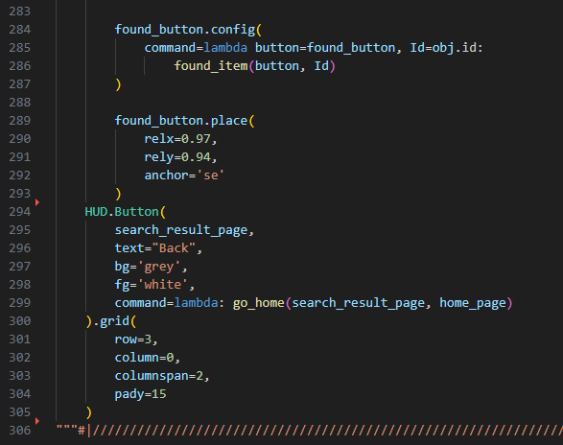
Search_Result_Page.py

Slide 19
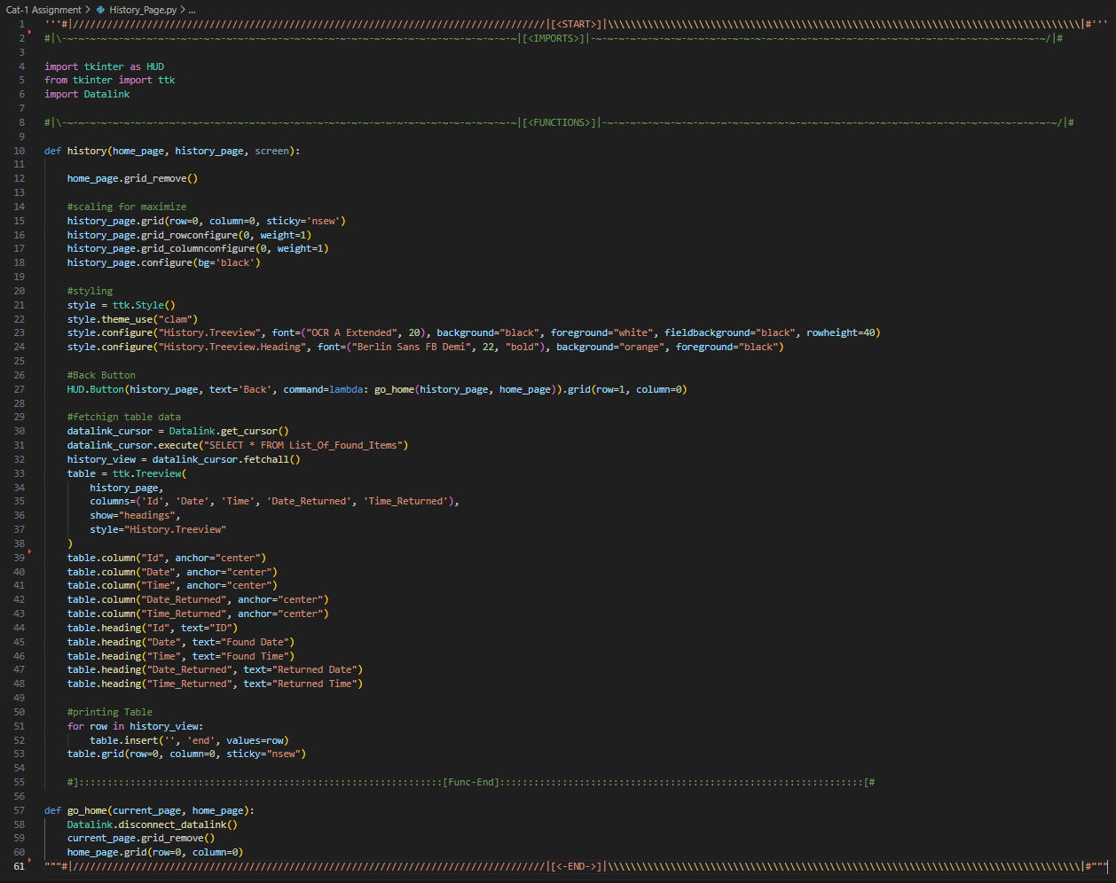
History_Page.py

