Slide 1

Image sharpening using knowledge distillation
INTERNSHIP 2
Sirisala Sai Tharuneswar
Kata Srikanth
Dept of Computer Science & Engineering

Slide 2
Abstract
This project introduces a deep learning-based system for the image sharpening problem using a light-weight variant of the U-Net architecture. The intention here is to sharpen out-of-focus images in computationally inexpensive ways, which would be useful for real-time applications or low-resource systems. Unlike traditional sharpening filters, the proposed approach utilizes deep learning-based features from edge and segmentation maps to control the sharpening.
Dept of Computer Science & Engineering

Slide 3
Image Sharpening using Knowledge Distillation
Sharpening of images is crucial for achieving clarity in images, monitoring, and medical imaging
They employ static filters that do not generalize well for different kinds of blur or noise
This project applies a deep learning-based U-Net model for adaptive image sharpening.
The input is not just the blurred image but also its edge map and segmentation mask.
These extra features assist the model in concentrating on key areas of improvement.
Dept of Computer Science & Engineering

Slide 4
Image Sharpening using Knowledge Distillation
The design is functional and suitable for resource-limited environments.
Training and testing procedures are carried out in GPU environments like Google Colab to enable quick iterations.
The model is designed to support future real-time deployment using OpenVINO or ONNX.
Dept of Computer Science & Engineering

Slide 5
Image Sharpening using Knowledge Distillation
The system is intended to be intelligent and lightweight through the use of deep learning.
The system takes blurred images as an input and enhances them using edge and segmentation features.
A compact U-Net model is used to process 5-channel input and generate sharpened output in an efficient way.
The model is trained with a hybrid loss function that combines MSE and SSIM to maintain perceptual quality.
Dept of Computer Science & Engineering

Slide 6
Image Sharpening using Knowledge Distillation
The implementation focuses on computational efficiency, thus making it suitable for low-cost hardware and regular CPUs.
The training and testing pipeline is run with PyTorch and works on platforms like Google Colab.
Future developments involve model deployment with OpenVINO or ONNX and real-time image enhancement support
Dept of Computer Science & Engineering

Slide 7
Image Sharpening using Knowledge Distillation
The design is a modular deep learning pipeline built in Python with PyTorch.
The central model is a small U-Net, optimized to handle 5-channel inputs: blurred image, edge map, and segmentation map.
Input Preprocessing: 1.Images are artificially blurred through Gaussian filters. 2.Edge maps are created by applying Sobel filters. 3.Segmentation masks are created through HSV-based color thresholding.
The input processing is combined into one tensor and subsequently fed into the U-Net model.
Dept of Computer Science & Engineering

Slide 8
Image Sharpening using Knowledge Distillation
The model reconstructs an enhanced RGB image and is trained using a loss function that is a mix of MSE and SSIM.
During testing, the model computes new blurred input and output either: 1.Fully sharpened image, or 2.Selective sharpening on edge and segmentation masks.
Results are visualized automatically and stored, and eventual GUI or interface integration is optional.
Dept of Computer Science & Engineering

Slide 9
Image Sharpening using Knowledge Distillation
Module Breakdown :
train.py / training section:
Supports training of models with blurred images along with edge and segmentation maps.
Loads dataset with custom BlurDataset class.
Performs the preprocessing: CLAHE, Gaussian blur, edge detection, segmentation mask generation.
Trains the U-Net model with MSE + SSIM loss.
Saves model check points and logs training loss, SSIM, and PSNR Metrics.
Dept of Computer Science & Engineering

Slide 10
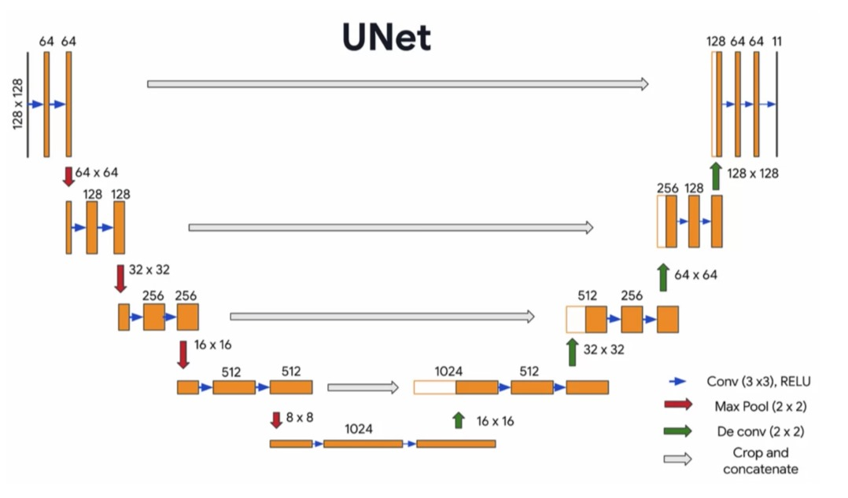
Image Sharpening using Knowledge Distillation
UNetSmallClass(model.py):
The light U-Net model is characterized by:
5 input channels (3 for image, 1 for edge, 1 for segmentation)
Three encoder blocks and three decoder blocks.
Tanh activation within the output layer for normalized image reconstruction.
Dept of Computer Science & Engineering

Slide 11
Image Sharpening using Knowledge Distillation
loss_fn() function:
Combines Mean Squared Error (MSE) and Structural Similarity Index (SSIM) into a unique loss.
Used for training and testing with enhanced perceptual quality.
Dept of Computer Science & Engineering

Slide 12
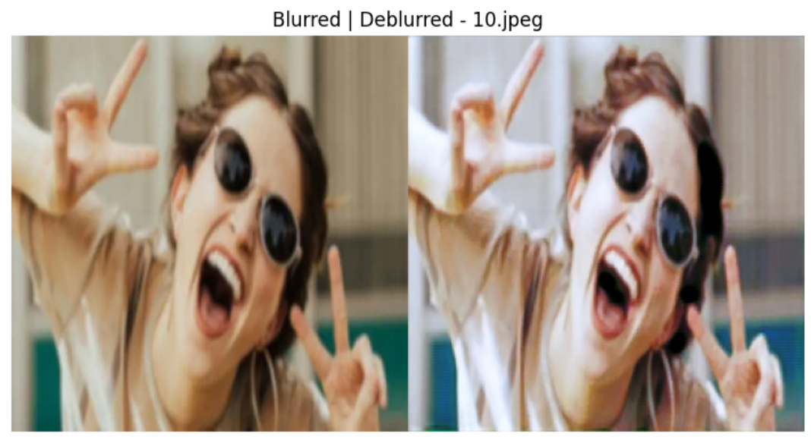
Image Sharpening using Knowledge Distillation
test.py / Test Section:
1.Loads a saved model for inference. 2.Processes input folder with blurred images. 3.Performs edge and segmentation maps for every image. 4. Conducts inference and, if desired, displays or saves comparison images (Blurred versus Deblurred).
Dept of Computer Science & Engineering

Slide 13
Image Sharpening using Knowledge Distillation
Transform and resize utilities:
All the images are resized into 256×256 pixels and normalized to [-1, 1] range for model compatibility. output directory:
Saves side-by-side visualizations of blurred and deblurred images.
Useful for qualitative inspection of results
Dept of Computer Science & Engineering

Slide 14
Image Sharpening using Knowledge Distillation
Use Cases :
Mobile Phone Photography Enhancement: The users are able to take low-light or slightly out-of-focus images, and the model can enhance and improve them in real time for increased clarity.
Surveillance Video Restoration: Security camera videos are motion-blurred or have low resolution. The model can be used to deblur frames for enhanced visibility in forensic or surveillance use.
Educational Visual Material Cleanup:
Restoration of out-of-focus scanned images of diagrams, textbooks, or notes is crucial for readability enhancement before distribution or study.
Preprocessing for Computer Vision Applications Sharpened images may be utilized as inputs to subsequent AI models (e.g., object detection, OCR) to enhance their accuracy.
Medical Image Enhancement (Future): Utilized to resolve fuzzy X-rays or microscope images for application in medical diagnosis, especially in low-cost or transportable systems.
Dept of Computer Science & Engineering

Slide 15
Image Sharpening using Knowledge Distillation
Future Enhancements :
Real-Time Video Stream Sharpening: Extend the model to sharpen real-time video streams frame by frame for webcams, drone, or surveillance system applications.
Integration with Desktop or Mobile GUI: Create a user-friendly application from where users can upload and edit pictures from their devices directly.
Use transformer or GAN-based models.:
Experiment with transformer models or generative adversarial networks to realize visual quality improvement and realism enhancement.
Robustness to Noise and Artifacts: Train the model to process noisy, low-light, or highly degraded images for application in extreme environments.
Dept of Computer Science & Engineering

Slide 16
Image Sharpening using Knowledge Distillation
Summary :
This project employs deep learning techniques for image sharpening owing to a light-weight U-Net model trained with structural elements such as edge and segmentation map.
The model's architecture is compact and optimized, and thus, it can be deployed real-time on resource-constrained hardware after optimization.
SSIM and PSNR evaluation indicates good performance on different categories of images, such as text, nature, and human.
This project demonstrates how deep learning can enhance visual content intelligently, offering a practical solution.
Dept of Computer Science & Engineering

Slide 17
Image Sharpening using Knowledge Distillation
Research Papers / Codebases:
DnCNN (Deep CNN Denoising): https://github.com/cszn/DnCNN
FFDNet (Fast & Flexible Denoising): https://github.com/cszn/FFDNet
FBCNN: https://github.com/jiaxi-jiang/FBCNN/tree/main
EDPN (Edge-Directed Progressive Network): https://github.com/zeyuxiao1997/EDPN/tree/main
Image Deblocking Task: https://paperswithcode.com/task/image-deblocking/latest
Dept of Computer Science & Engineering

Slide 18
Thank You
Dept of Computer Science & Engineering

