Slide 1
CRST
DATA LAKE

Slide 2




CRST Business Diagram
PROVIDER
CUSTOMER
AGENTS
Orders/Contract/Loads
Expedited
Dedicated
Malone
DWH
Reporting
Logistics
Reporting
Pegasus
Reporting
DWH
STI
BOS
OMS
CMS
Brokerage
Reporting
Gardner
Reporting
Truck mate
Reporting
BESL
F9
Lincoln Sales
Reporting

Slide 3
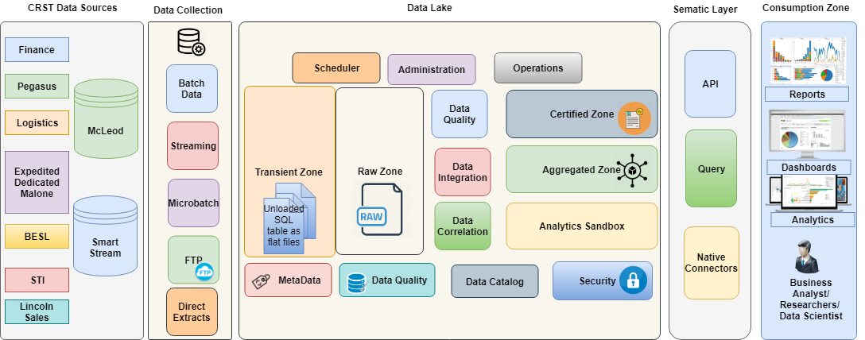
Component Architecture

Slide 4
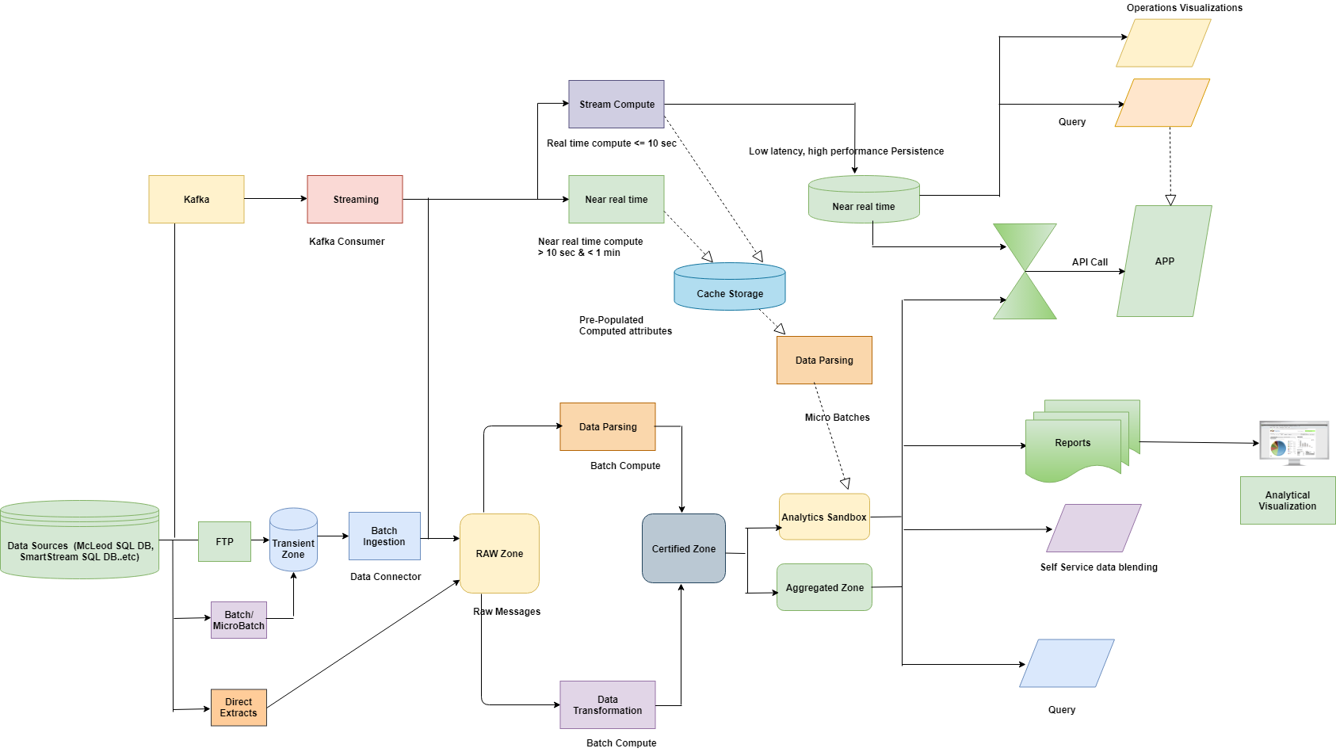
Data Flow diagram

Slide 5
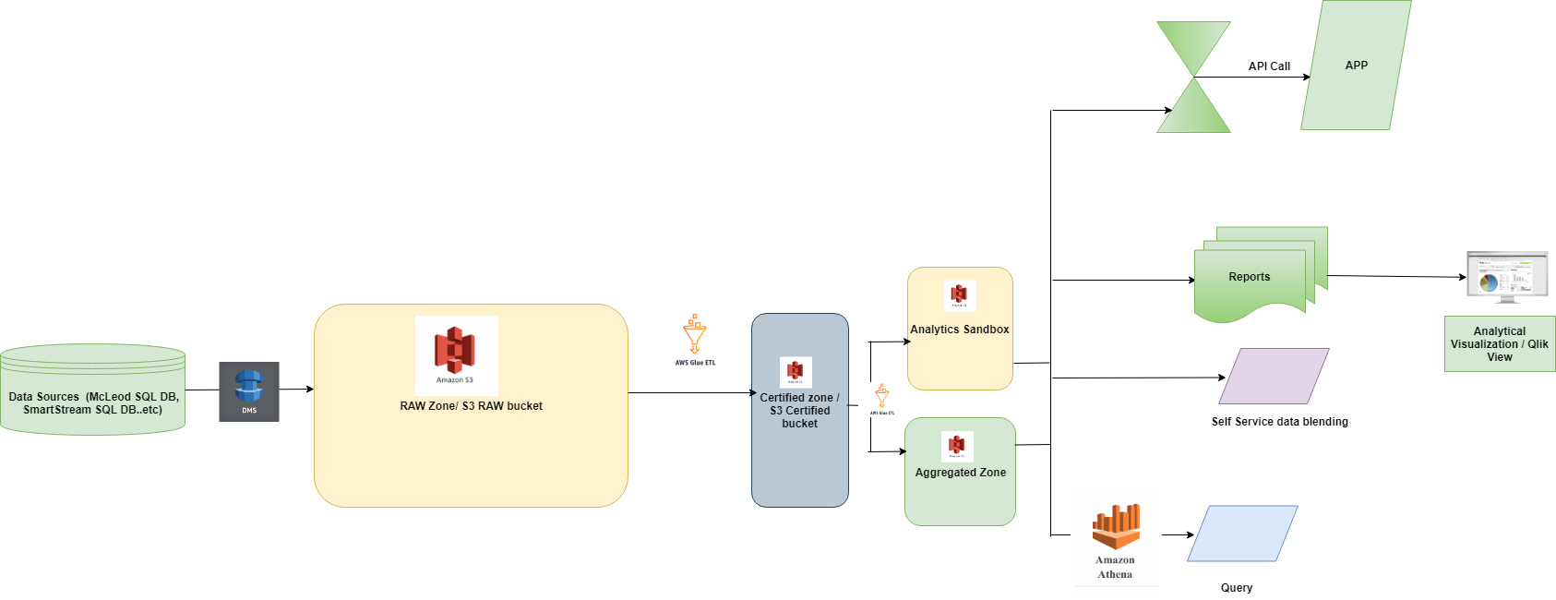
Option 1 - AWS

Slide 6












Option 2 - Azure
Analytics Sandbox
Certified Zone
ADLS
Azure Data Factory
HDInsight (Hive)
Raw Zone
ADLS
APIs
History Data
McLeod, SmartStream
Aggregated Zone
ADLS
PowerBI
Ad Hoc /
Canned Reports
Azure Data Catalog
Azure Data
lake Analytics
Data Extracts
Option 2
Data Ingestion (Copy), orchestration, Scheduling – with Azure Data Factory
Data Transformation, integration, aggregation, processing with – HdInsights (Hive) *
Raw, Certified , Aggregated, Sandbox data storage – with Azure Data lake Storage (Gen 2)
Analytics Sandbox – Databricks(Spark), HDInsight(Hive), Azure ML Service, PowerBI – On Demand
Adhoc / Canned reports – PowerBI - * Alternate option – SQL DWH and Qlikview
Data Catalog – Azure Data Catalog

Slide 7
Azure Solution Details
Azure Solution Details
For Raw, Certified, aggregated and sandbox data storage ADLS (Gen 2) is used. It is scalable, highly available and provides granular secure access.
For data processing, transformation, integration, aggregation Azure HDInsights Hive can be used. (Azure Databricks can also be used alternatively). Data copy, orchestration, scheduling is managed by Azure Data factory.
Azure Data Catalog is used to discover data from Hive, Azure Data Lake Storage and as well as SQL Server. It can also to do some basic profiling of the data, but it can profile SQL Server and Hive data sources only.
Qlikview does not have connectors for Azure Data Lake storage, but as a workaround it is possible to connect to ADLS through Rest APIs. It’s a little complex. Not recommended.
Analytics Sandbox can be created using data processing and AI/ML components of Azure – i.e. HDInsight Hive / Databricks Spark and Azure Machine Learning Service. These resources can be used on demand.
Creation of Data Extracts from ADLS will require Azure Data Lake Analytics Service (HDInsight Hive can also be alternatively used.)

Slide 8
Comparison Between AWS and Azure Solution
AWS | Azure
Qlikview has connector for AWS S3 | Qlikview does not have a connector for Azure ADLS. Hence data delivery layer should ideally have SQL DWH or Hive. As alternative, Power BI can be used.
Data Processing in AWS through GLUE is serverless. | Azure Data Factory uses HDInsight Hive or Databricks Spark for Data processing. These services are fully managed. But they are not serverless.
AWS Glue catalog has data lineage feature, but does not have data profiling ** | Azure Data catalog does not provide automated data lineage feature, it provides basic data profiling features though

Slide 9
Thank you

