Slide 1
Welcome To Data Science Project Review

Slide 2
Personal Info:
Name : Srikanthan NK
Email Id : srikanthan.nk@gmail.com
Contact Info : 9886864275
Currently Working For : Siemens Healthcare
Current Designation : Module Manager
Total IT Experience: 13 Years
Current Location : Bangalore

Slide 3
Project: Analyze NYC-Flight data
Domain: Airlines
Data Set Details:
This dataset contains information about all flights that departed from NYC
NYC has 3 Airports : EWR, JFK and LGA
Analyzing 2013 year data
Data Set contains 3,36,776 flight details which is departed from NYC

Slide 4
Project Introduction:
Thousands of flights flying every day from NYC
Lot of delayed and early departure or arrival every day
Good amount of re-planning / re-scheduling caused by delays
Difficult to mange runway on timing mismatch
Lets verify how each Airport is doing with respect to delays
Lets analyze how each carrier is contributing delays on each airport
Tones of data collected every day, Lets make some sense out of data,
Lets start the Exploratory data analysis……….

Slide 5

Raw Data Details

Slide 6
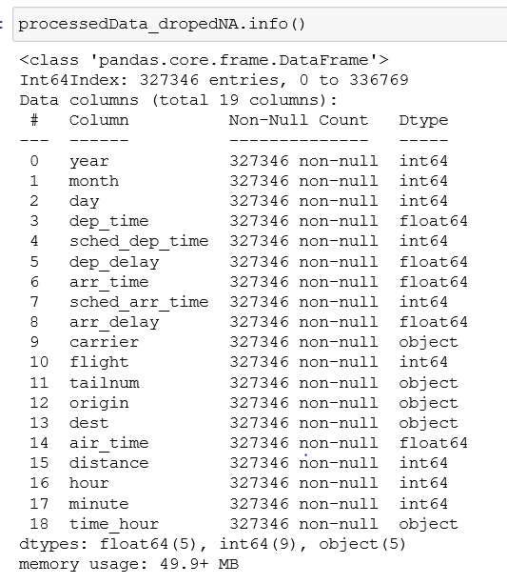
Processed Data
Removed rows which has null value for :
Departure time
Departure delay
Arrival time
Arrival delay
Found 3,27,346 valid data.

Slide 7
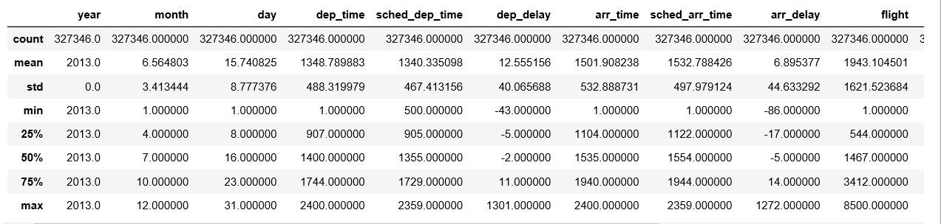
Data Description
3,27,346 flight data is used for analysis

Slide 8
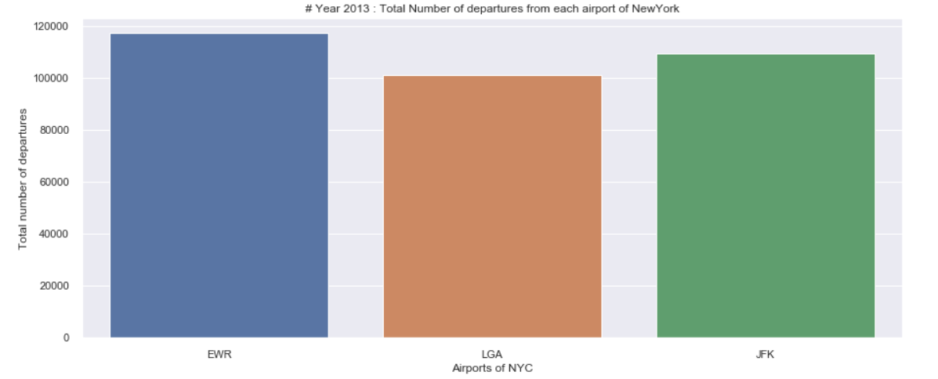
Total Flights of 2013
Observations:
More traffic in EWR airport compare to LGA & JFK
On Time Departure + Early Departure + Delayed Departure => 16466 + 127745 +183135 = 327346
A small delay in one flight may cause cascading delay for other flights, Chances of cascading delay scenario is more in EWR

Slide 9
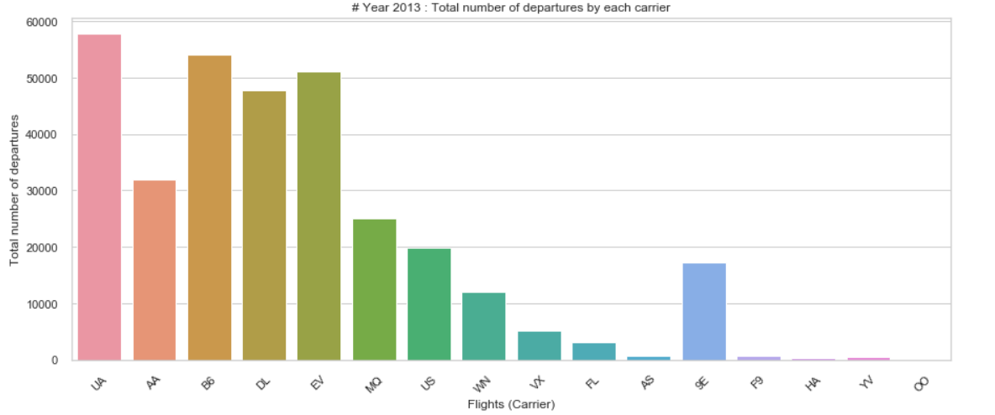
Flight Wise Data
Observations:
Major Traffic : UA, B6, EV flies 50K+ times from NYC

Slide 10
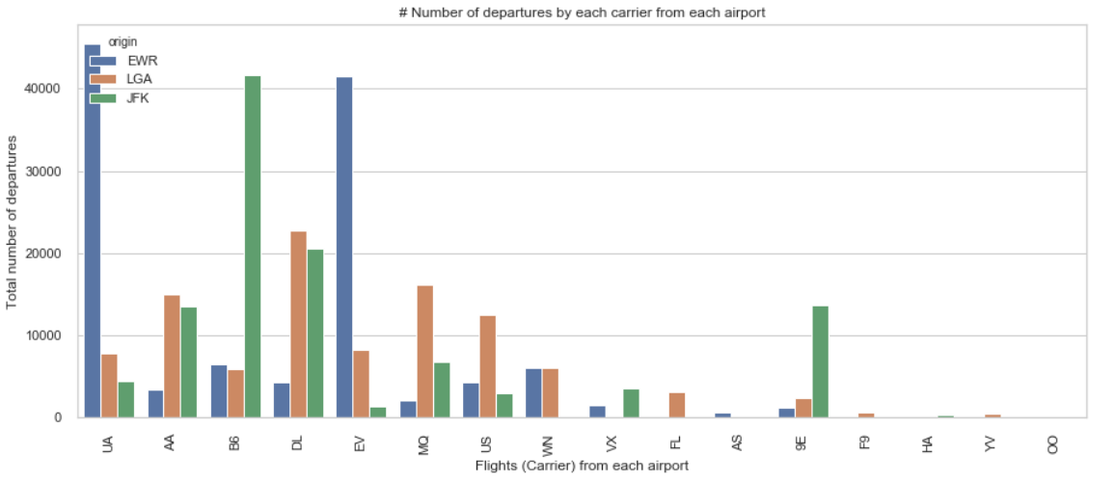
Different carriers from each airport
Observations:
40,000+ times UA and EV fly's from EWR, similarly B6 from JFK

Slide 11
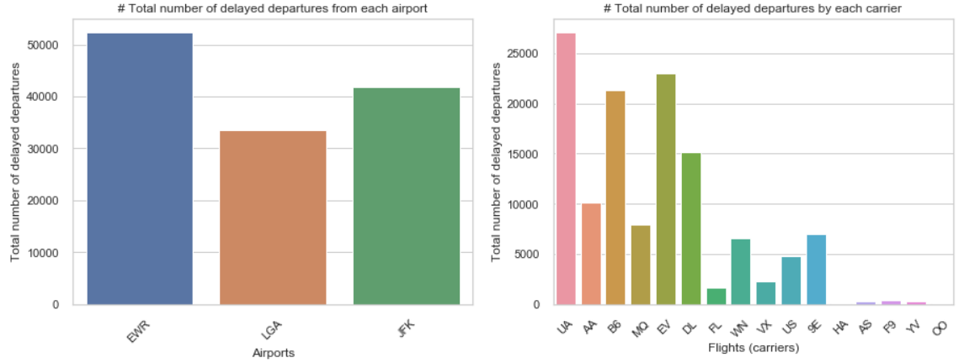
Delayed Departure
Observations:
1,27,745 delayed flights observed
UA, B6, EV carriers are the top contributors
LGA is best airport with respect to less delayed departure

Slide 12
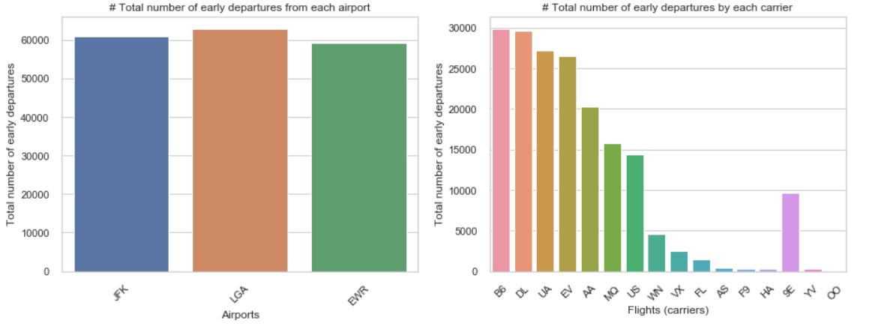
Early Departure
Observations:
1,83,135 early departures
26000+ times B6, DL, US, EV departed early

Slide 13
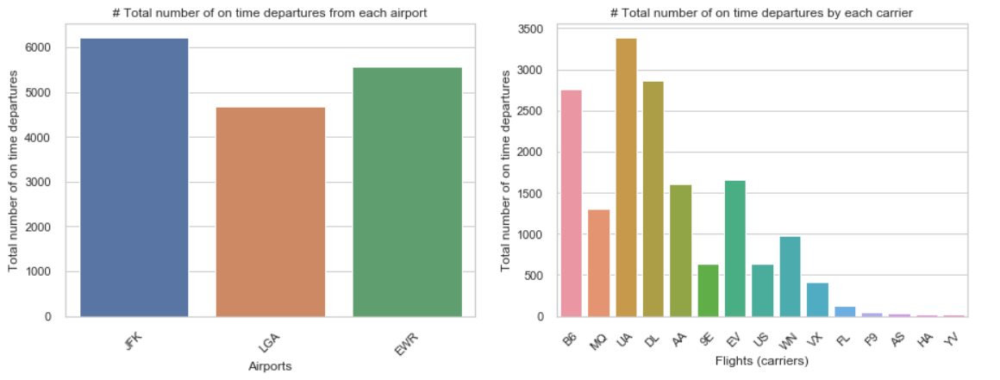
On Time Departure
Observations:
16,466 on time departures
Highest number of on time departure by UA
JFK is the major share holder with respect to on time departure

Slide 14
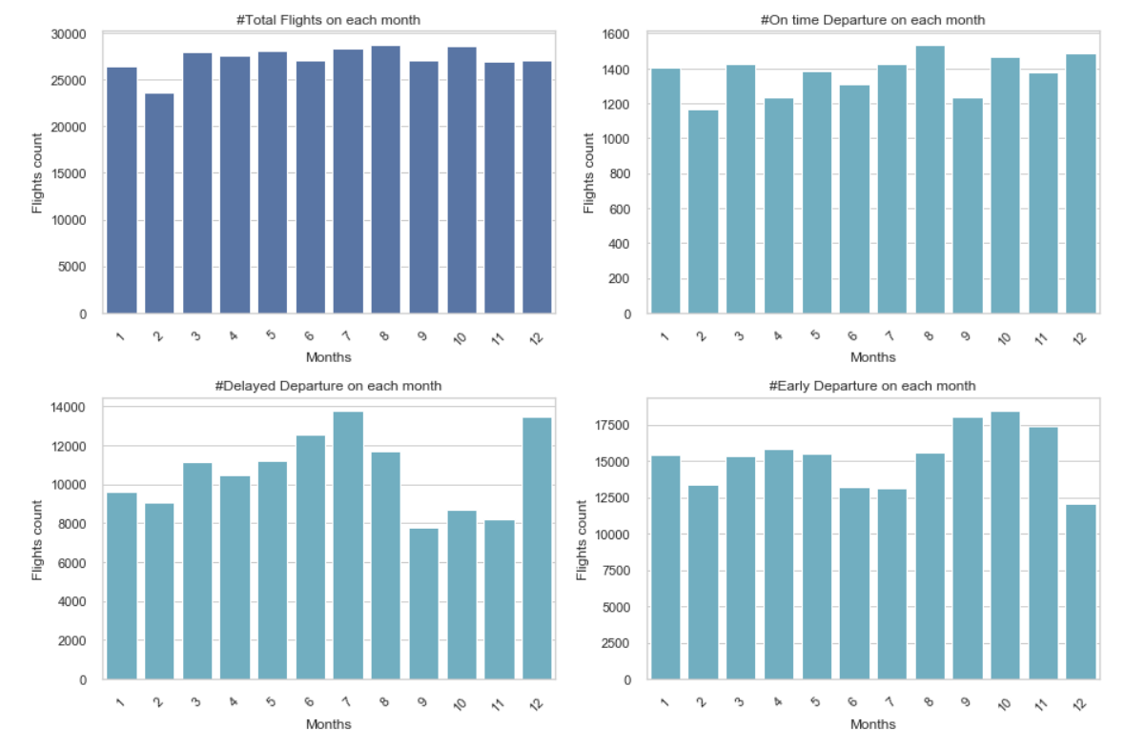
Is Season/Weather impacting….?
Hypothesis: 1. More than normal level of early/delayed departures observed from July to December
2. Could be weather is impacting (rain, fog/mist, snow)
Note : Spring (March-May), Summer (June-August), Autumn (September-November) and Winter (December-February)

Slide 15
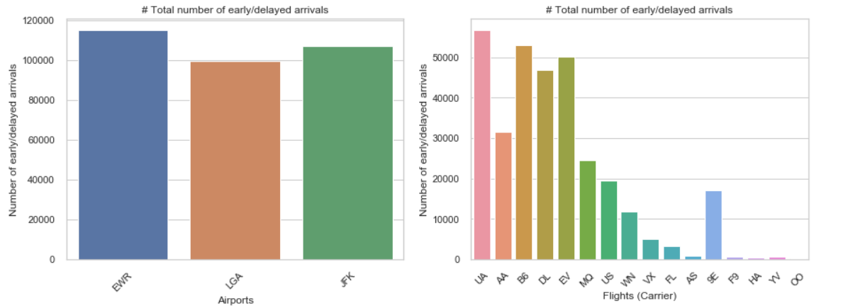
Early and Delayed Arrivals
Observations:
3,21,937 early/delayed arrivals
UA, B6, EV, DL carriers are the top contributors on arrival delay
LGA is the best airport as it has less early/delayed arrivals

Slide 16
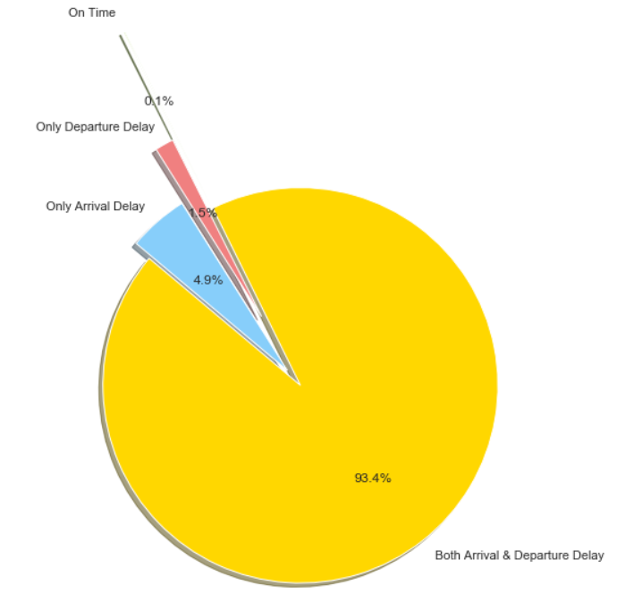
% Slice
Observation:
0.1 % flights are on time (Only 347 flights ☺)
99.9 % flights were delayed

Slide 17
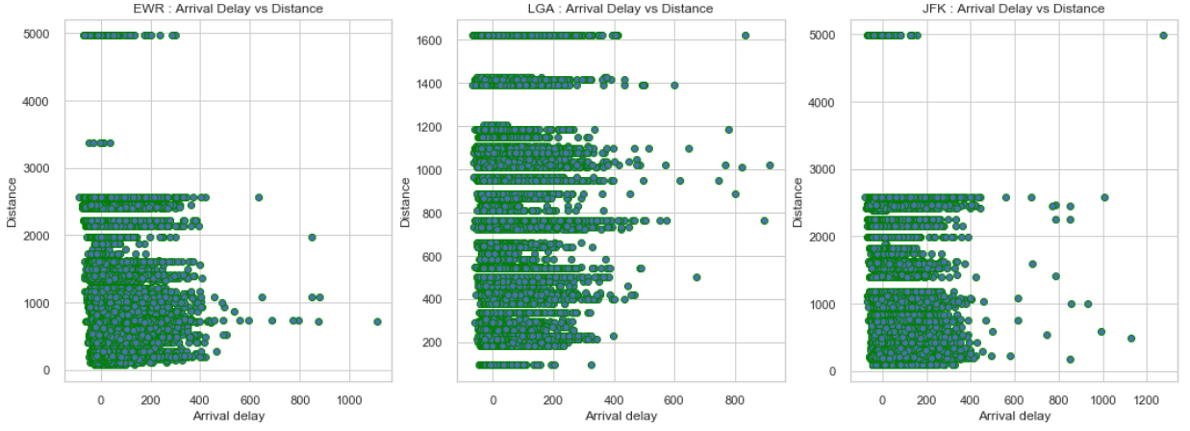
Arrival Delay vs Distance
Observations:
Distance is not much influencing on arrival delay
Less early arrivals ( -ve delay)

Slide 18
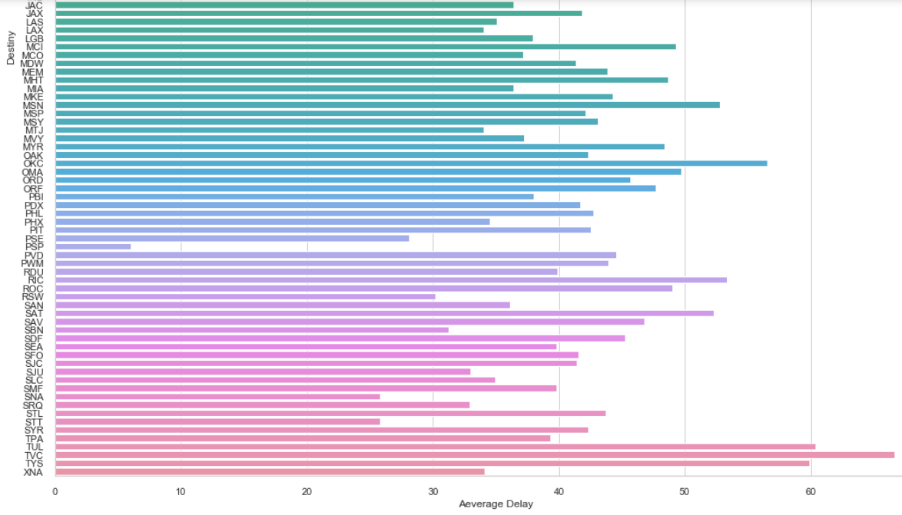
Average arrival delay
w.r.t destiny
Observations:
103 destiny points
Huge variations on avg arrival delay of each destiny

Slide 19
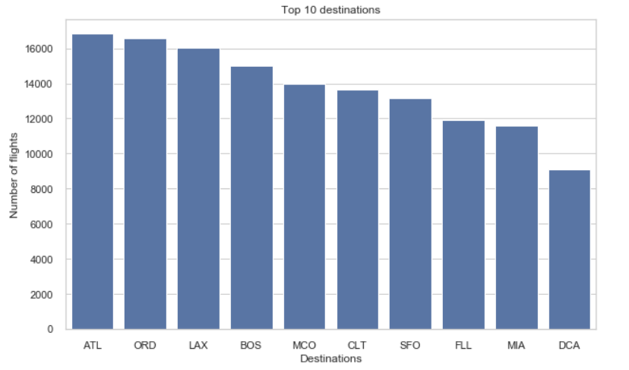
Top 10 destiny’s
Observations:
Total 103 destinations
16,837 flights to Atlanta

Slide 20
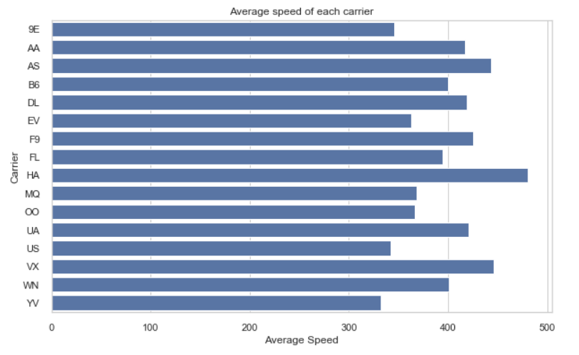
Average carrier speed
Observations:
Carrier HA, VX, AS has highest average speed
Minimal number of times delays observed for the flight which is maintaining highest average speed

Slide 21
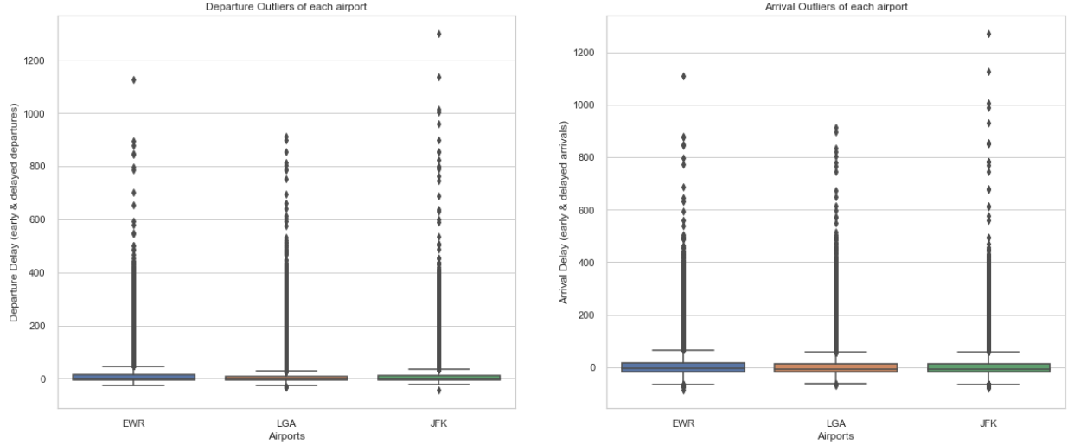
Outliers..?
Observations:
Lot of outliers on both departure and arrival delay
Arrival has better inter quartile delay range compare to departure delay

Slide 22
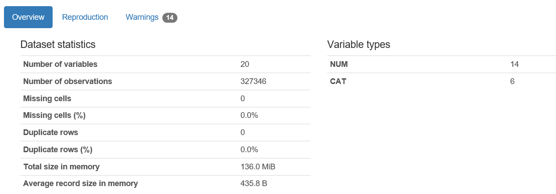
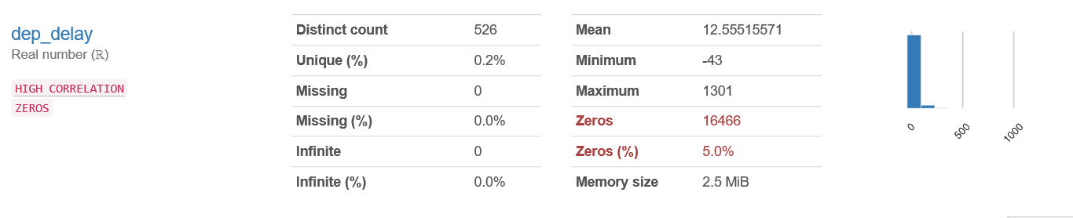
Glimpse of profiling output on processed data

Slide 23
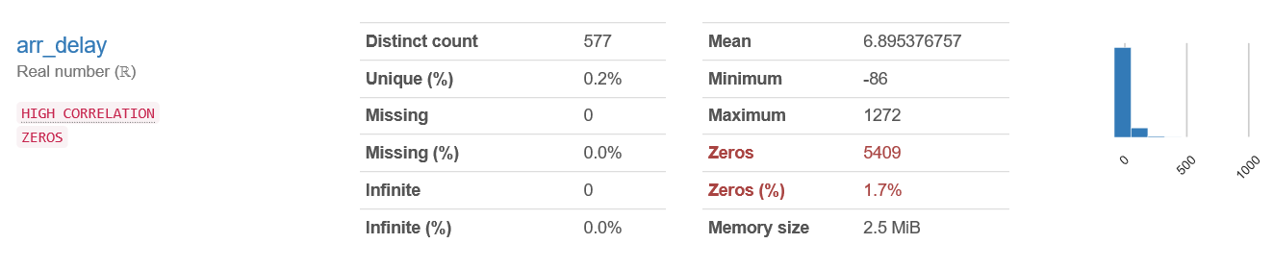

Glimpse of profiling output on processed data

Slide 24
Conclusion & Hypothesis:
More traffic in EWR
Major Traffic by UA, B6, EV. Flies 50K+ times from NYC
1,27,745 delayed departure, 1,83,135 early departures & only 16,466 on time departures
LGA is best airport with respect to less delayed departure
JFK is the major share holder with respect to on time departure
Slight increases in number of departure delays observed from June to December
3,21,937 early/delayed arrivals
LGA is the best airport as it has less early/delayed arrivals
99.9 % of the flights were delayed (arrival and departure delay)
Distance is not the root cause for delay
Top destiny is ATL. 16,837 flights to Atlanta
Minimal number of times delays observed for the flight which is maintaining highest average speed

Slide 25
Thank you

