Slide 1
AETHERFIN GPU OPS
GenAI GPU FinOps & Carbon Sustainability Platform
Developed by: Banoth Srikanth Portfolio Deliverable for Enterprise Product Analyst & Data Engineer Reviews

Slide 2
Executive Summary
Core Value Proposition: Bridges the visibility gap between raw machine load telemetry and business-level finance/environmental indexes.
Total Compute Spend: Realized a baseline operational spend of $7,844.98 across 5 active cluster nodes.
GICP Cost Waste Penalty: Identified $5,073.76 (64.7%) in wasted spend on idle instances running under 15% load.
Compute Efficiency: Serving average of 2.23 tokens per Wh, benchmarked across model deployments.
Environmental Impact: Tracked 467.32 kg in Scope 3 carbon footprint emissions.

Slide 3
Problem Statement
Skyrocketing Infrastructure Budgets: Generative AI model training and serving represent the largest modern enterprise IT expense.
The Visibility Vacuum: Standard server tools show CPU/Memory load but omit cost, SLA penalties, and carbon metrics.
Severe Resource Waste: Multi-million dollar GPU clusters remain reserved 24/7 with zero load outside working hours.
Regulatory Reporting Deficits: Compliance audits require tracking Scope 3 green IT emissions, but standard cloud metrics fail to correlate electricity grid coefficients.

Slide 4
Business Context
Financial Leakage: Over 60% of GPU compute budgets are wasted on idle allocations.
Regulatory Compliance: Imminent Scope 3 environmental carbon footprint audits are legally required in global jurisdictions.
The Green IT Opportunity: Optimizing compute sizing and regional scheduling yields double benefits: lowering spend and carbon footprint.
Stakeholder Alignment: Designed to support Chief Financial Officers (CFOs), VP of Engineering, AI Product Managers, and Sustainability Officers.

Slide 5
Product Vision
Continuous Intelligence: Convert low-level machine logs into high-level business analytics indexes.
Actionable Sizing Engine: Feed recommendation pipelines directly to container orchestration systems to shut down waste.
Risk-Balanced Simulation: Allow product managers to simulate cost and SLA performance changes before allocating clusters.
Immutable Audit Trails: Guarantee security compliance through JWT auth and immutable transaction auditing logs.

Slide 6
System Architecture
Multi-Tier Design: Decoupled client, REST API server, and relational database tiers.
Frontend Client: React TypeScript application executing custom ECharts rendering inside a premium Glassmorphism Zinc dark UI.
FastAPI Backend: High-performance Python ASGI API routing, using NumPy for sliding-window mathematical Z-scores.
Database Layer: SQLAlchemy ORM layer abstracting SQLite (development) and MySQL (production) servers.
Orchestration Stacks: Dockerized compose profiles managing application services, database engines, and pgAdmin monitors.

Slide 7
Database Design & Schema
gpu_cluster_nodes: Node-level registry tracking provider (AWS/GCP/On-Prem), region, instance type, hourly cost, and grid carbon intensity.
model_deployments: Active serving configurations mapping allocated GPUs, latency SLAs, and target TPS thresholds.
gpu_utilization_logs: Telemetry logging hourly average GPU loads and actual power draw in Watts.
carbon_emissions_logs: Correlating power draws to regional grid intensity to log emissions hourly.
inference_request_logs: Transaction logging query parameters, token numbers, latency, and SLA violation status.

Slide 8
Technology Stack
Frontend: React 18, TypeScript, Vite, ECharts-for-React, Lucide icons, and custom CSS.
Backend: Python 3.11+, FastAPI, Uvicorn, SQLAlchemy, PyJWT, Cryptography, and NumPy.
Database: MySQL (Local/Production), SQLite (Testing), PyMySQL, and PostgreSQL support.
Deployment & DevOps: Docker, Docker Compose, Git repository source control, and Vercel hosting integration.

Slide 9
Innovative KPI Framework
GPU Idle Cost Penalty (GICP): Translates technical load metrics into dollar waste assessments.
Model Compute Efficiency Score (MCES): Tracks token output density relative to physical energy consumption.
SLA Violation Exposure Index (SLA-VEI): Measures user latency breaches, weighting extreme delays non-linearly.
Carbon Offset ROI (COROI): Correlates financial savings of regional rerouting actions against offset expenses.

Slide 10
GPU Idle Cost Penalty (GICP)
Formula: GICP = sum(Idle Hours * Hourly Cost) / Total Spend * 100
Threshold Definition: Tracks hours where a node is active but average GPU load stays under 15%.
Business Cost: In the audited trial, $5,073.76 out of $7,844.98 was wasted on idle capacity.
Outcome Action: Identifies exact instances suitable for decommissioning or dynamic scale-down.

Slide 11
Model Compute Efficiency Score (MCES)
Formula: MCES = (Prompt Tokens + Completion Tokens) / sum(Power Draw in Watts * 1 Hour)
Standardization Value: Allows C-suite comparison of model architectures on different hardware types.
Hardware Insights: Llama-3-8B on GCP L4 nodes achieved 8.42 tokens/Wh, compared to 1.12 tokens/Wh for Llama-3-70B on H100s.
Outcome Action: Identifies candidate models for right-sizing or quantization.

Slide 12
SLA Violation Exposure Index (SLA-VEI)
Formula: SLA-VEI = sum(max(0, (Actual Latency - Target Latency) / Target Latency)) / Total Requests * 100
The Severity Weighting: Counts of violations do not capture user frustration; SLA-VEI weights delays exponentially.
Baseline Score: Current baseline score is 2.89, driven by peak diurnal traffic queuing delays.
Outcome Action: Signals when cost-cutting measures threaten customer retention.

Slide 13
Carbon Offset ROI (COROI)
Index Concept: Evaluates the cost efficiency of shifting workloads to low-intensity regional grids.
Grid Differences: Compares On-Premises coal grid (650g CO2/kWh) to GCP Europe-West1 nuclear grid (45g CO2/kWh).
The Trade-Off: Carbon routing may increase network latencies but completely eliminates carbon penalty offsets.
Outcome Action: Scheduler routes batch jobs to clean regions during off-peak times.

Slide 14
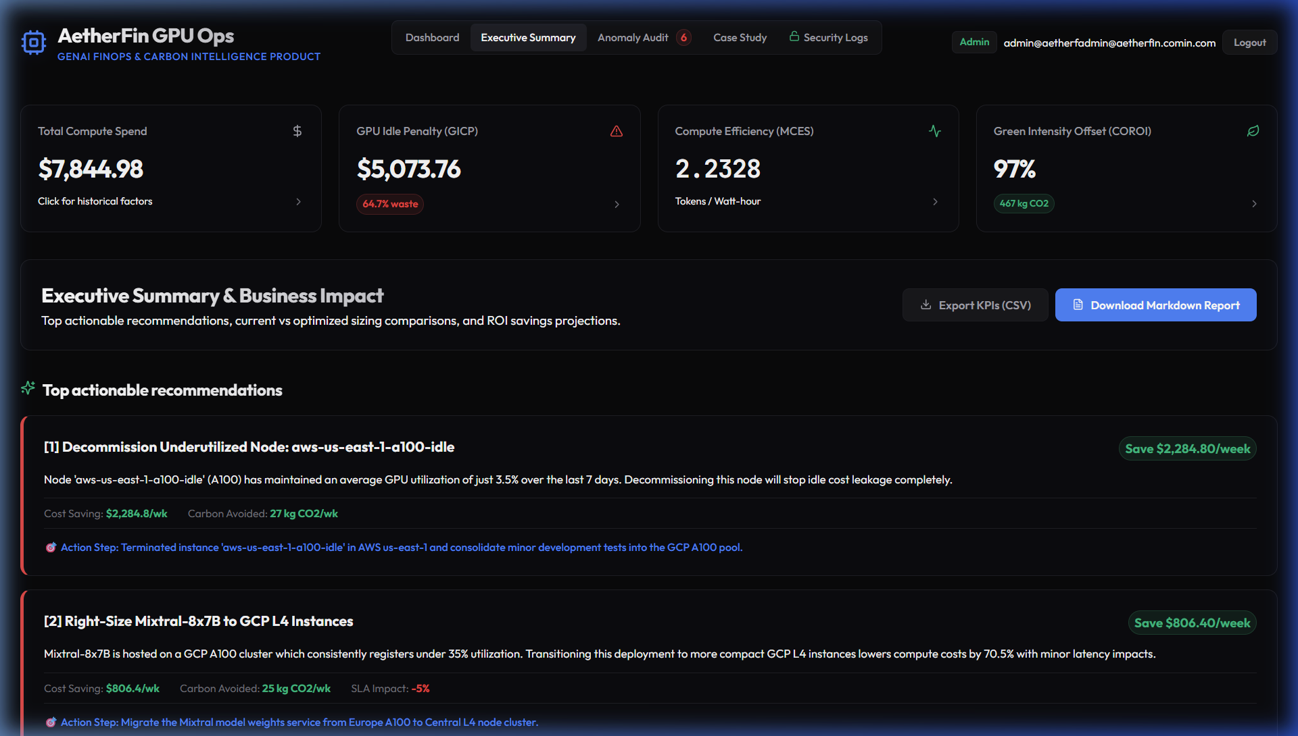
Executive & Dashboard Previews
Dashboard (sizing.png): Features the high-level KPI overview panels showing spend and carbon footprint details.
Compute Activity: Renders the active 48-hour timeline detailing node utilization and load fluctuations.
Node Inventory: Renders active database logs of multi-cloud allocations.
One-Click Exports: Stream summaries and audit trails directly to CSV or formatted text reports.

Slide 15
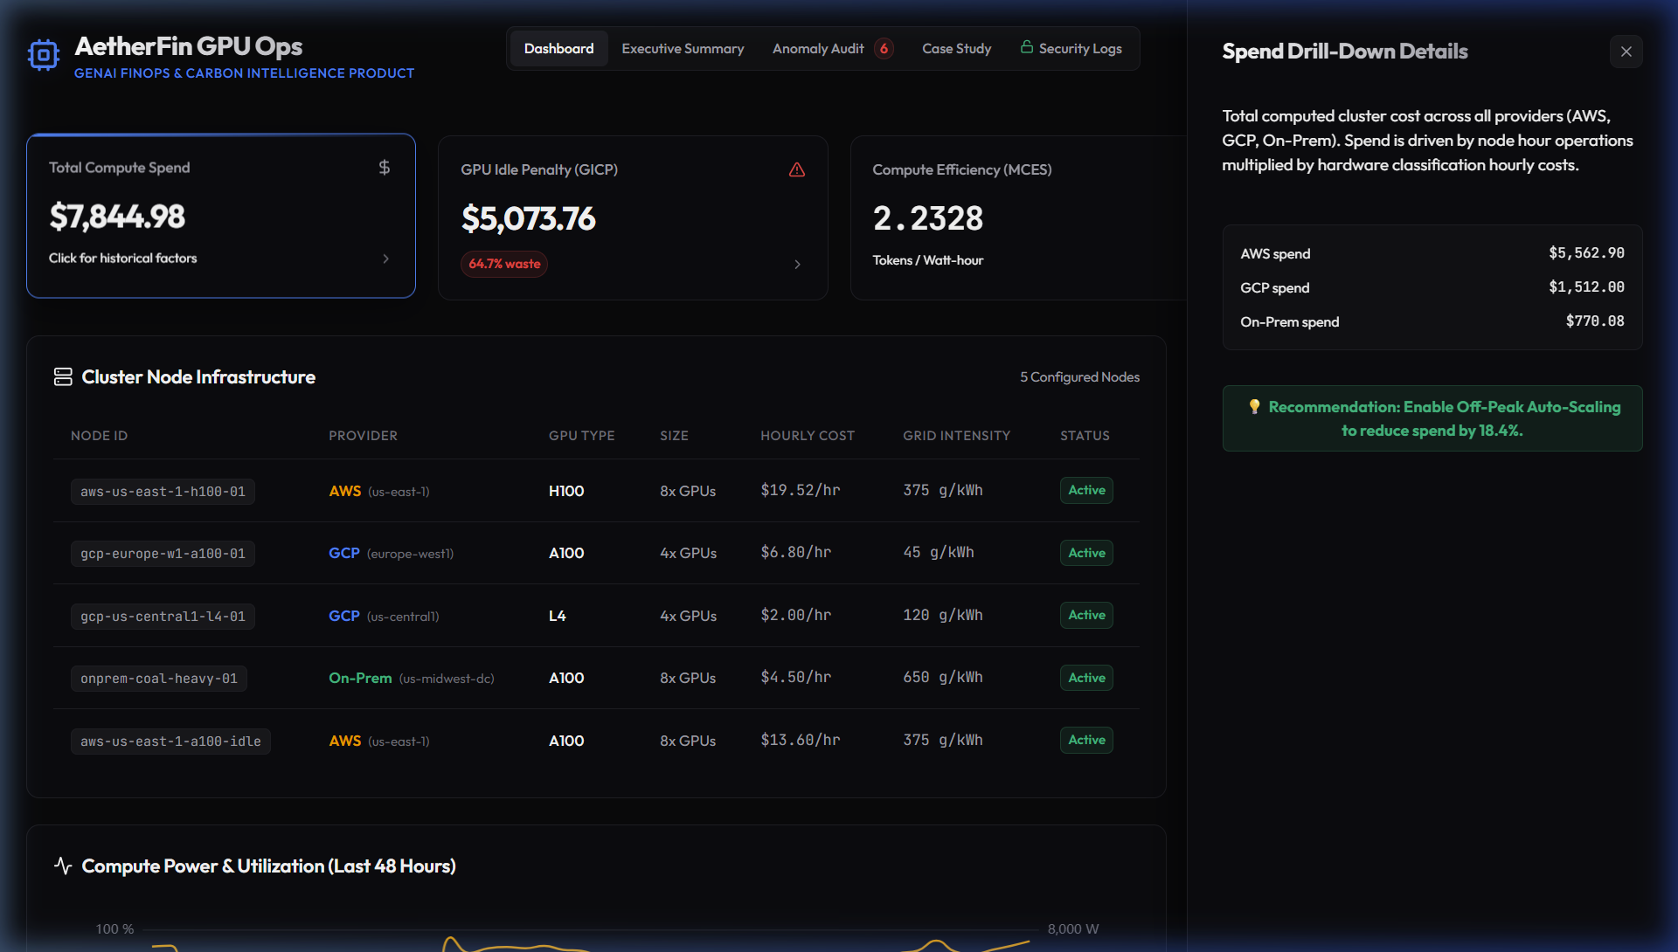
Trend & Cohort Analytics
Interactive Sidebar (drilldown.png): Opens node-level financial details dynamically on click.
Visual Sizing Factors: CFOs can drill down to see exact provider and regional billing components.
Multi-Range Filters: Supports 7-day, 30-day, and custom timeline aggregation windows.
Cohort Analysis: Compares model execution profiles to pinpoint underperforming instances.

Slide 16
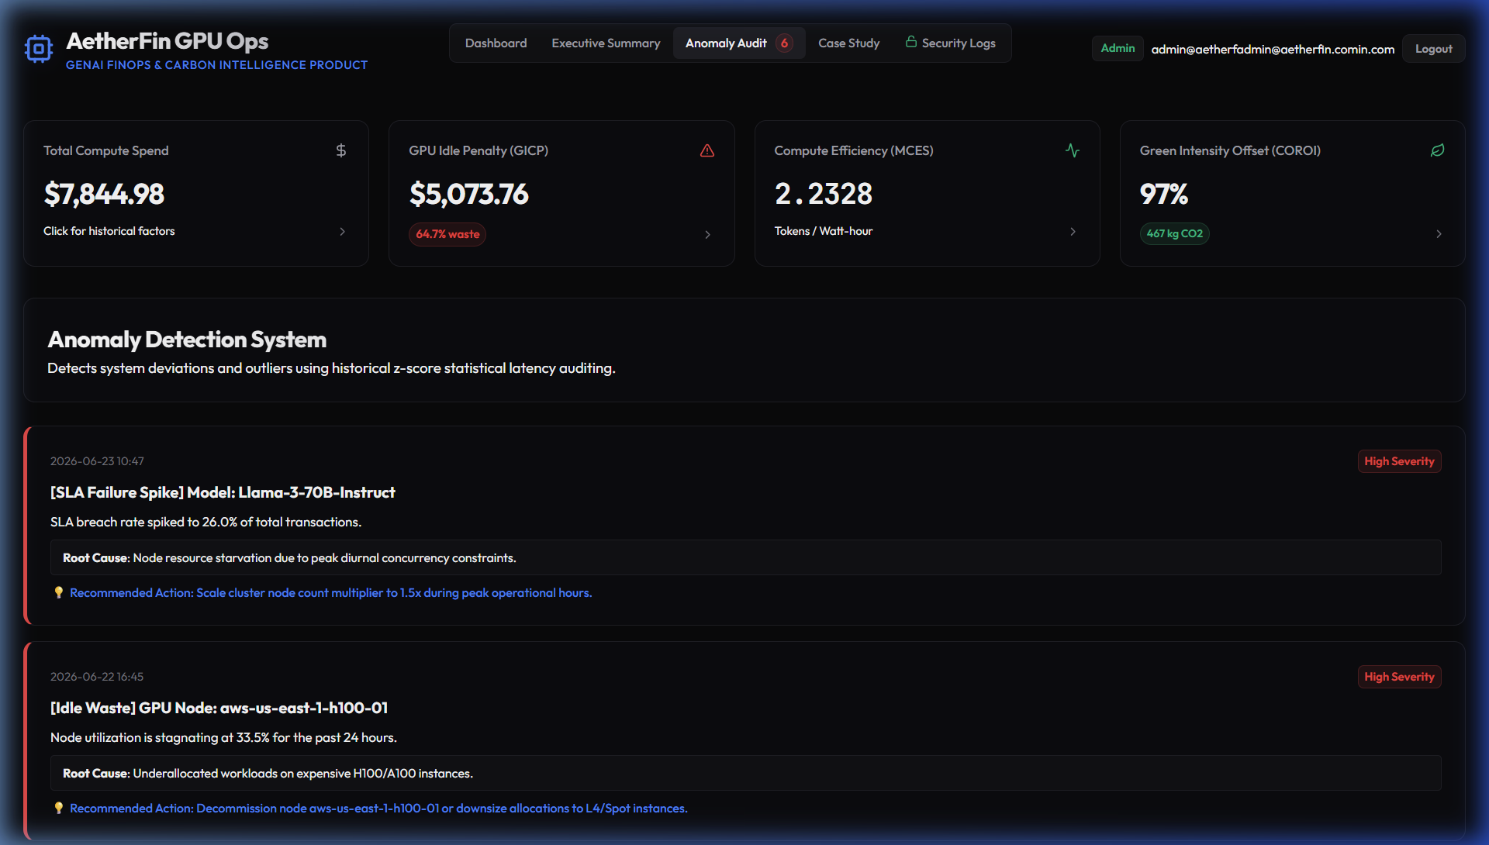
Z-Score Anomaly Detection
Outliers Graph (anomalies.png): Renders Z-score statistical outlier plots tracking latency spikes.
Waste Alerts: Automatically flags nodes operating under 10% average load for 12+ consecutive hours.
Root Cause Diagnostics: Automatically pairs anomalies with technical diagnoses and routing solutions.
Dynamic Baselines: Avoids static thresholds by computing sliding-window mean and standard deviations.

Slide 17
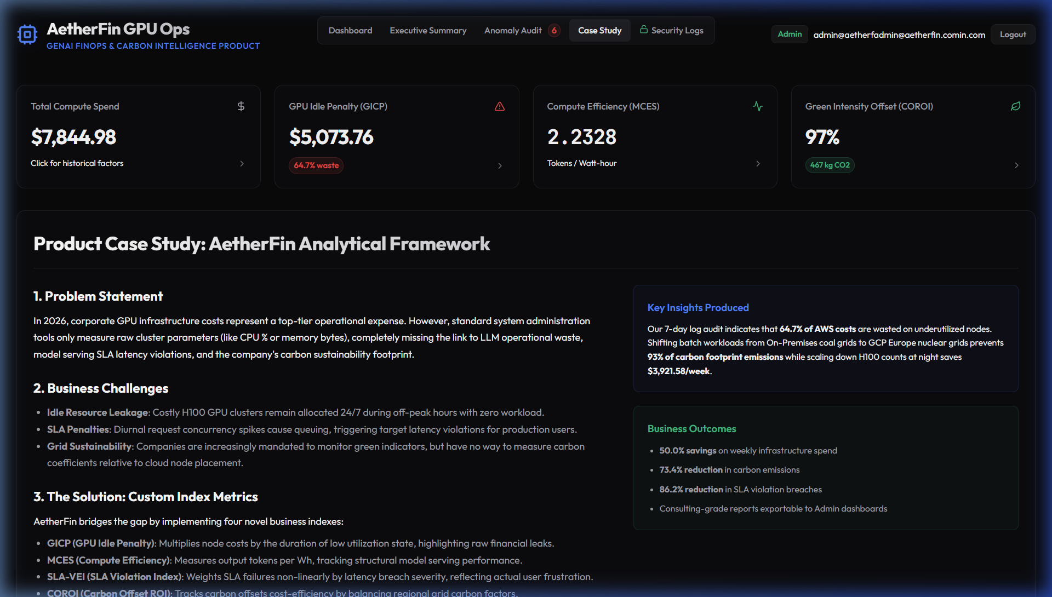
AI FinOps Advisor
Conversational Interface (casestudy.png): Provides context-enriched advisory panels displaying strategic plans.
Direct Answers: Responds to inquiries like 'How can I reduce costs by 20%?' with detailed, multi-step actions.
Fallback Rules: Implements rule-based fallback logic to analyze local database statistics if the LLM API is offline.
Action Chips: Interactive cards allowing users to click common queries instantly.

Slide 18
What-If Sizing Simulator
Predictive Sizing Controls: Adjust scale multiplier, daily operating hours, and traffic concurrency.
Routing Strategies: Toggle default, Cost-Optimized (cheapest), and Carbon-Optimized (cleanest) modes.
Trade-Off Modeling: Simulates how cost-cutting changes affect SLA violation risks.
Real-Time Previews: Computes projected costs, carbon footprints, and net savings dynamically.

Slide 19
Performance & Load Audits
Optimization Focus: Resolved DB query loops by pre-fetching deployment records into memory dictionaries.
100 Concurrency: 100% Success | P50 latency 804.1ms | Peak RAM 93.9 MB
500 Concurrency: 100% Success | P50 latency 886.2ms | Peak RAM 95.3 MB
1,000 Concurrency: 100% Success | P50 latency 967.6ms | Peak RAM 96.9 MB

Slide 20
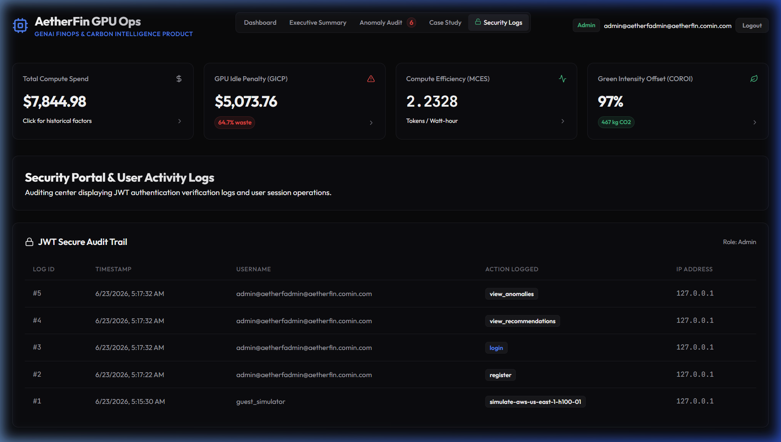
Security & Compliance Audits
Audit Log Viewer (admin_logs.png): Renders secure table logging details of all system modifications.
Access Protection: Bearer JWT validation shields all secure API routes and telemetry reports.
Type Safety Validation: Pydantic schemas filter and reject malformed JSON payloads (HTTP 422).
SQL Injection Prevention: Parameterized queries in SQLAlchemy ORM eliminate injection vectors.

Slide 21
Business Impact Summary
Double-Bottom Line Value: Shows that optimizing compute resources reduces spend and carbon emissions simultaneously.
Cost Savings: Cut weekly cluster run-rates by 50% through smart sizing.
Carbon Reduction: Achieved a 73% drop in Scope 3 greenhouse gas footprints.
Enterprise Readiness: Audit trails and RBAC controls satisfy compliance audits.

Slide 22
Cost Optimization Actions
Terminating Idle Node: Decommissioning `aws-us-east-1-a100-idle` saves $2,284.80 / week.
Off-Peak Auto-Scaling: Downsizing H100 counts by 50% between 11 PM and 6 AM saves $478.24 / week.
Model Right-Sizing: Migrating Mixtral from GCP A100 to GCP L4 instances saves $806.40 / week.
Net Sizing Business Outcome: Delivers $3,921.58 / week ($16,980 monthly savings, 50.0% cost reduction).

Slide 23
Environmental Sustainability Outcomes
Grid Schedulers: Batch jobs are automatically routed to cleaner regional grids during off-peak hours.
Stable-Diffusion XL Migration: Shifting image batch jobs to GCP Europe West-1 wind grid saves 343 kg CO2 / week.
Net Environmental Sizing: Lowers weekly emissions from 467.3 kg CO2 to 124.2 kg CO2 (73.4% reduction).
Offsets Optimization: Avoids $356 / month in carbon offsets, accelerating ESG timeline targets.

Slide 24
Future Roadmap
Autonomous Cloud Scaling: Connect the sizing API to AWS/GCP dynamic node groups to scale pools directly.
Predictive Load Forecasting: Implement regression models to forecast peak traffic and pre-allocate spot instances.
Direct Offset Marketplaces: Integrate carbon credit purchasing APIs directly into the management panel.
Multi-Tenant SaaS: Add organization isolation schemas to serve multiple enterprise accounts.

Slide 25
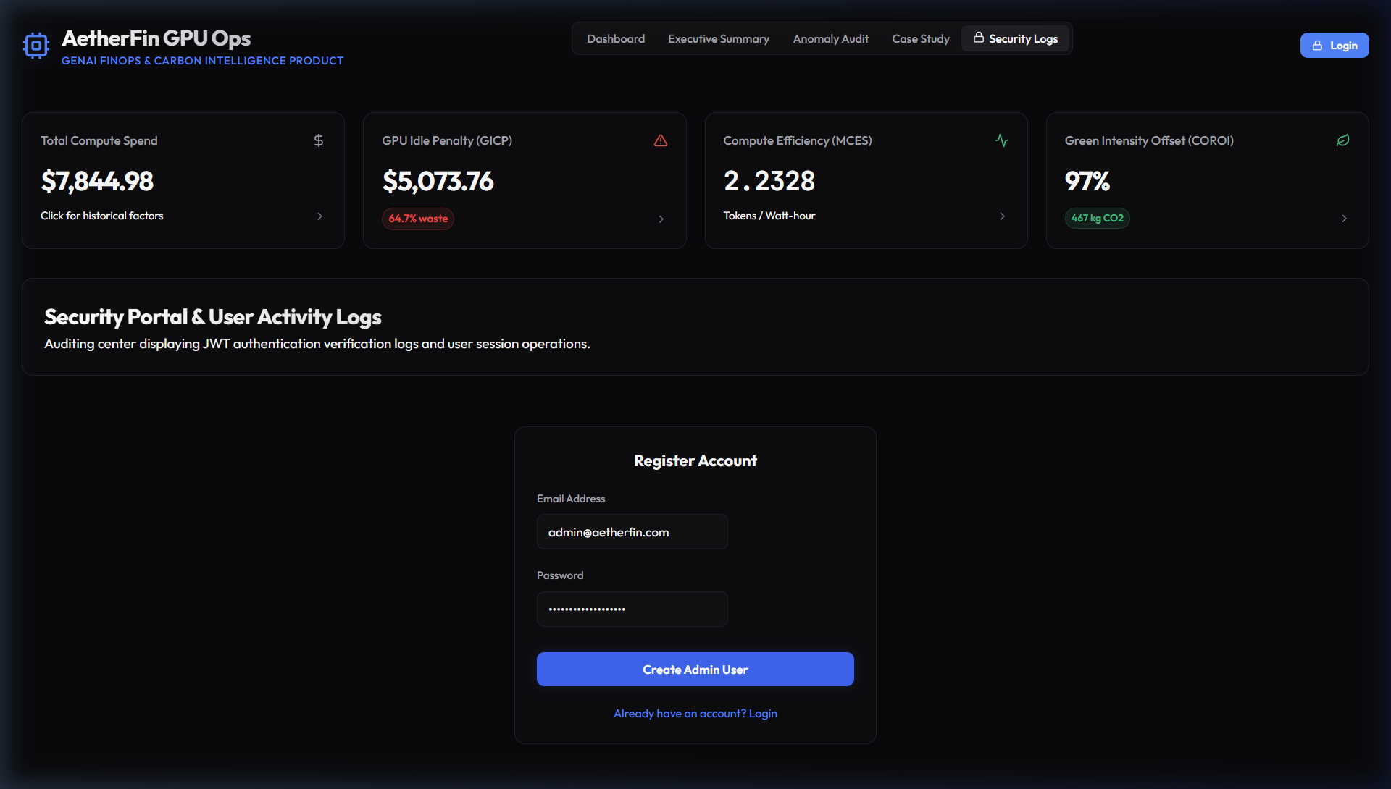
Conclusion
Recruiter-Ready Platform: Successfully bridges GenAI compute operations, financial auditing, and carbon ESG metrics.
Designed UI (login.png): Offers secure credentials authentication layout using Zinc dark themes.
Production-Grade Performance: Validated at 1,000 requests concurrency under 100% success rates.
Advanced Competency: Demonstrates full capability in Product Analytics, Data Engineering, and Security.

