Slide 1
MEDPAR
Regression framework
Evolution, delivered capability
and readiness for production-data analysis
Engineering and demonstration overview
01
Notes:
This presentation explains how the original test repository developed into the current MedPAR regression and reconciliation framework. We began with small JSON examples that helped us understand and test individual rules. The requested outcome expanded to production input discovery, connected stage processing, independent output comparison and evidence that a business reviewer can follow. The aim is to make the added work and its value clear. Today we can demonstrate the source configuration, stage decisions, reference searches and row evidence. Readiness means controlled production-data analysis. It does not mean that every supplied production record passes or that Final MEDPAR export has received full certification.
Sources: Project scope history supplied by the team. Current code in run_commands.py, src/medpar_qa/orchestration and src/medpar_qa/reporting.

Slide 2
The original test repository
A focused starting point for learning and checking the rules
Area | Initial approach | Current framework
Input | One or a few JSON records | JSON and Parquet datasets
Execution | Individual rule test cases | Connected stages and later entry points
Comparison | Known fixture expectations | Original, KEEP and DROP populations
Evidence | Test outcome and assertions | File, row and rule evidence
The initial tests remain the regression foundation.
02
Notes:
The initial repository concentrated on unit-style tests and small controlled fixtures. That was useful because a small input makes it easy to prove one rule branch and understand a failure. It did not yet answer questions such as how many files a source folder contains, which rows should continue, or whether a production KEEP file agrees with our decisions. We retained those focused tests while adding execution and reconciliation around them. If asked whether the first approach was wasted, the answer is no. The original tests now protect the business logic while we change ingestion, orchestration and reports. The scope expanded beyond what an isolated test repository needed.
Sources: Team-provided history. tests/unit, tests/integration, run_commands.py.

Slide 3
Scope added during development
01
Production inputs
Resolve local or S3 files and folders, identify formats and preserve source locations.
02
Connected processing
Start at the selected stage and continue retained records through downstream stages.
03
Independent reconciliation
Compare calculated decisions and values against supplied KEEP and DROP datasets.
03
Notes:
The expansion had practical consequences. A unit test can receive an in-memory record. A production analysis run needs to discover files, read real formats, preserve row numbers and handle source-specific configuration. A single-stage test can end at an assertion. The connected framework must create outputs, forward retained records and account for drops and exceptions. A fixture test knows the answer. Production reconciliation must search independent reference files and distinguish missing data, duplicate identities, conflicting membership and differing field values. These additions explain why the work involved more than adding test cases. Reporting then had to expose these distinctions clearly.
Sources: run_commands.py SOURCE_RUN. src/medpar_qa/ingestion/input_sources.py, row_selection.py. src/medpar_qa/orchestration/connected.py. src/medpar_qa/reporting/row_report.py.

Slide 4
Why delivery required additional time
Expanded requirement | Engineering work added
Document interpretation | Resolve revised rules and calculation precedence
Production input support | Add format handling, S3 discovery and source provenance
Record movement | Generate stage outputs and reconcile handoff counts
Output comparison | Search full references and explain real differences
Reviewable reports | Separate files, rows, checks and acceptance results
The delivery scope grew from rule tests to a usable analysis workflow.
04
Notes:
The additional time came from implementing a broader deliverable and incorporating review feedback. The team requested revised decision-tree behavior, source-only stage processing, local and S3 paths, multiple input formats, row sampling, full reference comparisons and simpler reports. Each change affected the meaning of counts and the evidence needed to explain them. For example, file counts cannot be used as row counts, and finding a record in KEEP does not establish acceptance if the same identity also appears in DROP. We corrected these distinctions and protected them with regression tests. We are not assigning invented durations or dates to these workstreams. The defensible explanation is the added engineering scope and repeated validation of its behavior.
Sources: User-requested change history. src/medpar_qa/reporting/row_flow.py, row_report.py, compact.py. Regression tests for reconciliation and handoffs.

Slide 5
One configuration controls the input
Configuration | Available choices
Source | Local or S3, selected through source_type
Paths | Files, multiple files, folders or multiple folders
Formats | JSON and Parquet, including extensionless S3 objects
Datasets | Original source with optional KEEP and DROP references
Entry point | One selected stage or all configured stage entries
SOURCE_RUN in run_commands.py
S3 objects download to a local cache for reading and traceable evidence.
05
Notes:
SOURCE_RUN is the single place for the normal input configuration. Both local and S3 sections can remain configured, and source_type selects which section runs. Each stage separates original, keep and drop datasets, with files and folders under each role. Keep and drop paths are reference populations, not replacement source inputs. S3 support resolves object or prefix inputs and downloads objects to the run cache before the common readers process them. Extensionless objects use format detection. This capability has stubbed integration-test evidence. We should not imply that the client AWS environment has already passed a live verification. Their credentials, access policy and actual bucket still require that check.
Sources: run_commands.py SOURCE_RUN and source_run_configuration. src/medpar_qa/ingestion/input_sources.py. tests/integration/test_row_reconciliation.py S3 stub test.

Slide 6
Five stages with distinct responsibilities
Stage | Main regression responsibility
Final Action | Apply revised claim routing and ICN cancellation rules
Split | Apply transaction eligibility and the four-year window
Stay | Group related bills and verify merge calculations
Intermediate | Validate derived fields and documented calculations
Final MEDPAR | Validate classification, configured layout and export readiness
A run can begin at any stage. Retained records continue from that point.
06
Notes:
Final Action decides the applicable business route for related claims. Rule 6 distinguishes matching ICNs and the QC0 cancellation action code from transaction code. Split checks eligible transaction codes and the documented retention window. Invalid transaction codes take an exception route rather than becoming silent business drops. Stay groups related bills and applies field-specific merge policies. Intermediate calculates and checks dates, monetary values, supported revenue mappings and other derived fields using the supplied calculation reference. Final MEDPAR checks configured classification and layout behavior. Starting at Intermediate does not require executing earlier stages. Final fixed-width export remains dependent on the approved complete layout and required reference inputs. Rule-level detail is available in the code and report rather than compressed into this overview.
Sources: Current stage modules under src/medpar_qa/stages and processors. Approved precedence supplied by the team: revised Final Action decision tree and byte-by-byte calculation document.

Slide 7
Architecture and regression responsibilities
Configuration
Input reading
Processing
Validation
Reporting
›
›
›
›
run_commands.py
ingestion / normalization
orchestration / processors
stages / comparison
reporting
A regression developer protects both rules and the execution around them.
Focused fixtures prove rule branches. Integration tests cover readers, source provenance, stage handoffs and reference reconciliation.
07
Notes:
The architecture separates configuration from data access, stage processing, rule checks and reporting. This separation lets a rule change without rewriting S3 discovery or presentation code. As regression developers, we maintain executable rule expectations, design boundary and negative cases, and check that fixes do not break earlier behavior. We also verify integration behavior that unit tests alone cannot prove. This includes reading nested source formats without counting inner arrays as separate claims, preserving a physical source row number, forwarding generated outputs and locating an expected row anywhere in the reference dataset. The report is an evidence consumer. A cosmetic report change must not rewrite a business decision.
Sources: Repository architecture: run_commands.py, src/medpar_qa/ingestion, normalization, orchestration, processors, stages and reporting. tests/unit and tests/integration.

Slide 8
Record processing and scale
100,000
Sampling
Current demonstration selects up to five top-level rows per original file. It adds no context rows.
source rows in the streaming selection test
Full input
mode="all" selects every input row. Reference searches always inspect all supplied reference rows.
Streaming selection evidence does not establish full-pipeline throughput at lakh scale.
08
Notes:
One JSON or Parquet file may contain many top-level claim records. The framework processes those records and keeps their file and physical row provenance. Nested diagnoses, procedures and revenue lines belong to their parent record and do not increase the input-row count. The current demonstration selects up to five rows from each original file and disables related-row enrichment. Generated outputs then continue through the downstream stages. The all mode selects complete input populations. Reference comparison does not inherit the five-row source sample limit. It searches the full supplied KEEP and DROP datasets. The repository includes a 100,000-row streaming selection test. This supports the ingestion design, but it is not a certified end-to-end performance result for lakhs of claims. Representative load testing remains an acceptance activity.
Sources: tests/unit/test_row_selection.py, 100000-row selection test. run_commands.py row_selection. src/medpar_qa/ingestion/row_selection.py and reporting/row_report.py.

Slide 9
Worked comparison with real row evidence
Four calculated KEEP rows: all four found with equivalent data
Source row | KEEP occurrences | DROP occurrences | Data-equivalent KEEP
1 | 3 | 3 | 3
3 | 1 | 11 | 1
4 | 3 | 3 | 3
5 | 1 | 5 | 1
The remaining result is an output-membership conflict.
Found records and accepted decisions are different measures. Evidence identifies both output locations.
09
Notes:
This is the first supplied Final Action file in the saved production report. It contains 98 source rows, and the demonstration selects five. The stage keeps rows 1, 3, 4 and 5, while one row stops. All four kept rows have data-equivalent candidates in supplied KEEP references. Earlier comparison logic blocked duplicate identities, and some numeric versus text differences caused false mismatches. The corrected comparison examines every candidate and normalizes lossless numeric representations. The table shows the observed occurrence counts by source identity. The remaining conflict is that each identity also appears in supplied DROP data. We must report that conflict rather than certify the output because a KEEP match exists. Whole-population count reconciliation remains separate from per-source-row presence. The reference evidence includes file paths and physical row numbers.
Sources: Saved production evidence: entries/final_action/final_action/row_review.json in report 20261015_213923. First supplied file ends 226db3ea-d940-46e9-8ee0-932dffc0f8a5.parquet. Source rows 1, 3, 4, 5.

Slide 10
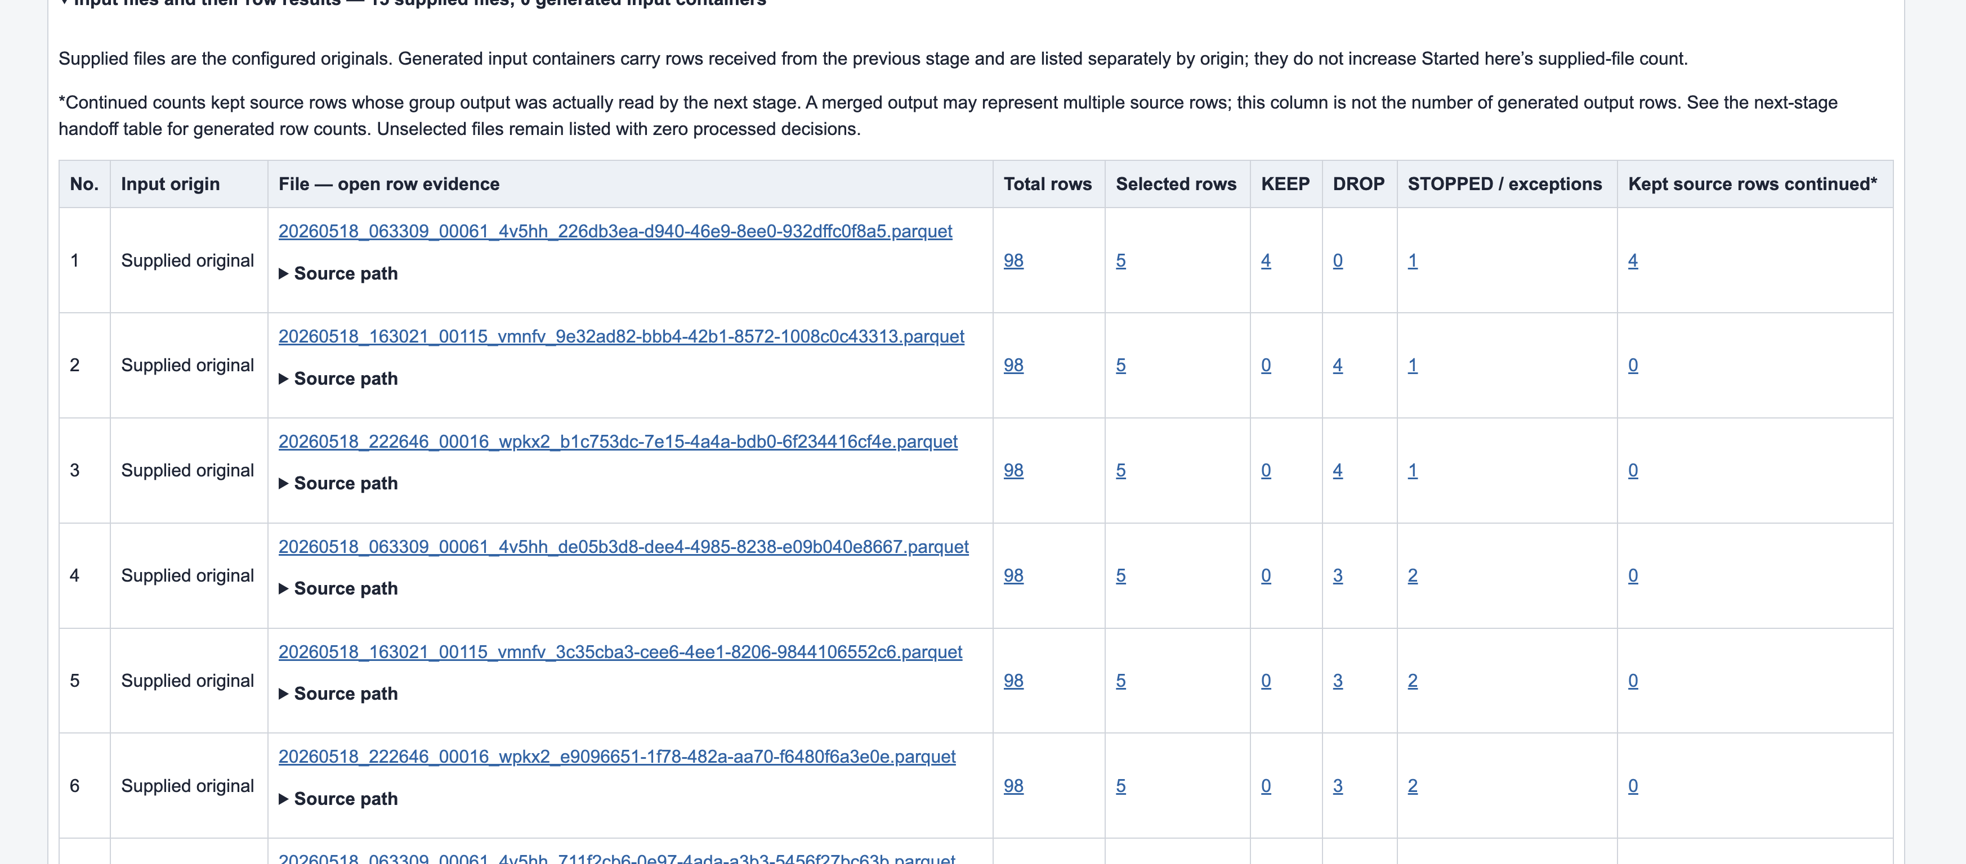
Actual report: files and their row results
Actual development capture, 15 October. The current view also adds KEEP/DROP comparison evidence.
10
Notes:
This is an actual report capture from the project, not a design mock-up. Use the first row to explain the units. The file has 98 total rows and five selected rows. Four receive KEEP, none receive DROP and one is stopped. The continued count refers to retained source rows represented in data consumed by the next stage. It is distinct from the number of output rows when grouping or merging occurs. The capture predates the added reference-comparison columns. The current report supplements this view with found versus calculated counts and verified, mismatched or unverified outcomes. Click a filename or count in the live report to open detailed row evidence. Expand an individual row to inspect the rule, expected value, observed value and reference location.
Sources: Actual report screenshot supplied for this project: Screenshot 2026-10-15 at 10.34.56 PM.png. Current report: reports/20261015_213923/master/index.html and saved row_review.json evidence

Slide 11
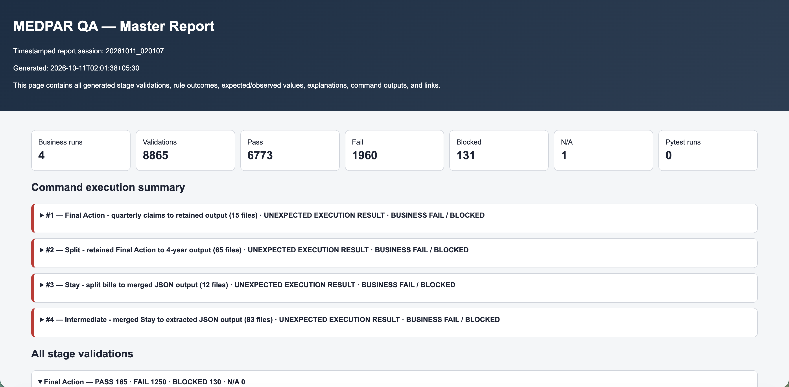
Actual report review and software verification
601
regression tests passed
15 targeted checks cover the latest comparison fixes.
Earlier summary capture. Its validation-event counts are historical and do not represent current unique row counts.
11
Notes:
The screenshot shows an earlier actual master-report summary. Its displayed counts belong to that historical run. They are individual validation events, not unique files or claims. The report has since evolved to separate source files, selected rows, decisions, reference presence and validation outcomes. The latest completed full software suite passed 601 tests, and the subsequent targeted comparison checks passed 15 tests. The offline report audit found no broken evidence links. These are software verification results. They do not certify supplied production output as correct. The current compact delivery uses one master HTML file and one HTML file for each of the five stages, while preserving inner logical screens and evidence routes. During the demonstration, explain a real discrepancy rather than interpreting a test-suite pass as production acceptance.
Sources: Actual project report capture dated 11 October 2026 at 02:03.20. Full suite log /tmp/candidate-full-suite.log. Latest targeted log /tmp/final-candidate-tests.log. Saved compact report audit /tmp/reconciled-link-audit.log.

Slide 12
Current readiness and next acceptance steps
Ready for controlled production-data analysis
and regression validation
Demonstrate now
Complete acceptance
Configure a source and run the stages. Trace each decision to its row and reference evidence.
Verify live AWS and representative loads. Align references and approve the final layout, required feeds and golden outputs.
The delivered value: repeatable analysis with an explanation for each result.
12
Notes:
The delivered framework supports controlled production-data analysis and repeatable regression validation. We can demonstrate configuration, real source reading, stage decisions, downstream processing and row-level reference evidence. We should distinguish that capability from final production acceptance. The remaining acceptance work includes live client AWS verification, representative end-to-end load tests, alignment of original and reference extracts, approved byte layout and required vendor, revenue or SSI reference inputs where applicable. Final MEDPAR stays a draft where those dependencies are missing. A useful demonstration begins with one configured source and one row, follows its decision and reference evidence, and then shows how the same mechanism supports the broader dataset. The central outcome is a framework that helps the team investigate actual differences with reproducible evidence.
Sources: Current run configuration, source and stage processors, export_readiness.json, supplied-reference population evidence, and test records cited on slide 11.

