Slide 1
Smart loans marketplace - AI underwriting (a619a5db)
AI-driven marketplace connecting MSMEs to micro-lenders with instant underwriting and dynamic pricing.

Slide 2
Title
AI micro-loans marketplace
Founders: You
Ask: ₹5 Cr
Notes: Intro and ask.

Slide 3
Problem
Slow access to credit
High paperwork
Traditional underwriting ignores alternative signals
Notes: Explain pain.

Slide 4
Solution
AI risk scoring using transaction & GST data
Marketplace of lenders
Paperless onboarding & instant disbursal
Notes: How solution solves pain.

Slide 5
Market
Addressable: 6M formal MSMEs
Initial TAM: 1M in cities
Notes: Sizing notes.

Slide 6
Business Model
1-3% origination fee
Subscription analytics for lenders
Notes: Revenue levers.

Slide 7
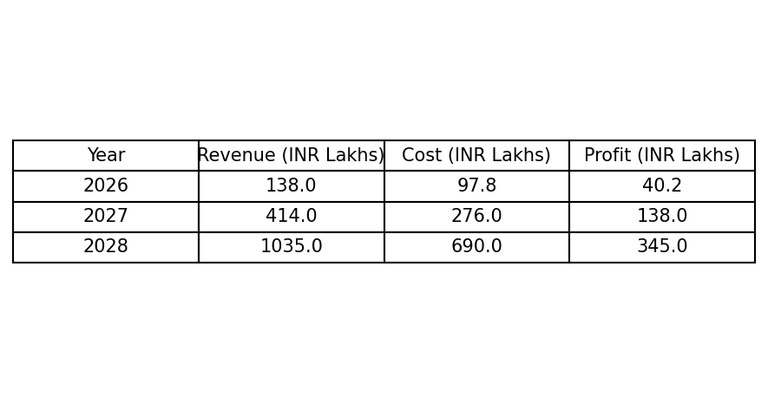
Go-to-Market
Partnerships with NBFCs
Field pilots in 2 cities
Notes: Channels & pilots.

Slide 8
Financials (3-year)
See financial table slide
Notes: High-level assumptions.

Slide 9
Appendix
Executive Summary:
We enable MSMEs to access micro-loans via AI risk signals and a lender marketplace. Target urban SME clusters and scale to 200k merchants in 3 years.
Assumptions:
Avg loan ticket: ₹1.5L
Originations growth: 3x YoY
Take rate: 2% origination

