Slide 1
MicroLoans for Indian MSMEs - faster capital, smarter underwriting.
An AI-driven marketplace connecting MSMEs in India to micro-lenders with instant credit decisions using transaction and GST signals - reducing friction and empowering growth.

Slide 2
Title
AI micro-loans marketplace for Indian MSMEs
Founder(s): Srikar M (example)
Ask: ₹5 Cr
Notes: Quick intro and ask.

Slide 3
Problem
MSMEs face slow access to credit
Traditional underwriting ignores alternative signals
High paperwork & time to disburse
Notes: Explain pain and anecdote.

Slide 4
Solution
AI risk-scoring using GST & transaction data
Marketplace of lenders with dynamic pricing
Paperless onboarding & instant disbursal
Notes: How model and marketplace reduce friction.

Slide 5
Market
Addressable: 6M formal MSMEs in India
Initial TAM (servicable): 1M in urban clusters
Notes: Market sizing notes.

Slide 6
Business Model
Platform takes 1-3% origination fee
Subscription for premium lender analytics
Notes: Revenue levers.

Slide 7
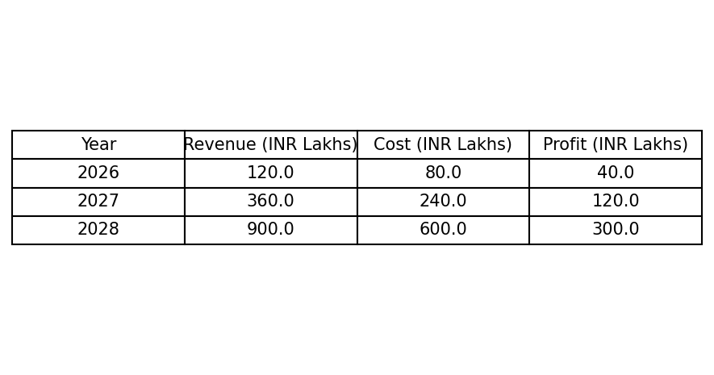
Go-to-Market
Partnerships with NBFCs & trade platforms
Field ops pilot in 2 cities
Notes: Channels & early traction plan.

Slide 8
Financials (3-year)
See financial table slide
Notes: High level financial assumptions.

Slide 9
Appendix
Executive Summary:
PitchPro-powered MicroLoans Marketplace enables MSMEs to access micro-loans with AI-based risk scoring, transparent terms, and a marketplace of lenders. We target urban & semi-urban MSMEs across retail, manufacturing and services, aiming to serve 200k merchants within 3 years.
Assumptions:
Avg loan ticket: ₹1.5L
Originations growth: 3x year-over-year
Take rate: 2% average origination fee

