Slide 1

YEAR
2024-25
UoH Placement
Portal
Agile project plan for website.
Srikar (21MCME19)
Akashkumar Dhrana(21MCME28)

Slide 2
01
Role-based access control (students, coordinators, TPO, chairman).
Key
Highlights
02
Data analytics for placement statistics
03
Job posting and application submission.
04
Provide students with the ability to track the status of their job applications
NEXT

Slide 3
Technologies used:
JSP, JAVA SERVLETS, AJAX, J-QUERY,
TAILWIND CSS, HTML, JAVA SCRIPT
Technical
Details
Security measures
encryption, authentication, access control
Database Technology
mySQL
Additional properties
Scalable, Modular, Low down time
NEXT

Slide 4
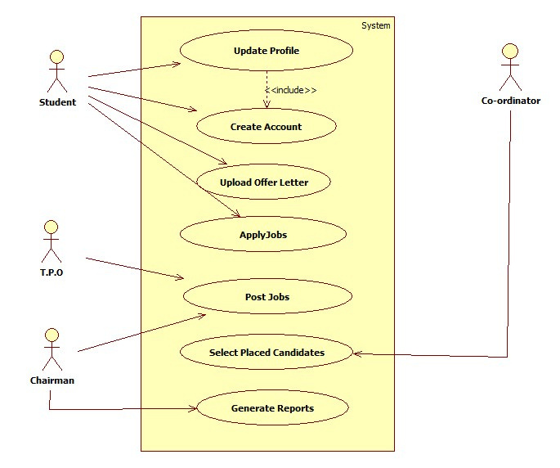
Use-case
Diagram
NEXT

Slide 5
01
02
03
Better interaction between the stakeholders of the university
Increases number of students placed
and stream line the current process
Generate the Reports effectively
Outcomes
04
05
Enhanced Collaboration and Engagement
Continuous Improvement and Innovation
NEXT

Slide 6
.
Thankyou

