Slide 1
Task 4 — Dashboard Design (Power BI)
Interactive Dashboard plan and executive summary
Dataset: Sales.csv

Slide 2
Executive Summary — Key Metrics
Total Sales: 18,591,125.41
Average MRP: 140.99
Total Outlets: 10
Average Item Weight: 12.86
Outlet Years Range: 1985 - 2009

Slide 3
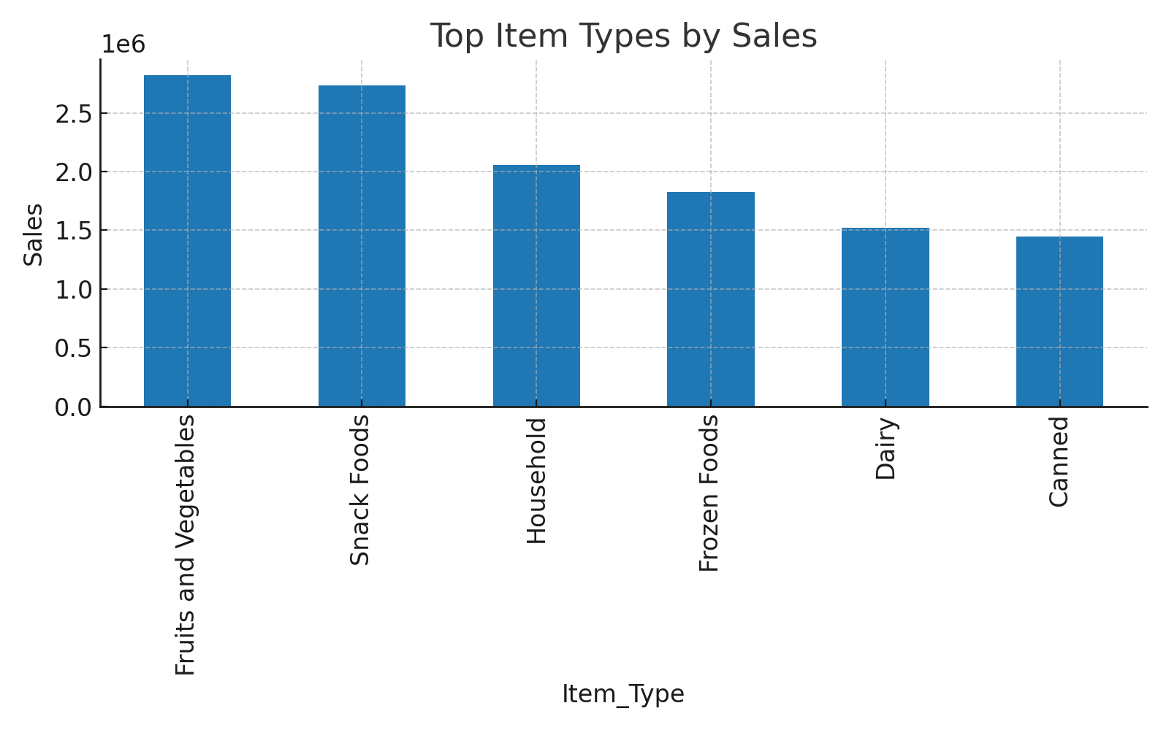
Sales by Product Category
Insight:
• Top product categories contribute majority of sales.
• Consider focusing promotions on high-volume, high-margin categories.

Slide 4
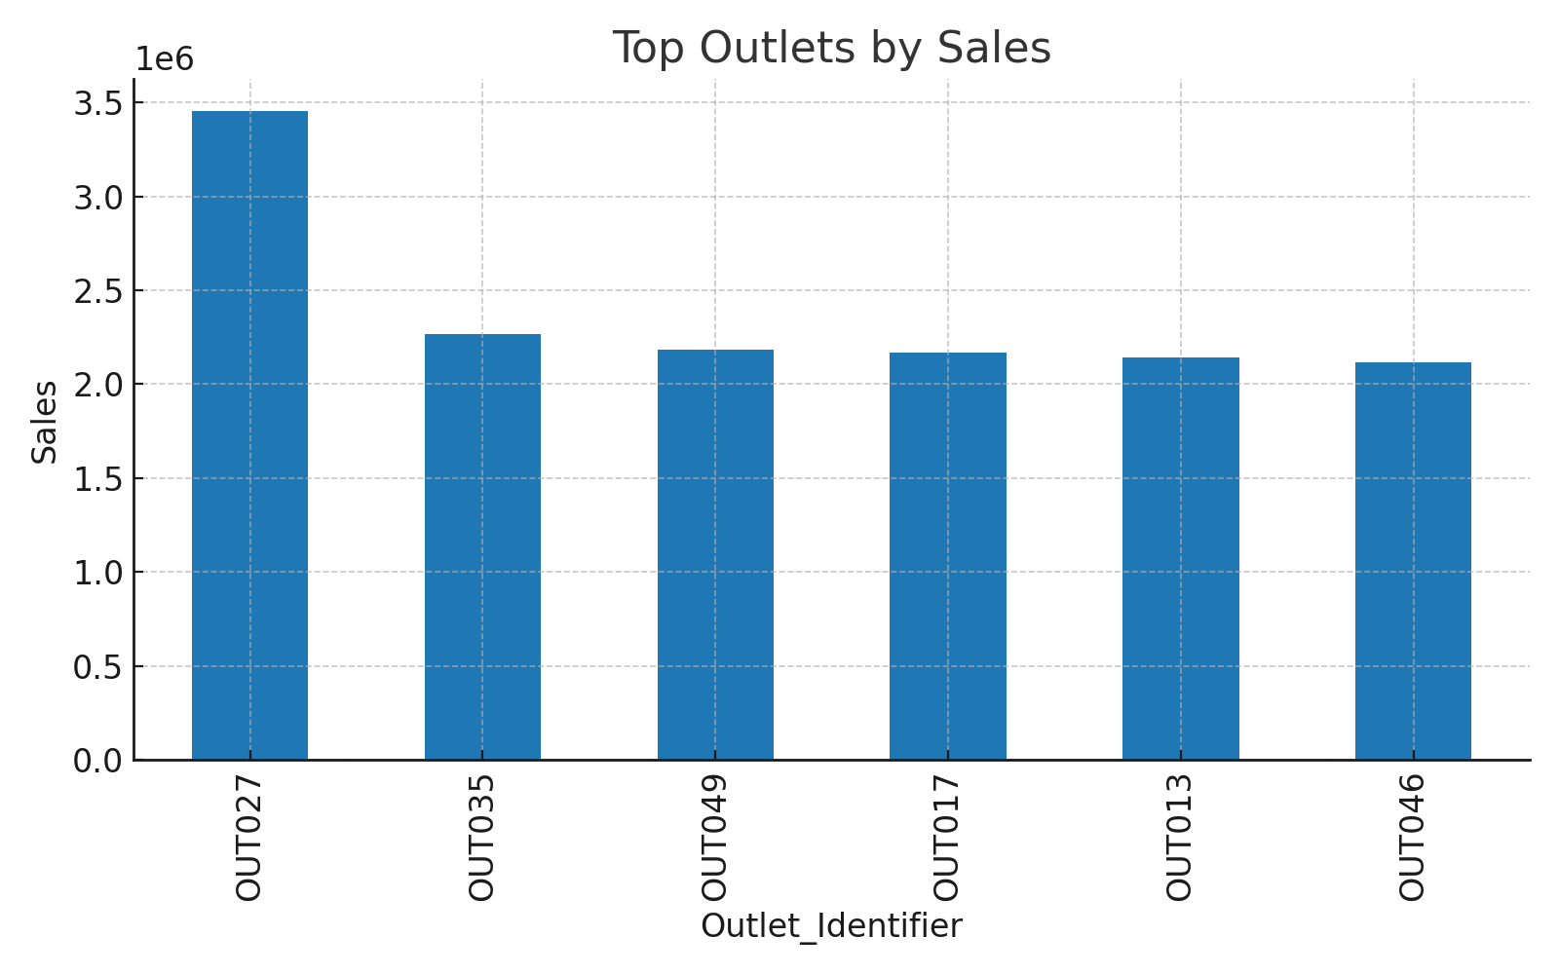
Top Outlets — Sales Contribution
Insight:
• Top outlets drive a disproportionate share of sales.
• Explore outlet-level promotions and inventory allocation.

Slide 5
Dashboard Design — Next Steps & Actions
Design checklist and recommended actions for Power BI dashboard:
1. KPIs: Total Sales, Avg MRP, Total Outlets, Avg Item Weight, Top Categories.
2. Filters/Slicers: Item_Type, Outlet_Type, Outlet_Size, Establishment Year.
3. Visuals: KPI cards, Time series (by year), Treemap (product mix), Bar charts (top products/outlets), Scatter (MRP vs Sales).
4. Interactivity: Use slicers, drill-through for outlet and product details, bookmarks for navigation.
5. Styling: Consistent color theme, titles with one-line insights, data labels for top items.
6. Business Actions: Reallocate inventory to top outlets, review pricing for low-MRP high-sales items, target promotions to high-margin categories.

