Slide 1

Employee Management System

Slide 2

About Us :-
1. A. SRIVARDHAN : Completed B.Tech in CSE
Linked in :- ALUGU SRIVARDHAN | LINKEDIN
2. NAGA PRANEETH: - Completed B.Tech in IT
Linked in :- NAGA PRANEETH | LINKEDIN
3. ALASAPURI SRIKAR:- Completed B.Tech in CSE
Linked in :- SRIKAR ALASAPURI

Slide 3
Agenda
Objective of the Project
Key analysis questions (use cases)
Conclusion (Key finding overall)
Q&A Slide
Your Experience/Challenges working

Slide 4
Objective of the Project:
Manage Employee Information
Store employee personal, contact, and login details.
Maintain unique employee records for easy retrieval and management.
Manage Job Roles and Departments
Assign employees to appropriate job positions.
Organize job roles according to different departments.
Maintain salary ranges associated with job roles.
Manage Salary and Payroll
Store employee salary and bonus information.
Calculate payroll amounts based on salary and other applicable factors.
Maintain accurate payroll records for each employee.
Track Qualifications and Skills
Store employee qualifications, certifications, and required skills.
Compare employee qualifications with job requirements.
Support identification of employee skill gaps and development opportunities.
Manage Leave and Absence
Record employee leave dates and reasons.
Track employee leave history.
Use leave information for payroll-related calculations where applicable.

Slide 5
Key Analysis Questions:
How many unique employees are currently in the system?
Which departments have the highest number of employees?
What is the average salary per department?
Who are the top 5 highest-paid employees?
What is the total salary expenditure across the company?
How many different job roles exist in each department?
Which job roles offer the highest salary?
How many employees have at least one qualification listed?
Which employees have taken the most leaves?
Which department receives the highest total bonuses?

Slide 6
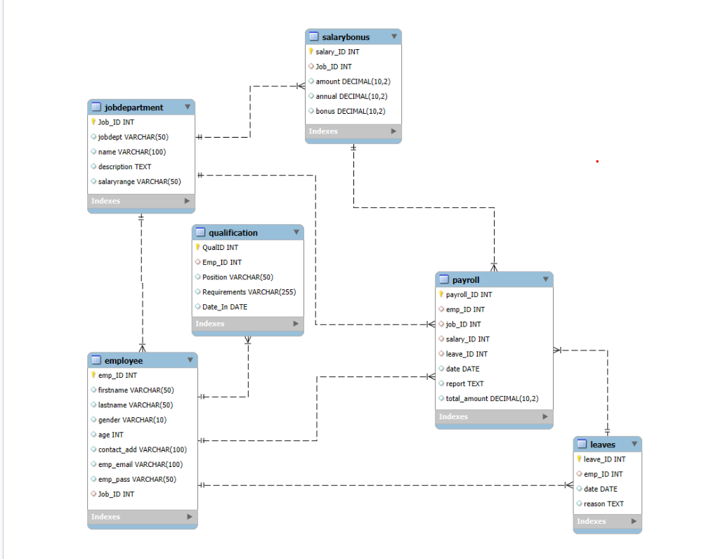
Schema Diagram :

Slide 7
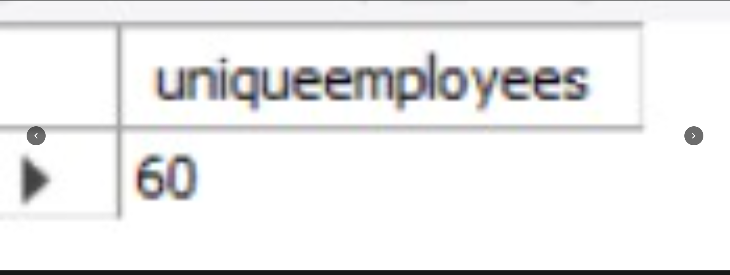
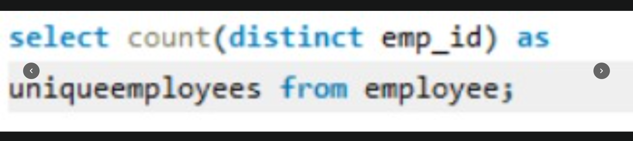
1.How many unique employees are currently in the system?
Query :
Output :
Key Insight :-
The system currently contains 60 unique employees, indicating that employee records are maintained for the complete workforce in the dataset.

Slide 8
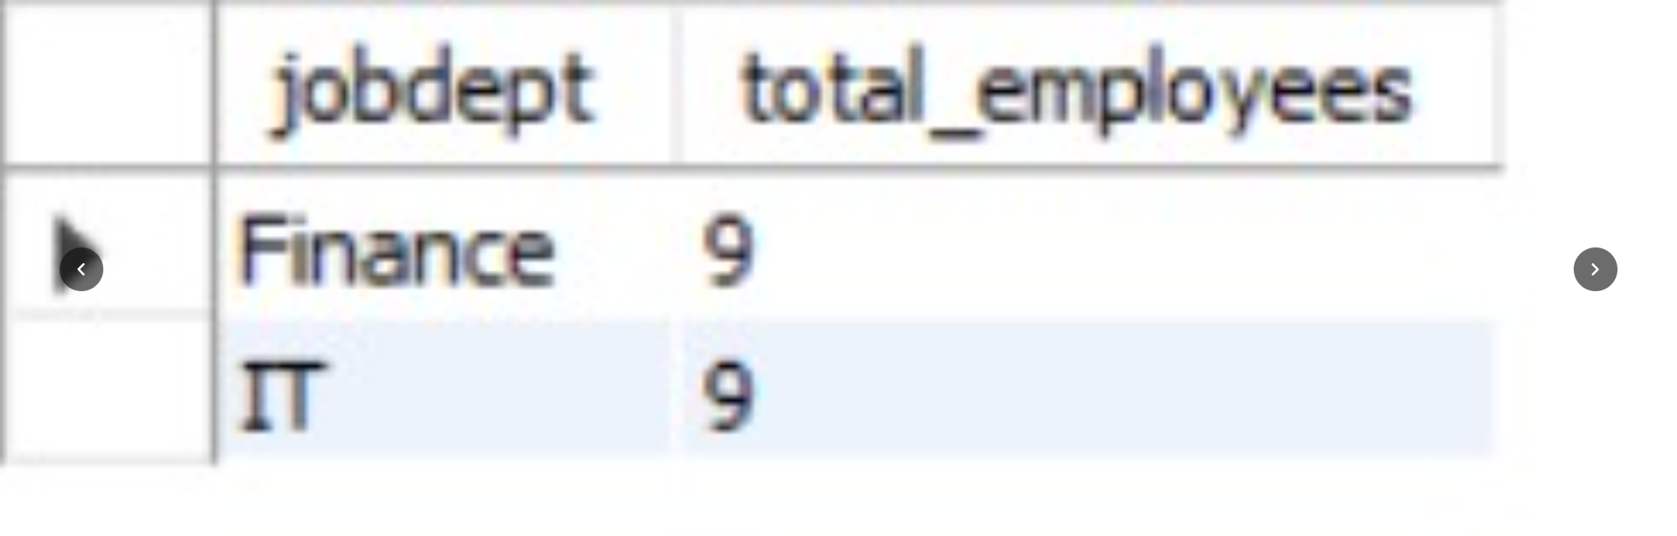
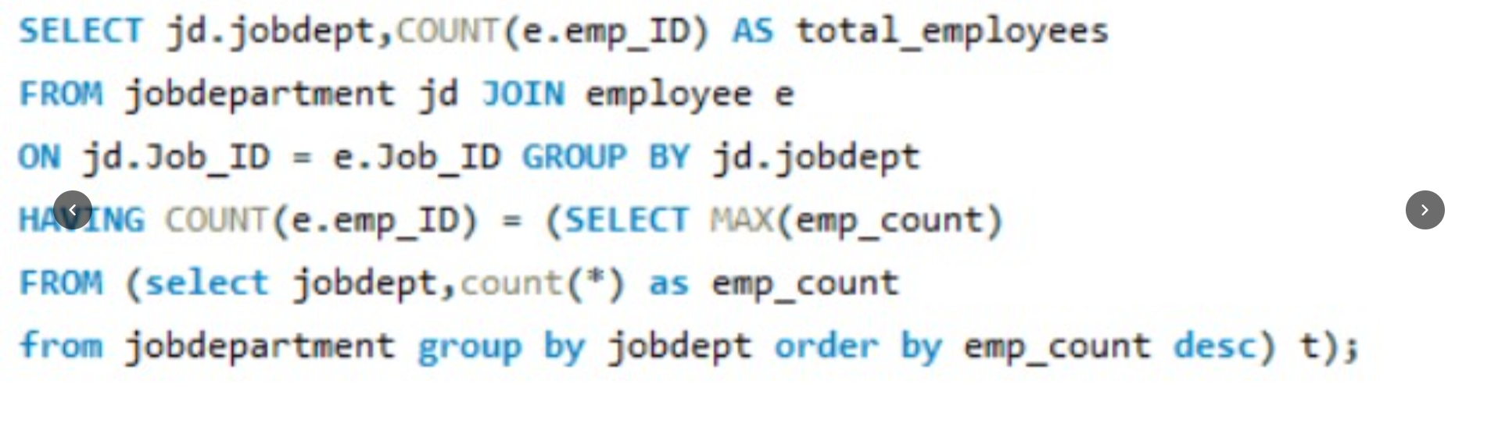
2.Which departments have the highest number of employees?
Query :
Output :
Key Insight :-
Employee distribution is not uniform across departments. Some departments have a higher concentration of employees, indicating greater workforce requirements in those areas.

Slide 9
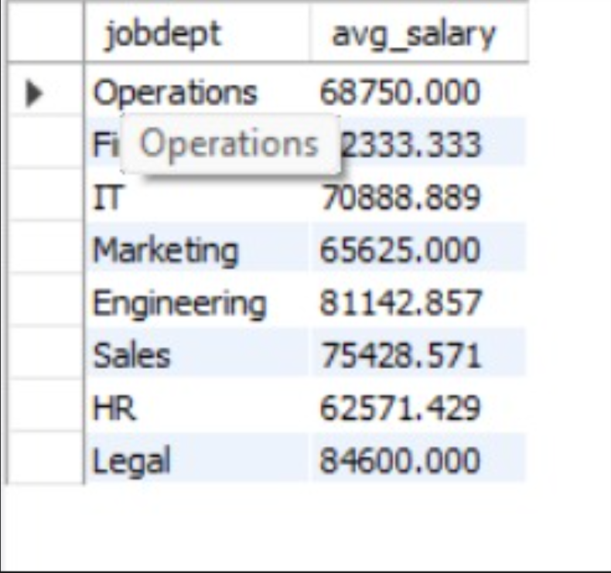

3.What is the average salary per department?
Query :
Output :
Key Insight :-
Average salary varies by department, mainly because different departments contain different job roles and salary levels. Higher-level technical and managerial roles generally contribute to higher departmental averages.

Slide 10
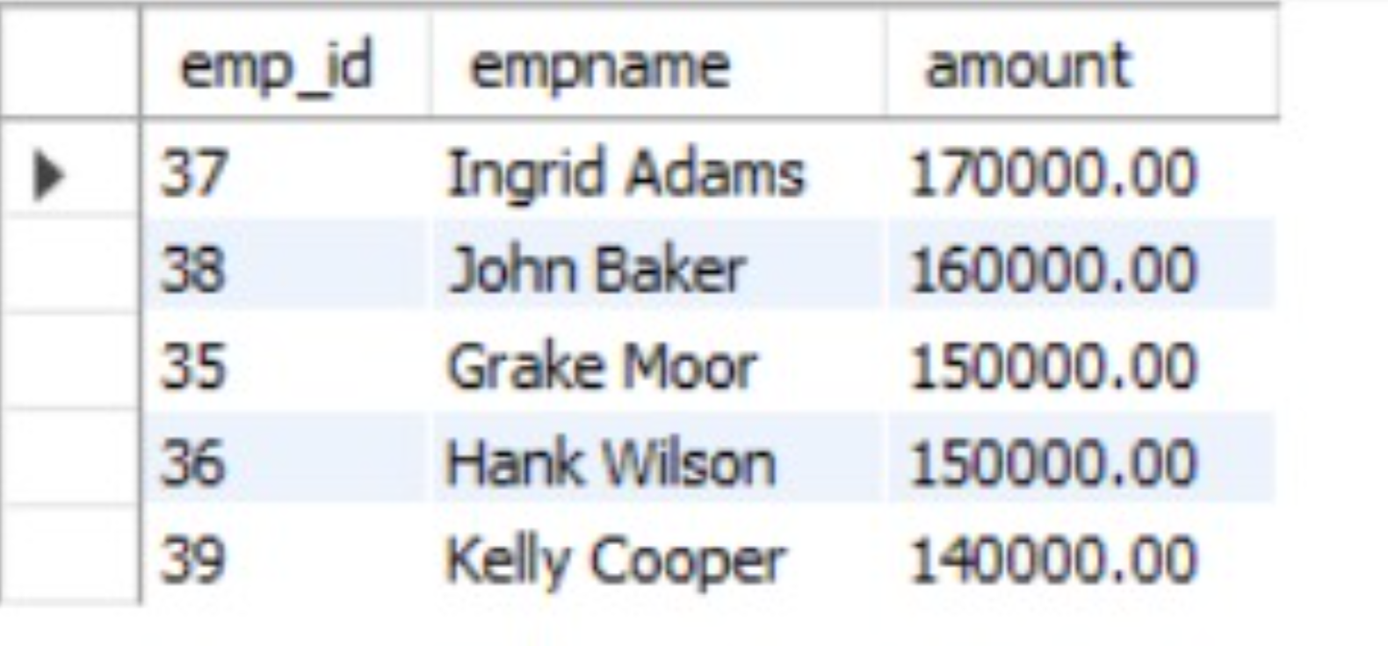
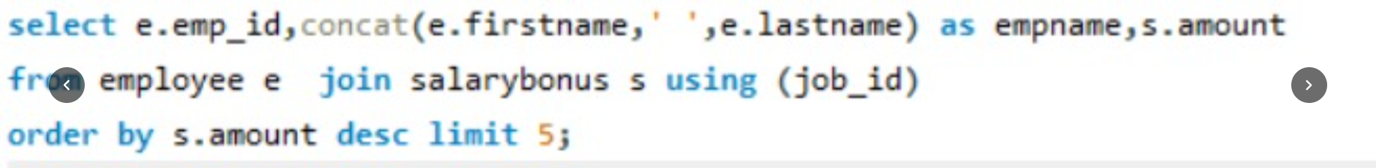
4.Who are the top 5 highest-paid employees?
Query :
Output :
Key Insight :-
The top-paid employees are associated with senior, managerial, or specialized positions, showing that compensation increases with responsibility, experience, and job specialization.

Slide 11
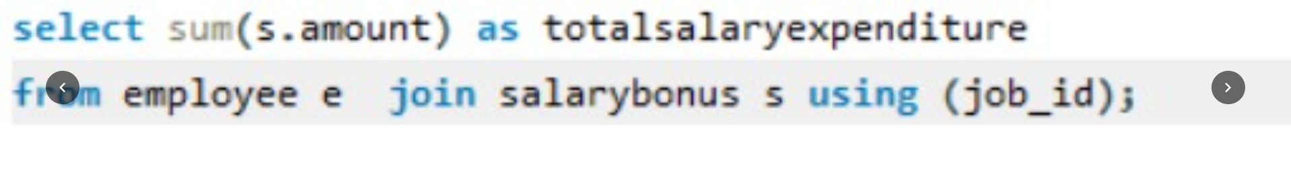
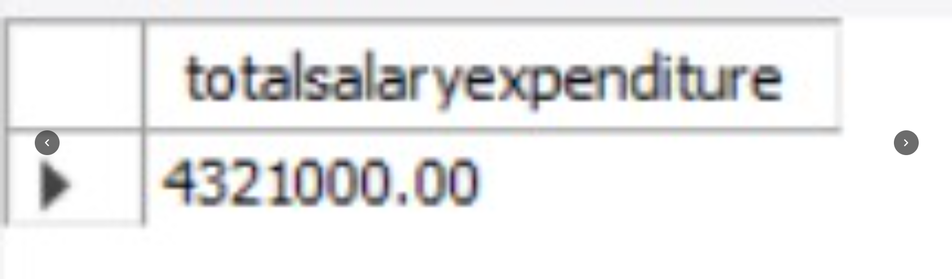
5.What is the total salary expenditure across the company?
Query :
Output :
Key Insight :-
The company has a significant overall payroll expenditure because compensation is distributed across 60 employees and multiple job roles.

Slide 12
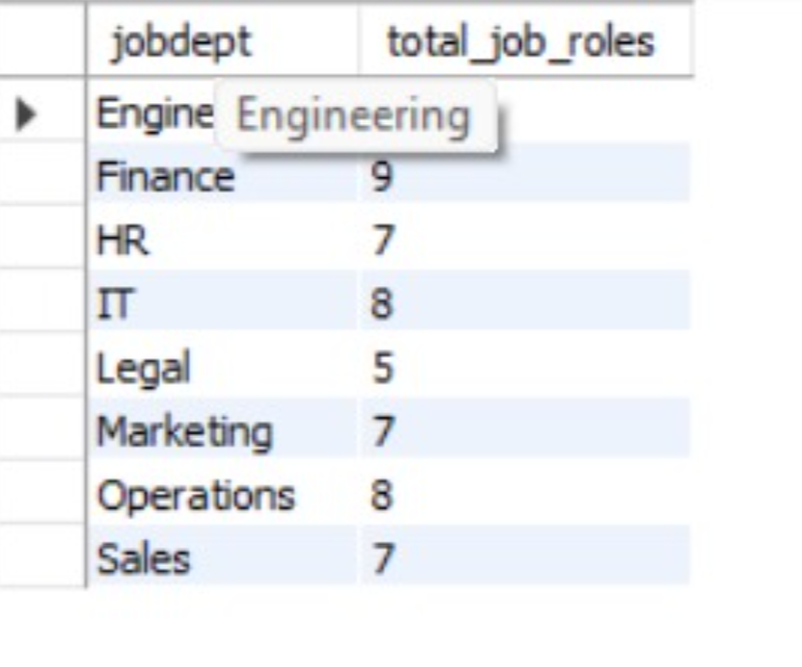
6.How many different job roles exist in each department?
Query :
Output :
Key Insight :-
The organization has multiple job roles across departments, showing a structured hierarchy with roles ranging from entry-level positions to senior management and specialized positions.

Slide 13
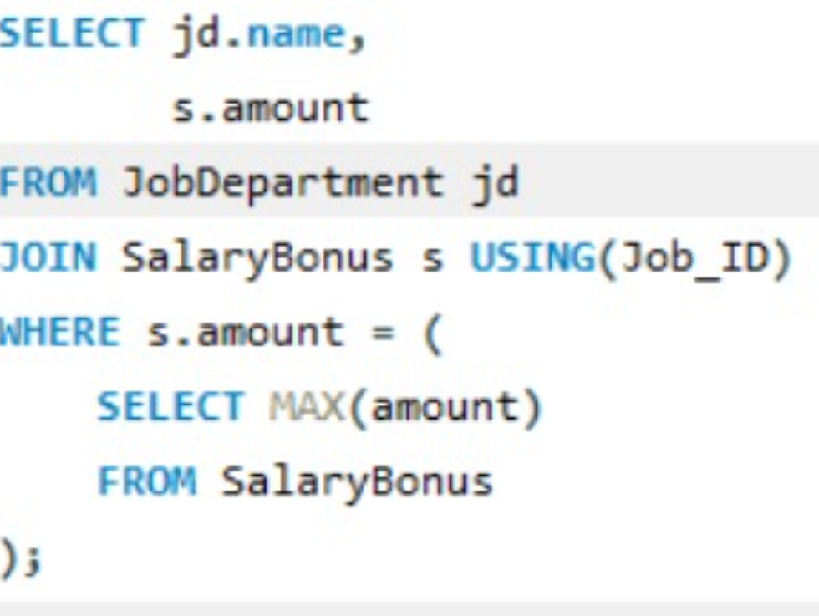
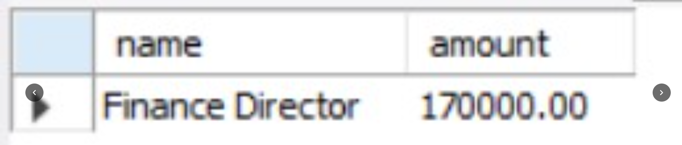
7. Which job roles offer the highest salary?
Query :
Output :
Key Insight :-
Senior management, leadership, and highly specialized technical roles tend to offer the highest salaries because they require greater expertise, experience, and responsibility.

Slide 14
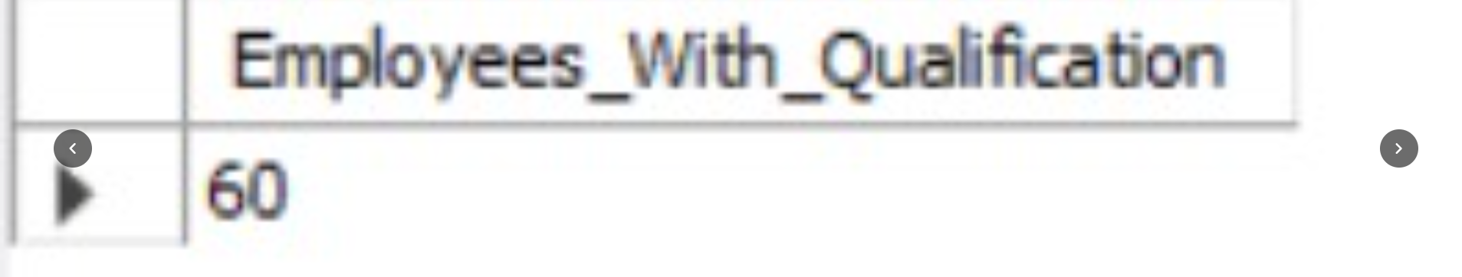
8.How many employees have at least one qualification listed?
Query :
Output :
Key Insight :-
All 60 employees have a qualification record in the provided Qualification table, meaning 100% of employees have at least one qualification listed.

Slide 15
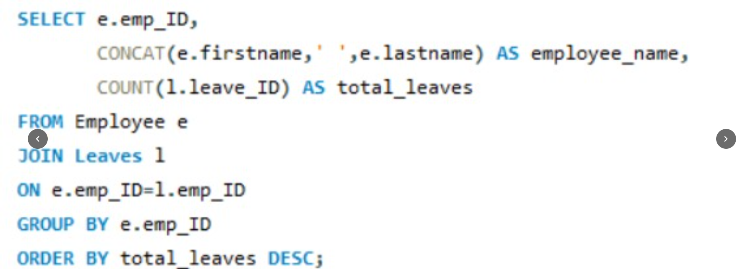
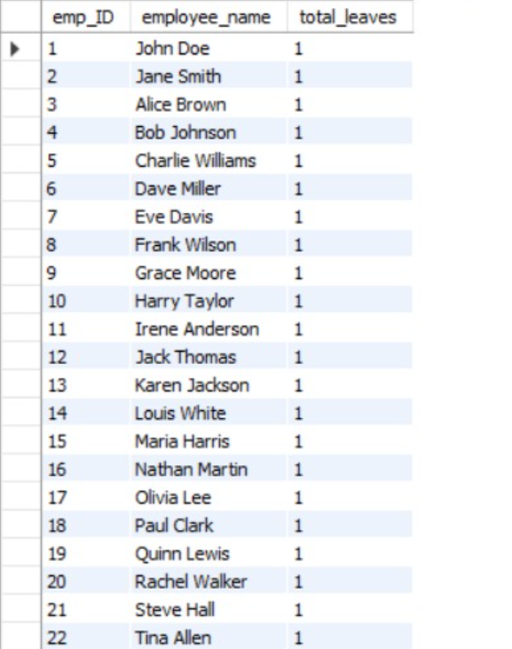
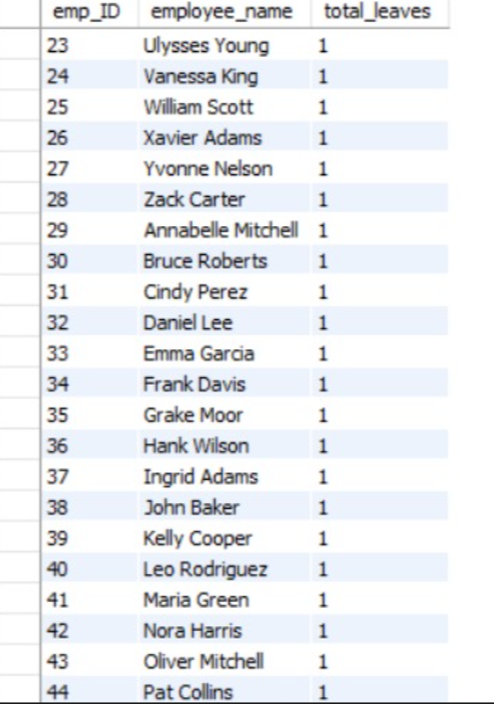
9.Which employees have taken the most leaves?
Query :
Output :
Key Insight :-
In the current LeaveTable, each employee has exactly one leave record, so no single employee has taken more leaves than the others. All 60 employees are tied with 1 leave record.

Slide 16
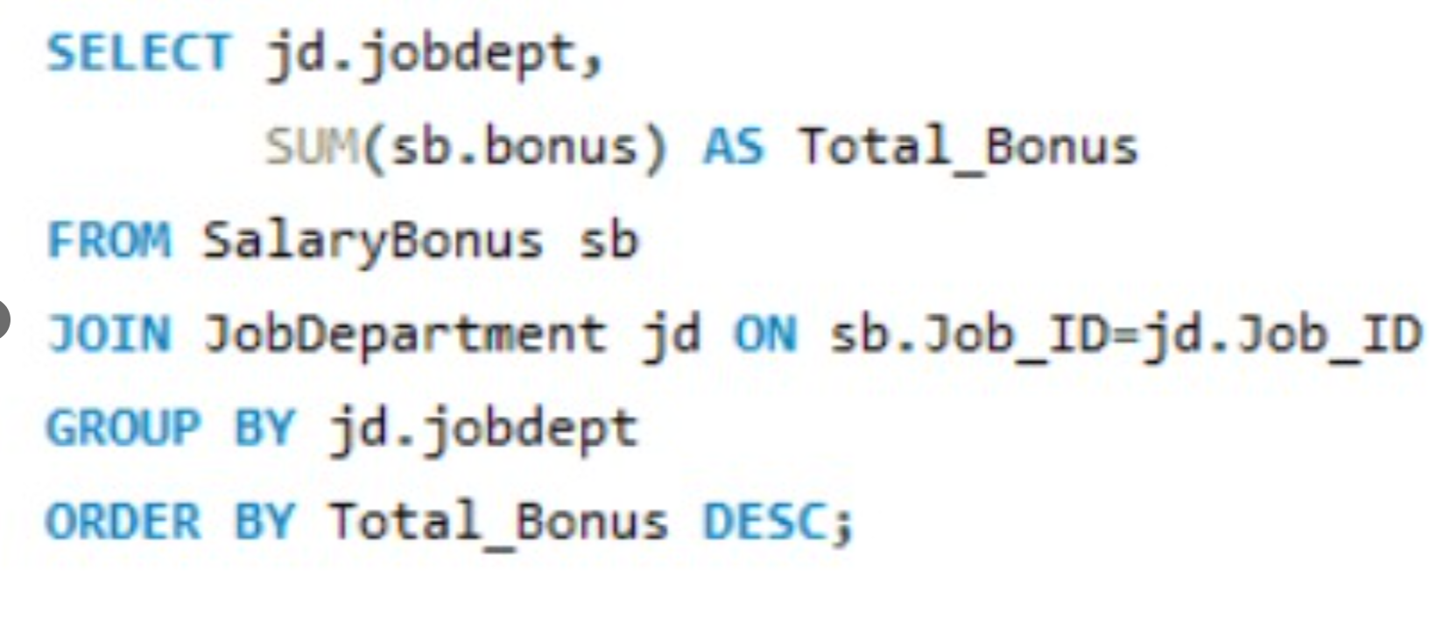
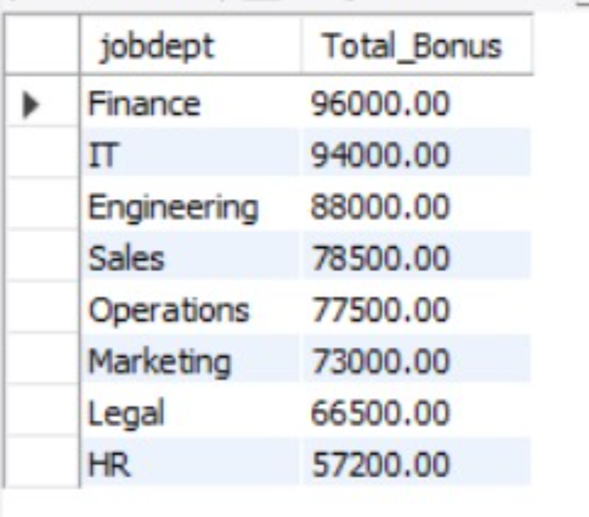
10.Which department receives the highest total bonuses?
Query :
Output :
Key Insight :-
The department with the highest total bonus depends on the SalaryBonus data. Typically, departments with more employees and/or higher-paid senior positions will have a larger total bonus allocation.

Slide 17
Conclusion:-
The Employee Management System successfully provides a structured way to manage and analyze employee-related information within an organization. The system integrates employee details, job roles, departments, salaries, qualifications, leave records, and payroll information using relational database concepts.
The analysis of the system provides valuable insights into employee distribution across departments, average salaries, highest-paid employees, job roles, employee qualifications, leave patterns, and bonus allocation. These insights can help HR teams understand workforce structure, monitor compensation, track employee skills, and manage employee absences more effectively.
The project also demonstrates the practical use of important SQL concepts such as JOIN, GROUP BY, COUNT, SUM, AVG, ORDER BY, DISTINCT, and LIMIT to extract meaningful information from organizational data.
Overall, the Employee Management System improves data organization, accuracy, accessibility, and decision-making, making HR operations more efficient and supporting better workforce and compensation management.

Slide 18
Our Experience / Challenges Working
Gained practical experience in MySQL and relational database management by creating and managing multiple interconnected tables.
Learned how to use SQL queries, JOINs, GROUP BY, COUNT, AVG, SUM, and ORDER BY to analyze employee and payroll data.
Designing the correct relationships between multiple tables using primary and foreign keys.
Writing complex JOIN queries to combine employee, job, department, salary, leave, and payroll information.
Performing department-wise salary, employee, qualification, and leave analysis using aggregate functions.

Slide 19

THANK YOU

