Slide 1
Small Recommendation Engine
Recommending Top Products Based on Purchase Frequency
Team members
P.SRIKAR 2403A52188
CH.SAI VARSHITH 2403A52189
B.SATHWIKA 2403A52190

Slide 2
Project Objectives
Build:To buld a basic,functional recommendation system from scratch
Analyze:To analyze a raw transaction dataset to identify top-selling products.
Logic:To implement a core recommendation logic based purely on purchase frequency.
Demonstrate:To demonstrate a working MVP (Minimum Viable Product)in a Python environment

Slide 3


Project Stakeholders
Instructor /
Supervisor
Primary stakeholder for grading,
ensuring all project requirements, and academic integrity are met.
Business User
(Conceptual)
A conceptual user (e.g.an e- commerce manager)who would
use this tool to understand product popularity.
The Development
Team
Responsible for successfully
planning,coding,testing,and
documenting the entire project
from start to finish.

Slide 4

Technology Stack
Core Technologies
HTML5:
Used to structure all the content and layout of the web pages.
CSS3:
Used for styling, formatting, colors, fonts, and making the interface look clean.
JavaScript (Optional):
Used for simple interactions, validations, and improving user experience.
Tools &Environment
Google Colab:The cloud-based notebook
environment used for development,testing,and
execution.
GitHub: The platform used for version control and
final project submission.

Slide 5
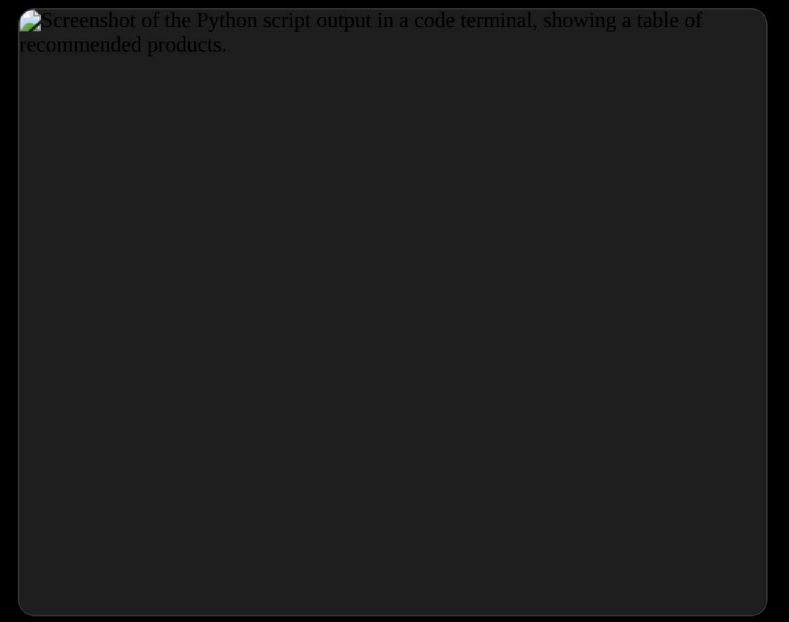
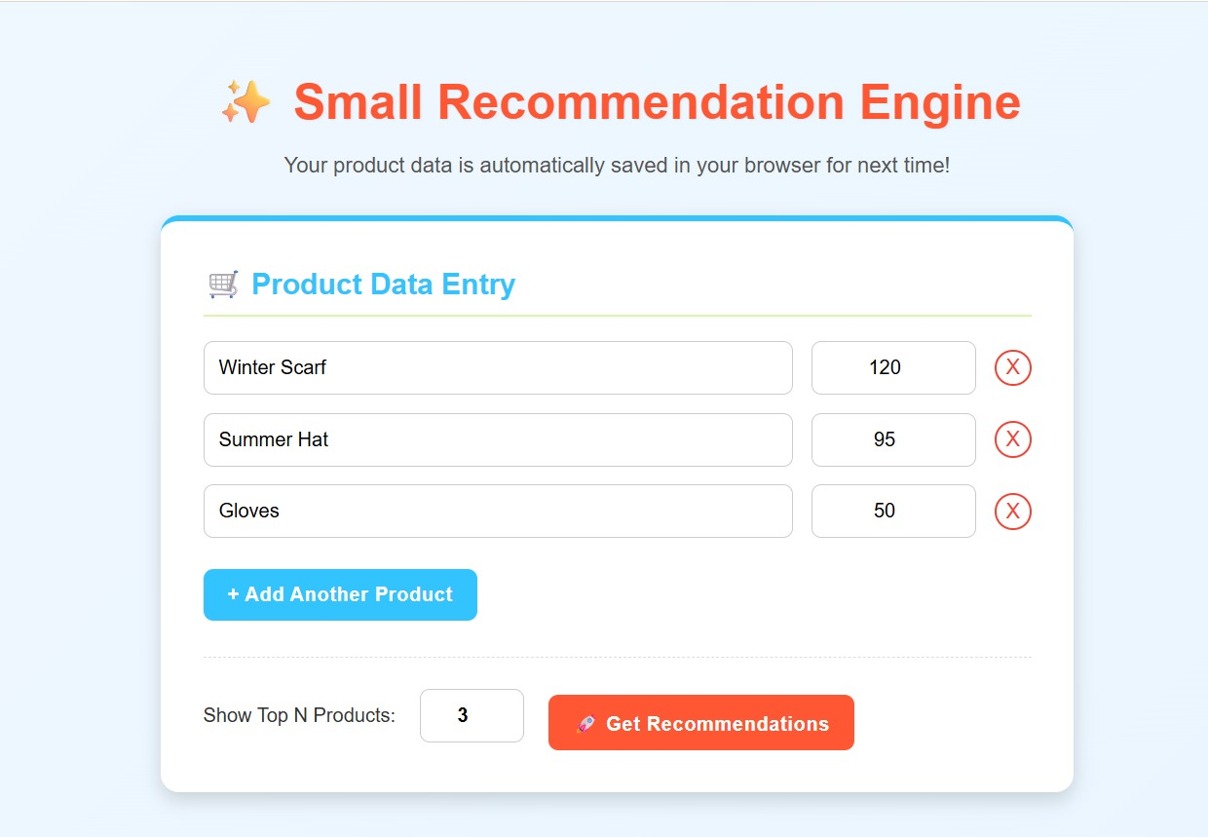
Front-End View /Final Output
Command-Line Interface(CLI)
As this project is a backend script,the "front-end"is the final output presented to the user directly in the console.
This view shows the script successfully running in Google
Colab.It analyzes the transactions.csv file and prints the
final,ranked table of top recommended products-fulfilling the project's main objective.

Slide 6
SOFTWARE APPLICATIONS
• Simple recommendation system
• Uses purchase frequency
• Outputs top products
Tools
• Google Colab
• GitHub
• AI-assisted debugging
.

Slide 7
CONCLUSION
This project successfully demonstrates a simple yet effective recommendation engine.
The system recommends top-purchased products based purely on transactional data.
The approach proves that even basic frequency logic can deliver meaningful insights.
Google Colab provided a flexible environment for development and testing.
The implementation is lightweight and easy to extend with additional features.
The project highlights the importance of data preprocessing in analytics tasks.

Slide 8

:

