Slide 1
Problem Description:
A restaurant is a business which prepares and serves food and drink to customers in return for money,
either paid before the meal, after the meal, or with an open account.
The idea is to look for an ideal location to start a restaurant in the city of New York

Slide 2
Target Audience:
The objective is to locate and recommend to the management which neighbourhood of Newyork
city will be best choice to start a restaurant.
The Management also expects to understand the rationale
of the recommendations made.
This would interest anyone who wants to start a new restaurant in Newyork city

Slide 3
Data :
For the below analysis we will get data from wikipedia as given below :
1. New York Population
2. New York City Demographics
3. Cuisine of New York city
https://en.wikipedia.org/wiki/New_York_City
https://en.wikipedia.org/wiki/Economy_of_New_York_City
https://en.wikipedia.org/wiki/Portal:New_York_City
https://en.wikipedia.org/wiki/Cuisine_of_New_York_City

Slide 4
Analytic Approach :
New York city neighbourhood has a total of 5 boroughs and 306 neighborhoods.
In this project first part is clustering of Manhattan and Brooklyn .
And second part is clustering of Bronx, Queens and Staten Island.
This is done because of the following Exploratory data analysis

Slide 5
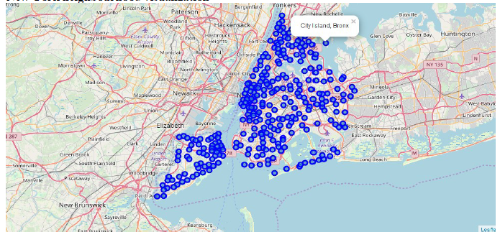
New York Neighborhood Visualization

Slide 6
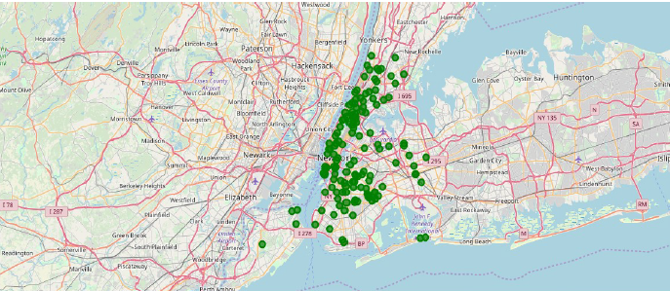
Farmers Market visualisation-New York City

Slide 7



Most favourite cuisines
BROOKLYN CUISINE
MANHATTAN CUISINE
QUEENS CUISINE

Slide 8
RESULTS
Cluster0 :
The Total and Total Sum of cluster0 has smallest value.
It shows that the market is not saturated.
Number of restaurants are relatively low
Cluster1 :
The Total and Total Sum of cluster1 has highest value.
It shows that the markets are saturated.
Number of restaurants are very high

Slide 9
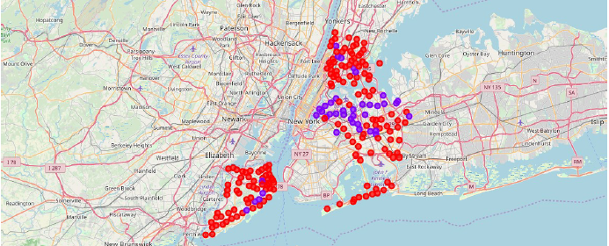
Map of above two clusters

Slide 10
DISCUSSION:
1. There is scope to increase Farmers markets in Bronx, Queens and Staten Island.
2. There is scope to explore cuisines of various countries in Bronx, Queens and Staten Island.
3. In Manhattan and Brooklyn restaurants of cuisines of many countries are available. So if risk can be taken with great menu on board. It also shows people love eating cuisines of various countries.

Slide 11
CONCLUSION:
This analysis is performed on limited data.
If good amount of data is available there is scope to come up with better results.
If there are lot of restaurants probably there is lot of demand.
Brooklyn and Manhattan has high concentration of restaurant business.
Very competitive market.
Bronx, Queens and Staten Island also has good number of restaurants but not as
many as required. So this can be explored

