Slide 1
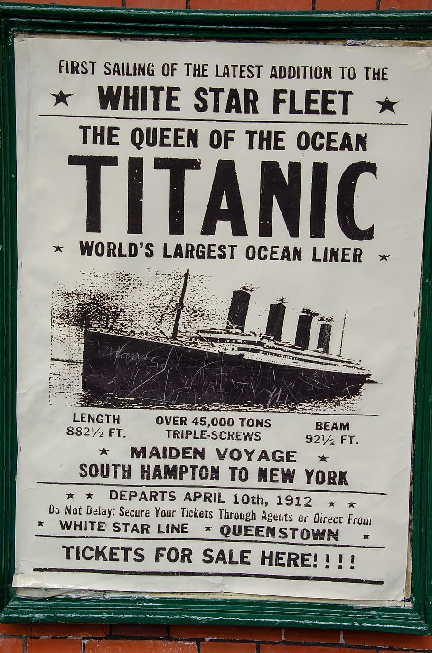
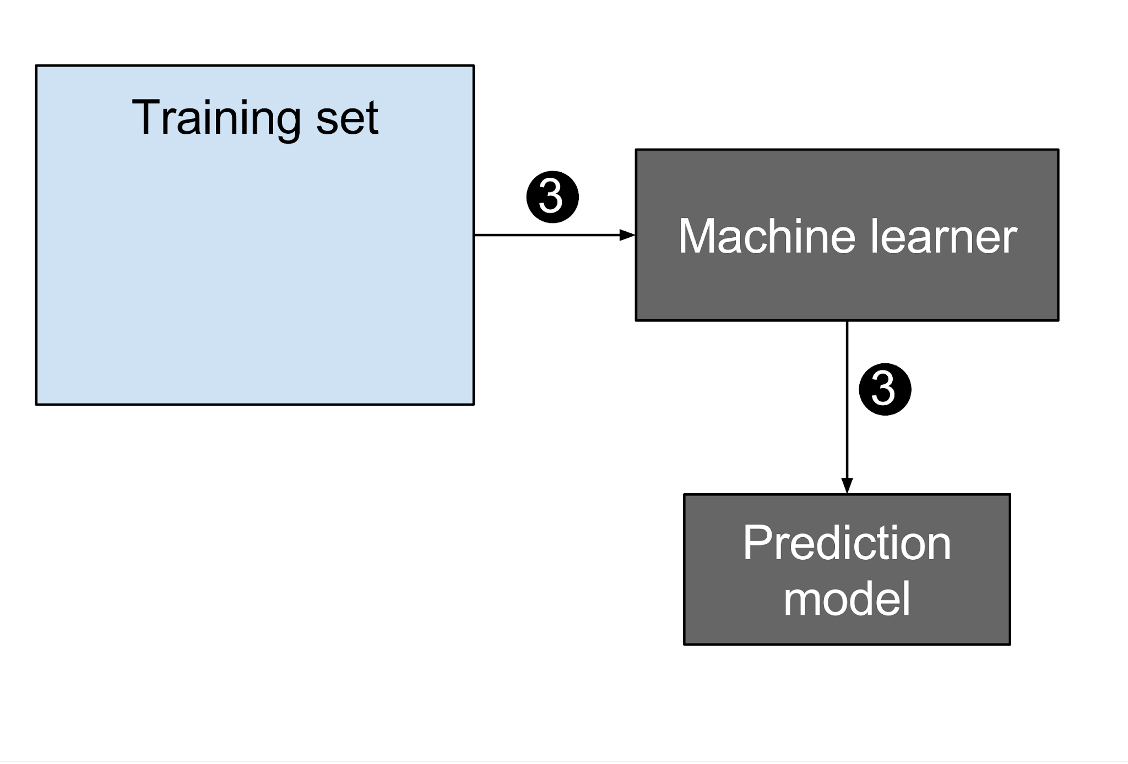
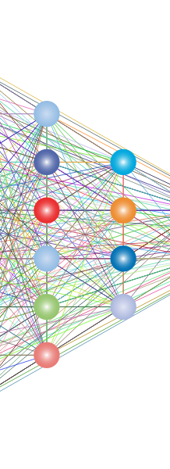
Predictive Modelling for passenger survival on Titanic
Srikar Mukkamala • 12141590

Slide 2

The sinking of the Titanic is one of the most infamous shipwrecks in history.
Unfortunately, there weren’t enough lifeboats for everyone onboard, resulting in the death of 1502 out of 2224 passengers and crew.
While there was some element of luck involved in surviving, it seems some groups of people were more likely to survive than others.
In this project, I try to build a predictive model that answers the question: “what sorts of people were more likely to survive?” using passenger data (i.e. name, age, gender, socio-economic class, etc).

Slide 3
Training Dataset: 891 passengers with survival labels
Testing Dataset: 418 passengers with survival labels
Dataset?

Slide 4
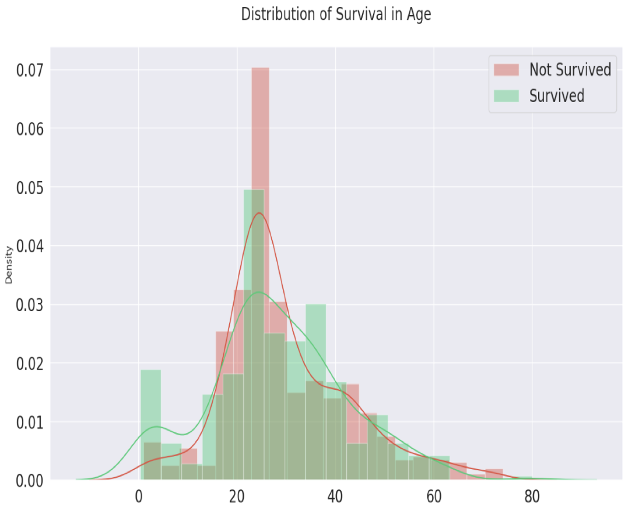
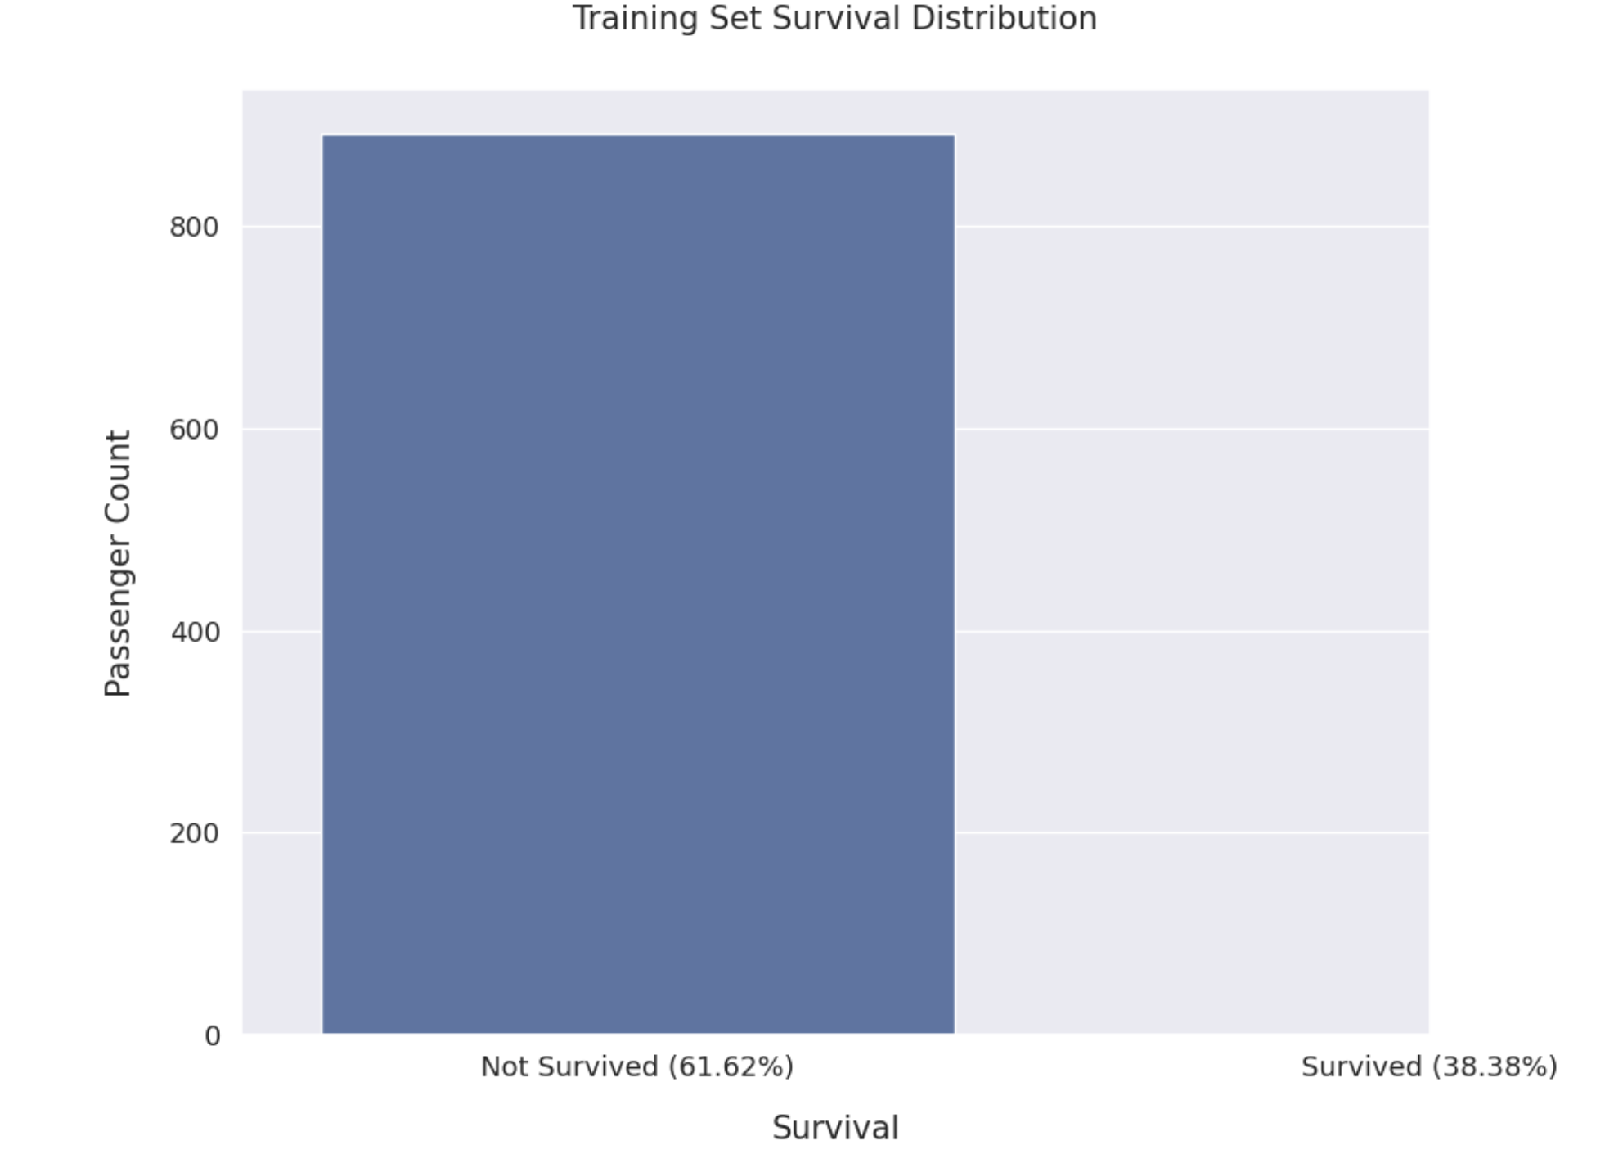
Exploratory Data Analysis (EDA)
Comprehensive examination of data types, missing values, and basic statistics. Visualization of survival distribution, correlations, and target distribution in features. Analysis of continuous and categorical features to understand their impact on survival.

Slide 5
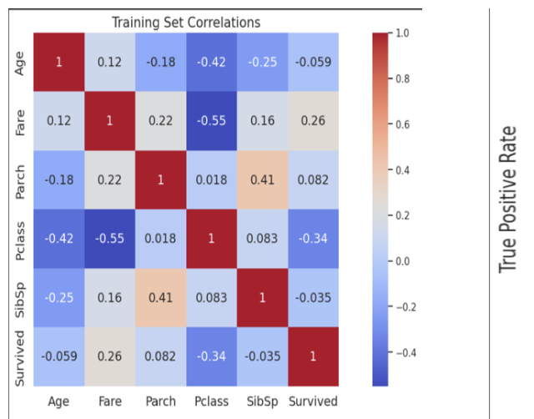
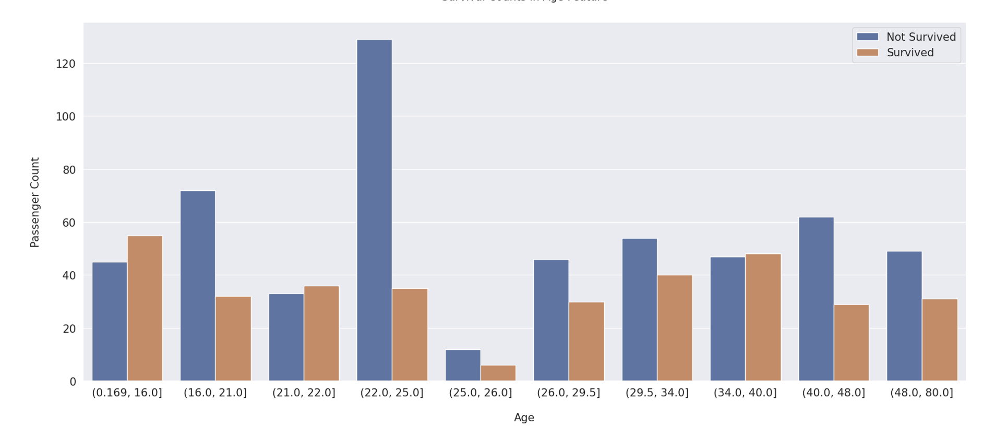
Feature Engineering
Binning of continuous features (Age, Fare) to capture patterns. Frequency encoding for Family Size and Ticket Frequency. Creation of new features: Family Survival Rate, Ticket Survival Rate, Survival Rate, etc. Label encoding and one-hot encoding for categorical features.

Slide 6
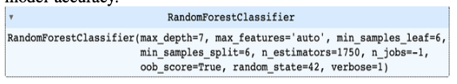
Model Developement
Utilization of a Random Forest classifier for prediction. Hyperparameter tuning for optimal model performance. Implementation of stratified k-fold cross-validation for model evaluation. Calculation of ROC-AUC scores for assessing model accuracy.

Slide 7
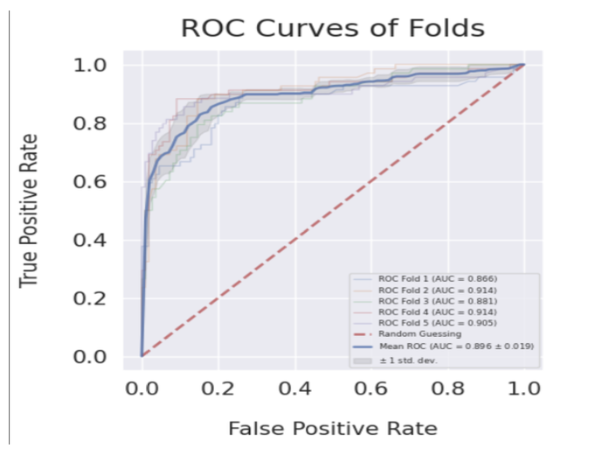
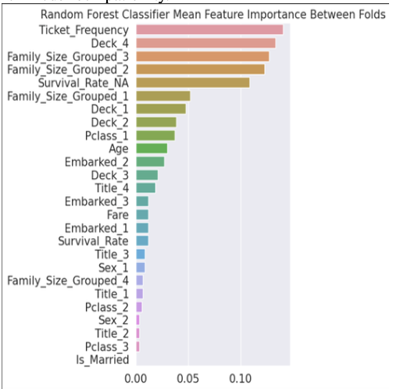
Results
Achieved a strong ROC-AUC score through Random Forest classification. Feature importance analysis for better interpretability. Robust handling of missing data through imputation. Effective transformation of categorical features for model compatibility.

Slide 8

The developed model demonstrates promising predictive capabilities for passenger survival on the Titanic. The combination of feature engineering techniques and a Random Forest classifier yields accurate and reliable predictions. The project provides valuable insights into the factors influencing survival, contributing to the broader field of predictive modeling in data science.

Slide 9
Explore additional feature engineering techniques for enhanced model performance. Investigate alternative machine learning algorithms for comparison. Conduct further analysis on misclassified instances to identify potential improvements. Consider ensemble methods to combine multiple models for increased robustness.
RECOMMENDATIONS AND FUTURE WORK

Slide 10

Find the project and report at my GitHub: Click Here

