Slide 1
WaterNet: Municipal Pipeline Flow & Pressure Telemetry
Software-based telemetry simulation, data visualization and threshold alerts
Project Guide
Dr. Karumuri Sri Rama Murthy
Asst. Professor, Department of CSE, KLU Hyderabad, Hyd
Team No: 1
2520040006 S. Srikar Prathap
2520040060 D. Dakshesh Kumar
React.js • Node.js • Express.js • PostgreSQL
WATERNET • SOFTWARE-BASED PIPELINE TELEMETRY
1

Slide 2
Abstract
02
WaterNet is a software-based municipal pipeline telemetry monitoring prototype.
It generates simulated flow-rate, pressure and turbidity readings at regular intervals.
The Node.js backend processes readings and exposes REST API endpoints through Express.js.
PostgreSQL stores user accounts, telemetry measurements and alert records.
A React dashboard presents key metrics, recent readings and flow/pressure charts.
Threshold rules flag possible leaks when flow is high and pressure is low.
Additional rules identify unusually high turbidity for review.
Authenticated API requests demonstrate controlled access to telemetry operations.
The current version uses simulated data and does not require physical sensors.
Future work can connect real sensors or a gateway while retaining the dashboard and database.
WATERNET • SOFTWARE-BASED PIPELINE TELEMETRY
2

Slide 3
Technologies Used
03
Frontend, backend / middleware, and database
FRONT-END
BACK-END / MIDDLEWARE
DATABASE
React.js
Recharts — data visualization
Lucide React — interface icons
HTML, CSS and JavaScript
Node.js — runtime
Express.js — REST API
JWT — token-based authentication
bcrypt — password hashing
CORS — cross-origin requests
PostgreSQL
users — account information
telemetry — readings and source
alerts — detected conditions
Current data source: software simulator • No physical sensors connected in this version
WATERNET • SOFTWARE-BASED PIPELINE TELEMETRY
3

Slide 4
Problem Description
04
Need for an accessible pipeline monitoring view
Limited visibility
Abnormal readings
Trend monitoring
Readings may be difficult to review when they are not presented in one interface.
High flow combined with low pressure may indicate a possible leak.
Recent stored readings help users observe changes over time.
PROPOSED SOLUTION
WaterNet simulates telemetry, stores readings in PostgreSQL, visualizes trends in a React dashboard, and applies threshold rules to generate alerts.
Scope note: current results are generated by software and are not measurements from a real municipal pipeline.
WATERNET • SOFTWARE-BASED PIPELINE TELEMETRY
4

Slide 5
Architecture Diagram
05
Current data flow from simulation to visualization
Telemetry
Simulator
Express API
PostgreSQL
React Dashboard
Node.js
Routes + rules
Readings + alerts
Charts + metrics
Simulator → API / threshold logic → PostgreSQL → React dashboard
The dashboard polls the API periodically; the simulator currently generates a reading every 30 seconds.
WATERNET • SOFTWARE-BASED PIPELINE TELEMETRY
5

Slide 6
Implementation Details
06
How the main components work together
1
1. Generate
Node.js simulator creates flow, pressure and turbidity values every 30 seconds.
2
2. Store
Backend inserts telemetry into PostgreSQL with a simulated source label.
3
3. Evaluate
Threshold rules check for possible leaks and high turbidity.
4
4. Serve
Express endpoints return readings, summaries and alerts to authenticated clients.
5
5. Display
React dashboard refreshes periodically and updates cards, charts and tables.
Leak rule example: pressure < 1.5 bar AND flow rate > 20 L/min
WATERNET • SOFTWARE-BASED PIPELINE TELEMETRY
6

Slide 7
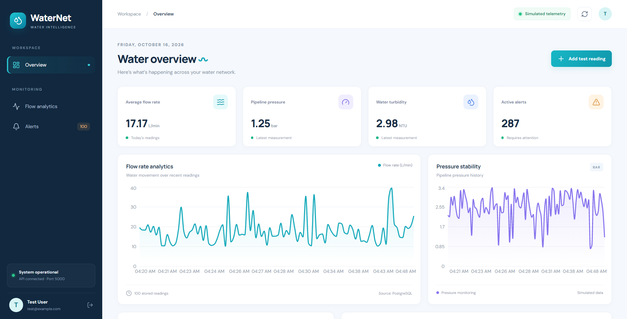
Output Screens — Dashboard
07
OUTPUT SCREENSHOT
MAIN WATERNET DASHBOARD
Include metric cards, navigation, charts, alert summary and recent readings
WATERNET • SOFTWARE-BASED PIPELINE TELEMETRY
7

Slide 8
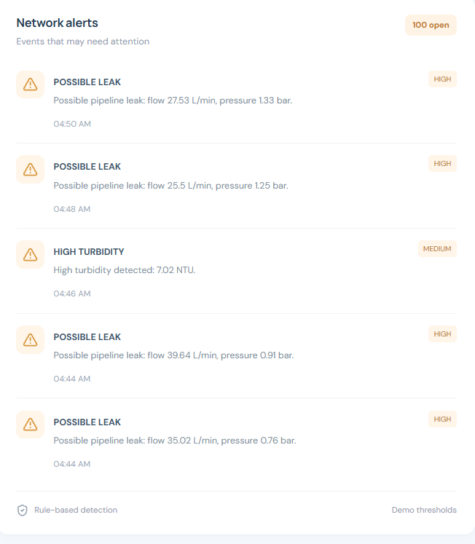
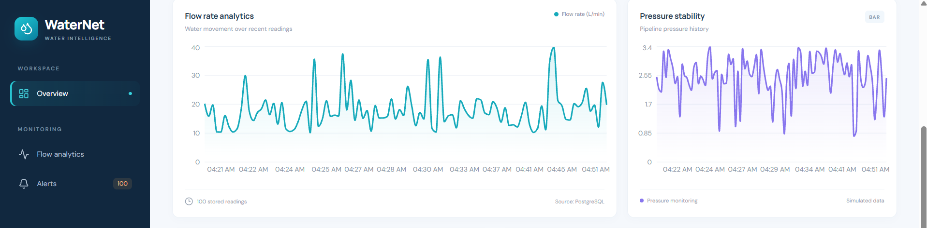
Output Screens — Charts & Alerts
08
OUTPUT SCREENSHOT PLACEHOLDER
OUTPUT SCREENSHOT PLACEHOLDER
FLOW & PRESSURE CHARTS
NETWORK ALERTS
Capture charts after readings have updated
Capture the alert list; avoid showing excessive duplicate alerts if possible
WATERNET • SOFTWARE-BASED PIPELINE TELEMETRY
8

Slide 9
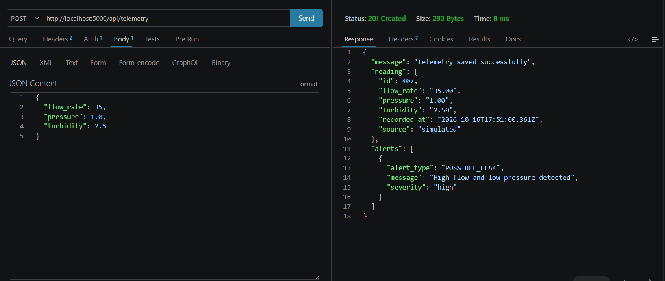
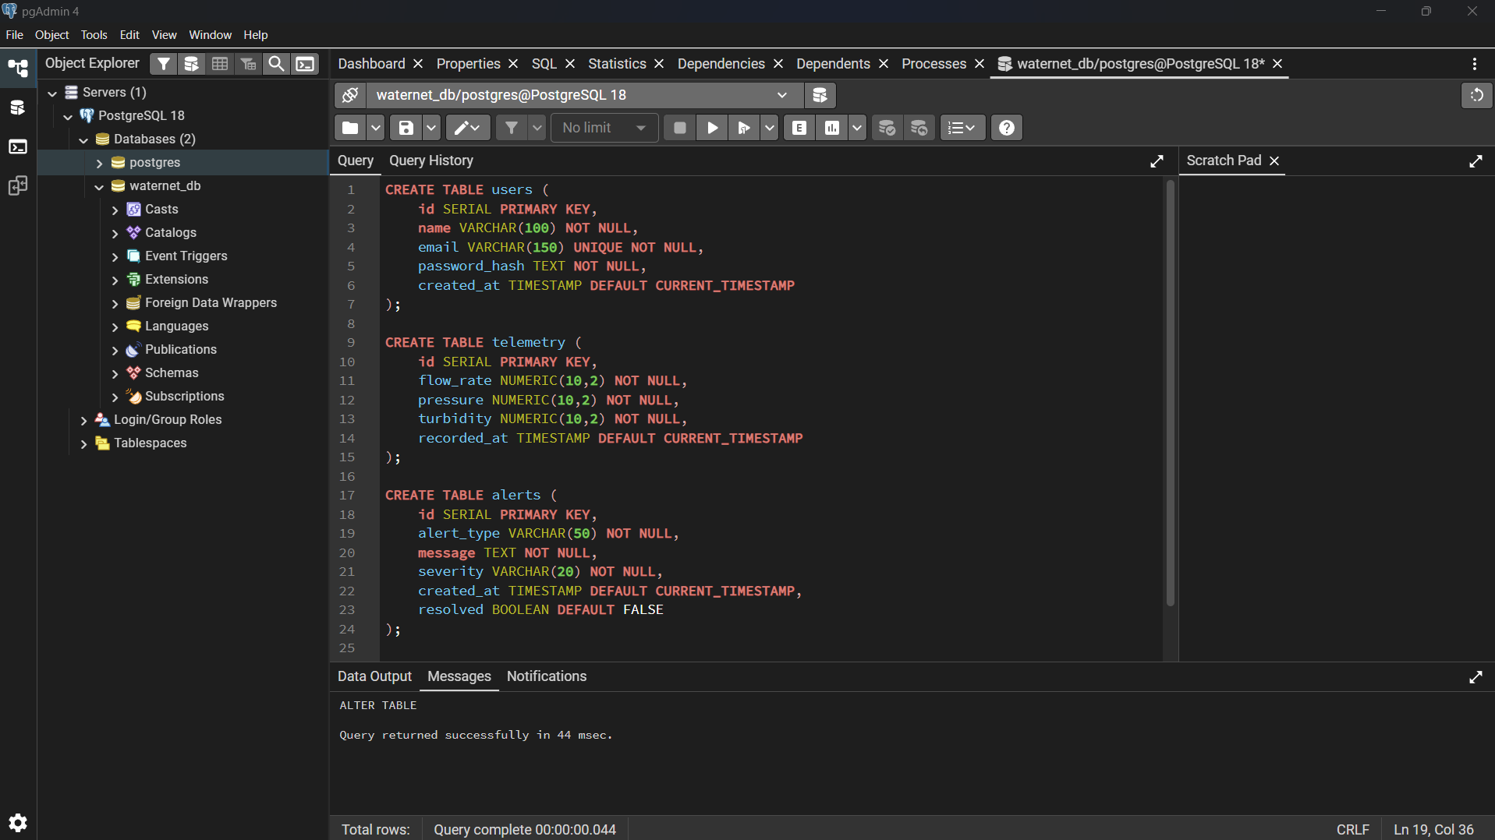
Output Screens — API & Database
09
Demonstrate data submission and persistence
OUTPUT SCREENSHOT PLACEHOLDER
OUTPUT SCREENSHOT PLACEHOLDER
THUNDER CLIENT POST
POSTGRESQL TABLE OUTPUT
Show successful authenticated POST response; hide JWT tokens and passwords
Show telemetry rows and alert records in pgAdmin
WATERNET • SOFTWARE-BASED PIPELINE TELEMETRY
9

Slide 10
Future Enhancements
10
Possible extensions beyond the current software-only prototype
Real sensor integration
Alert deduplication
Connect physical flow, pressure and turbidity sensors through a suitable gateway.
Avoid creating repeated unresolved alerts for the same continuing condition.
Historical analytics
Configurable thresholds
Add date filters, longer-term trends and downloadable reports.
Allow authorized users to adjust alert thresholds and simulation rate.
Notifications
Deployment
Add email or app notifications for important alerts.
Host the application and database in a secure deployment environment.
WATERNET • SOFTWARE-BASED PIPELINE TELEMETRY
10

Slide 11
Conclusion
11
WaterNet demonstrates a software-first telemetry workflow
WaterNet combines simulated measurements, persistent storage, data visualization and threshold-based alerts in one web application.
SIMULATE
STORE
VISUALIZE
ALERT
Generate readings
PostgreSQL
React dashboard
Threshold rules
Thank you
Team No: 1 • T. Sai Pavan Reddy • K. Kushal Kumar
WATERNET • SOFTWARE-BASED PIPELINE TELEMETRY
11

