Slide 1
UNDERSTANDING BINOMIAL AND POISSON DISTRIBUTIONS: PROBABILITY MODELS FOR DISCRETE EVENTS

Slide 2

Introduction
Binomial and Poisson distributions are probability models used to describe the likelihood of discrete events. The binomial distribution is used to model the number of successes in a ﬁxed number of trials, while the Poisson distribution is used to model the number of events occurring in a ﬁxed interval of time or space.

Slide 3
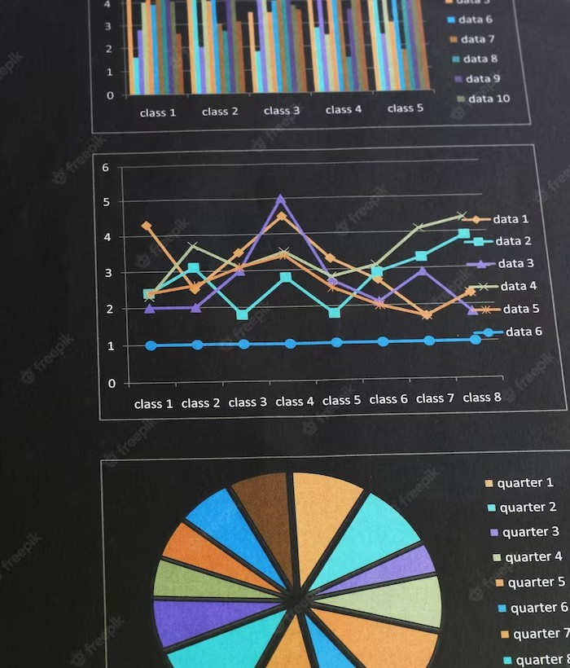
BINOMIAL DISTRIBUTION
The binomial distribution is characterized by the number of successes in a ﬁxed number of independent trials, each with the same probability of success. It is widely used in ﬁelds such as quality control, biology, and ﬁnance to model binary outcomes.

Slide 4

POISSON DISTRIBUTION
The Poisson distribution is used to model the number of events occurring in a ﬁxed interval of time or space. It is employed in various real-world scenarios, including insurance claims, queueing theory, and telecommunications to predict rare events.

Slide 5

Probability Mass Function
Both the binomial and Poisson distributions have a probability mass function that describes the probability of each possible outcome. Understanding the PMF is crucial for analyzing the likelihood of speciﬁc events in these distributions.

Slide 6

MEAN AND VARIANCE
The mean and variance of the binomial and Poisson distributions provide important insights into the central tendency and spread of the data. Calculating these measures helps in understanding the distribution's characteristics.

Slide 7

APPLICATIONS IN BUSINESS
Binomial and Poisson distributions ﬁnd applications in business analytics, such as inventory management, sales forecasting, and risk assessment. Understanding these distributions is essential for making data-driven decisions.

Slide 8

REAL-WORLD EXAMPLES
From website trafﬁc analysis to defect detection in manufacturing, binomial and Poisson distributions offer valuable insights into discrete event occurrences. Real-world examples demonstrate the relevance and applicability of these distributions.

Slide 9
MODELING RARE EVENTS
The Poisson distribution is particularly useful for modeling rare events, such as natural disasters, machine failures, and emergency room arrivals. Its ability to predict infrequent occurrences makes it indispensable in risk management.

Slide 10
LIMITATIONS AND ASSUMPTIONS
Both binomial and Poisson distributions have certain limitations and assumptions that must be considered when applying them to real-world data. Understanding these constraints is crucial for accurate modeling and interpretation.

Slide 11

STATISTICAL INFERENCE
Statistical inference techniques, such as hypothesis testing and conﬁdence intervals, can be applied to data modeled by binomial and Poisson distributions. These methods enable the extraction of meaningful insights from the data.

Slide 12

COMPARATIVE ANALYSIS
A comparative analysis of binomial and Poisson distributions highlights their distinct characteristics and areas of application. Understanding the differences between these distributions is essential for choosing the appropriate model for a given scenario.

Slide 13

Challenges and Considerations
Challenges in applying binomial and Poisson distributions include model selection, data transformation, and interpretation of results. Addressing these challenges requires a comprehensive understanding of the underlying principles.

Slide 14

Future Research and Developments
Ongoing research in the ﬁeld of probability modeling continues to advance the understanding and application of binomial and Poisson distributions. Emerging developments aim to enhance the accuracy and versatility of these models in diverse domains.

Slide 15
CONCLUSION
Binomial and Poisson distributions are powerful tools for modeling discrete events and predicting their probabilities. Understanding these distributions is essential for various ﬁelds, from ﬁnance to healthcare, and continues to drive advancements in probability modeling.

